Slide 1

mL: Shrinking the Verification volume using
Machine Learning
Yash Phogat and Patrick Hamilton

Slide 2
Find Fails?
1
2
3
4
5
(5 x 4) grid
2 dimensions
Find Red Boxes?
6
7
8
9
10
11
12
13
14
15
16
17
18
19
20
Notes:
First ask audience to just find red boxes. After a few attempts ask them to suggest a strategy.
Most probably someone would suggest a traversal approach.
Then question if the grid is not bounded, what strategy to use?
Then suggest constrained random is an approach. Then move to next slide.

Slide 3
Find Fails?
2
3
4
5
1
3
4
5
1
2
4
5
1
2
3
5
1
2
3
4
1
2
3
4
5
1
2
3
4
5
1
2
3
4
5
6
7
8
9
10
6
7
8
9
10
6
7
8
9
10
6
7
8
9
10
6
7
8
9
10
7
8
9
10
6
8
9
10
6
7
9
10
11
12
13
14
15
11
12
13
14
15
11
12
13
14
15
11
12
13
14
15
11
12
13
14
15
11
12
13
14
15
11
12
13
14
15
11
12
13
14
15
16
17
18
19
20
16
17
18
19
20
16
17
18
19
20
16
17
18
19
20
16
17
18
19
20
16
17
18
19
20
16
17
18
19
20
16
17
18
19
20
1
2
3
4
5
1
2
3
4
5
1
2
3
4
5
1
2
3
4
5
1
2
3
4
5
1
2
3
4
5
1
2
3
4
5
1
2
3
4
5
6
7
8
10
6
7
8
9
6
7
8
9
10
6
7
8
9
10
6
7
8
9
10
6
7
8
9
10
6
7
8
9
10
6
7
8
9
10
11
12
13
14
15
11
12
13
14
15
12
13
14
15
11
13
14
15
11
12
14
15
11
12
13
15
11
12
13
14
11
12
13
14
15
16
17
18
19
20
16
17
18
19
20
16
17
18
19
20
16
17
18
19
20
16
17
18
19
20
16
17
18
19
20
16
17
18
19
20
17
18
19
20
Result
1
2
3
4
5
1
2
3
4
5
1
2
3
4
5
1
2
3
4
5
6
7
8
9
10
6
7
8
9
10
6
7
8
9
10
6
7
8
9
10
11
12
13
14
15
11
12
13
14
15
11
12
13
14
15
11
12
13
14
15
16
18
19
20
16
17
19
20
16
17
18
20
16
17
18
19
Notes:
After saying these are all the moves possible in this example, ask them if we know these individual results, can we now find all the fails any sooner?
After a few answers reveal the result by clicking on the Result box.
Ask the question what if the grid is bigger, unbounded and there are more dimensions to this setup, how complex the problem becomes….
Draw relation of the grid setup to CRT very clearly.
Then extrapolate that finding the pattern in this tiny setup was difficult, and in verification its more complicated.
Then ask the question that if we draw patterns using a machine feeding it all these state images, the machine can learn a pattern and use it to classify fails

Slide 4
Scalability or Reality?
Num. of Tests – 20!! No…….How about 10s or 100s of thousands
2
3
4
5
1
3
4
5
1
2
4
5
1
2
3
5
1
2
3
4
1
2
3
4
5
1
2
3
4
5
1
2
3
4
5
6
7
8
9
10
6
7
8
9
10
6
7
8
9
10
6
7
8
9
10
6
7
8
9
10
7
8
9
10
6
8
9
10
6
7
9
10
11
12
13
14
15
11
12
13
14
15
11
12
13
14
15
11
12
13
14
15
11
12
13
14
15
11
12
13
14
15
11
12
13
14
15
11
12
13
14
15
16
17
18
19
20
16
17
18
19
20
16
17
18
19
20
16
17
18
19
20
16
17
18
19
20
16
17
18
19
20
16
17
18
19
20
16
17
18
19
20
Num. of Dimensions (Test Parameters) – 2!! No…….How about thousands
1
2
3
4
5
Shapes
Sizes (Height, Width, Depth, Rotation…)
Colors
6
7
8
10
11
12
13
14
15
16
17
18
19
20
Num. of Values per Dimension (1,2,3…..many)

Slide 5
The Problem
Pre-simulation test filtering would save compute and makes regressions efficient i.e.,
SHRINKING THE VERIFICATION VOLUME
We can use Machine Learning to frequently and automatically weed out tests that typically consume compute but always pass.
Optimization over the baseline, Constrained Random Testing (CRT)
Using Classification ML models, we classify test input to predicted Fail/Pass decision.
Notes:
Ask if finding those fails in half or smaller regression provides value?

Slide 6

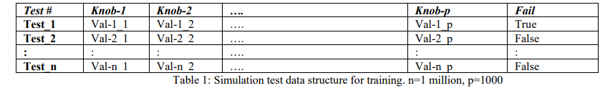
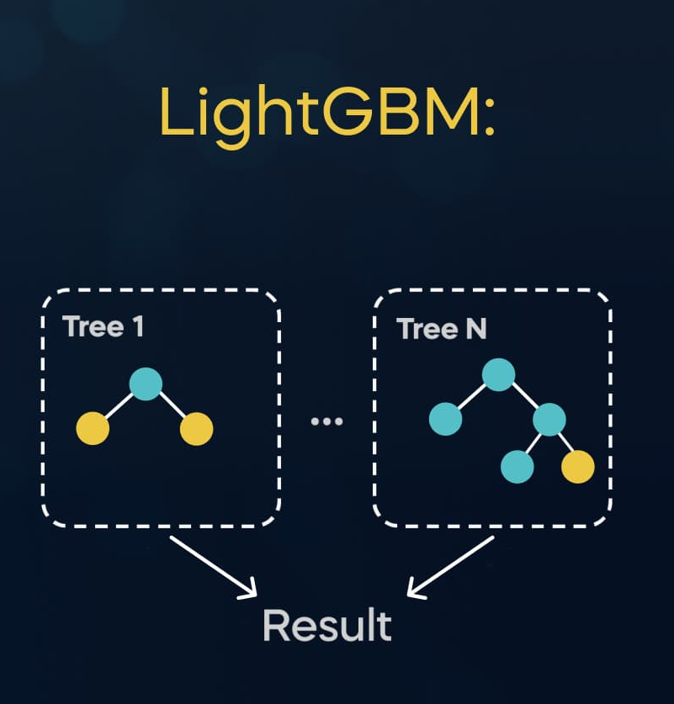
Data and ML Pipeline
Data
Inference
Training Algorithm
Learned Model
Picture Credit: https://365datascience.com/tutorials/python-tutorials/xgboost-lgbm/

Slide 7
Data and ML Pipeline
0
0
0.6
0.9
0.7
Data
0
0.6
0.9
0.8
0.5
0.6
0.9
0.6
0
0
0.9
0.6
0
0
0
Inference
Training Algorithm
Learned Model
Picture Credit: https://365datascience.com/tutorials/python-tutorials/xgboost-lgbm/

Slide 8
Verification Architecture
Note: ML and CRT flows need to run together for retraining data generation and exploring unexplored design regions
Model
Retraining
ML Flow
CRT Generator
ML
application
Filter tests
Input
Settings
Simulate filtered tests
Upload to Datastore
Compute Metrics
CRT Flow
Input
Settings
Debug failures
CRT Generator
Simulation
CR/CRT – Constrained Random Testing
UFS – Unique Fail Signature
Notes:
Retraining Needs to be explained here.
Animation

Slide 9
Evaluation Metrics
Definition
UFS – Unique Fail Signature
Fail_1
Fail_2
Fail_1
Fail_1
Fail_2
Unique Fail Signature - Fail_1
Unique Fail Signature - Fail_2
Notes:
Constrained Random instead of CRT
UFS – Unique Fail signature
State illustrative examples
Take out illus
Separate plots

Slide 10

Evaluation Metrics - Efficiency
Rate of Finding Fail Signatures
Efficiency Metric
(UFS per CPU_Hour)
Number of Unique Fail signatures found in 1 CPU Hour spent by either flow.
* These examples are illustrative for explanation. Real results are in result section.
CR/CRT – Constrained Random Testing
UFS – Unique Fail Signature
Notes:
Higher the better

Slide 11

Evaluation Metrics – Quality
Ability to find available fail signatures in the Design
Quality Metric
(UFS Recovery Rate)
Given 1 CPU hour, what portion of UFS’s present in the design are found by ML and CRT flows.
Common UFS
Machine Learning UFS
(3)
Constrained Random UFS
(3)
(2)
* These examples are illustrative for explanation. Real results are in result section.
CR/CRT – Constrained Random Testing
UFS – Unique Fail Signature
Notes:
Constrained Random instead of CRT
UFS – Unique Fail signature
State illustrative examples
Venn diagram
Add numbers in Venn diagram
Rearrange plot
Add words to state use of quality metric

Slide 12

Evaluation Metrics – Saving
Compute spend to find fail signatures attributed to ML
Cost Saving Metric
Estimate of compute saved by ML in finding the UFS’s it found, which in an ML absent scenario would have to be found by CRT.
Common UFS
Machine Learning UFS
(3)
Constrained Random UFS
(3)
(2)
CR/CRT – Constrained Random Testing
UFS – Unique Fail Signature
* These examples are illustrative for explanation. Real results are in result section.
Notes:
Constrained Random instead of CRT
UFS – Unique Fail signature
State illustrative examples

Slide 13
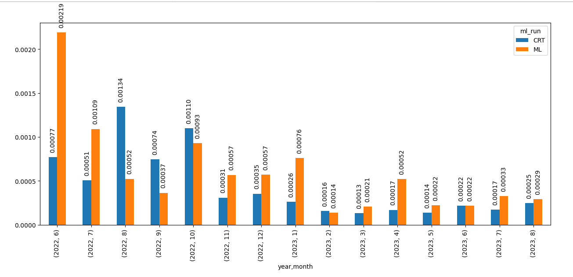
Results – Efficiency Metric
Efficiency Metric ML averages 1.35X better than CRT

Slide 14
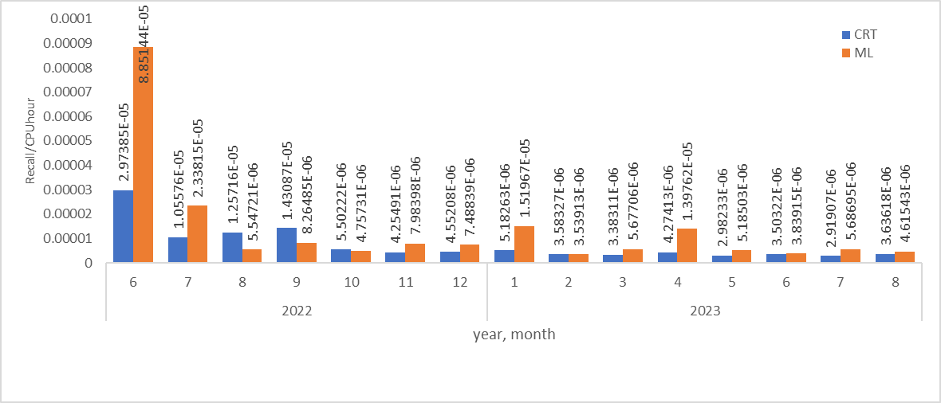
Results – Quality Metric
Quality Metric
ML averages 1.6X better than CRT

Slide 15
Results – Cost Metric
ML volume is 16% of CRT volume
ML + CRT saves 7.6% of verification costs compared to traditional CRT Only verification

Slide 16
Challenges
Class Imbalance - The number of fails and passes present in our training data are highly imbalanced (5:95). Hence, we use gradient boosted training algorithms which handle class imbalances well.
Adaptability to project phases and the verification strategy.
Adoptability of ML into mainline project regressions.
ML is a science of probability and hence comes with a margin of approximation. It’s hard to reason for ML picking a test stimulus.

Slide 17
Future Work
Deployment Improvements:
Find ML:CRT tests ratio for best savings by the phase of the project?
Find the best ratio of generated test to the num of filtered tests for ML?
Machine Learning Improvements:
Tune ML models - feature selection, other training algorithms, creation of better Cross Validation scoring functions etc.
Use ML to find efficient test set for quantifying RTL coverage.
Using generative AI to control knob generation and hit bug prone test knobs.
Notes:
Try keeping it small with quick skim

Slide 18

Summary
Efficiency
1.35x
Quality
1.6x
Cost Savings
7.6%
Data Driven Processes and Improvements
ML is a path toward enabling efficient simulation regressions
ML is a good fit for DV - ML streamlines random selection.
Continuously changing RTL and TB makes this an uncommon ML problem as the models need to mutate often to stay relevant

Slide 19
Questions

Slide 20
Thank You

Slide 21
Backup Slides

Slide 22
Shrinking the Verification Volume
Would you wish, the random constraint simulation run a smaller proportion of passing tests? [At least not the ones that most certainly pass.]
Would you wish to have intelligent ways to safely skip some of those tests from your regressions?
By classifying tests as Fails or Passes pre-simulation, we can run smaller size simulations of tests that will find us all the fails more efficiently.
Which one would
you prefer?

Slide 23
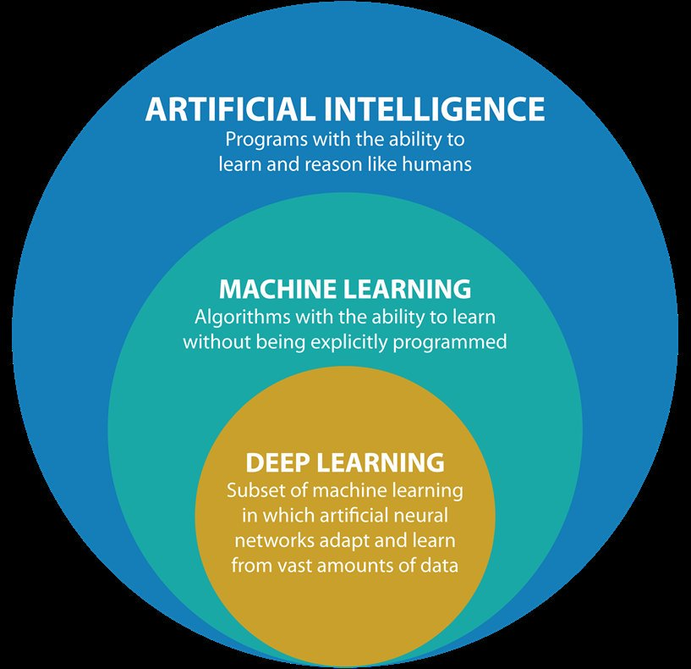
Artificial Intelligence vs Machine Learning vs Deep Learning

Slide 24
Machine Learning - Types
Supervised Learning
Unsupervised Learning
Semi-supervised Learning
Reinforcement Learning

Slide 25
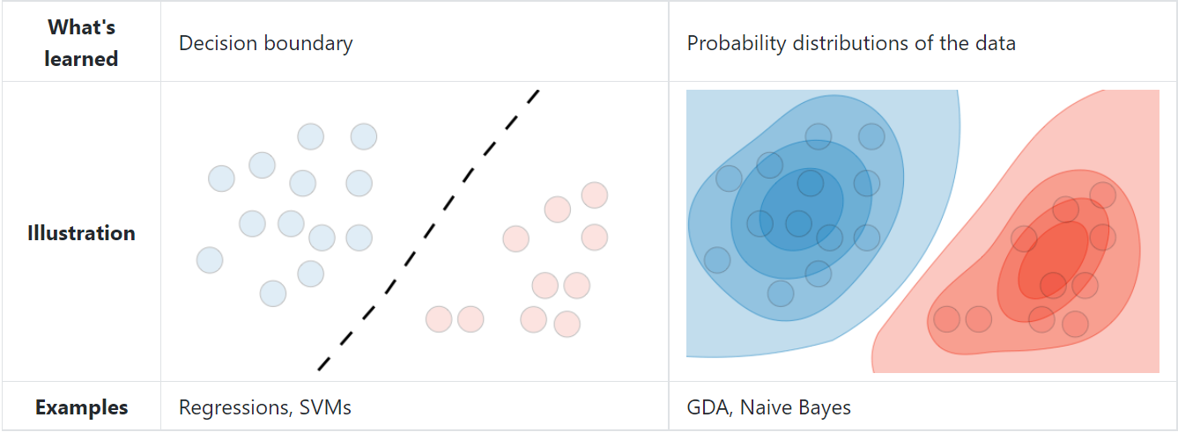
Machine Learning – Problem Classification
Discriminative – Given data x try to predict (estimate) the label (/output) y.
      Mathematically: P(y|x)
Generative – Try to estimate the probability distribution of a specific output in a given dataset. Then deduce the label using this distribution
          Mathematically: Estimate P(x∣y) to then deduce P(y|x)
Credit - https://stanford.edu/~shervine/teaching/cs-229/cheatsheet-supervised-learning

