Slide 1
IP-XACT Tutorial
Richard Weber, Fellow, Director of Engineering Arteris
Anupam Bakshi, CEO, Agnisys

Slide 2
Outline
Introduction
Component
Design and design configuration
Bus and abstraction definitions
Component bus interfaces and design interconnections
Component memory maps and registers
Component address spaces and bus interface bridges
Type definitions

Slide 3
IEEE 1685 - IP-XACT, A Standard Structure …
“Electronic IP Data Sheet”
Bus interfaces
Ports
Registers
Parameters
Views
Files
For packaging IP
XML document format for IP data sheets
Design rules (SCRs), e.g., no overlapping registers
For integrating IP
XML document format for IP instances and their connections
Design rules (SCRs), e.g., no multiple drivers
For reusing IP within tool flows
Tool interface (TGI) to access XML data using web services
In practice, programming language specific APIs
“Electronic IC Data Sheet”
IP instances
Parameter values
Interconnect
Generators
Database
XML

Slide 4
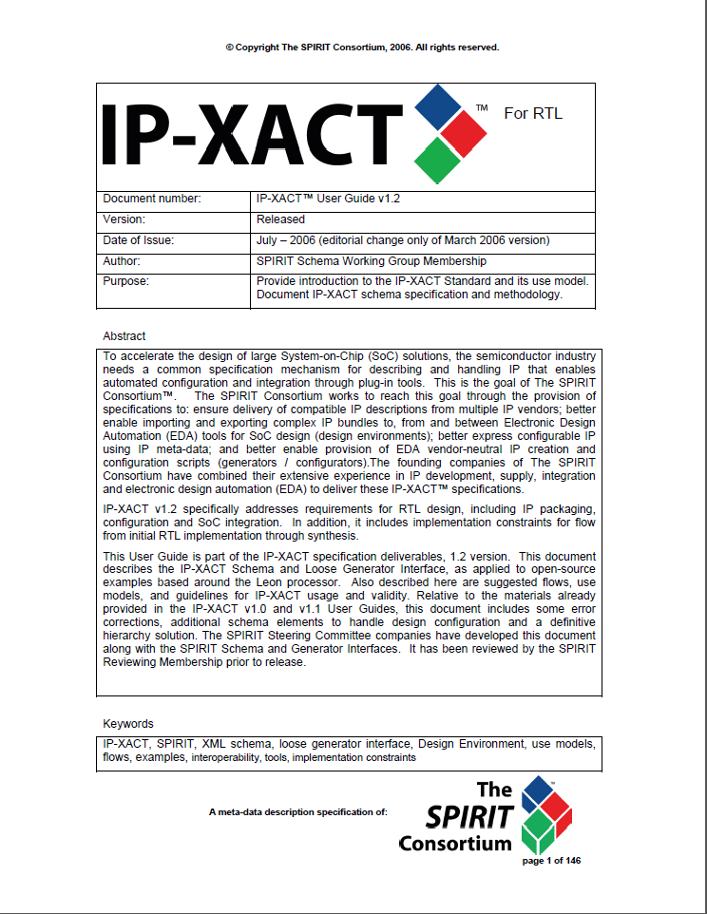
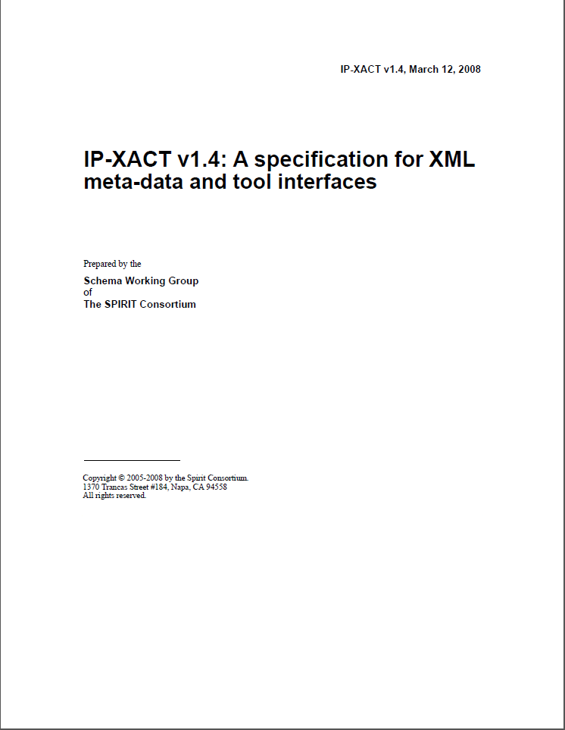
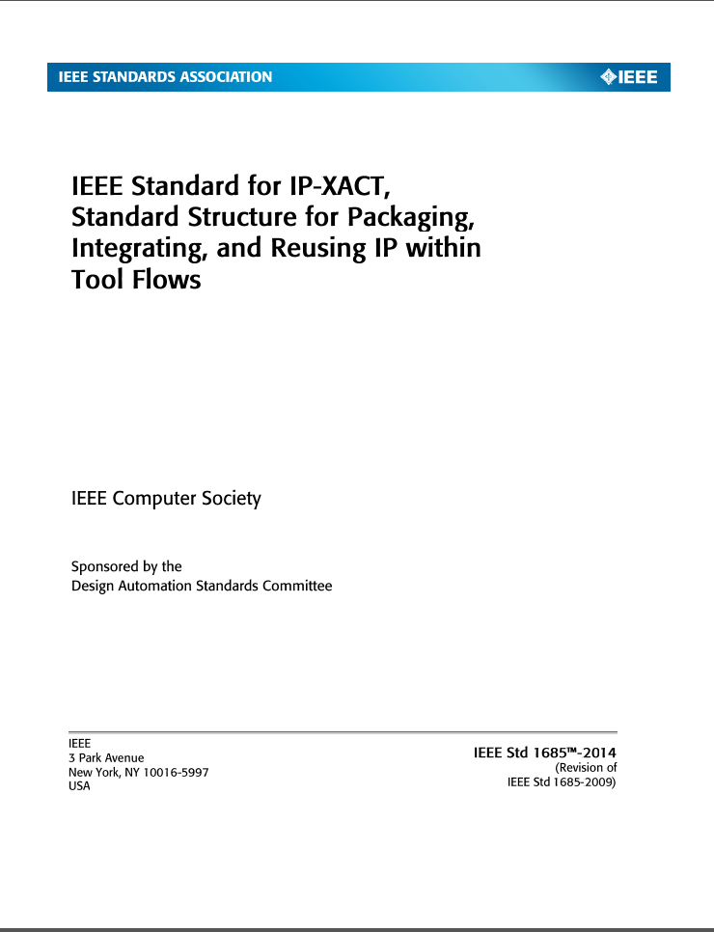
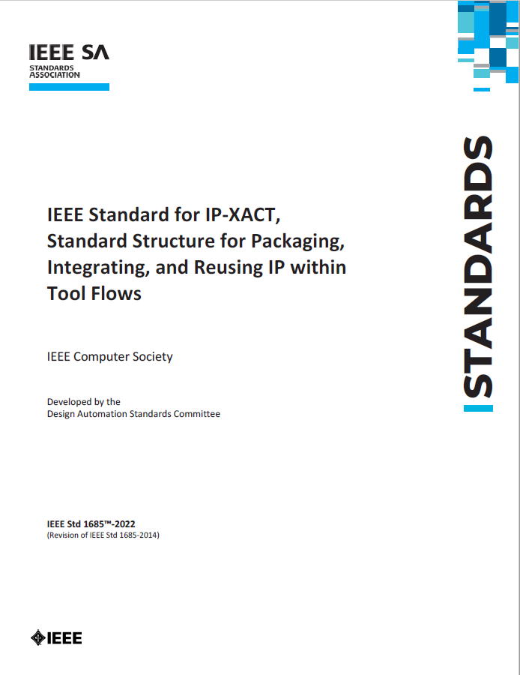
IP-XACT Releases
1.2: RTL
1.4: TLM & TGI
1685-2009: IEEE & Registers
The Spirit Consortium
IP-XACT 1.0 December 2004
IP-XACT 1.1 June 2005
IP-XACT 1.2 April 2006
IP-XACT 1.4 March 2008
IEEE Std. 1685-2009 December 2009
Accellera Systems Initiative
IEEE Std. 1685-2014 June 2014
IEEE Std. 1685-2022 September 2022
1685-2014: - Mixed RTL and TLM - Conditionality - Parameter passing - Full TGI editing
1685-2022: - Type definitions - Structured ports - Component modes
- Mode-dependent access
- Power domains

Slide 5
IP-XACT Document Types
Document types (also known as top-level elements)
component
design and design configuration
bus definition and abstraction definition
type definitions
abstractor
generator chain
catalog

Slide 6
IP-XACT Document Identifier - VLNV
<?xml version="1.0" encoding="UTF-8"?> <ipxact:component xmlns:ipxact=http://www.accellera.org/XMLSchema/IPXACT/1685-2022 xmlns:xsi=http://www.w3.org/2001/XMLSchema-instance xsi:schemaLocation="http://www.accellera.org/XMLSchema/IPXACT/1685-2022 http://www.accellera.org/XMLSchema/IPXACT/1685-2022/index.xsd">
<ipxact:vendor>accellera.org</ipxact:vendor> <ipxact:library>i2s</ipxact:library> <ipxact:name>initiator_transmitter</ipxact:name> <ipxact:version>1.0</ipxact:version>
</ipxact:component>
Document type →
VLNV identifier →

Slide 7
IP-XACT Catalog - VLNV Reference
The purpose of a catalog is to manage collections of IP-XACT files by documenting the location of IP-XACT files and the identifiers of the IP-XACT elements documented in those files.
<?xml version="1.0" encoding="UTF-8"?> <ipxact:catalog … > <ipxact:vendor>accellera.org</ipxact:vendor> <ipxact:library>ug</ipxact:library> <ipxact:name>my_catalog</ipxact:name> <ipxact:version>1.0</ipxact:version> <ipxact:components> <ipxact:ipxactFile> <ipxact:vlnv vendor="accellera.org" library="i2s" name="initiator_transmitter" version="1.0"/> <ipxact:name>../components/initiator_transmitter.xml</ipxact:name> </ipxact:ipxactFile> </ipxact: components > </ipxact:catalog>
Document type →
VLNV identifier →
VLNV reference →
File location →

Slide 8
Component

Slide 9
IP-XACT Component
The purpose of a component is to enable the (re-)use of an IP through IP-XACT without the need for information from the implementation files. To this end, a component documents aspects such as
the interfaces of an IP such as parameters, registers, ports, and grouping of ports into bus interfaces,
the views of an IP such as RTL and TLM descriptions, and
the files implementing each view, such as Verilog, VHDL, and SystemC files.

Slide 10
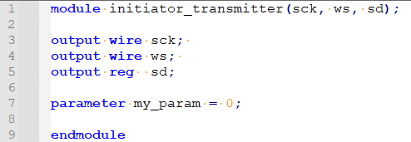
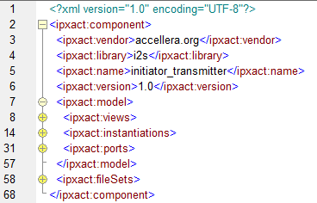
Example IP-XACT Component
HDL
IP-XACT component
model →
An IP-XACT component model describes views, instantiations, and ports of the IP

Slide 11
Example IP-XACT Component – Model (1)
An IP-XACT component view describes a “view” of the IP
view name →
reference to → component instantiation

Slide 12
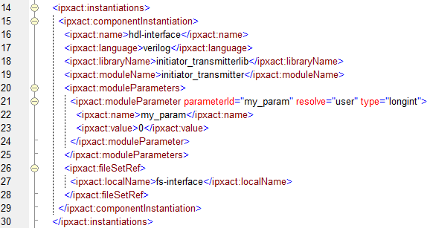
Example IP-XACT Component – Model (2)
A componentInstantiation contains information to instantiate a module
language →
library →
module →
module parameters →
parameters are specific for this module
reference to file set→

Slide 13
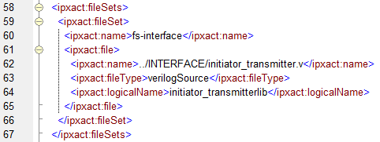
Example IP-XACT Component – Model (3)
A fileSet contains the files to compile a module
file set name →
list of files →

Slide 14
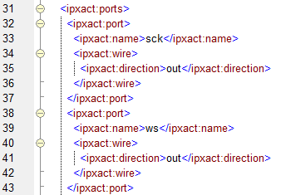
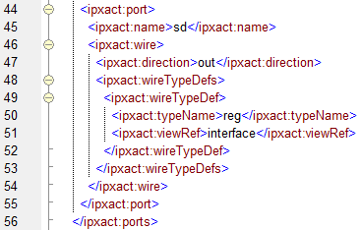
Example IP-XACT Component – Model (4)
An IP-XACT component model describes the component ports
type is specific for this view
Notes:
The wireTypeDef describes a view specific type name for port sd because the type “reg” is specific for the verilog language. For ports sck and ws, the type is the default type for any selected view; in this case “wire” since there is only one verilog view.

Slide 15
Use cases for this example
From the HDL interface, one can automate
IP-XACT component generation
From the IP-XACT component, one can automate
human-readable document (data sheet) generation
compilation and elaboration
HDL interface generation

Slide 16
Design

Slide 17
IP-XACT Design
The purpose of a design is to describe the structure of a hierarchical IP and enable generation of views related to logical interconnect (e.g., system memory map) and physical interconnect (e.g., structural HDL). A design documents an internal structure of a component by describing
instances of sub-components that are used to implement a component,
parameter values for component instances, and
connections between component instances.

Slide 18
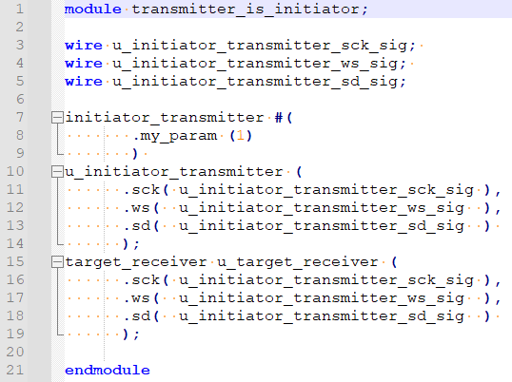
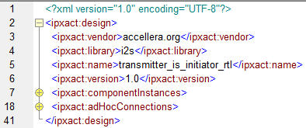
Example IP-XACT Design
HDL
Schematic
IP-XACT Design

Slide 19
IP-XACT Design – Component Instances
Component instances have an instance name and a VLNV reference

Slide 20
IP-XACT Design – Ad Hoc Connections
Ad Hoc Connections reference internal or external ports of a net

Slide 21
Design configuration

Slide 22
IP-XACT Design Configuration
The purpose of a design configuration is to configure a design for a particular purpose by selecting an appropriate combination of views for its component instances. A design configuration documents a configuration of a design by describing
views that are used for component instances and
abstractor instances that are used for communication abstraction conversion on interconnections.

Slide 23
Example IP-XACT Design Configuration
A view configuration selects a view for a component instance
instance name →
ref to view name →
view specific → parameter values

Slide 24
Example IP-XACT Component – Hierarchical (1)
The view also references a designInstantiation and designConfigurationInstantiation

Slide 25
Example IP-XACT Component – Hierarchical (2)
The view also references a designInstantiation and designConfigurationInstantiation

Slide 26
Use cases for this example
From the HDL structure, one can automate
IP-XACT component, design, and design configuration generation
From the IP-XACT component, design and design configuration, one can automate
human-readable document (data sheet) generation
compilation and elaboration
physical connectivity generation (RTL/ESL structure, connectivity assertions)

Slide 27
Bus and abstraction definition

Slide 28
IP-XACT Bus Definition
The purpose of a bus definition and an abstraction definition is to describe aspects of a hardware communication protocol. A bus definition documents properties of a hardware communication protocol that are independent of the representation of the protocol such as
if direct connections between initiator and target interfaces are supported for a protocol
if the IP-XACT address calculations apply to a protocol to map target memory maps into initiator address spaces.
An abstraction definition documents a representation of a hardware communication protocol in terms of the logical ports and their properties such as direction and number of bits for initiator and target interfaces.

Slide 29
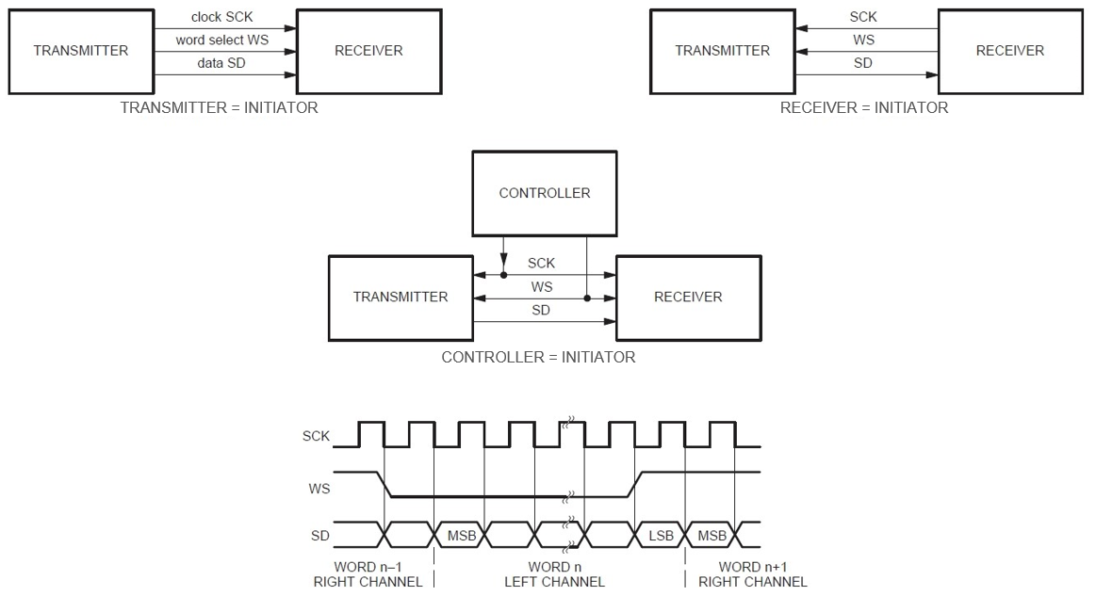
Example Protocol - Inter-IC Sound (IIS or I2S)

Slide 30
Example IP-XACT Bus Definition
<?xml version="1.0" encoding="UTF-8"?> <ipxact:busDefinition>
<ipxact:vendor>accellera.org</ipxact:vendor> <ipxact:library>i2s</ipxact:library> <ipxact:name>I2S</ipxact:name> <ipxact:version>1.1</ipxact:version>
<ipxact:description>I2S (Inter-IC Sound) bus definition</ipxact:description>
<ipxact:directConnection>true</ipxact:directConnection> <ipxact:isAddressable>false</ipxact:isAddressable>
</ipxact:busDefinition>

Slide 31
Example IP-XACT abstraction definition (1)
An abstraction definition references a bus definition and describes the logical ports used in this representation of the protocol

Slide 32
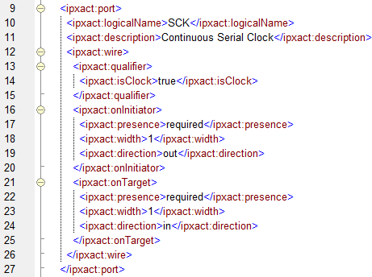
Example IP-XACT abstraction definition (2)
Logical port SCK
I
T
→ SCK
→ SCK

Slide 33
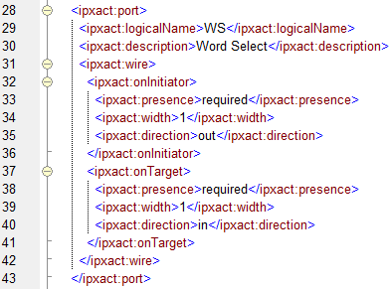
Example IP-XACT abstraction definition (3)
Logical port WS
I
T
→ SCK
→ SCK
→ WS
→ WS

Slide 34
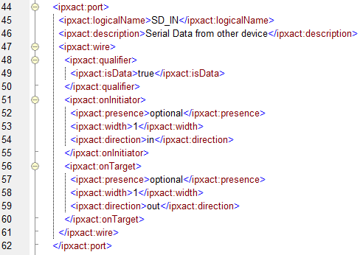
Example IP-XACT abstraction definition (4)
Logical port SD_IN (naming _IN is based on initiator side)
I
T
→ SCK
→ SCK
→ WS
→ WS
← SD_IN
← SD_IN

Slide 35
Example IP-XACT abstraction definition (4)
Logical port SD_IN (naming _IN is based on initiator side)
I
T
→ SCK
→ SCK
→ WS
→ WS
← SD_IN
← SD_IN
→ SD_OUT
→ SD_OUT

Slide 36
Component bus interfaces and design interconnections

Slide 37
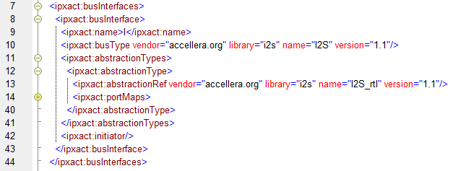
Example Component Bus Interface (1)
A bus interface references a bus definition and an abstraction definition
This reference can be view specific. → different abstraction types for different views (see user guide for details on mixed- abstrction design)

Slide 38
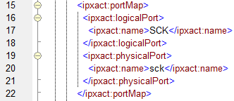
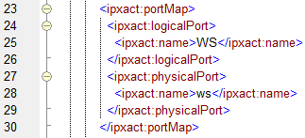
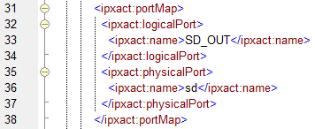
Example Component Bus Interface (2)
An abstraction definition provides logical ports on which the component ports shall be mapped
→ sck - SCK
→ ws - WS
→ sd - SD_OUT

Slide 39
Design Interconnections
A design interconnection connects the mapped logical bits at its end points. Here:
SCK[0] connects to SCK[0]
WS[0] connects to WS[0]
SD_OUT[0] connects to SD_OUT[0]
u_initiator_transmitter
u_target_receiver
I
T
→ sck - SCK
SCK - sck →
→ ws - WS
WS - ws →
→ sd - SD_OUT
SD_OUT - sd →
Then the port maps are applied to get the physical connections:
sck connects to sck
ws connects to ws
sd connects to sd

Slide 40
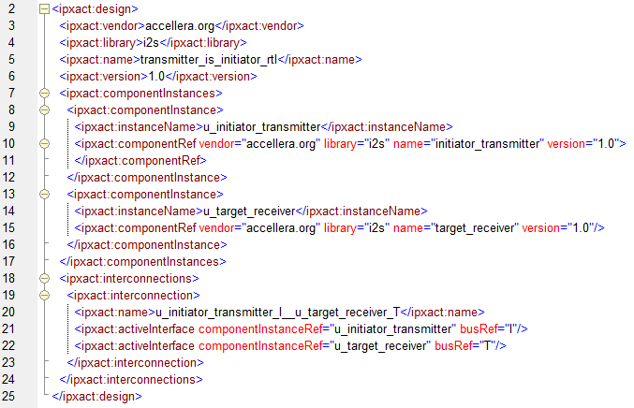
Example IP-XACT Design Interconnection
u_initiator_transmitter
u_target_receiver
I
T

Slide 41
Design Interconnections
u_target_transmitter
u_initiator_receiver
T
I
← sck - SCK
SCK - sck ←
← ws - WS
WS - ws ←
→ sd - SD_IN
SD_IN - sd →

Slide 42
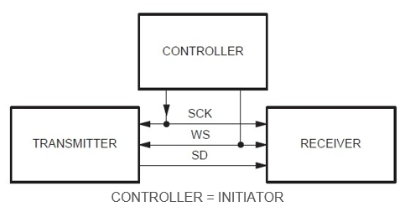
Design Interconnections
u_controller
I
WS - ws ←
SCK - sck ←
u_target_transmitter
u_interconnect (phantom ports)
u_target_receiver
SCK
WS
T
T
← sck - SCK
SCK
sck
SCK
SCK - sck →
← ws - WS
WS
ws
WS
WS - ws →
→ sd - SD_IN
SD_IN
sd
SD_OUT
SD_OUT - sd →

Slide 43
Component memory maps and registers

Slide 44
Component memory map
A non-hierarchical addressable target bus interface shall reference a memory map and/or contain one or more transparent bridges
T
memory map
address block

Slide 45
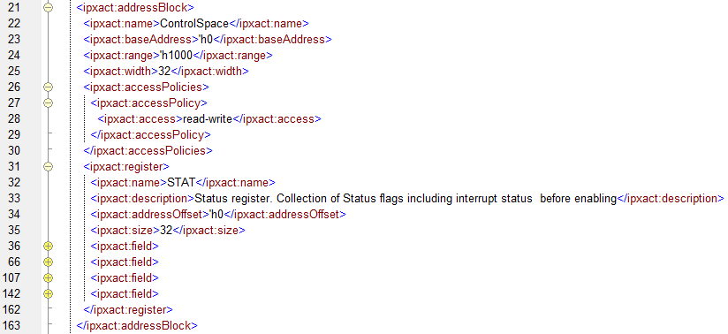
Address blocks, registers, and fields
A memory map may contain address block elements which may contain registers or register files with registers
A register contains at least one field
Fields may contain enumerated values

Slide 46
Component address spaces and bus interface bridges

Slide 47
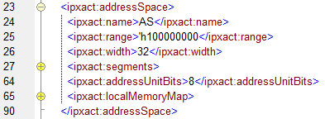
Component address space
A non-hierarchical addressable initiator bus interface shall reference an address space
address space
I
segment
segment

Slide 48
Mapping memory map into address space
A design interconnection maps the memory map referenced by a target bus interface into the address space referenced by an initiator bus interface
address space
I
T
memory map
address block
segment
address space
segment
address block

Slide 49
Mapping address space into memory map ( transparent bridge )
A transparent bridge maps the address space referenced by an initiator bus interface into the memory map referenced by a target bus interface using the given base address offset
T
bridge
memory map
address space
I
address block
computed MM
address block

Slide 50
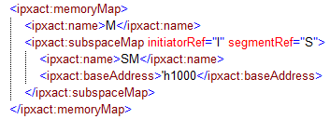
Mapping address space into memory map ( subspace map - opaque bridge )
A subspace map maps the address space (segment) referenced by an initiator bus interface into the memory map referenced by a target bus interface using the given base address offset
T
memory map (M)
address space
I
address block
subspace map (SM)
segment (S)
computed MM
segment of block

Slide 51
Elaborating system memory map (1/2)
I0
T
I
T
B0
I1
T
B1

Slide 52
Elaborating system memory map (2/2)
B0
B0
B1
B1
B0
B0
B1
B1

Slide 53
Type definitions

Slide 54
Type definitions
The purpose of typeDefinitions is to enable re-use of memory map related elements by providing definitions for access policies, enumerations, register fields, registers, register files, address blocks, banks, memory maps, and memory remaps. Type definitions can be instantiated in other type definitions and in components as external type definitions. Elements in external type definitions can be referenced to describe (internal) memory maps or memory map elements.

Slide 55
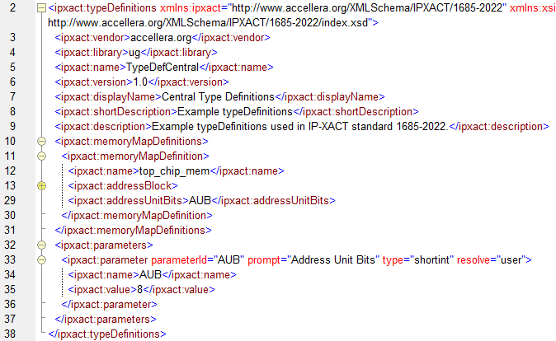
Example memory map definition
This typeDefinitions defines a memoryMapDefinition that contains an addressBlock.
The addressUnitBits value is parameterized

Slide 56
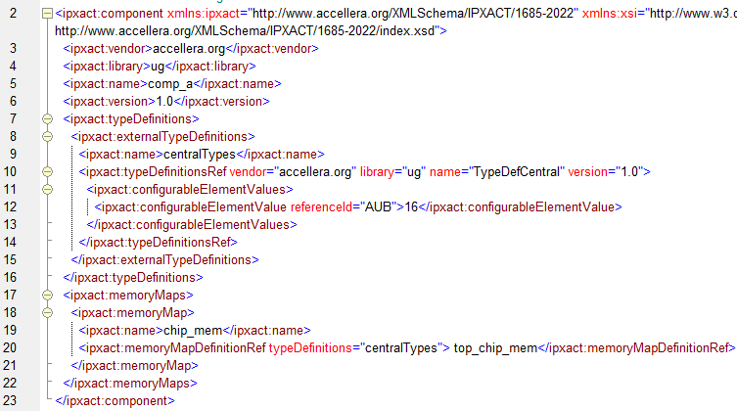
Example memory map definition usage
This component instantiates an external typeDefinitions and sets its parameter values
The memory map references the memoryMapDefinition from the typeDefinitions

Slide 57
Example fieldAccessPolicyDefinition
A fieldAccessPolicyDefinition defines register field access properties.
Example: UVM acces type W1C can be described as
and can be used in a fieldDefinition or field:

Slide 58
Common Issues

Slide 59
Common IP-XACT Issues
IP-XACT file does not pass xmllint with IP-XACT schema:
xmllint –schema http://www.accellera.org/XMLSchema/IPXACT/1685-2022/index.xsd ip.xml
File does not pass IP-XACT SCRs
File does not contain register field volatile elements
Volatile for fields is false when unspecified
Example: read-only field without reset and with volatile false is unknown

Slide 60
Thank you any questions?

