Slide 1
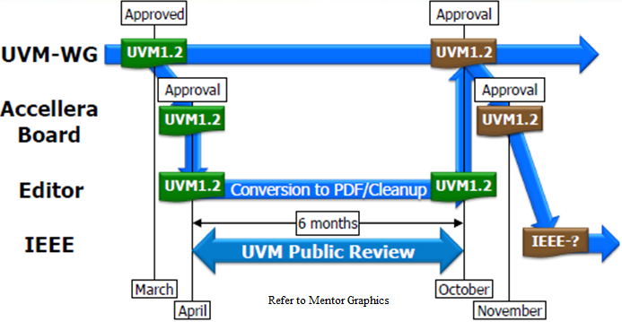
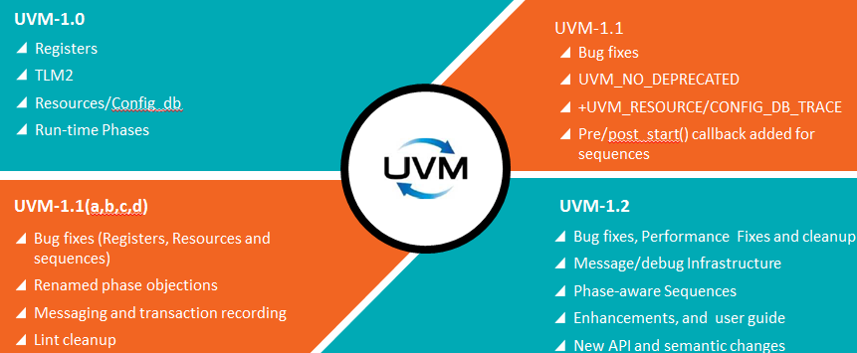
A New Epoch is beginning: Are You Getting Ready for Stepping into UVM-1.2?
Roman Wang
AMD - China
roman.wang@amd.com
Uwe Simm
Cadence - Germany
uwes@cadence.com
Malathi Chikkanna
AMD - India
malathi.chikkanna@amd.com
INTRODUCTION
UVM-1.2 is coming!
UVM has experienced great adoption and been a tremendous success throughout the verification industry since the first release of UVM in early 2011. UVM was proved a 486% strong growth in adoption between 2010 and 2012 based on study of the Wilson Research Group. UVM skills are usually a plus or even a must when hiring of verification engineers. Today, it’s the defacto standard for any functional verification activity. A key point for UVM is that a lot of focus is being put upon backward compatibility for any change applied to the UVM core library. Lots of enhancements to the library have been deferred in order to avoid migration problems in the past.
In 2014, UVM methodology starts a new epoch and takes another step forward with the next version of UVM labelled 1.2. UVM-1.2 is the first release since the initial release of UVM-1.0 which will have new facilities, enhancements and capabilities which are not fully API compatible with the older UVM versions. In addition, the UVM working group is also working on push the UVM methodology to the IEEE in the future.
This paper will not only share notable changes in UVM-1.2, but also point out why the changes were made and how do the changes affect the way we write UVM test benches. It’s to help UVM end users to better understand the differences between UVM-1.2 and UVM-1.0/1.1, and estimate the effort/path to migrate to UVM-1.2. Debug is always the biggest pain, and we will introduce the UVM1.2 generic debug capabilities to address such problem. Migration may introduce big effort and some problems, and for that we will share the migration experience from UVM-1.1 to UVM-1.2 based on our experiment. All verification engineers (from those just starting with UVM to those with years of experience) will gain new knowledge from this paper with the practical patterns.
In 2014, UVM methodology takes another step forward with the next version of UVM labelled 1.2 which will have bug fixes, performance fixes, cleanup, new facilities, enhancements and capabilities NOT API compatible with the older UVM versions.
Notable Changes in UVM-1.2
Notable Changes in UVM-1.2
Changes in reporting infrastructure
Reporting is fully object oriented and all UVM core messages now routed through uvm_report_server. It removed all $display calls(mostly for debug output) from BCL.
Uvm_report_server now becomes a virtual class and can be extended or chained using the delegate pattern.
New added message reporting macros, uvm_*_begin/end, uvm_message_add_*, etc.
Now object based with ability to add values/objects. Can record messages to some other storage.
Changes in sequences
New API <seq>.set_automatic_phase_objection(arg) which automatically performs a raise/drop of the objection before/after the sequence execution.
The starting_phase variable is now data access protected within uvm_sequence_base, and user must use the “get/set_starting_phase” functions
New added: +uvm_set_default-sequence=<sqr>, <phase>, <type> allows you to start a sequence from the command-line
Changes in UVM RAL
The uvm_hdl.c is updated to allow vendor tools to perform backdoor access to VHDL
It has the ability to control transaction order when register access result in multiple bus transactions in case register size and bus size mismatch. New added virtual class “uvm_reg_transaction_order_policy” could address this challenge.
Changes in objects
Classes extended from uvm_object now require an explicit constructor with a string-type name argument and this functionality is now the default.
Component names are being checked for compliance. This avoids bad names such as “…”, “☺” or “a.b.c.d”
In order to improve memory performance of “bitstream [4K bits]” interfaces for report/record/compare/pack etc. The implementation now could support a less memory-expensive uvm_integral_t which is sized as a 64bits packed logic vector.
Changes in phases
It removed objections from non-task-imps (because objections do not make sense with function phases).
New added uvm_phase.get_objection_count() can be used to retrieve pending objections for the phase.
New added phase transitions callbacks.
New added functions for phase jumping: set_jump_phase and end_prematurely
Changes in configure database
Meta characters/ regex in field names disabled due to performance and semantic issues. Ex. uvm_config_int::set(this,””,”/my_complex.* /”,3);
set_config_*, get_config_* now deprecated. It should be careful when covering *_config_object with clone semantic during migration.
Notable Changes in UVM-1.2
Migration from UVM-1.1x to UVM-1.2
Changes in factory
uvm_pkg::factory has been removed. You can retrieve the factory via uvm_factory::get() instead.
It adds the ability to undo a factory override now.
It can replace factory in order to trace or log factory calls or build a dynamic factory
Changes in objections
It allows for hierarchical propagation of uvm_objections to be disabled via set_propagate_mode. It could be used to avoid rippling of objections through hierarchy. Better performance gain in high-frequent raise/drop use-case.
uvm_objection::drop_objection now works even when total objection count is 0.
Changes in UVM event
It provides parameterized uvm_event.
Changes in transaction recording
Support for run-time disabling of auto item recording, it adds new disable_auto_item_recording() function.
Changes in Misc
1. Introduces Data access policy (DAP) objects which provide controlled access to embedded objections.
2. uvm_coreservice_t common container for package scope variables with set/get accessors and uvm_enum_wrapper#(T) functionality to set enumerations by string name.
Largely backward compatible but maybe not 100% for your projects
Some items still need to be manually modified after conversion script.
Encrypted VIP could NOT be migrated by conversion script.
UVM-1.2 could NOT be mixed with other UVM version in one verification environment.
You have to manually change items which don’t be included in the script.
You may have to do some manual changes to the script’s output.
CONCLUSIONS
UVM-1.2 is coming, it introduces more benefits to users and we should get ready for that to move forward. This paper could bridge users to the gap and be a UVM-1.2 primer to all verification engineers (from those just starting with UVM to those with years of experience) and they will gain new knowledge for sure.
we would like to thank for continued support to Roman’s wife (Liangliang Li) and AMD managers ( Davis.Wan & Leo.Zhang). The authors also wish to acknowledge Tom Fitzpatrick’s seminar at mentor verification academy. Thanks for Malathi to help present this poster in DVCon India.

