Slide 1
Verification Techniques for CPU Simulation Model
Sandeep Jain, Freescale
Gaurav Sharma, Circuit Sutra
TM

Slide 2
Agenda
Simulation Models & Verification
The Design under Test
Related work
Our Methodology
Test Generation
Trace Generation
Trace Analysis
Conclusion & Future Directions

Slide 3
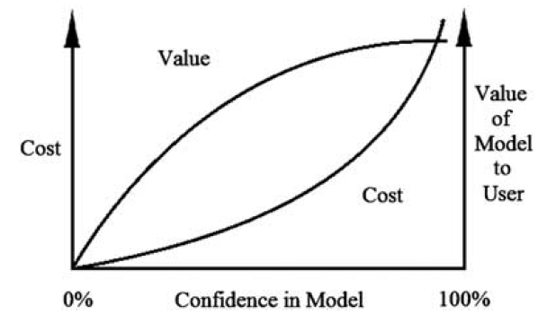
Simulation Models & Verification
Simulation Models are used for a variety of purposes
Design of systems
Development of system operating policies
Research to develop system understandings
Model and its results must be correct for its ‘use’
[1] R G Sargent, “Verification and validation of simulation models”, Journal of Simulation (2013)

Slide 4
Simulation Models & Verification
A model should be developed for a specific purpose (or application)
Its validity determined with respect to that purpose
Often too costly and time consuming to determine ‘absolute’ validity
Tests and evaluations are conducted until sufficient confidence is obtained

Slide 5
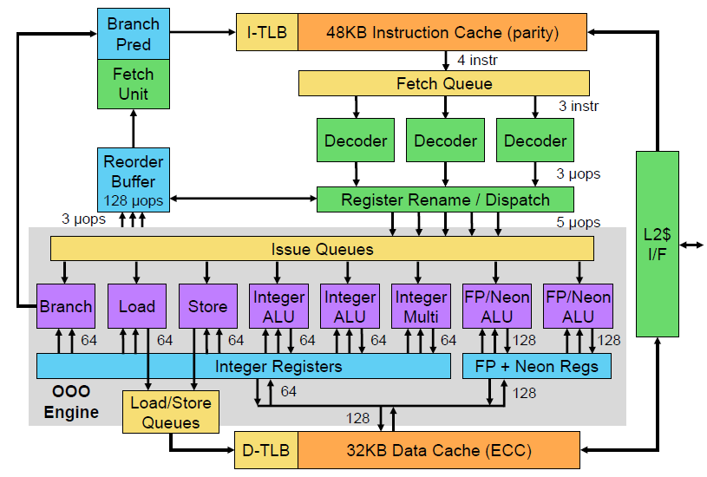
The Design-Under-Test (DUT)
Instruction-level fast simulation model (Just in time dynamic binary translation) of a modern 64b Processor
Optimized for simulation speed: block chaining, DMI, host register allocation, hierarchical TLB and Translation caching
Functional only
No timing
Caches, pipeline stages and debug logic not modeled
Instruction Accurate
Unmodified binaries can be ported from simulator to silicon

Slide 6
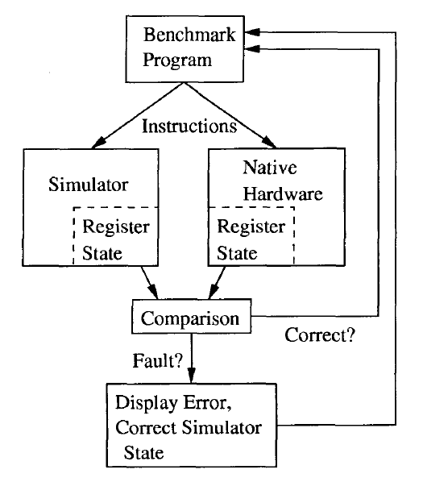
Synchronized State Comparison
Very little work has been done on verifying correctness of processor simulators [2]
Previous work in this area has been focused on
Hardware Verification
Simulation Functionality
Simulation Speed
[2] Bob Glamm and David J Lilja, “Automatic Verification of Instruction Set Simulation using Synchronized State Comparison”, IEEE Simulation Symposium (2001)

Slide 7
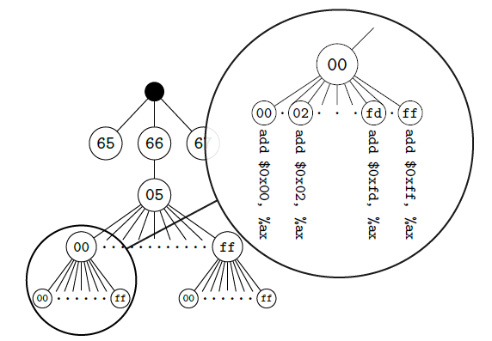
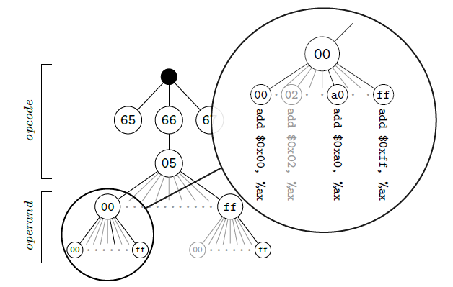
Fuzzing based Automatic Test Generation
EmuFuzzer : Fully automated testing methodology for CPU emulators, based on fuzzing [3]
Random Test case generation
CPU assisted test case generation
Several functional defects reported in state-of-the-art CPU emulators – QEMU, Valgrind, Pin, BOCHS
Development of CPU emulator is a very challenging task
Need for specialized testing methodology
[3] Lorenzo Martignoni, et al, “Testing CPU Emulators”, ISSTA, 2009

Slide 8
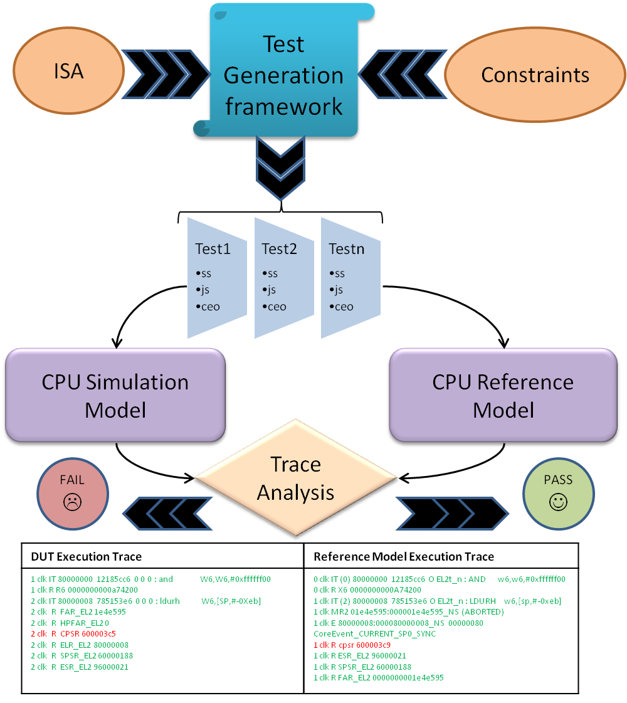
Test Framework

Slide 9
Test Generation
Initialization Phase
Register initialization
Various Register Files: GPR, FPR, VR, Condition Code Registers
System Register considerations (Invalid State Constraints, MMU constraints)
Memory initialization
Page Table Setup
Opcode Fill
Execution Phase
Instruction randomization
Exception handling code insertion
Termination Phase
Breakpoint on computed end address or exception address
Instruction limit

Slide 10
GPR and VR Initialization
Constrained-Random initial values for all register files
General purpose registers: Min, Max and 64-b random values
Vector registers: Min, Max and 128-b random values
SIMD operations enable/trap

Slide 11
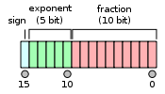
FPR Initialization
Floating point registers
IEEE 754 Single, Double and Half precision formatting
Special Values: Signed zeros, Subnormal numbers, Infinities, NANs
FPCR: Rounding Modes, Default NAN, Trap Enables

Slide 12
Processor State Initialization
Processor State
Multiple test variants to cover all possible processor state settings
Constraints to not enable processor states not modeled (debug, etc)
Directed constrained tests to cover illegal/interrupt scenarios
Field | Description | Randomization
NZCV | ALU Flags | Fully randomized
DAIF | Exception Mask Bits | Fully randomized
SPSel | SP Select | Fully randomized
Current EL | Current Exception Level | Fully randomized
IL | Illegal Flag | Constrained
SS | Single Step | Don’t generate
E | Data Endian-ness | Fully randomized

Slide 13
System State Initialization
System registers
Multiple test variants to cover all interesting combinations
Execution at all exception levels, computation modes, exception endianness, alignment control, vector base addresses, interrupt routing modes
Avoid invalid state settings

Slide 14
Test Generation: Instruction Randomization
Instruction decoding information from simulator fed to test generator
Valid instructions with operands fully randomized
ADD (Shifted Register)
Instruction Operation
ADD Rd, Rn, Rm {<shift>, <amt>}
SF: 32b/64b values
S: Set Condition Codes
Shift: Shift Type to be applied
Imm6: Immediate Operand
Rd, Rn, Rm: Register Operands
Instruction Decode Data
Encoding: 0x0B000000
Mask: 0x7F200000
~Mask: 0x80DFFFFF
Generated Instruction Test
Encoding | (< 32b random value > & ~Mask)

Slide 15
Test Generation: Invalid Operands
For some instructions, certain combination of operands result in illegal encoding
Processor takes undefined interrupt when such instructions are executed
Not possible to generate such instructions since assembler/compiler will never generate such opcodes
Can be generated if using raw decode data from simulator itself for test generation
ADD (Vector)
Instruction Operation
ADD Vd, Vn, Vm
If size:Q == ‘110’ then undefined;
Instruction Decode Data
Encoding: 0x0E208400
Mask: 0xBF20FC00
~Mask: 0x40DF03FF
Generated Instruction Test
Encoding | (< 32b random value > & ~Mask)

Slide 16
Test Generation: Using Assembler
Exception/Interrupt handling typically supported late in simulator development phase
Mechanism to generate tests without illegal operand combinations
Retain capability to randomize operands
Generate instructions as per the assembler syntax
ADD (Vector): add $V5, $V5, $V5
AND (Shifted Regsiter): and $X5, $X5, $X5, $SHIFT_R_4 #$UNSIG6
Generated Test
add V8, V20, V1
add V7, V3, V29
add V0, V12, V14
Generated Test
and X8, X20, X1 , ASR #32
add X7, X3, X29 , LSR #52
add X0, X12, X14 , LSL #38

Slide 17
Test Generation: Alignment Requirements
Load/Store instructions have alignment requirements
Stack Pointer needs to be aligned
Any load/store address must be aligned under certain conditions
Accessing Device Memory
MMU disabled
Alignment Check forced via system register settings
Add fix-ups in test generator to avoid alignment interrupts
Add extra instructions to mask the index register value
When using SP as index register
Insert a instruction to align SP
Insure immediate offsets are 16-byte aligned
ldrh Test: GPR as index
and X10,X10, 0xfffff00
ldrh W5, [X10], #112
and X14,X14, 0xfffff00
ldrh W16, [X14], #-25
ldrsh Test: SP as index
and SP, SP, 0xfffff00
ldrsh W10, [SP, #-240]!
ldrsh W22, [SP, #10]!

Slide 18
Test Generation: Handling Branches
Fully randomized branch instruction operands can take the control to unknown memory addresses
Will result in uninitialized memory being read as instruction opcode
Resulting in illegal/undefined interrupts
Add extra instruction to save the return address in X0
Fill uninitialized memory with “return X0” opcode
Constrain branch operands to be outside the test instruction memory range
branch test
adr x0, 8
B 67066032
adr x0, 8
B -30761752
branch test command line
./sim -s sim.uninit_mem_fill_word=+str(get_mem_fill_word(arch_prefix)) <rest of the arguments>
Example: ./sim -s sim.uninit_mem_fill_word=0x00005fd6 <other arguments>

Slide 19
Test Generation: MMU Initialization
MMU Enabled or Disabled
System Register Controls
Write Execute Never (WXN)
Top bit – address size
Page & Granule Size
Translation Table Base Addresses
Stage 1, Stage 2 enables
Don’t care: Shareability and Cacheability controls
Address Translation System
Translation regimes & stages
Translation table format
Memory Attributes
Translation Faults

Slide 20
Trace Generation
Both DUT and reference model generate execution trace when running a test
Instruction address & opcode
Register updates
Any register update due to execution of the instruction will be captured – destination registers extracted from decode data
GPR, FPR, VR, SPR, CR
Any register update due to instruction taking exception/interrupt will be captured – custom tracing
ELR, ESR, FAR, SPSR, CPSR, etc
Memory updates
Load/Store instructions accessing/updating memory
Custom tracing via memory access interface
< Inst No > < Addr > < Opcode > : < Disassembly >
< Inst No > R < Reg Name > < Value >
< Inst No > MR< width > < VA > : < PA > < Value >
< Inst No > MW< width > < VA > : < PA > < Value >

Slide 21
An Example Trace
2 1004 8b87a61d : ADD x29,x16,x7, ASR #41
2 R X29 CB613045F7B498D7
...
4 1008 f84c84c7 : LDR x7,[x6],#0xc8
4 MR8 0000fa00:00000000fa00 d65f0000_d65f0000
4 R X7 D65F0000D65F0000
4 R X6 000000000000FAC8
...
7 1018 f808148a : STR x10,[x4],#0x81
7 R X4 000000000007FE81
7 MW8 0007fe00:00000007fe00 76ace219_000ff900
…
9 1020 f800802a : STUR x10,[x1,#8]
9 R ESR_EL2 93ca8044
9 R FAR_EL2 00000002f2ebbd20
9 R ELR_EL2 00000000000001020
9 R SPSR_EL2 000003c5
9 R CPSR 000003c9
Arithmetic Inst
Memory Read Inst
Memory Store Inst
Memory Store Inst Causing Exception

Slide 22
Trace Analysis
Post processing of execution traces from DUT and reference model
Determines equivalence between the two traces for each instruction execution
Instruction address
Instruction opcode
Register updates
Memory updates
Detect special scenarios
Undefined behavior
Exception during execution of a micro-op
Known limitations
Self Modifying code
Low Power Instruction execution

Slide 23
Generated Test Suites
Test Suite | Description | Number of Tests
Single Starter (ss) | Exercise Basic Functionality of every instruction – Integer, Floating Point, SIMD, Crypto: Arithmetic, Logical, Load, Store, Branch, System, etc Registers randomized – Fix-ups to avoid alignment requirement violations Operands constrained to avoid generating exceptions All computation modes | 20K
Jump Starter (js) | Same behavior as ss, but in a repeated fashion 100s of same instruction with different/random operands executing back to back | 20K
Instruction Mix (imix) | Random mix of various instructions with valid operands 1000s of instructions per test | 5K
Random ss/js/imix | ss/js/imix suites with System Registers randomized Execute instructions under different contexts set by system register settings | 45K
Random operands | Generated using raw decode data from simulator to cover invalid operand combinations – stresses on negative test case scenarios and exception handling | 45K
MMU Validation | Individual Control of MMU at different exception levels Support for virtual address, validation of different translation levels , TLB caching Random mix of Load, Store and Branch Instructions for different exception levels and computation modes | 5K

Slide 24
Conclusion & Future Directions
Tests developed along with ISS development
No extra/dedicated effort for model verification
Leverage in-depth understanding as well as simulator code for ISS for model verification
Instrument ISS for trace generation as required
Minimize test framework effort
Instrumentation of golden model for trace generation
Development of trace analysis tool
Thorough testing of required simulator features along with simulator development
Several hard to find defects caught and fixed early in the development phase
Much less tests required to be generated to achieve desired coverage
A few hundred thousand, instead of millions in pure fuzzing based approach
Future directions
Code coverage measurement to detect simulator aspects weekly tested and increase focus on covering such aspects
Challenges with JIT DBT as static instrumentation approach will not work with dynamically emitted/executed code

Slide 25
Questions

