Slide 1
Using a Generic Plug and Play Performance Monitor for SoC Verification
Dr. Ambar Sarkar
Kaushal Modi
Bhavin Patel
Janak Patel
Ajay Tiwari

Slide 2
Agenda
Introduction
Challenges – Why Performance Monitor
Features
Architecture and Configuration
Measurements Supported
Performance Result Report
Steps for Monitor Usage

Slide 3
Introduction
Two parameters of Performance Verification:
Latency : Time taken by data to reach from one point to another
Bandwidth : Amount of data transferred in a given time
The parameters have to be measured and verified against an expected value for all paths of interest; the process known as performance verification
Functional Verification alone cannot guarantee meeting of performance criteria
With the complexity of SoCs increasing, importance of performance verification grows in verification cycle

Slide 4
Complex SoC : Diagram
7 Dual Core Scalar Floating Point Processors
7 Dual Core Scalar Floating Point Processors
7 Dual Core Scalar Floating Point Processors
7 Dual Core Scalar Floating Point Processors
7 Dual Core Scalar Floating Point Processors
7 Dual Core Scalar Floating Point Processors
7 Dual Core Scalar Floating Point Processors
7 Dual Core Scalar Floating Point Processors
7 Dual Core Scalar Floating Point Processors
7 Dual Core Scalar Floating Point Processors
DPHY
Scalar Floating Point Processors
Vector Floating Point Processors
DPHY
DPHY
DPHY
DPHY
IOMUX
DPHY
PCIe EP
Generic DMA
JTAG
DPHY
Interrupt & Error Controller
CSI-RX
CSI-RX
CSI-RX
CSI-RX
CSI-RX
OCP Mst
OCP Mst
CSI-RX
OCP Mst
OCP Mst
CSI-RX
OCP Mst
OCP Mst
OCP Mst
OCP Mst
Image Processor
OCP Mst
OCP Mst
OCP Mst
OCP Mst
Image Processor
OCP Mst
OCP Mst
Image Processor
OCP Mst
OCP Mst
OCP Mst
Image Processor
OCP Mst
OCP Mst
OCP Mst
Image Processor
Mst
Slv
Mst
Slv
Image Processor
Image Processors
DMA
Timers & Watchdog
F/W
INTERCONNECT
F/W
F/W
F/W
F/W
I2C, SPI, UART
Clock & Reset Generator
Boot ROM
System RAM Controller
Memory Scheduler
Chip Specific IPs
Debug & Trace Controller
Sensor
Bank0
DDR Memory Controller
Bank1
Bank2
DRAM PHY

Slide 5
Complex SoC : Perf Requirement
Paths | Traffic Type
Image Processor 0 -> DDR | 128B WR 75% Sequential, 25% Random
Image Processor 1,2 -> DDR | 128B WR 75% Sequential, 25% Random
Image Processor 3 to M -> DDR | 128B WR 75% Sequential, 25% Random
Floating processor 0,1 -> DDR | [1] Sequential 128B RD [2] Random 32B RD [3] Random 32B WR
Floating processor 2,3 -> DDR | [1] Random 32B RD [2] Random 32B WR
Floating processor N -> System RAM | Sequential 128B RD
Other Floating processor -> DDR | [1] Random 32B RD [2] Random 32B WR
PCIe -> DDR | [1] Sequential 128B RD [2] Sequential 128B WR

Slide 6
Why Performance Monitor Challenges in Performance Verification
Multiple interfaces having different protocols
Bunch of data paths of measurement
Each path can have specific measurement requirements
Paths can have interleaved traffic pattern
Variable measurement window for different traffic patterns possible
Selective traffic measurement on particular interface
Possibility of change in Performance requirements during course of the project
Possibility of addition of new paths in derivative SoC
Notes:
Bunch of data paths of measurement
From single master to multiple slaves, multiple masters to multiple slaves, multiple masters to single slaves

Slide 7
Why Performance Monitor Challenges in Performance Verification
Different approaches used
Calculation in tests or callbacks
Testcases become too complex and lengthy
Reporting using post processing
Testcase developer has to print unique and appropriate messages
Requires development of extra script, overhead in terms of time and effort
No standard method – approach becomes dependent on individual
Solution :: “Performance Monitor”
Notes:
Calculation in tests or callbacks
Testcase developer has to take care of calculations in tests
Reporting using post processing
In absence of a script, manual effort is required to check the success or failure of performance requirement – from log files
Solution ::
A scope of reduction in time and effort put behind performance verification was realized
A Performance Monitor was thought of – that could take care of the challenges
Accordingly, this monitor had to be:
Protocol independent
Re-usable
Plug-and-play entity
Using result reporting that is easy to read, presentable and helpful in debugging

Slide 8
Features
Highly Configurable
Multiple paths and multiple traffic patterns supported
Types of Measurements
Per transaction & Average latency
Reporting
Configurable units for latency (ns, us, ms) and bandwidth (KBps, MBps, GBps, Kbps, Mbps, Gbps)
Configuration methods convenient, uncomplicated
Configuration compliance check
Bandwidth
Alternate bandwidth and latency window
Cumulative bandwidth measurement for multiple traffic patterns
Uniformity comparison between interfaces
Root mean square (RMS) value calculation for latency, bandwidth and error values
Measurement report depending upon user defined verbose level
Error reporting in case of incorrect result
Run time reporting of measurements
Trace file reporting for all the measurements
Miscellaneous
Callback support to collect functional coverage
API support to get performance statistics on-the-fly
Measurement Enable/Disable Support

Slide 9
Architecture Use Model
Top Environment
Perf
Trans
General
Transaction
top_env_cfg
Performance Environment
cfg
perf_mon_env_cfg
perf_mon_cfg[ ]
perf_mon_N
cfg
perf_mon_1
Adapter
leaf_mon_cfg[]
cfg
perf_mon_0
leaf_mon_cfg[]
leaf_mon_sel
De-Multiplexer
leaf_mon_N
cfg
leaf_mon_cfg[ ]
DUT
leaf_mon_sel
De-Multiplexer
cfg
leaf_mon_N
leaf_mon_1
cfg
leaf_mon_sel
De-Multiplexer
cfg
leaf_mon_N
leaf_mon_1
leaf_mon_0
cfg
cfg
Agent
cfg
leaf_mon_1
leaf_mon_0
cfg
cfg
leaf_mon_0
cfg

Slide 10
Architecture Hierarchy of Monitor
The measurement over different interfaces and traffic patterns is taken care of by the hierarchical structure of the performance monitor
Each level has its own configuration parameters
Perf Top Env
Perf Mon
Leaf Mon
Leaf Mon
Perf Mon
Leaf Mon
Top level Environment
Instantiated inside testbench
Performance monitor
One performance monitor instantiated per interface of measurement
Leaf monitor
Basic entity that performs calculations
One instance per traffic pattern, per interface

Slide 11
Architecture Performance Transaction
Since the monitor can be used with different interfaces, a generic transaction type is needed – Performance Transaction. The fields of which are:
User will update these fields upon the occurrence of required event
This can be done inside any of the testbench components, where the required data will be available
Passed to performance monitor through connecting port
Field | Description
Id | Decides the leaf monitor that this transaction is intended for
req_lat_start_time | Stores the start time for latency calculation
req_lat_end_time | Stores the end time for latency calculation
bw_start_time | Stores start time for bandwidth calculation
bw_end_time | Stores end time for bandwidth calculation
data_bytes | Stores the total number of bytes being transferred in a transaction

Slide 12
Configuration
Configuration class based approach
Instance of the configuration class is taken inside testbench
CSV file based approach
A pre-defined format of CSV file to configure 3 levels of hierarchy
Sr. No. | SEQUENCE NAME | LEVEL | NUM OF PERF MON | PERF MON NAME | NUM OF TRANS TYPE | LEAF MON ID | MEASUREMENT TYPE | EXPECTED LATENCY | EXPECTED PER_TRANS LATENCY | LATENCY UNIT | EXPECTED BANDWIDTH | BANDWIDTH UNIT
1 | ocp_axi_read_write | L1 | 2
 |  | L2 |  | OCP | 2
 |  | L3 |  |  |  | READ | AVG_LATENCY + BANDWIDTH | 48 | 48 | ns | 100 | MBps
 |  | L3 |  |  |  | WRITE | AVG_LATENCY + BANDWIDTH | 48 | 48 | ns | 100 | MBps
 |  | L2 |  | AXI | 2
 |  | L3 |  |  |  | READ | AVG_LATENCY + BANDWIDTH | 48 | 48 | ns | 100 | MBps
 |  | L3 |  |  |  | WRITE | AVG_LATENCY + BANDWIDTH | 48 | 48 | ns | 100 | MBps

Slide 13
Measurements Supported
Per Transaction Latency measurement
Performed when traffic requirement is of guaranteed service
Measurement over a number of transactions
Gives the value of bandwidth and latency over a user defined window of transactions – ‘setup’ and ‘hold’ transactions can be configured
Measurement between two events
Used when measurement window has to be defined by the total bytes to be transferred, instead of total number of transactions.
Measurement over an alternate window
To get the latency and bandwidth measurement over a window other than the configured window; helps to check the consistency of results

Slide 14
Measurements Supported
Cumulative Bandwidth measurement
Helps if there is a requirement of different traffic patterns meeting a bandwidth requirement collectively
Uniformity comparison
If the measured value for any interface has to be compared against the other interface, uniformity comparison can be used

Slide 15
Result Reporting
Two types of reporting:
Log file reporting
Trace file reporting
Configurable report verbosity
Default Reporting : Summary of results reported in report_phase. This includes total windows, number of matching windows, average latency over all the windows among other details
Reporting Level 1 : Run-time reporting of results for each window, in addition to default reporting
Reporting Level 2 : Run-time reporting of results for each transaction, in addition to default and level 1 reporting
Debug Reporting : Debug messages for all the relevant information, apart from above mentioned details

Slide 16
Steps for Usage Integration Steps
Apply configuration
Instantiate in Testbench
Generate Perf Trans
Run Simulation
Use this information to configure each hierarchy of monitor – using config class instance or CSV based approach
Define requirement – What to measure, where to measure
Create instance of Performance top Environment
Connect the Perf Mon ports to testbench
Include the package in testbench
Pass the transaction to Perf Mon through connecting ports
Use adapter class if required
The name of the monitor in report helps to identify erring traffic pattern, if any
Tabular reporting helps analysis
Run the simulations as usual
Create perf trans inside the testbench

Slide 17
SoC Performance Requirement
Interconnect
PCIe EP
Ethernet RGMII
DMA
CPU
System RAM
USB Device
Performance Requirements
USB
Bulk In & Bulk Out
PCIe
Descriptor Mem Read
Descriptor Mem Write
Ethernet
TX Packet from RAM
CPU
DMA
TX Eth Packet Mem Write, Avg. Latency
RX Eth Packet Mem Write - 980Mbps, Avg. Latency 3us
RX Packet from RAM
PCIe Read/Write
RAM Random Read/Write
RAM Sequential Read/Write
TX Descriptor Read/Write
RX Packet Read/Write
RX Descriptor Read/Write
TX Packet from PCIe, Avg. Latency
RX Packet from PCIe, Avg. Latency
Scenario1:
PCIe <-> Ethernet
Scenario2:
DMA enabled traffic
Start Event: Start of Trans 1
End Event: End of Trans 512
Start Event: DMA GO
End Event: DMA DONE

Slide 18
Summary
The monitor is used in three different projects for different clients so far
With ad-hoc methods, for a complex SoC with 20+ masters and 80+ slaves, building the set-up for performance verification took as long as a month. Apart from this, another month was spent achieving closure through testcase and debugging
A derivative of same SoC was verified using Performance Monitor and complete performance verification closure was achieved in 3 weeks duration, with lesser resources
This demonstrates a saving in the man-hours for the closure

Slide 19
Questions

Slide 20
Configuration
Allows the user to create the performance monitor and performance leaf monitors as per the measurement and traffic requirements; makes it re-usable across projects
Level | Hierarchy Name | Configuration Control
L1 | Performance Environment Configuration | Number of Performance Monitor(s) ID of each Performance Monitor Uniformity check configuration
L2 | Performance Monitor Configuration | Number of Leaf Monitor(s) ID of each Leaf Monitor Cumulative measurements configuration
L3 | Leaf Monitor Configuration | Measurement types Expected values for each measurement Measurement window information and window type Reporting level and trace file configuration

Slide 21
Result Reporting Log File Reporting
An example of default report :
This message will be displayed as an error in case the average values or the alternate window values don’t meet the requirement
The name of the leaf node helps to quickly identify the erring path and traffic pattern
A message will inform the user about the measurements that have been disabled

Slide 22
Result Reporting Trace File Reporting
Reporting of the performance parameters is dumped in trace file, if enabled
This trace file can be used to generate a graph of results by reading it in an Excel file
For each simulation, two types of trace files can be generated as per configuration parameters:
Leaf Monitor Trace file:
Includes the latency information per transaction, average latency information per window and bandwidth information per window
Common trace file for all leaf monitors
Default Reporting Trace file:
Default reporting trace file for all leaf monitors

Slide 23
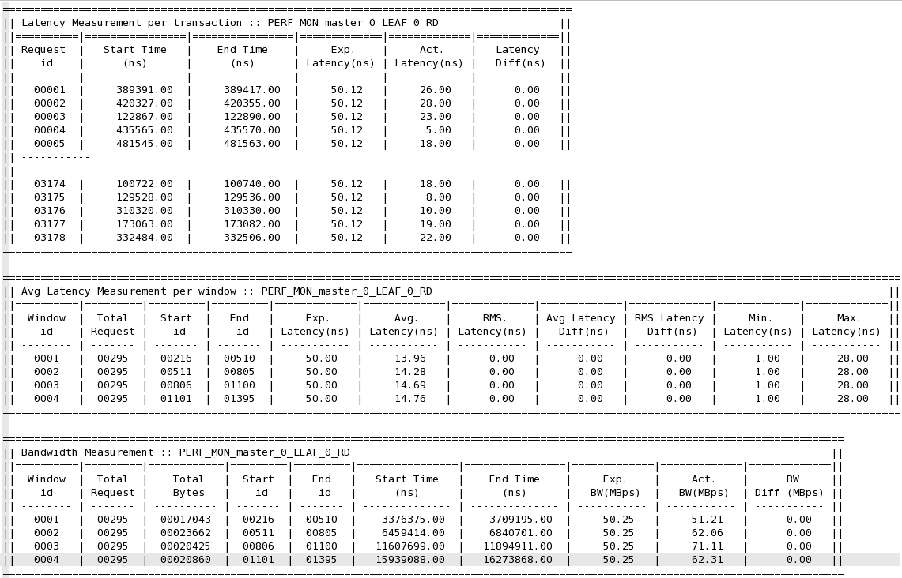
Result Reporting Trace File Reporting Example

Slide 24
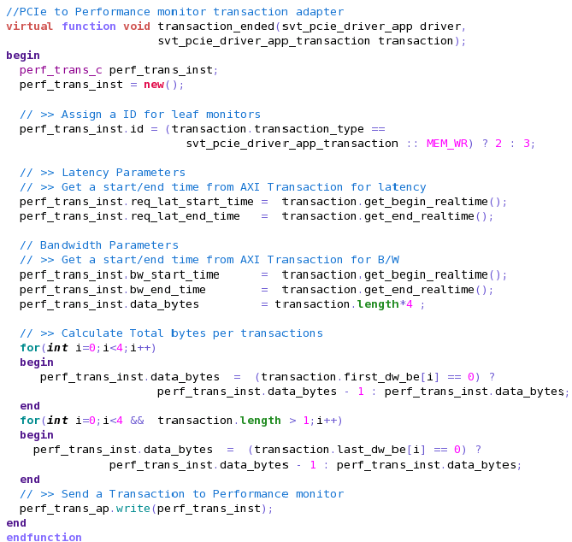
Adaptor Example PCIe to PerfMon Trans Adaptor

Slide 25
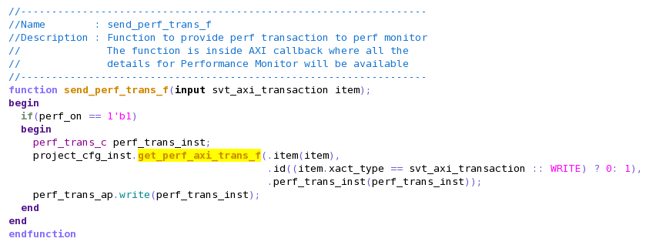
Architecture Example – Perf Trans Generation

Slide 26
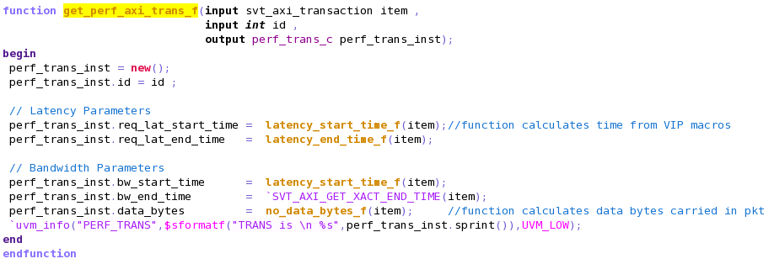
Architecture Example – Perf Trans Generation

Slide 27
Why Performance Monitor Solution
A scope of reduction in time and effort put behind performance verification was realized
A Performance Monitor was thought of – that could take care of the challenges
Accordingly, this monitor had to be:
Protocol independent
Re-usable
Plug-and-play entity
Using result reporting that is easy to read, presentable and helpful in debugging

