Slide 1
Unleashing the Power of UPF 3.0: An innovative approach for faster and robust Low-power coverage
Awashesh Kumar, Mentor a Siemens Business
Madhur Bhargava, Mentor a Siemens Business

Slide 2
Agenda
Introduction
Motivation for low power coverage methodology
IEEE 1801-2015 (UPF 3.0) Information model
UPF 3.0 HDL package functions
Proposed methodology
Case studies and examples
Benefits of proposed methodology
Current challenges and future work
Conclusion

Slide 3
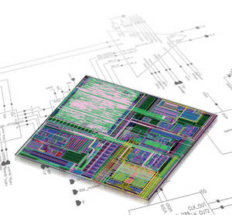
Introduction
Today's SoCs
Are incredibly Complex
Have sophisticated power management strategies for highly power efficient design
Integrate variety of implementation cells
Isolation, retention, buffers etc.
They Must
Verify the power management
Debug the complex issues

Slide 4
Unified Power Format(UPF)
RTL is augmented with a UPF specification
To define the power architecture for a given implementation
RTL + UPF drives implementation tools
Synthesis, place & route, etc.
RTL + UPF also drives power-aware verification
Ensures that verification matches implementation
UPF
RTL
Synthesis
UPF
Simulation, Logical Equivalence Checking, …
Netlist
Place & Route
UPF
Netlist
IEEE Std 1801™-2013

Slide 5
Motivation for Methodology
Are all control sequences covered?
Are all complex interactions between power domains covered?
Are all the desired power states reached or not?
Are all desired power state transitions reached or not?
Is there any illegal power state reached?
Is there any illegal power state transition occurred?

Slide 6
Motivation for Methodology Cont.
No pre-defined coverage metric to capture power states and their transitions
UCIS (Unified Coverage Interoperability Standard) does not provide any metric to capture low power intent (power states etc.)
Tool generated metrics
Not suitable for some specific requirement
Tool may not always keep pace with low power technology advancements

Slide 7
UPF 3.0 Information Model
Introduced in UPF 1801-2015
Abstract data model to represents low power objects created in UPF
E.g. Power Domain, Power State, Supply Set etc.
Provides access to properties of low power objects
API interface; to allow access of objects and properties
Tcl Interface:
To access objects/properties in a Tcl script or UPF file
HDL Interface:
to access/manipulate objects/properties in a testbench or simulation model
UPF
Database
(IMDB)
TCL/
HDL
Read
Write
Access

Slide 8
UPF 3.0 Information Model Cont.
Native HDL representation
For object with dynamic properties e.g. power domain
Represented by struct/record in HDL containing two fields
A value field – dynamic property value
A handle/reference to UPF object – to access other properties of the object
Type Name | SV Representation
upfPdSsObjT | struct { upfHandleT handle; upfPowerStateObjT current_state; } upfPdSsObjT

Slide 9
UPF 3.0 HDL Package Functions
Provides to access low power object and their properties in HDL
Five different classes of HDL functions
HDL access functions: basic functions to access the low power objects and properties
Ex. upfHandleT pd = upf_get_handle_by_name("/top/dut_i/pd")
Immediate read access HDL functions:
Ex. upfHandleT ps_active_hndl = upf_query_object_properties(ps, UPF_IS_ACTIVE )
integer ps_on_value = upf_get_value_real(ps_active_hndl)
Immediate write access HDL functions:
E.g. supply_on(“/tb/dut_i/vdd_net”, 0.9)
Continuous access HDL functions: enables continuous monitoring of dynamic values
E.g. upfSupplyObjT vdd_monitor = upf_create_object_mirror("/top/dut_i/vdd", "vdd_monitor")
Utility functions: general utility function to assist users.
E.g. upfClassIdE upf_query_object_type(upfHandleT handle)

Slide 10
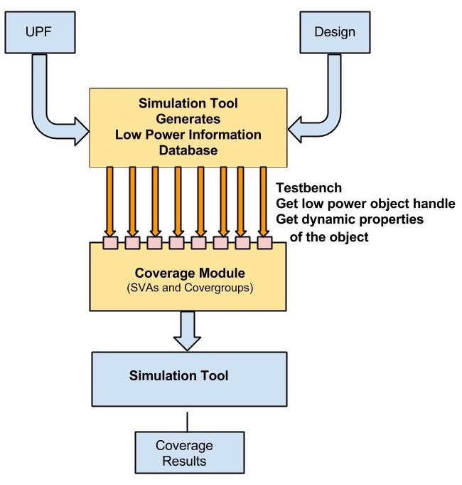
Proposed Low Power Coverage Methodology
Coverage methodology developed using UPF 3.0 HDL package functions and System Verilog coverage constructs
Allows users to do random directed scenarios verification
Steps Involved:
Get the low power object handle
upfHandleT pd = upf_get_handle_by_name("/tb/dut/pd")
Get the dynamic property of the object
upfPdSsObjT pd_hdl;
upf_create_object_mirror(“/tb/dut/pd”, “pd”);
upfPowerStateObjT pwr_state = pd.current_state;
Create the coverage module with coverbin/coverpoints to calculate coverage metric
Pass the dynamic information to coverage module

Slide 11
Case Study I – Coverage of Isolation Strategies
How to ensure if all possible values of isolation controls are covered
UPF
set_isolation iso –domain pd \
–isolation_signal isoCtrl \
–applies_to outputs \
–clamp_value 0 …
Coverage module
module covIsoModule (int isovalue, string isoName)
reg cov_clk = 0;
covergroup ISO_SIG_STATE_COVERAGE(posedge @cov_clk)
ACTIVE_LEVEL: coverpoint isovalue { bins ACTIVE = 1; }
ACTIVE_LOW: coverpoint isovalue { bins ACTIVE = 0; }
endgroup
…
endmodule

Slide 12
Case Study I – Coverage of Isolation Strategies
HDL Code (modeled in testbench)
upfHandleT iso = upf_get_handle_by_name("/top/chip/mod/pd.iso");
upfHandleT iso_ctrl = upf_query_object_properities(iso, UPF_ISOLATION_CONTROLS);
upfHandleT ctrl_value_hndl =
upf_get_object_properties(iso_ctrl,UPF_CURRENT_VALUE);
integer ctrl_value = upf_get_value_int(ctrl_value_hndl);
// passing the properties to coverage module
covIsoModule covPdIso(ctrl_value, "/top/chip/mod/pd.iso");
Get handle of isolation strategy
Get handle of isolation control
Get dynamic value
of isolation control
Pass value to coverage module

Slide 13
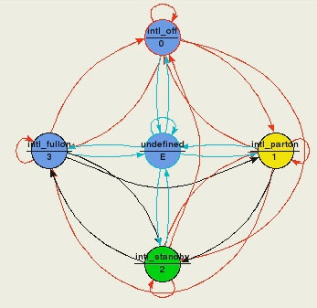
Case Study II – Coverage of Power States
Camera domain (PD_CAMERA) with three power states “ON, SLEEP, OFF”.
Video domain (PD_VIDEO) with three power states “ON, SLEEP, OFF”.
These power states are defined in UPF using the “add_power_state” command.
add_power_state PD_CAMERA \
-state ON \
{-logic_expr {primary == ON} } }
…

Slide 14
Case Study II – Coverage of Power States Cont.
HDL Code:
// Native HDL objects for power states
upfPowerStateObjT ps_ON;
upfPowerStateObjT ps_OFF;
upfPowerStateObjT ps_SLEEP;
// Handle to hold active state
upfHandleT state_ON_active;
upfHandleT state_OFF_active;
upfHandleT state_SLEEP_active;
//integer values of active states, 1 indicates active
integer state_ON;
integer state_OFF;
integer state_SLEEP;

Slide 15
Case Study II – Coverage of Power States Cont.
// continuous access of power states
create_upf_object_mirror (“/tb/top/PD_CAMERA.ON”, “ps_ON”)
create_upf_object_mirror (“/tb/top/PD_CAMERA.OFF”, “ps_OFF”)
create_upf_object_mirror (“/tb/top/PD_CAMERA.SLEEP”, “ps_SLEEP”)
always @(ps_ON, ps_OFF, ps_SLEEP) begin
state_ON_active = upf_get_object_properties (ps_ON.handle, UPF_IS_ACTIVE)
state_OFF_active = upf_get_object_properties (ps_OFF.handle,UPF_IS_ACTIVE)
state_SLEEP_active = upf_get_object_properties (ps_SLEEP.handle, UPF_IS_ACTIVE)
state_ON = upf_get_value_int(state_ON_active);
state_OFF = upf_get_value_int(state_OFF_active);
state_SLEEP = upf_get_value_int(state_SLEEP_active);
end

Slide 16
Case Study II – Coverage of Power States Cont.
module covPowerStateModule (int state_ON, state_OFF, state_Sleep, string StateName)
wire [2:0] curr_state;
assign curr_state = {state_OFF, state_ON, ……};
covergroup PD_CAMERA_STATE_COVERAGE;
OFF: coverpoint state_OFF { bins ACTIVE = (0=>1); }
ON: coverpoint state_ON { bins ACTIVE = (0=>1); }
SLEEP: coverpoint state_SLEEP { bins ACTIVE = (0=>1);
Endgroup
PD_CAMERA_STATE_COVERAGE PS_primary = new;
covergroup primary_TRANSITION_COVERAGE;
PA_CAMERA_TRANSITION_COVERAGE: coverpoint curr_state
{
wildcard bins OFF_to_ON = (4'b???1=> 4'b??1?);
wildcard bins OFF_to_SLEEP = (4'b???1=> 4'b?1??);
wildcard bins ON_to_OFF = (4'b??1?=> 4'b???1);
……
}
endgroup
Covergroup for states
Covergroup for state transitions

Slide 17
Case Study III – Assertions with UPF 3.0 Information Model
A combination of state ON for PD_CAMERA and state ON for PD_VIDEO cannot be true at the same time.
Assertion Module
module assertionPowerState (int state_ON_CAMERA, int state_ON_VIDEO)
reg cov_clk = 0;
always @(state_ON_CAMERA, state_ON_VIDEO)
cov_clk = 1'b1;
always @(cov_clk)
cov_clk = 1'b0;
always@(posedge cov_clk)
assert (state_ON_CAMERA != state_ON_VIDEO) else $error(“Camera and Video both on at same time”)
endmodule

Slide 18
Benefits of Proposed Methodology
Early low power coverage closure
Directed scenario testing
Custom assertion for mutual exclusion of two domains
Coverage code and scripts development can be automated easily
UPF based methodology
Consistent and usable across multiple vendors
Making life easier for verification engineers
No detailed knowledge of UPF is needed
Easily scalable to more complex scenarios
Unlike other coverage methodologies; low level details like supplies and logic values is not required.

Slide 19
Unaddressed Low Power Verification Challenges
Proposed approach robust at RTL level
Lacks few things
Ability to access analog/mixed-signal parameters from onboard regulators & voltage sources

Slide 20
Conclusion
Ad-hoc approaches of low power coverage not likely to succeed
Proposed a methodology for low-power coverage of the design using the UPF 3.0 HDL package functions
Faster verification closure
Case studies using covergroups and coverpoints
Advantages of proposed methodology discussed

Slide 21
References
[1] IEEE Std 1801™-2015 for Design and Verification of Low Power Integrated Circuits. IEEE Computer Society, 05 Dec 2015.
[2] “Amit Srivastava, Awashesh Kumar”, PA-APIs: Looking beyond power intent specification formats, DVCon USA 2015
[3] “Veeresh Vikram Singh, Awashesh Kumar”, Cross Coverage of Power States, DVCon USA 2016
[4] “Pankaj Kumar Dwivedi, Amit Srivastava, Veeresh Vikram Singh”, Let’s DisCOVER Power States, DVCon USA 2015

