Slide 1
UVM, VMM and Native SV: Enabling Full Random Verification at System Level
Ashok Chandran, Analog Devices

Slide 2
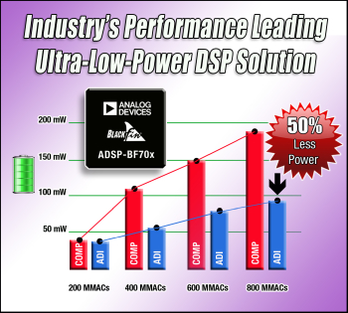
Introduction
Latest Product in Blackfin Processor Family – BF70x
Enhanced Core
Low Power System
Memory
Peripherals
Security

Slide 3
Overall DV Methodology
Bottom Up Approach
MDV for blocks
Spec->Executable Vplan-> CRV >Coverage->QA
Significant set of VIP in VMM/UVM/SV
Focus on System Level Verification
Constrained random verification at system level
Complemented by Formal for connectivity, glue logics

Slide 4
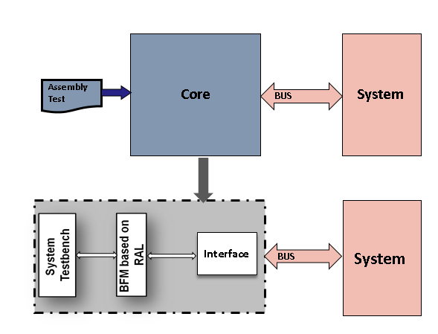
System Level Approach
Core Independent Testbench
Why ? – We work with Blackfin, ARM, Sharc Cores
Uses BFM Driver for MMR and Memory access initiated by Core
Enables peripheral and system oriented verification
Core System DV
Dynamic Backdoor Memory load with random code generation
Actual core executes random code (cache, data, execute)
Arbitration Mechanism between BFM and actual core

Slide 5
System Level Approach
What we had - VMM based SoC Level Testbench
Has worked well for past projects
VMM Features Used
Register/memory Model
Memory Allocation
MS Scenarios
Callback To Modify/drop Transactions
X(A)
S(A)
MS
MS Gen
X(B)
S(B)
MS
R
X(C)
S(C)
MS
All transactions pass through common xaction router
X(D)
S(D)
Xactor Start-Stop
A,B,C and D represent different IO
S is a scenario of the IO
MS represents a multi-stream scenario
MS gen is a MS scenario generator
X is the xactor which handles the scenario
R is the xaction router and xactor manager

Slide 6
Adopting UVM - Challenges
Industry trend - UVM is now preferred for block DV
Challenges for us in moving to UVM:
Top level was VMM based
Wide variety of VIPs
Huge set of VMM based VIPs – Scenario Driven
SV and pure Verilog Testbenches (file based)
New UVM Testbenches – Sequence Driven
Goals
Randomize and execute across all VIPs independent of the Methodology
Manage shared system resources effectively between all components
Layered approach to ensure reusability
Unify the methodologies by a new layer on top for multi-peripheral verification

Slide 7
Key Requirements
System Resource Management
Shared resources should be managed
Configuring system resources should be simplified
Standard DMA, Interrupts, Pinmux, Interconnect priorities
Enabling VMM blocks inside UVM sequences
Block to system reuse of UVM agents
Multi-Peripheral Wrapper
Allow to run VMM and UVM block together

Slide 8
System Level UVM Platform
Migrated Top Level to UVM
Takes time, but was an investment for future
Testbench Integration Approach Improved
Components for UVM testbench – register model, mem, configuration are generated from spec directly
Verilog side is instantiated for multiple instances and stitched by script based on pinmux spec – UVM config db helps pass interfaces

Slide 9
System Level UVM Platform
Layered Approach
Made migration to UVM easier
Xactors were switched in place with UVM components
New system transaction for UVM components

Slide 10
System Level UVM Platform
Register Model Migration
Had been using reg model from VMM
Created the toplevel register and memory model in UVM
The access methods were identical
Scripts to change functions which differed

Slide 11
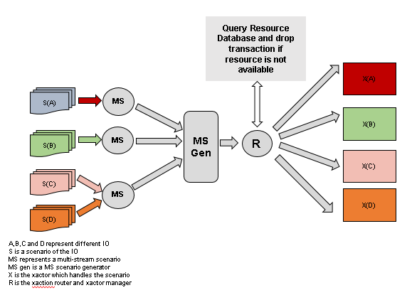
Resource Allocation
Environment maintains a resource database
Resource Management is at input side itself (Lossy generator)
VMM transaction router queries the DB and drops if resource conflict is present

Slide 12
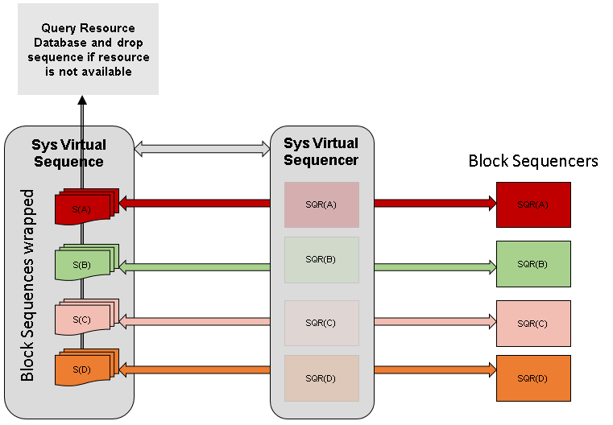
Resource Allocation (contd .. )
In UVM side, system sequence checks resource DB

Slide 13
Resource Allocation (contd .. )
Ensuring Randomness in allocation
For Shared resources, need to ensure that randomly different sources should get the resource
Ensured by starting all scenarios and sequences at the same time.
Resource checking should be the first action in the system level virtual sequence for a uvm block.

Slide 14
Resource Management
System resources (which are now allocated to each peripheral) are managed by individual system components
DMA, Pinmux, Each interrupt Interface , Interconnect, Fault Management etc
Manages all resource requirements for the peripheral
Block environments communicate to system resources via transactions and utility functions

Slide 15
Resource Management (contd …)
n
m
DMA1
DMA0
Core 0 Int
Transaction router
R
R
TLM Port
TLM Port
Dm
Int
VSr
Dr
Dm
Int
X
UVM Block Testbench
VMM Block Testbench

Slide 16
Running VMM block
Running a VMM Scenario/MS Scenario
Macros wrap VMM Scenarios under UVM sequences
VMM scenario generators are instantiated inside the syslvl_vir_sequencer
Sequence
Sequencer
MS Scenario
MS Generator
Scenario

Slide 17
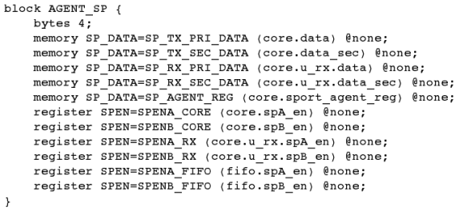
Running SV block
Pure Verilog/SV blocks present for some IO blocks
File based – reading from file into Verilog arrays
Arrays mapped to memories via UVM register model
Read/write via backdoor of register model
Need to create components to randomize
HDL Path
Verilog Array
Agent Register

Slide 18
Running UVM blocks
UVM Sequences can be run directly
Need to create system virtual sequence
Performs system configuration
Performs resource allocation
Extends from common class to allow multi-peripheral seq
Sys Virtual Sequence
Sys Virtual Sequencer
Block Sequencers
S(A)
SQR(A)
SQR(A)

Slide 19
Multi-Peripheral Sequence
Enables VMM and UVM blocks to run together
Macros create virtual sequences for uvm and vmm from common base class
Sequences are registered inside multi_periph_test
Randomly picks “N” sequences out of “M” registered items.

Slide 20
Results
Integrated UVM and VMM into single environment
Capable of randomly picking UVM/VMM/SV blocks
Ensures random resource allocation
Ease of integration of new peripheral environments
Reused into other ADI projects
Many bugs caught through random verification
First silicon sampling to customers

Slide 21
Questions

