Slide 1
UVM usage for selective dynamic re-configuration of complex designs
Kunal Panchal
Pushkar Naik

Slide 2
Agenda
Introduction
Sample DUT
Verification Considerations
Basic Recommendations
Limitations Faced
Solution Proposed
Flow Chart
Conclusion

Slide 3
Introduction
Verification of single sub-system chip
Demand for multi-subsystem chip
Verification complexity of multi-subsystem chip
Re-use of proven verification env(s)

Slide 4
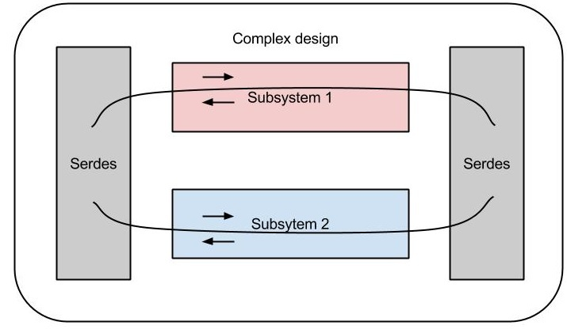
Multi-Subsystem Chip

Slide 5
Sample DUT
Subsystem variation parameters
Rate Variation (10G, 40G ETH)
Protocol Variation (ETHERNET, OTN, INTERLAKEN)
Switching Fabric for Subsystem to I/O’s selection using software
Total 6 basic I/O channels of 10G rate each to provide 60G aggregate BW
Multiple channels clubbed to form higher BW pipe

Slide 6
10G/40G Networking PHY

Slide 7
Sample Test Scenario
Initial Setup
3 x 10G ETH Channels
3 x 10G OTN Channels
Setup after reconfiguration
1 x 40G ETH Channel
1 x 10G OTN Channel (Untouched)
1 x 10G INTERLAKEN Channel

Slide 8
BW allocation for Dynamic Reconfig
1st Setup:
60G Chip supporting 6x10G protocols
TO
Setup after reconfiguration:
60G Chip supporting 1x40G & 2x10G protocols
10G Ethernet channel
40G Ethernet channel
10G Ethernet channel
10G Ethernet channel
10G OTN channel
10G OTN channel
10G OTN channel
10G OTN channel
10G Interlaken channel

Slide 9
Verification Considerations
A DUT Subsystem with given Rate/Protocol variation forms one UVM environment
A test case will create as many Env’s as required by test scenario’s Rate/Protocol requirement

Slide 10
Multi-Environment Test Bench

Slide 11
Verification Considerations
Interface connections
An interface with all signals across all DUT features is created
Each Env has its own Virtual Interface instance created of above Interface type
Idea is that respective Env touches only those signals that it is supposed to
A top level Virtual Interface instance is created, again of same interface type, that finally connects to DUT’s Real Interface
As per Env’s “active” status, its local VIF is connected to the top level VIF, using the connection agent shown

Slide 12
Basic Recommendations
Use uvm_config_db for Env components config
Env components with enable/disable config as per datapath(sb, mon, drv, etc)
Configurable clocks as per Reconfig requirements
Proven tests of every subsystem env, tested individually, forms base for Dynamic Reconfig Test Scenario’s
Reset to all TB components and DUT must be in sync, and placed in reset_phase
Any DUT specific reset requirements at the time of reconfig should be carefully taken care of

Slide 13
Basic Recommendations
Data sequences lifetime need to be adjusted correctly
Env’s untouched need to have sequence(s) running till end of test
Env’s being phased out need to have their sequence(s) end right at Reconfig time (Graceful exit)
New Env’s being created need to start sequence(s) after they are correctly configured/connected.
Common Reconfig tasks to be placed in base_test for all test scenario’s to leverage upon
Untouched channels should not loose data integrity, ever
Newly made active channels should eventually establish data integrity

Slide 14
Limitations Faced
Large configuration requirement of components against standard approach
UVM’s constraint on creation of components outside build_phase
UVM’s restriction on connection of TLM ports outside connect_phase
UVM’s phase looping feature cannot be used for Reconfig since few Env’s are required to continue their data sequences ‘untouched’ while few new are required to be created

Slide 15
Solution Proposed
As per test scenario, all the required environments (both pre and post reconfig) will be created in build_phase
TLM port connections, if any, will be done in connect_phase
Switching of Env’s is done using dynamic connection of Env’s local VIF to the top level VIF during the main_phase
Logs reported from all env(s) to conclude test Pass/Fail

Slide 16
Multi-Channel Reconfig Flow Chart
Create all env(s) required in Test Scenario
Perform component connections as usual. Push all 1st setup env(s) in Q & assign channel number to each
Enable environment components, configure DUT channels as per env(s) in Q
Start sequence(s) of env(s) in Q which are not started yet
1st setup:
Channel reconfiguration required?
Wait for only those channel env sequence(s) to end that needs to be reconfigured
Disable current env(s) on channels undergoing reconfiguration
Insert new env(s) into Q. Assign vif_top to env_vif, complete env config and enable it. Perform DUT configuration.
2nd setup:
Start sequence(s) of env(s) in Q which are not started yet
2nd setup:
Channel reconfiguration required?
Wait for all running sequence(s) to end
Report component logs for all env(s) in Q

Slide 17
8 env: 3x10G enet, 3x10G otn, 40G enet, 10G ikn
Disable 3x10G enet on ch 0-2 and 2xotn on ch 3&5. (stop clocks, mon, drv, etc)
1st Setup for 6 channels:
3x10G enet, 3x10G otn
Start seq(s) of env in Q (3x10G enet, 3x10G otn env)
Add 40G enet on ch 0 & 10G ikn on ch 5. Assign env_vif to top_vif
Wait for seq(s) to end for inst 40G enet on ch0, 10G otn on ch4 and 10G ikn on ch5
Wait for seq(s) on ch 0-3 and 5 to end (ch 4 is untouched)

Slide 18
Conclusion
Multi-subsystem Chips with Dynamic Reconfig requirement
UVM limitations due to phasing structure
Components require heavy configurability
Paper proposes a work-around :
Create all required env(s) at start and switch environments by controlling the Virtual Interface connection(s) during reconfiguration

Slide 19
Questions

