Slide 1
UVM Update
Srivatsa Vasudevan

Slide 2
Agenda
3.0 release
Additional backward compatibility updates
New feature : Signal polling
New feature : Process guard
Public Github repo
Q/A

Slide 3
Backward Compatibility updates
README now documents the usage of the uvm_compat code
Messaging macros do not require “import uvm_pkg::*;”
Library code scrubbed of old UVM_ENABLE_DEPRECATED_API define
Restored get_by_name() and get_by_type() to uvm_resource#(T)
uvm_compat_packer corrected behavior of pack_object() and unpack_object() being passed null

Slide 4
Signal polling addition to UVM

Slide 5
Polling Capability
Need ways to know when a signal in RTL has changed.
Waiting on value change of a register / field
Polling a signal for a specific value change
Performing a user-defined action upon each value change of a field in a register
Monitoring volatile fields (changed by HW) and performing prediction and transaction logging

Slide 6
Use Model: (Default Method)
task mytask;
uvm_poll_status_e status;
uvm_poll_data_t val;
...
poll1.wait_for_change(status,val);`
...
endtask
Declare instances in your env class and build in build_phase method
uvm_hdl_polling poll1;
uvm_hdl_polling poll2;
…
// Build polling instances
poll1 = uvm_hdl_polling::type_id::create("poll1");
poll2 = uvm_hdl_polling::type_id::create("poll2");`
// register signals to poll:
poll1.register_hdl_path("top.child1.sub1.signal3") poll2.register_hdl_path("top.child7. signal0");`
OR
class my_signal_callback extends uvm_hdl_polling_cbs;
virtual function void do_on_path_change(string hdl_path, uvm_poll_data_t val, int size);
...
endclass
…
Environment:
` uvm_callbacks #(uvm_hdl_polling,my_signal_callback)::add(poll2,my_signal_callback_inst1);

Slide 7
Enabling Polling Mechanism
UVM classes added to base library:
Code under `ifdef
uvm_hdl_polling
uvm_hdl_polling_cbs
uvm_polling_backdoor
Code not normally included by default
Enabled after defining: UVM_ENABLE_EXPERIMENTAL_POLLING_API
Add +define/-define to your simulator compile command line per vendor documentation
->Default mechanism uses VPI for access to signals.
-> Mode without VPI is also provided.

Slide 8
Backdoor – User defined Method
If you want performance, use a user defined backdoor
More code, but more performant
Leverages simulator optimizations
signal1_backdoor signal1;
signal2_backdoor signal2;
signal1 = signal1_backdoor::type_id::create("signal1");
signal2 = signal2_backdoor::type_id::create("signal2");
use
poll1.set_backdoor(signal1);
poll2.set_backdoor(signal2);
or
$cast(poll1._bkdr, signal1);
$cast(poll2._bkdr, signal2);
Construct a backdoor class:
class signal2_backdoor extends uvm_polling_backdoor;
virtual task poll_bkdr_wait_for_hdl_change(ref uvm_poll_status_e status, ref uvm_poll_data_t val);
virtual function hdl_read(ref uvm_poll_status_e status, ref uvm_poll_data_t val);
virtual function int get_signal_size();
virtual function bit create_backdoor_probe(int key, string fullname, bit enable = 1);
endclass
Can mix and use VPI and Backdoor any number of times for different signals

Slide 9
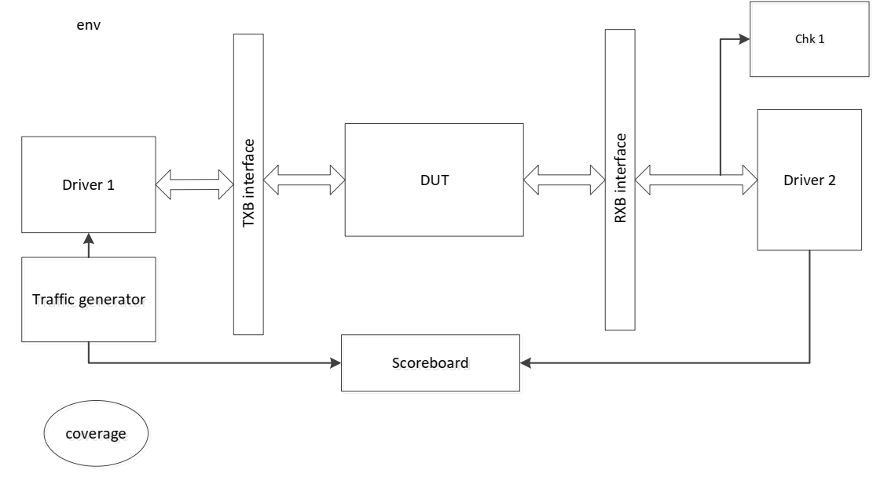
Using Polling inside Modules…
UVM_SET_POLL
module top;
…..
initial begin
my_signal_watcher my_sigwa;
my_sigwa = my_signal_watcher::type_id::create("my_sigwa");
….
void'(uvm_set_poll(my_`sigwa,"simple_name"));
// Not showing how my_sigwa registers what signals it can
void'(uvm_resource_db #(uvm_hdl_polling)::set("","poll2",my_sigwa));
….
end
endmodule
UVM_GET_POLL
module tb;
….
initial begin
uvm_hdl_polling my_poll;
my_poll = uvm_get_poll("top.child1.sub1.signal3");
….
begin
uvm_poll_status_e status;
uvm_poll_data_t val;
forever begin
my_poll.wait_for_hdl_change(status,val);
……
end
end
endmodule
M1
M2

Slide 10
Process Guard

Slide 11
Abrupt Process Termination
A thread can be terminated abruptly, killing all processes within
Kill
Disable fork
Phase ending
Sometimes a process needs to reset state variables when it ends
If an abrupt kill does not do this reset, the system state is broken
A common example is a sequence maintaining state within the sequencer
Such processes need a way to be informed of abrupt termination

Slide 12
Example Zombie Process
Sequence scenario:
Process 'A' calls my_seq.start() inside of a fork…join_none/join_any
my_seq.body() calls my_reg.write(…), and is blocked while the write executes.
Process 'A' calls disable fork
The problem:
The process for my_seq.body() is in the KILLED state.
The process for my_reg.write() is in the KILLED state.
The atomic lock for my_reg's frontdoor is deadlocked
The sequencer associated with the my_reg seq_item is in a bad state

Slide 13
Introducing uvm_process_guard class
New class that "guards" the process in which it is created.
If the process terminates (FINISHED or KILLED) before the guard is cleared, then a hook is called.

Slide 14
Step 1: Declare Guard Object
class my_sequence extends uvm_sequence;
... constructor, etc ...
typedef uvm_process_guard#(my_sequence) guard_t;
guard_t body_guard;
…
extern function void process_guard_triggered(guard_t guard);
endclass

Slide 15
Step 2: Start/Clear Guard Around Process
task my_sequence::body();
// Start the guard
body_guard = new("my_sequence::body_guard", this);
...time consuming tasks...
// Important tasks complete, clear the guard. We
// can cast the return to void because we no longer
// require it.
void'(body_guard.clear());
endtask : body
function void do_kill();
…
if (body_guard != null) void'(body_guard.clear());
endfunction

Slide 16
Step 3: Implement Guard Callback
function void my_sequence::process_guard_triggered(guard_t guard);
// Recover if the process has terminated unexpectedly
this.kill();
endfunction : process_guard_triggered

Slide 17
Process Guards Already In The Library
uvm_sequence
Calling my_seq.start() will now guard the sequence automatically.
Detects process kills from above and below (both the parent process and body tasks can kill the sequence process)
A detected process kill will automatically cause my_seq.kill() to get called
uvm_reg_frontdoor sequence
Has an additional guard for the atomic lock

Slide 18
Public Github Repo

Slide 19
Public Repo Motivation
Before, if you were not an Accellera UVM project member
The only way to get official updated code was through tarball releases or vendor
The only way to provide suggested code modification was posting on the Accellera forum or via vendor
Now, with a public Github repo, anyone with a Github account can
Download the latest committee-approved code or other versions (e.g. bug fixes while members are focused on 1800.2 LRM issues)
Submit a proposed errata fix, performance enhancement (no functional change), and/or test, using committee-provided regression test strategy
(Enhancement requests can only go through Accellera committee)

Slide 20
The Github Repos
Osci-wg
uvm-core and uvm-tests
Private repos that committee owns and will do all its work in
Accellera-official
uvm-core and uvm-tests
Public repo
Updated with public releases of the reference library
Occasionally updated with bug fixes not yet part of release

Slide 21
Release Process
Committee decides to release a new tarball version
Testing
Create a tarball
Merge private repo code into public repo
Committee decides to make available some bug fixes
Testing
Merge private repo code into public repo

Slide 22
Public Updates Between Tarball Releases
Important bug fixes
Performance enhancements that do not affect API
NO Experimental features
NO API changes

Slide 23
Public Submission of Fix
Public can submit a pull request with a code fix (feature or performance)
UVM committee will reject any such pull request with enhancement
UVM committee member may champion other pull requests
Pull request change may be taken as-is or with modifications into a private repo pull request
Normal UVM committee process to accept the pull request (private repo)
At some point, a new version with all fixes will be made available

Slide 24
For More Details…
(…including how to detect version downloaded)
See the Development document
https://github.com/accellera-official/uvm-core/blob/main/DEVELOPMENT.md

Slide 25
Questions

