Slide 1
Thinking In Transactions Visualizing and Validating
Rich Edelman, Mentor
Mustufa Kanchwala, Mentor

Slide 2
Waveform Debug
Waveform Debug is what happens most often to find problems
Why is this signal ‘1’?
Which signal changed most recently?
How many edges have happened since time 10?

Slide 3
Transaction Debug
Sometimes Transaction Debug is used to find problems
Why did this transfer take so long?
Is any transfer causing delay of other transfers?
How many bytes per second are being transferred?
What’s the state of the cache? How many flushes have happened?

Slide 4
What is a Transaction?
A transaction is an event. It occurs at some time.
It might have a begin time and an end time. It might other have a begin time.
It might have attributes: ADDR, DATA, ID, etc.
A transaction might represent
A bus transfer
A cache read or write
A cache flush
An ALU operation

Slide 5
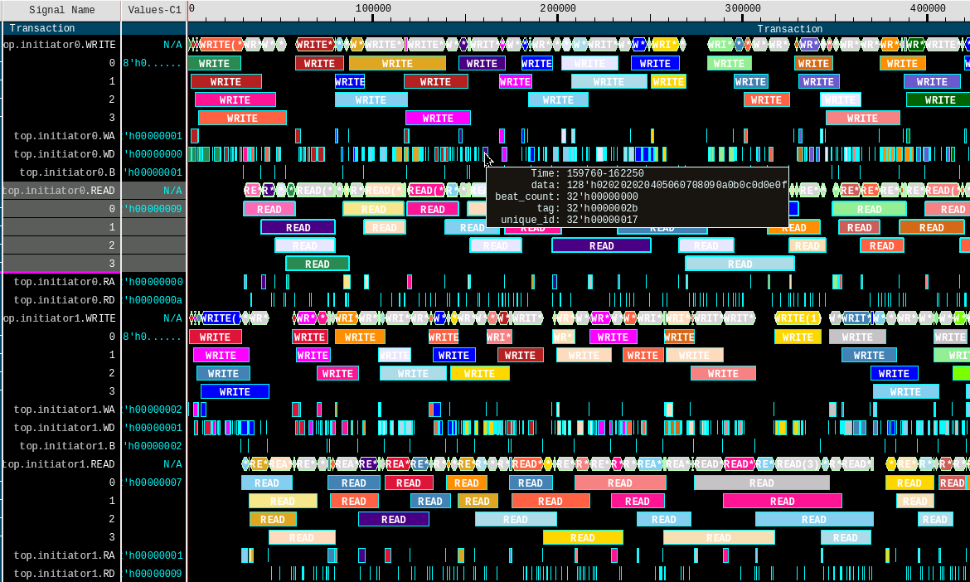
Transaction Viewing
You can “see” things with transactions
Two simple RW channels on the initiator

Slide 6
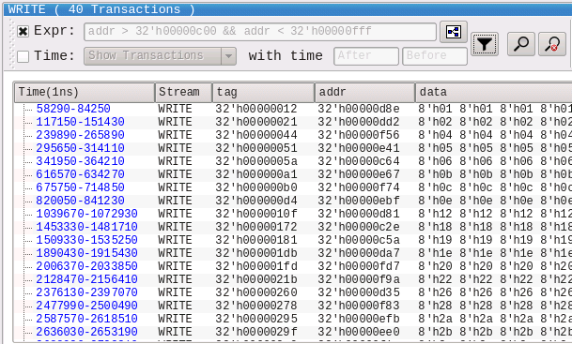
Stripe Viewing
Search / Filter
Find WRITE transactions with address between c00 and fff
There are 40 of them

Slide 7
Creating Monitors
UVM Monitor
Implement a write routine and connect analysis ports.
ap.write(t)
PLI based transaction recording
Simple CSV generator

Slide 8
UVM Monitor
class monitorA extends uvm_monitor;
`uvm_component_utils(monitorA)
virtual abc_if vif;
uvm_analysis_port #(sequence_item_A) ap;
sequence_item_A t;
task run_phase(uvm_phase phase);
forever begin
@(posedge vif.CLK);
if ((vif.READY!==1) || (vif.VALID!==1)) begin
t = sequence_item_A::type_id::create("t");
t.rw = vif.RW;
t.addr = vif.ADDR;
if (t.rw == 1) begin /* READ */ end
else begin /* WRITE */ end
ap.write(t);
end
endtask
endclass
class recorder extends uvm_subscriber#(sequence_item_A);
`uvm_component_utils(recorder)
function void write(sequence_item_A t);
$display(“...”);
endfunction
endclass

Slide 9
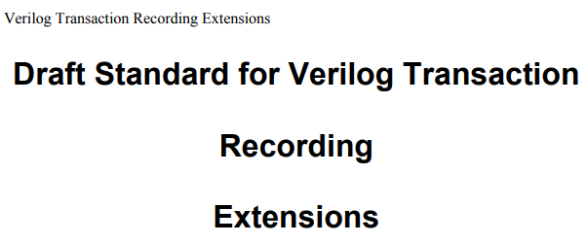
PLI based transaction recording
task READ(transaction t);
tr = $begin_transaction(stream, "READ");
$add_attribute(tr, t.tag, "tag");
$add_attribute(tr, t.addr, "addr");
$add_attribute(tr, t.qos, "qos");
...
$add_attribute(tr, t.data, "data");
$end_transaction(tr);
$free_transaction(tr);
endtask
Instrument code with PLI calls.
Begin
End, Free
Add Attribute
For example, recording transactions
Every vendor has a set of these routines
http://www.boyd.com/1364_btf/report/full_pr/attach/435_IEEE_TR_Proposal_04.pdf

Slide 10
Example design
monitor
monitor
monitor
INITIATOR
(master)
FABRIC
FABRIC
TARGET
(memory)
monitor
monitor
monitor

Slide 11
The Bus - Channel
typedef bit [ 31:0] tag_t;
typedef bit [ 31:0] addr_t;
typedef bit [127:0] data_t;
interface channel(input wire clk);
logic RA_ready; // RA Channel
logic RA_valid;
tag_t RA_tag;
addr_t RA_addr;
int RA_beat_count;
logic RD_ready; // RD Channel
logic RD_valid;
tag_t RD_tag;
int RD_beat_count;
data_t RD_data;
...
endinterface
Simple Bus – ready/valid signaling
READ
RA – Read Address
RD – Read Data, with byte count
WRITE
WA – Write Address
WD – Write Data, with byte count
B – Write Response

Slide 12
The Monitor
interface monitor_interface(channel bus);
always @(posedge bus.clk)
if ((bus.WA_ready == 1 ) && (bus.WA_valid == 1)) begin
end
always @(posedge bus.clk)
if ((bus.WD_ready == 1 ) && (bus.WD_valid == 1)) begin
end
always @(posedge bus.clk)
if ((bus.RA_ready == 1 ) && (bus.RA_valid == 1)) begin
end
always @(posedge bus.clk)
if ((bus.RD_ready == 1 ) && (bus.RD_valid == 1)) begin
end
always @(posedge bus.clk)
if ((bus.B_ready == 1 ) && (bus.B_valid == 1)) begin
end
endinterface
Simple monitor
@posedge clk
Ready && Valid
→“Transaction”

Slide 13
Simple Instrumented Code
Info about “outstanding transactions”
Struct of useful information
Associative array (index by TAG)
Display a CSV “Header Row”
typedef struct {
time begin_time;
time end_time;
int number_of_bytes;
bit first_RD_beat;
bit first_WD_beat;
} outstanding_t;
outstanding_t outstanding[int];
initial begin
if (onetime == 0)
$display("CSV: HEADER: name,rw,tag,begin,end,nbytes,mbps");
onetime = 1;
end

Slide 14
Simple Instrumented Code – Read Channel
BEGIN a transaction -> RA
Save the time and set a flag.
always @(posedge bus.clk) begin
if ((bus.RA_ready == 1 ) && (bus.RA_valid == 1)) begin
stats["RA"]++;
outstanding[bus.RA_tag].begin_time = $time;
outstanding[bus.RA_tag].first_RD_beat = 1;
-> stat_change;
end
end

Slide 15
Simple Instrumented Code – Read Channel
RD Phase. Data byte. If it is the first, remember the byte count.
always @(posedge bus.clk) begin
if ((bus.RD_ready == 1 ) && (bus.RD_valid == 1)) begin
outstanding[bus.RD_tag].end_time = $time;
if (outstanding[bus.RD_tag].first_RD_beat == 1) begin
outstanding[bus.RD_tag].first_RD_beat = 0;
outstanding[bus.RD_tag].number_of_bytes = bus.RD_beat_count*16;
end

Slide 16
Simple Instrumented Code – Read Channel
RD Phase. Last Data Byte
else if (bus.RD_beat_count == 0) begin
Mbytes_per_second =
real'(1000 * outstanding[bus.RD_tag].number_of_bytes) /
real'(outstanding[bus.RD_tag].end_time –
outstanding[bus.RD_tag].begin_time);
$display("CSV: STAT: %m,READ,%0d,%0t,%0t,%0d,%0f",
bus.RD_tag,
outstanding[bus.RD_tag].begin_time ,
outstanding[bus.RD_tag].end_time ,
outstanding[bus.RD_tag].number_of_bytes,
Mbytes_per_second
);
outstanding.delete(bus.RD_tag);
end
end
end

Slide 17
CSV Database
grep CSV transcript | sed –e ‘s/^CSV.*: //’ > transactions.csv
name,rw,tag,begin,end,nbytes,mbps
top.mono0,WRITE,4098,2640,22960,32,1.574803
top.monm0,WRITE,4098,1960,26040,32,1.328904
top.mono1,WRITE,344065,1480,27280,208,8.062016
top.monm1,WRITE,16385,1060,28960,208,7.455197
top.moni1,WRITE,2,1480,29120,32,1.157742
top.mono0,WRITE,4100,11960,29600,192,10.884354
top.mono0,WRITE,4102,12440,30080,16,0.907029
top.moni0,WRITE,1,440,30640,208,6.887417
top.monm0,WRITE,4100,8840,31480,192,8.480565
top.monm0,WRITE,4102,9320,31960,16,0.706714
...
top.monm1,WRITE,16389,9040,44320,0,0.000000
top.moni0,WRITE,5,5600,47540,0,0.000000
top.mono1,READ,348169,38880,49380,32,3.047619
top.mono0,READ,10,34160,51260,224,13.099415
top.monm1,READ,20489,35560,52880,32,1.847575
top.mono1,WRITE,344071,12400,53360,176,4.296875
top.monm1,WRITE,16391,9140,53400,176,3.976502
top.moni0,WRITE,7,6100,53440,176,3.717786
...
$display("CSV: STAT: %m,READ,%0d,%0t,%0t,%0d,%0f",
bus.RD_tag,
outstanding[bus.RD_tag].begin_time ,
outstanding[bus.RD_tag].end_time ,
outstanding[bus.RD_tag].number_of_bytes,
Mbytes_per_second);

Slide 18
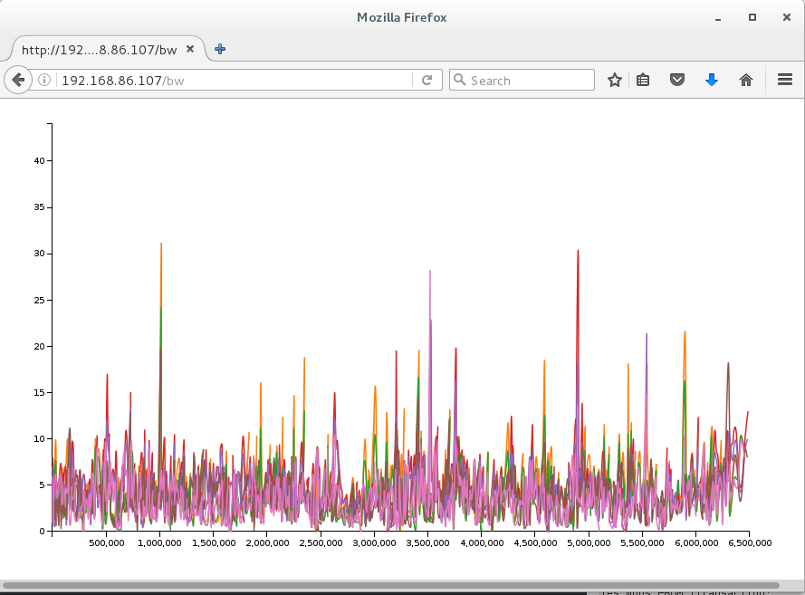
Infrastructure
Python
Flask
D3.js
Web Server
Simulation
Python
Flask
CSV
D3.js
SQL DB
Visualization

Slide 19
Schema
What’s a transaction?
Data transfer
Cache state change
Memory Read/Write
For our purposes a simple definition
CREATE TABLE ttransaction (
name text,
rw text,
tag integer,
begin integer,
end integer,
nbytes integer,
mbps real)

Slide 20
Populating the SQL database
import csv
import sqlite3
conn = sqlite3.connect('transaction.db')
cur = conn.cursor()
cur.execute("""DROP TABLE IF EXISTS ttransaction""")
cur.execute("""CREATE TABLE ttransaction
(name text, rw text, tag integer, begin integer, end integer,
nbytes integer, mbps real)""")
with open('transaction.csv', 'r') as f:
reader = csv.reader(f.readlines()[1:]) # exclude header line
cur.executemany("""INSERT INTO ttransaction VALUES (?,?,?,?,?,?,?)""",
(row for row in reader))
conn.commit()
conn.close()

Slide 21
Running SQL Queries
Just SQL…
Simple queries
Full power of SQL available.
SELECT * FROM ttransaction;
SELECT * FROM ttransaction where name = 'moni0';
SELECT SUM(nbytes) FROM ttransaction where name = 'moni0';
SELECT SUM(nbytes) FROM ttransaction where begin between 5000000 AND 6000000;
SELECT name,nbytes FROM ttransaction;
SELECT name,SUM(nbytes) FROM ttransacction GROUP BY name;

Slide 22
Flask…
View the whole database → http://192.168.122.1/viewdb
View a specific “RW” → http://192.168.122.1/rw/WRITE
View a specific “monitor” → http://192.168.122.1/name/monm0
@app.route("/viewdb")
def viewdb():
rows = execute_query("""SELECT * FROM ttransaction""")
return '<br>'.join(str(row) for row in rows)
@app.route("/rw/<rw>")
def sortby(rw):
rows = execute_query("""SELECT * FROM ttransaction WHERE rw = ?""", ([rw]))
return '<br>'.join(str(row) for row in rows)
@app.route("/name/<name>")
def fname(name):
rows = execute_query("""SELECT * FROM ttransaction WHERE name = ?""", [name])
return '<br>'.join(str(row) for row in rows)

Slide 23
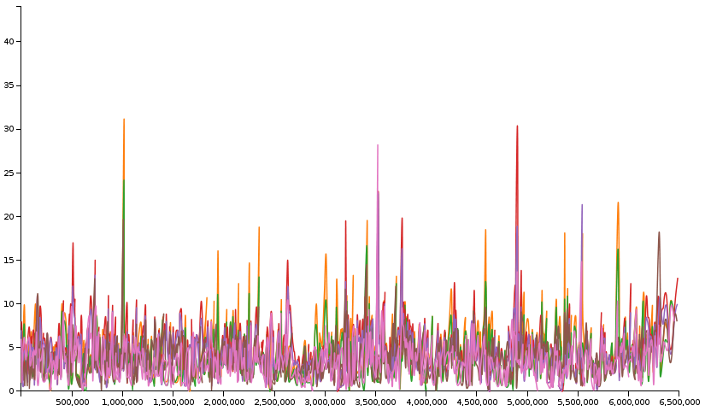
Bandwidth Visualization
Draw the graph → http://192.168.122.1/bw
Bw.html contains the smarts
About 80 lines of javascript
Uses d3.js
Magic!

Slide 24
Flow Visualization

Slide 25
Other Visualizations

Slide 26
What we’ve done
Instrument the simulation
Simulate
Collect Info into an SQL database
Use web infrastructure including
Flask
D3.js
Now the hard part – use your imagination to create visualizations that are important to you.

Slide 27
Questions
Contact authors for source code

