Slide 1
The Formal Way – Fast and Accurate Hashing Algorithm Verification
Sini Balakrishnan, Sireesha Tulluri, Bindumadhava SS, Disha Puri

Slide 2
Agenda
Hashing Technique
Design Overview and Configurations
Verification Challenges
E2E Hashing Algorithm Verification Methodology
Validation of Architecture, Implementation and Algorithmic blocks
Results and Conclusion

Slide 3
Hashing
A popular address lookup technique
Helps to achieve balanced load distribution of the memory
Avoid memory collision
Typically expected to support multiple operating modes
Does complex mathematical calculation on input address and generates hashed address (hash value)
Hash value is the memory location where the data is to be stored.

Slide 4
Design Overview [Cache controller - CC_IP]
Used in high-performance Graphics SoC and resides between Ln-1 nodes and GDDR
AFM classifies the transaction flow and sends the requests to the appropriate memory path(Cache or GDDR)
Hashing algorithm uses input address from AFM and generates port selection and hashed address for GDDR access.
Port selection is used to map the hashed address to respective GDDR.
GDDR : Graphics Double Data Rate memory
AFM : Flow manager

Slide 5
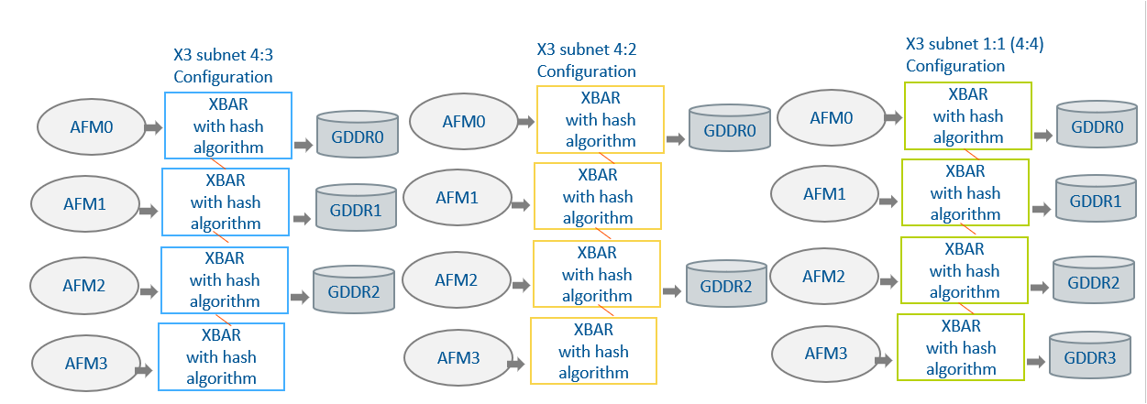
X3 Subnet Configurations
IP supports N number of AFMs or Ln-1 nodes to M number of GDDRs.
Hash algorithm selection is based on the configuration settings

Slide 6
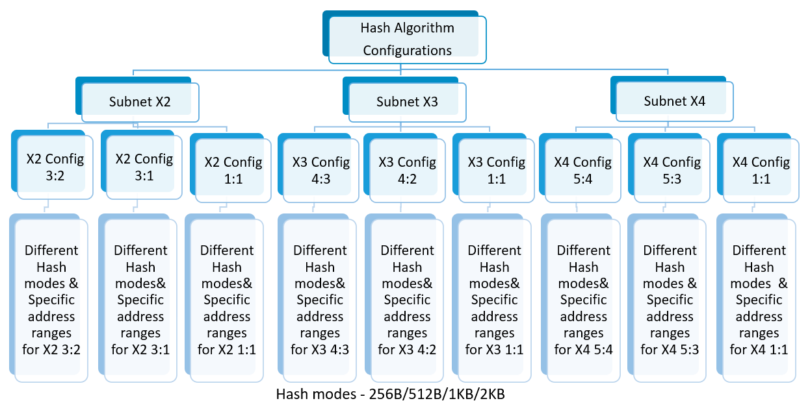
Configurations

Slide 7
Hashing Algorithms - Verification Challenges
Verifying hashing algorithms is challenging due to
Algorithmic complexity
Multiple operating modes & configurations
[Subnets, Node2gddr ratios, hash-modes]
Vast address space to be covered
Hard to be completely covered by any conventional verification
As incorrect hashing algorithms could result in re-spins, validation at both architectural and implementation levels is critical.

Slide 8
E2E Hashing Algorithm Verification
End-to-end (E2E) Verification - Validate both architecture and design implementation
Ensuring correctness of Architecture
Verification for algorithmic blocks implementation
Ensuring Implementation correctness

Slide 9
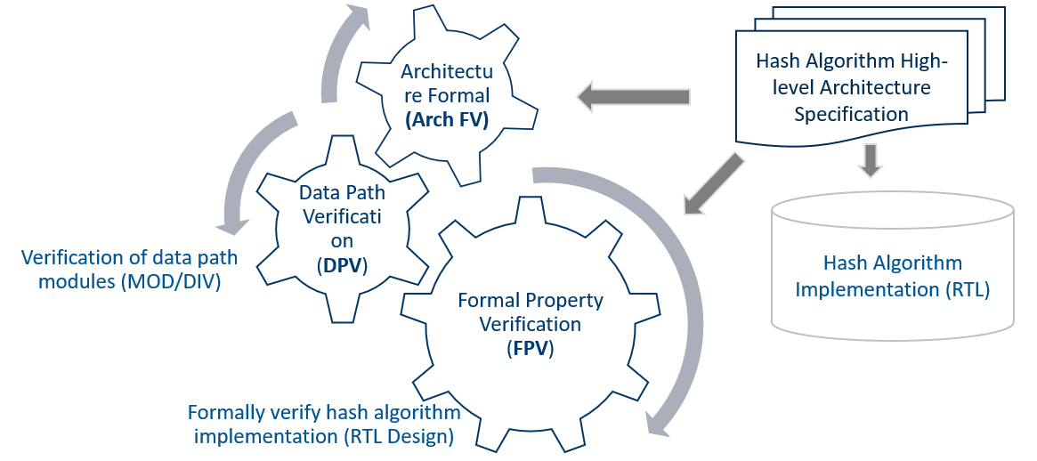
E2E Hashing Algorithm Verification Methodology Overview

Slide 10
Architecture Validation
Ensuring correctness of Architecture using architecture Formal Verification technique (Arch FV)
Modelling
Architectural ideas or Specification is modeled at a higher level of abstraction
Python is used for the modelling. Rainbow framework also can be used
Formally Verify the Model
Formally verify the model by using Z3 Satisfiability Modulo Theories (Z3 SMT)
Z3 Python wrapper enables the integration of Arch FV Python model with Z3 SMT
Exhaustive verification of hashing algorithm which helps architects to deliver functionally verified golden specifications.

Slide 11
Hashing Arch FV checks
Address Aliasing Check
No two input addresses should map to same output address.
For unique AFM id and address combination must result in a unique GDDR id and address combination
Output Validity Check
For all valid AFM id and address combination, there should be a valid GDDR id and address combination.
This helps to confirm that entire size of all AFMs must fit into all available GDDR channels.
Spurious Check
For every output address, there is a valid input address.
In the CC_IP, for all valid GDDR id and address combination, there should be a valid AFM id and address combination. Able to find out spurious gddr address generation due to wrong logic.

Slide 12
Hashing Arch FV checks
Load Balancing Check
Load distribution must be balanced for all egress ports.
X3 configuration contains 4 subnets, and each subnet contains 4 AFMs [Total 16 AFMs]
The 64KB page is 4KB aligned per AFM (64KB/16AFMs = 4KB/AFM).
For 64KB, address distribution for GDDR0/1/2 follows patterns 5/5/6, 5/6/5, or 6/5/5
Two consecutive 64KB regions must not repeat the same pattern.
Three consecutive 64KB regions (3*64KB aligned) cover all the three distributions

Slide 13
Implementation Verification
Ensuring Implementation correctness using FPV
Using Formal Property Verification (FPV)
FPV mathematically prove the behavior of a system using properties & reference models.
Generates all possible stimuli as per the constraints and assumptions given.
Validates implementation by using System Verilog assertions and reference models.
Covers all hashing implementation except for some of the algorithmic blocks
Adding algorithmic modules hampers the convergence of checkers especially address aliasing checks

Slide 14
Datapath Verification (DPV) for algorithmic blocks
Contains algorithmic blocks - division by 3 (DIV3) and mod by 9 (MOD9)
Cannot be verified by traditional FPV due to limitations of the tool engines.
Use RTL2RTL with data-path optimized formal verification tool
The tool does an input-output equivalence check
between a golden reference model with the optimized implemented model.
Golden reference model is a simplified implementation of algorithmic block.
For DIV3 - Golden: Simple math division operator to divide by 3. Implemented model: Uses case switches and booth mult reduction algorithm
For MOD9 Golden: Simple mod operator. Implemented model: Uses bit wise manipulations for effective implementation

Slide 15
Hashing Implementation checks
Address Aliasing Check
Address aliasing check or collision detection check - For any two different input address, there should not be same GDDR output address & port.
Two different symbolic random input addresses (sym_in_addr) captured
Checker confirms different hashed output addresses
As the output has latency of 3, counters are used to track the output availability.
Symbolic address helps to sweep through or cover entire address space.

Slide 16
Hashing Implementation checks
Port Select Check
Validates the port selection logic implementation in the hash.
Port selection logic checker compares expected port selection output from FPV with actual output from the design.
Spurious output checks
For every output address, there is a valid input address.
For all valid GDDR id and address combination, there should be a valid AFM id and address combination. This covers if there is a spurious gddr address generation due to wrong logic.
Output Address Check (hash value check)
Validates the GDDR address generation (hash value) logic.
The checker compares expected output address generation from FPV with actual output address from the design

Slide 17
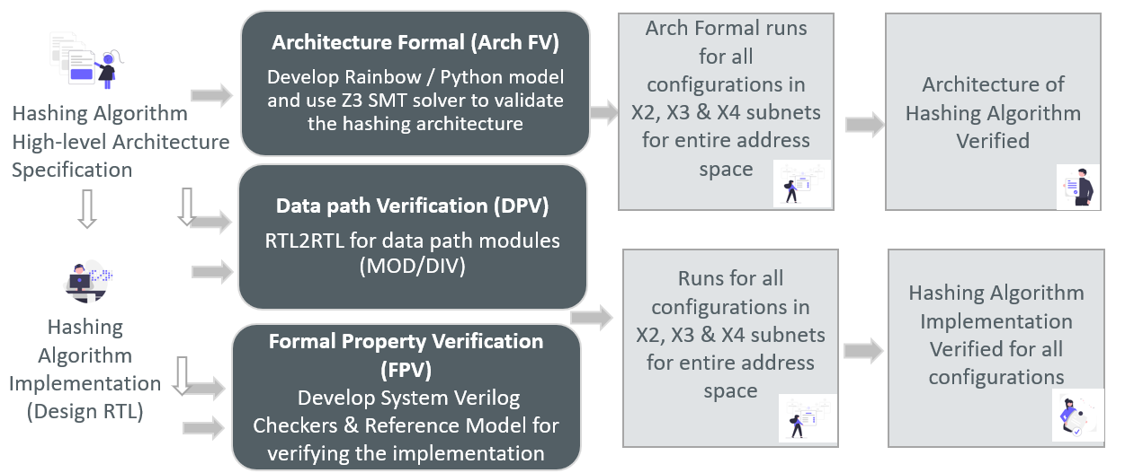
Verification of Architecture to Implementation Flow

Slide 18
Task Based Approach
To validate all configurations in FPV
Different set of subnets, address range, hash mode and node to GDDR ratio for each configuration
Constraints changes using “assume -from_assert”

Slide 19
Results
Hashing algorithm E2E architecture to implementation verification in CC_IP
Verification closure of all config within short verification cycle (~3-4 weeks)
Sweep through entire address space for collision detection/address aliasing checks
Uncovered 3 architectural and 1 implementation issues
Imbalanced load distribution among egress ports using Arch FV.
For X3, 4:3 config and hash-size 512B - Arch FV could find the imbalance among two consecutive 64KB regions
Detected couple of wrong out-of-range address generation architectural issues using output validity checks
Detected wrong port selection logic in 5:3 config using FPV

Slide 20
Conclusion
E2E solution for verifying hashing algorithms from architecture to implementation
Architectural check for balanced load distribution among egress ports helped to improve the performance
Cover entire valid address space in all configurations
Address aliasing checks boosted the confidence on the quality
Hashed address generation logic and out of range address check are verified fully in both architectural and design level

Slide 21
Questions

