Slide 1
Solving Problems with hierarchal CDC analysis of large designs with encrypted blocks.
Abdul Moyeen, Principal Product Engineer, Siemens EDA
Arpita Agarwal, NXP Semiconductors
Aman Shaikh, Siemens EDA
Abhay Deshpande, RVCE

Slide 2
Problem Statement
SoC’s are getting big.
Flat Static Analysis like CDC and RDC is getting tough. At times not possible.
We need to Divide and Conquer.
But we cannot compromise on quality.

Slide 3
Problem Statement
EDA industry provides Hierarchal solutions.
Where low level blocks are analyzed individually and then a Hierarchal model of that low level modules are created and used in place of that block.
This model replicates the boundary conditions of the block.
And help close the Static analysis

Slide 4
Problem Statement
Many SoCs use third Party IPs or IPs under legal bindings where you cannot have access to the actual RTL or schematic of the IP.
These IPs are provided in form of Encrypted RTL.
Which help the EDA tool to read/ compile and analyze the design defined in those encrypted RTL.
But all the paths/ Reg Names are encrypted.

Slide 5
Problem Statement
This Becomes a problem for Hierarchal Analysis.
Teams can by Geographically and emotionally divided
How to report the part of problem lying inside the encrypted block?
How do teams communicate on such problems?
How do teams know where the problem lies? How to solve it?

Slide 6
Problem Statement → Solution
In doing so , we should not expose the block RTL or Schematic.
We should not miss on any problem expected to be reported.
In CDC all boundary crossings must be reported.
We should be able to report only the boundary register name involved in the crossing.
Plus some minimal information like clock names etc. to get the debug information right.
We have tried various solutions available and checked if it satisfies the goal with appropriate testcases.

Slide 7
Available HDM solutions
WhiteBox HDM
TCL HDM
iHDM
Abstract HDM

Slide 8
WhiteBox HDM
Questa CDC® supports third generation HDM. Which means, although the Binary Hierarchal data model is used in place of actual RTL resulting in huge performance improvement, all the relevant information of the block is present with the User. Complete browsable schematic is available where user can cross reference to the actual RTL used at the time of HDM model creation. This is as good as using plain RTL without any restriction with added advantage of smaller runtime.

Slide 9
TCL HDM
Questa CDC® supports a range of “hier” commands to define the interface behavior of hierarchal blocks.
These TCL command can be used to define the boundary or interface CDC related behavior for any port of the hierarchal block.
Questa CDC® generates a TCL file along with binary data
As this is a strictly text-based constraint flow, there are some inherent limitations.
Like the reconvergence are not correctly reported.
Enable based crossings, if synchronizer is outside the block, the tool will not be able to detect that.

Slide 10
Interface HDM
iHDM or Interface HDM is another flavor of HDM available with Questa CDC®.
This essentially brings all the internal block information to the boundary and then reports all crossings from the block interface.
Output port which is driven by multiple clocks, a property ‘multiple clocks’ is added to the port so that User will get a crossing from “Multiple clock”
Similarly, if an input port of the block is sampled by multiple clocks, this information is translated to interface as “multiple clocks” property without explicitly mentioning all the contributing clocks.
Additionally, all RTL cross reference is available hence giving access to the end user to the RTL of the HDM block.

Slide 11
Abstract HDM
This allows user to translate all the CDC related information from the block to the interface additionally adding the names of TX and RX registers just inside the boundary of the block.
Also, Information about the registers driven by multiple clocks and are connected to output ports and the input ports sampled by multiple clocks is saved in the Abstract HDM model.
The cross reference to the RTL and Schematic reference to the internal structure of the block is not saved in the binary data model.
These properties make Abstract HDM the best suited solution for the problem at hand.

Slide 12
Behaviors of Different Binary models
Feature | Standard HDM | Interface HDM | Abstract HDM
Block Schematic | Available | Available | Not Available
Crossings report point | From and to internal registers | From and to HDM ports | From and to HDM ports
Multi-clock crossings | Not expanded in TCL but individual violation for each clock in reports. | Not expanded | Expanded
Reference to block RTL in report and GUI | Available | Available | Not Available

Slide 13
Use Cases
Let us consider some use cases for Hierarchal CDC analysis and discuss the details reported in order to set expectations and satisfy our limitations.
We will do the required experiments and see if this satisfies the requirement and solves the problem.

Slide 14
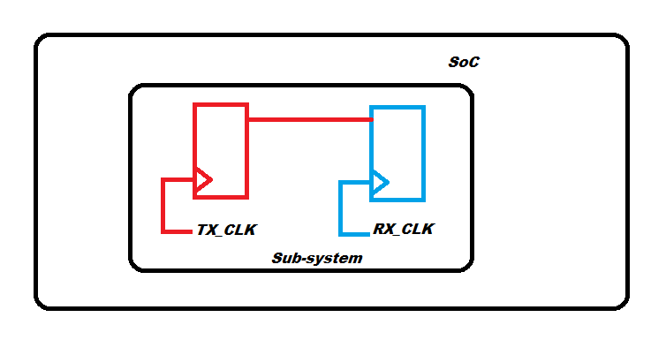
Case1: Where complete crossing with TX, RX and the connecting path is completely inside the sub-system.
This is essentially type of crossings we don’t want to report in SoC CDC analysis as we are working in hierarchal mode, all such crossings must be reported and resolved in Block level analysis.
Basic Clock domain Crossing completely inside low-level block

Slide 15
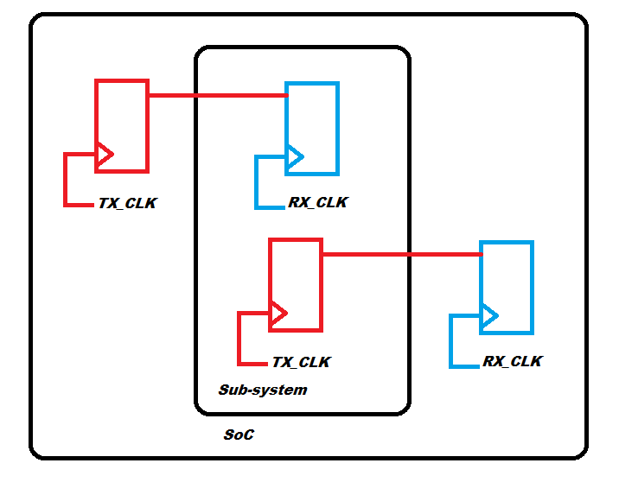
Case2: Where a part of crossing is inside the block and part is outside the block
Clock domain Crossing spread across interface boundary
For this use case, as depicted by the image above, we expect two crossings reported

Slide 16
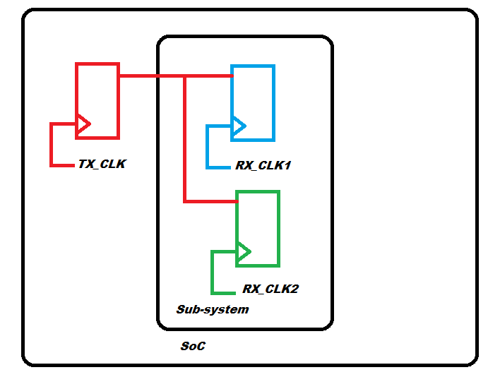
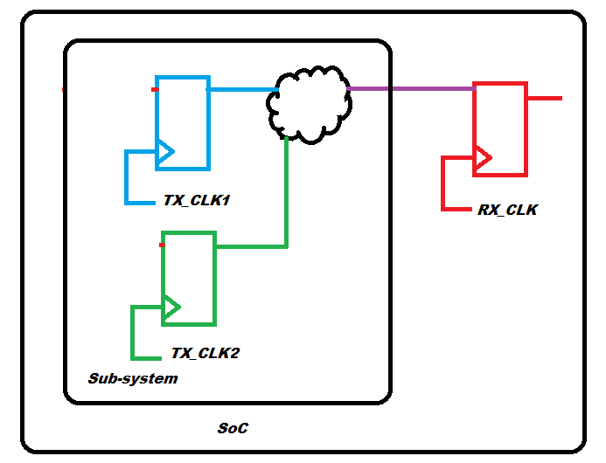
Case3: Where a part of crossing is inside the block and part is outside the block but the TX which is outside the block is captured by multiple clocks inside the block or RX register which is outside the block is driven by more than one clock domain
Input sampled by multiple clocks.
Output driven by multiple clocks
For this use case, we expect only two crossings reported, one for input and one for output.

Slide 17
Case3.1: Same as Case3 just that all flops inside the block are on same clock. In this case, a White box HDM will report one crossing per TX/RX pair, but for secure blocks only one crossing is sufficient.
For this use case also, we expect only two crossings reported, one for input and one for output.

Slide 18
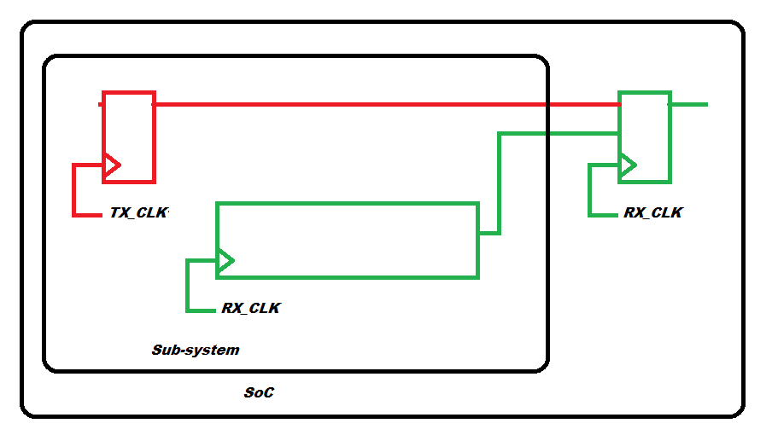
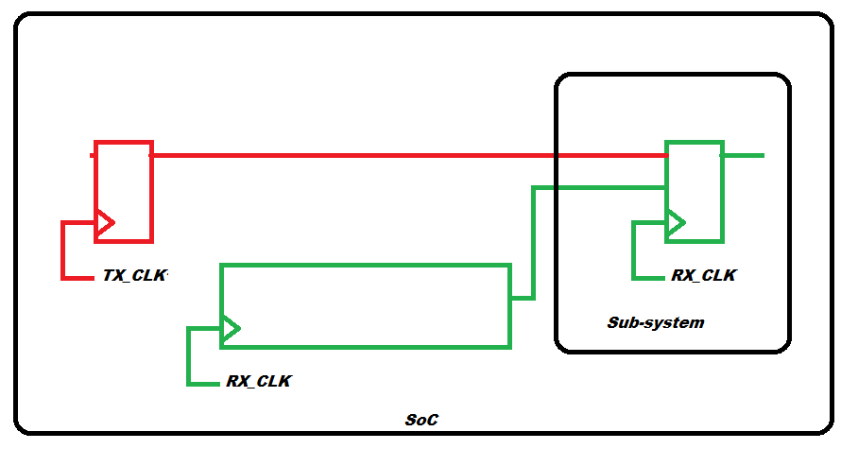
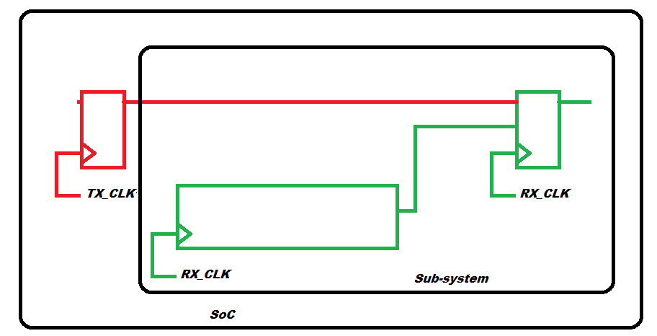
Case4: Qualifier based crossings where synchronizer on control path, TX and the RX register are spread across sub-system boundary.
Enable-based CDC with synch inside block
Enable-based CDC with synch outside block
For this use case, as depicted by images 5,6 and 7, we expect 3 dmux crossings reported, one for each structure and zero async CDC crossings.
Enable-based CDC with synch and Rx inside block

Slide 19
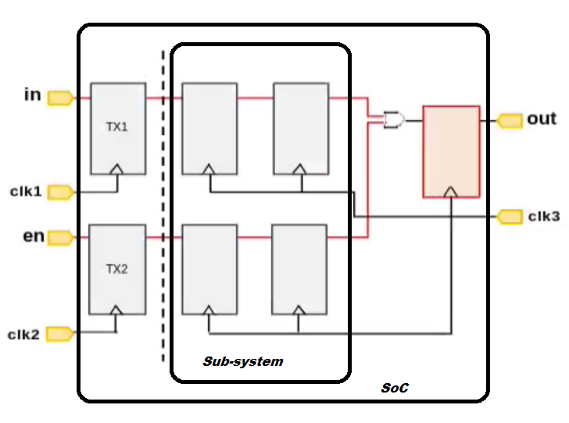
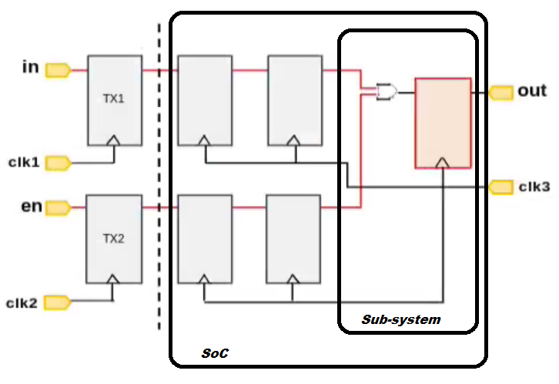
Case5: Reconvergence in and outside the block.
Image 8. Reconvergence of signal outside block
Image 9. Reconvergence of signal outside block
For this use case, we expect two crossings reported, one for input and one for output.

Slide 20
Based on the Use cases above, we will use following criteria to decide which solution to use.
All interface violations are reported, and internal Block violations are not reported.
Convergence violations and enable based crossings at boundary are reported correctly
RTL cross referencing and Schematic Information is blocked.
Debug Easy. Minimum level of information about interface crossing part lying within the block is reported in reports and logs.
 | Expected Violations
Case1 | 0
Case2 | 2
Case3 | 4
Case3.1 | 2
Case4(dmux) | 3
Case5 | 2

Slide 21
We created a small sample testcase(s) with all use cases discussed above from Case1 till Case5 and got following number of violations per case:
 | Plain RTL | With Encrypted RTL | With TCL flow and stub RTL | Whitebox HDM | iHDM | abstract HDM
Case1 | 1 | 1 | 0 | 0 | 0 | 0
Case2 | 2 | 2 | 2 | 2 | 2 | 2
Case3 | 4 | 4 | 4 | 4 | 4 | 4
Case3.1 | 4 | 4 | 2 | 4 | 2 | 2
Case4(dmux) | 3 | 3 | 1 | 3 | 3 | 3
Case5 | 2 | 2 | 0 | 2 | 2 | 2
 | Expected Violations
Case1 | 0
Case2 | 2
Case3 | 4
Case3.1 | 2
Case4(dmux) | 3
Case5 | 2
Table for number of violations in each case.

Slide 22
Comparing above discussed HDM solutions,
we can populate following table based on our experiments.
 | All interface violations reported | Internal block violations not reported | Convergence reported correctly | Enable based crossings reported correctly | RTL cross referencing blocked | Schematic information Blocked | Debug Easy.
Plain RTL
Encrypted RTL
TCL based model with Stub
Whitebox HDM
Interface HDM
Abstract HDM

Slide 23
Based on Last 2 slides, we can see that Abstract HDM satisfy all requirements as a solution. So, we comprehensively verified and recommend this solution if we are incorporating Encrypted block in large SoC design.

Slide 24
Questions

