Slide 1
Reconfigurable Radio design and verification
September, 10, 2015
Vladimir Ivanov, LG Electronics
Markus Mueck, Intel Corporation
Seungwon Choi, Hanyang University
DVCON’2015
Bangalore, India

Slide 2
Outline
Reconfigurable Radio Architecture Overview
Abstract Machine for Reconfigurable Radio
Design Flow & Verification
Conclusion

Slide 3
Reconfigurable radio architecture overview
Hardware & Software Architecture

Slide 4


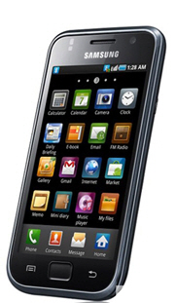

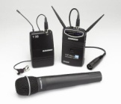
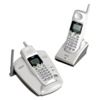







Reconfigurable Radio Concept
Modem software can be developed independently of hardware platform.
This concept can be applied to various kinds of devices and/or machines operating in wireless communication signal environments, although we focus only on MD (Mobile Device) at present.
WiMAX
Long Term Evolution
Hanyang Univ.
Mobile WiMAX
WiMAX Forum
Wireless Mic
Walkie-Talkie
Radio Apps Store provide modem software.
Wireless-Phone
Wireless Microphone
June’s Software House
Walkie Talkie
Radio Software Inc.
DECT Telephone
VATEL Software.
RFID
<Reconfigurable MD>
<Radio Apps Store>

Slide 5


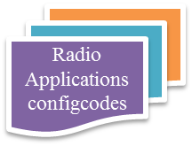


Reconfigurable Radio System Architecture
Standard Software Architecture for Radio Computer (ETSI EN 303 095, 2015)
Standard Interfaces for Radio Computer (to be published ETSI EN 303 146-1, 2015)
upload
Radio
Apps Store
download
Run Time
Design Time
Multiradio Interface (MURI)
Radio Control Framework
Radio Apps Store
Interface
Unified Radio Applications Interface (URAI)
Front-end
Compiler
RVM¹
Radio
Lib
Back-end
Compiler
Radio Programming
Interface (RPI)
Reconfigurable RF Interface (RRFI)
Radio OS
FEM
XCVR
BB
MAC
Radio Platform
Radio Computer
¹RVM: Radio Virtual Machine

Slide 6
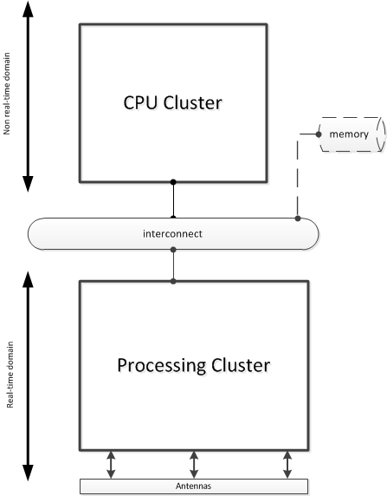
Reconfigurable Radio Architecture: Hardware
Parameters/constraints
Structural constraints:
    Data plain
    Control plain
Behavioral constraints:
    Triggering conditions
Sync mechanisms:
    Interrupts
    Polling
Control patterns:
    Client-server
    Master-slave
    Data driven
Memory:
    Shared
    Distributed

Slide 7
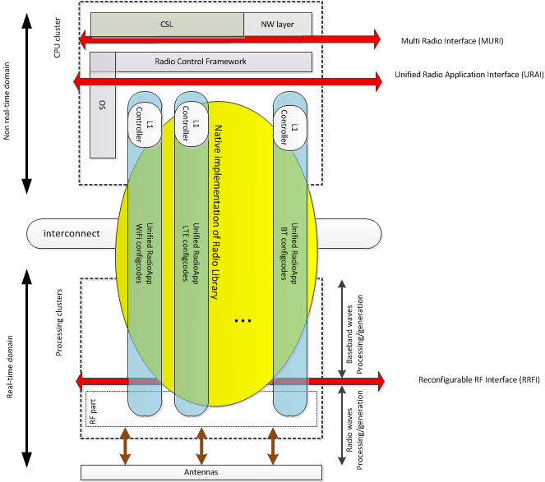
Reconfigurable Radio Architecture: Software
The RCF includes the following components:
1) Configuration Manager (CM)
2) Radio Connection Manager (RCM)
3) Flow Controller (FC)
4) Multiradio Controller (MRC)
5) Resource Manager

Slide 8
Abstract Machine for reconfigurable radio
Radio Virtual Machine

Slide 9
Specific Radio Virtual Machine

Slide 10
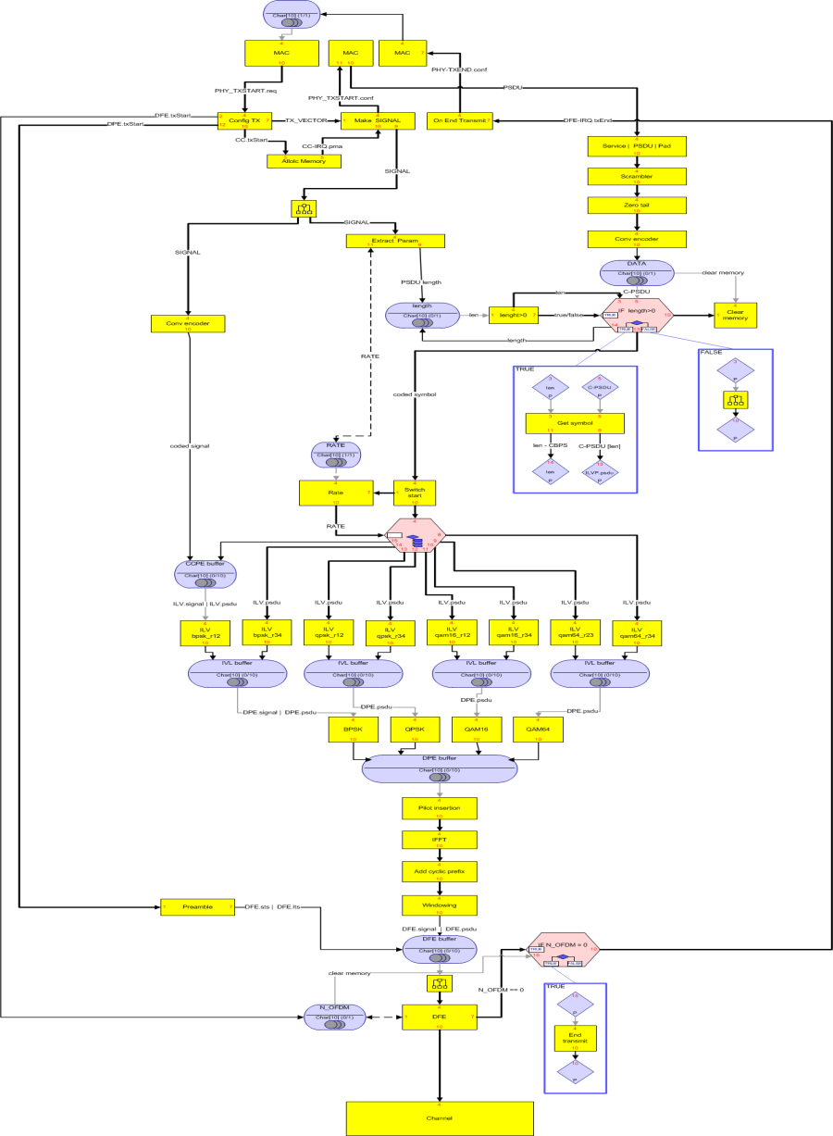
Radio Application
  includes modules of different granularity;
  modules are taken from Radio Lib or composed from Radio Lib elements;
  concurrent and data-driven execution;
  static or dynamic apps unrolling
802.11a TX

Slide 11
Universal Radio Virtual Machine

Slide 12
Example 1: Convolution
a0
S
*
a
0
+
+
a1
S
*
+
a
1
a2
C
*
a
2
2-order FIR filter
Specific RVM for 2-order FIR

Slide 13
Example 2 : Pipeline
d0
d0
d1
F0
CU
d1
F0
F1
F1
Specific RVM
Universal RVM

Slide 14
Design flow & Verification
Main Flow and Base Phase

Slide 15
Design Flow
Design Phases
Base Phase
Reference Radio Library mapping
Phase 1 (application model)
RadioApp Exploration: RadioApps to FUs mapping
Phase 2 (arch model)
System-Level Architecture Exploration: RadioApps to Arch Template mapping
Phase 3
System Level Refinement

Slide 16
Design flow & Verification: phase 1
Radio Application Exploration

Slide 17
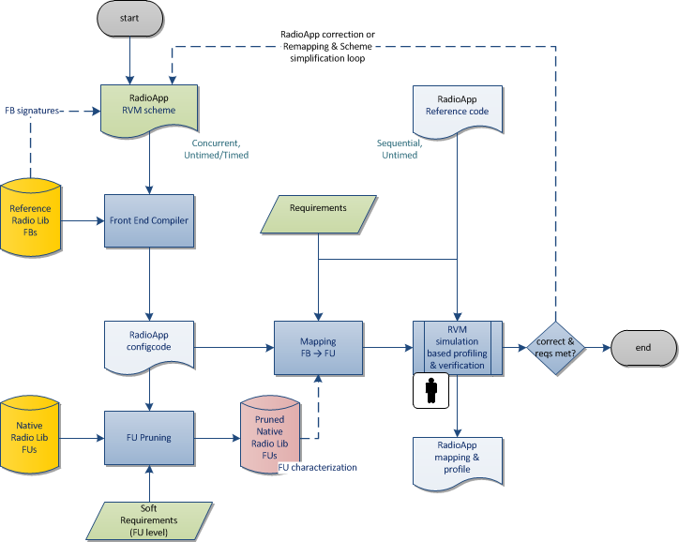
Radio Architecture Exploration
Solving Tasks:
Verified RVM program
Selected HW components

Slide 18
RVM front-end compiler
RVM scheme
Compiler
Preprocessor
Radio Lib
AST
RVM front-end
compiler optimizes
SW IR
Performs basic input-level error corrections
Detects RVM scheme errors
Validates output SW IR
Parser
IR Builder
Analysis
Transformations
Validation
IR Generation
SW IR

Slide 19
Design flow & Verification: phase 2
System Level Architecture Exploration

Slide 20
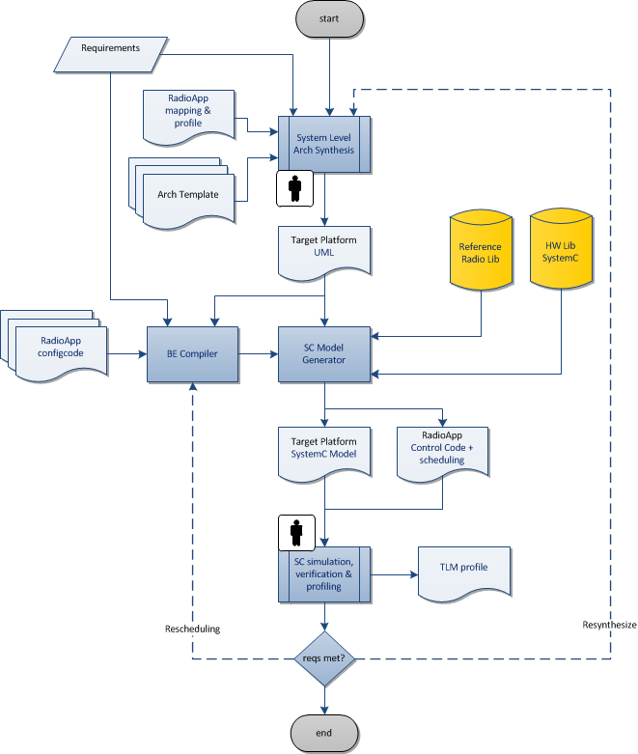
System Level Architecture Exploration
Solving Tasks
- System-Level Architecture exploration
Verification and simulation
SC simulator generation
Control code generation

Slide 21
Template Class Diagram

Slide 22
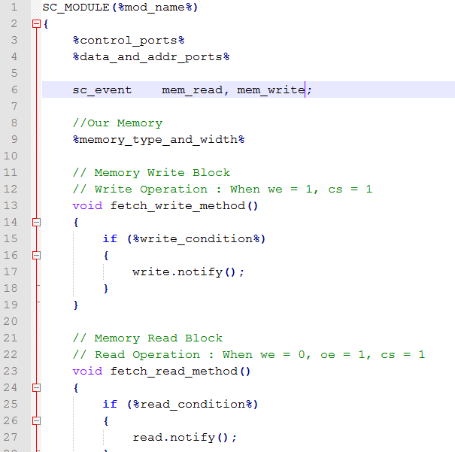
SystemC templates
SystemC code generation is based on customizable templates
Custom templates can be created using the defined tags
Examples of components
    PE
    Bus
    Switch
    Memory

Slide 23
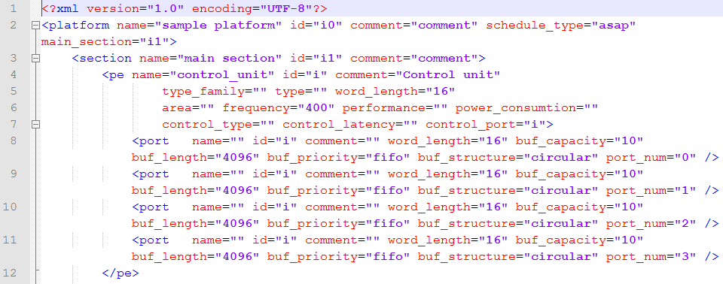
HW front-end language & HW IR
UML model for architecture declaration
Translation XMI to HW IR

Slide 24
Control code generation
Generate control flow from the RVM program
Generate state-machine for each PE block
Implement each state-machine for the selected control mode (i.e. flag, data-driven, direct-control)

Slide 25
Design Flow & Verification:
Phase 3
System Level Refinement

Slide 26
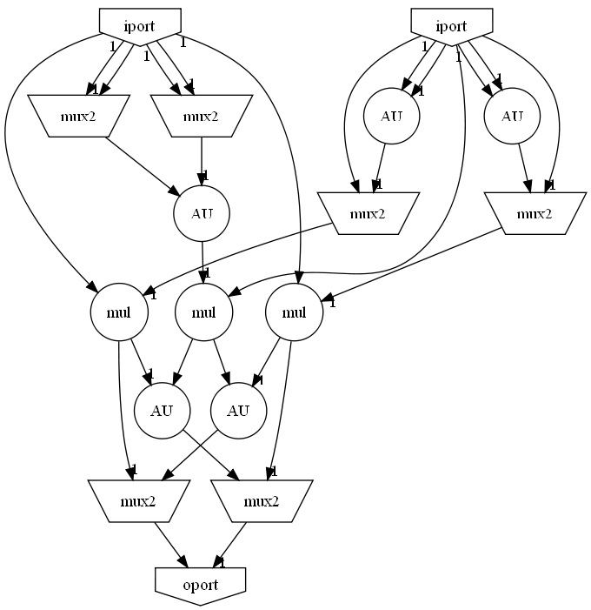
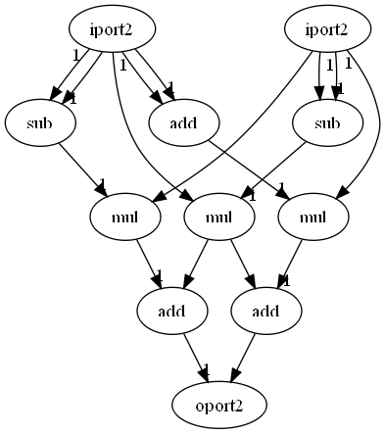
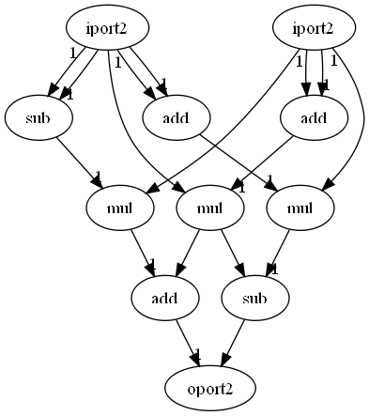
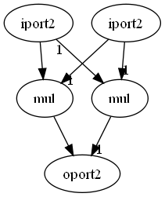
Co-Compiler
Architecture
Cnfg Alg. 1
CoCo
Cnfg Alg. 2
Memory allocation
Operation allocation
Scheduling & Merging
Code
Cnfg Alg. 3
  DO_N DP_Cfg1
  DO_R DP_Cfg2, N
  …
SC Lib
Notes:
Co-compiler is a tool which has the following inputs:
A few algorithms divided into configurations;
Library of SC blocks (like: ALU, adder, multiplier, MUX, 2-radix butterfly and etc.).
Co-compiler builds common datapath for input algorithms and generates configuration codes which corresponds input algorithm configurations.

Slide 27
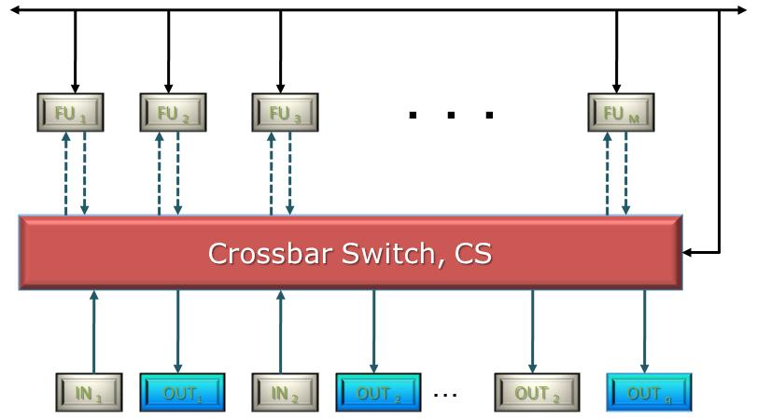
Synthesizable Data path
CU
Registers
Config. 3
Config. 2
Datapath
Config. 1
Co-Compiler
Memory
Notes:
How to synthesize datapath?
Co-compiler merges input pieces of algorithms (⬄ configurations) and customizes the generic template to execute these particular configurations. After merging co-compiler generates SC code for the datapath. NC can configures the datapath for execution of configurations 1, 2 and 3.

Slide 28
Data path Synthesis
DFG 1
DFG 2
DFG n
Take algorithm source
codes
Allocation
Allocation
Allocation
Allocate operations to FU library
Merging
Merge to a single datapath graph
Control unit configuration
Datapath architecture
Reconfigurable Accelerator is ready for RTL synthesis
Notes:
Datapath architecture is represented in SC. After that we can apply Forte’s Cynthesizer and generate RTL code.

Slide 29
Conclusion
- Reconfigurable Radio is emerging wireless technology enabling independent development of hardware and radio applications;
- Reconfigurable Radio has being standardized in Europe by ETSI;
- Reconfigurable Radio is based on Radio Computer concept and corresponding Radio Virtua Machine;
- RVM gives a holistic vision on design of Reconfigurable Radio including hardware and program code co-design and verification

Slide 30
Related Papers
Software Radio Architecture: Mathematical Perspective by J. Mitola, III, IEEE JOURNAL ON SELECTED AREAS IN COMMUNICATIONS, VOL. 17, NO. 4, APRIL 1999
“The Radio Virtual Machine: A Solution for SDR Portability and Platform Reconfigurability” by Riadh Ben Abdallah, Tanguy Risset and Antoine Fraboulet, IEEE International Symposium on Parallel & Distributed Processing, May 23 – 29, 2009
Multi-Radio Scheduling and Resource Sharing on a Software Defined Radio Computing Platform by Kees van Berkel and et.al., Proceedings of the SDR’09, 2009
“Virtual Machine for Software Defined Radio: Evaluating the Software VM Approach” by Tanguy Risset, Antonie Fraboulet, Jerome Martin and Riadh Ben Abdallah, International Conference on Embedded Software and Systems, ICESS, 2010
“Multi-radio coexistence and collaboration on an SDR platform” by Antii Piiponen and et.al., Analog Integr Circ. Sig. Process., Springer, Vol.69, 2011
Radio Computer Architecture, Regulatory and Security Framework for Next Generation Wireless Mobile Communication, Markus Mueck and et.al. , IEEE Wireless Communications, August 2012, p.9 – 16
Reconfigurable Radio: Architecture and Programming Model, Vladimir Ivanov, Int. Workshop on SR and SDR, Seoul, 2012
Reconfigurable Radio Systems as Enabler for Exploiting the Future Heterogeneous Wireless Communications Landscape, Markus Mueck and et.al., ETSI RECONFIGURABLE RADIO SYSTEMS WORKSHOP 12 December 2012, Sophia Antipolis France
Reconfigurable Radio & Radio Virtual Machine, Vladimir Ivanov, Int. Workshop on SR and SDR, Seoul, 2015

Slide 31

Thanks!
Questions?

