Slide 1
Functional Verification of CSI2 Rx-PHY using AMS Co-simulations
Ratheesh Mekkadan
Advanced Micro Devices, Inc.

Slide 2
Agenda
Introduction
Scope of the Paper
AMS Verification Approach
Application and Results
Conclusion
Questions

Slide 3
Introduction

Slide 4
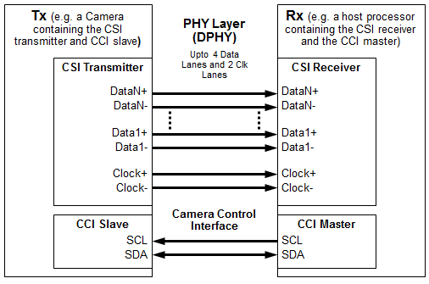
Introduction
MIPI Camera Serial Interface 2 (CSI2) - standard interface between a peripheral device and host processor. Its Physical layer is the MIPI DPHY
Notes:
Peripheral device (camera/Transmitter (Tx)) and a host processor (Reciever Rx)

Slide 5
CSI2 PHY – An AMS IP
CSI2-PHY is an AMS IP
Supports HS mode data traffic and a LP mode for control sequencing
LP -> Single Ended High Swing (1.2V high, 0V low)
HS -> Differential Low Swing (e.g., 300mV high, 100mV low, 200mV common mode)
PPI
Finite State Machine
LP- Rx
Dp
De-serialized Data; Clk Outputs
Clock Dividers
Dn
De-serializer
HS - Rx
Other Outputs
Termination Block
Analog Blocks
Other Digital Blocks
Other Analog Blocks
Digital Blocks
Notes:
Each of its (Clk/Data) Lanes has analog and digital blocks
At IP/SoC simulations, RTL behavioural models are used for all analog blocks

Slide 6
Operational Modes of CSI2 PHY
DPHY HS Mode is used for data transfer in CSI2 protocol
Data serialized in Tx PHY and de-serialized in Rx-PHY
HS Mode sequencing seen for data transfer by Rx-PHY
LP-11 (StopState) ➔ LP-01(HS-Request) ➔ LP-00(HS- Prepare) ➔ HS-0 ➔[HS Sync Pattern -- HS Payload Data -- HS Trailer] ➔ LP-11 (StopState)
During the HS Mode, the CSI2 PHY design enables line termination

Slide 7
Conventional RTL Verification Overview
At IP/SoC simulations, RTL behavioral models are used for all analog blocks
UVM based constrained random environment is used for verification.
Tb generates data bursts of random length and random data, error injection during start, payload or trail bits.
The UVM tb validates the mission mode and DFT functionality of the design.
Notes:
Error injection into valid line LP and HS sequences during entry into or exit from HS burst mode or control modes or into the HS Sync Pattern.
Functionality of the LP-Rx and the HS-Rx blocks are not verified: since these blocks are represented by rtl behavioural models in IP level or SoC level simulations. These behavioural models do not model all of the analog functionality). For example, the LP and HS line voltage levels are different, but they cannot be distinguished in a digital simulation as they are both represented as 1’s and 0’s.
Functionality of the HS line termination which gets enabled during HS mode cannot be validated in digital simulations.

Slide 8
Functional Verification Challenges
RTL simulation environment is inadequate for verifying:
Functionality of the LP-Rx and the HS-Rx blocks
LP and HS line voltage levels are different, but indistinguishable in a digital simulation.
Dynamic switching of voltages when transitioning LP <==> HS modes
HS line termination
Analog functionality not modeled in the RTL behavioral model of the analog block
Notes:
Error injection into valid line LP and HS sequences during entry into or exit from HS burst mode or control modes or into the HS Sync Pattern.
Functionality of the LP-Rx and the HS-Rx blocks are not verified: since these blocks are represented by rtl behavioural models in IP level or SoC level simulations. These behavioural models do not model all of the analog functionality). For example, the LP and HS line voltage levels are different, but they cannot be distinguished in a digital simulation as they are both represented as 1’s and 0’s.
Functionality of the HS line termination which gets enabled during HS mode cannot be validated in digital simulations.

Slide 9
Scope of the Paper

Slide 10
Scope of the Paper
Focus is on overcoming the challenges in conventional RTL verification of CSI2 Rx PHY
The paper discusses:
How an Analog Mixed Signal (co-simulation) approach can be used
Additional scenarios can be covered using the cosim environment for functional verification of the CSI2 Rx PHY
Notes:
Error injection into valid line LP and HS sequences during entry into or exit from HS burst mode or control modes or into the HS Sync Pattern.
Functionality of the LP-Rx and the HS-Rx blocks are not verified: since these blocks are represented by rtl behavioural models in IP level or SoC level simulations. These behavioural models do not model all of the analog functionality). For example, the LP and HS line voltage levels are different, but they cannot be distinguished in a digital simulation as they are both represented as 1’s and 0’s.
Functionality of the HS line termination which gets enabled during HS mode cannot be validated in digital simulations.

Slide 11
AMS Verification Approach

Slide 12
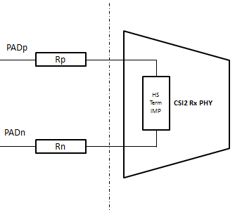
AMS Verification Approach (1/3)
Setup:
Top layer is the UVM testbench
Tool used: XA-VCS tool from Synopsys
Key highlights of the setup:
Analog and digital block partitioning for co-simulations
Signal source impedance
Notes:
To resolve the inadequacies of the RTL behavioural models of analog blocks, these are replaced by their spice description, in the co-simulation environment. The blocks include HS-Rx, LP-Rx blocks, Termination block, Clk Settle and Miss circuits to measure DPHY time parameters, etc.

Slide 13
AMS Verification Approach (2/3)
Key highlights of the setup:
c) Converter block - LP and HS line voltage levels are different, and dynamic switching of voltages occurs when transitioning LP <==> HS
Normal d2a commands (from co-simulation tool) will not work here
Pseudo code:
always@(tb.hs_mode_en or tb.pad_csi_dl_p) begin
if(tb.hs_mode_en==1 && tb.pad_csi_dl_p==1)
$snps_force_volt (<hierarchy>.PADPp, <hs_hi_voltage>);
else if(tb.hs_mode_en==1 && tb.pad_csi_dl_p==0)
$snps_force_volt (<hierarchy>.PADPp, <hs_low_voltage>);
else if(tb.hs_mode_en==0 && tb.pad_csi_dl_p==1)
$snps_force_volt (<hierarchy>.vpadp, <lp_hi_voltage>);
else if(tb.hs_mode_en==0 && tb.pad_csi_dl_p==0)
$snps_force_volt (<hierarchy>.vpadp, <lp_low_voltage>);
end
Notes:
To resolve the inadequacies of the RTL behavioural models of analog blocks, these are replaced by their spice description, in the co-simulation environment. The blocks include HS-Rx, LP-Rx blocks, Termination block, Clk Settle and Miss circuits to measure DPHY time parameters, etc.
(Dp/Dn sees dynamic change in PAD signal voltage for HS -> LP mode transitions.
Inserted between UVM tb and actual design. So normal d2a rules wont work)

Slide 14
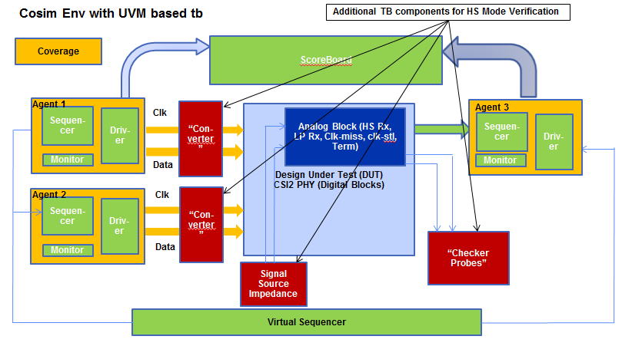
AMS Verification Approach (3/3)
Notes:
To resolve the inadequacies of the RTL behavioural models of analog blocks, these are replaced by their spice description, in the co-simulation environment. The blocks include HS-Rx, LP-Rx blocks, Termination block, Clk Settle and Miss circuits to measure DPHY time parameters, etc.

Slide 15
Application and Results

Slide 16
Application and Results (1/4)
LP Rx and HS Rx functionality validated for “data transfer” mode (which uses LP to HS sequencing)
Stimulus from the Digital UVM testbench
Actual LP and HS voltage levels at the PADs
LP signals (LP11, LP01, LP00)
HS-0
HS Signals (Sync Pattern and Data Payload)
LP-11
De-serialized data out of the CSI2 Rx-PHY

Slide 17
Application and Results (2/4)
Ensured valid voltage levels (per DPHY standard) are recognized by LP-Rx / HS-Rx by randomly varying voltage driven by “converter block”
Pseudo code
real lp_hi_int_v, lp_hi_frac_v, lp_hi_v;
real lp_low_int_v, lp_low_frac_v, lp_low_v;
lp_hi_int_v = $urandom_range(<LP_1_max>,<LP_1_min>);
lp_hi_frac_v = $urandom_range(999,1) / 1000;
lp_hi_v = lp_hi_int_v + lp_hi_frac_v;
lp_low_int_v = $urandom_range(<LP_0_max>,<LP_0_min>);
lp_low_frac_v = $urandom_range(999,1) / 1000;
lp_low_v = lp_low_int_v + lp_low_frac_v;

Slide 18
Application and Results (3/4)
CSR configuration of HS termination block
Pseudo code
Rx-PHY is powered-up and HS-Mode enabled
Fixed (HS differential level) voltages driven on PADs
Iterated through different settings for HS-termination
//thermometer coding; valid codes are 0,1,3,7,15,31,63,127
for (int i=0; i<8; i++) begin
Term_CSR[6:0]={ Term_CSR [5:0], 1'b1};
end
In each case, measure PAD voltage and PAD current and determine the termination resistance
always@(<tb_signal_for_CSR_Term_cfg_done>) begin
if(Core_dft_pwr_intf.iPWRGD_PWROK===1'b1) begin
#<delay_value>;
voltage_padp = $snps_get_volt(<hierarchy>.PADP);
voltage_padn = $snps_get_volt(<hierarchy>.PADN);
current_padp = $snps_get_port_current(<hierarchy>.PADP);
term_impedance = (voltage_padp - voltage_padn) / current_padp;
end
end
Notes:
and HS-Mode enabled (so that HS-termination is “ON”)
Fixed (HS differential level) voltages driven on PADs (PADp = 250mv, PADn = 150mv)

Slide 19
Application and Results (3/4)
Sample log file and waveform dump
UVM_INFO at 6015971: HS_TERM_IMP = 0, PADp(V) = 0.250000, PADn(V) = 0.150000, PADp current = 0.000884 :: Term-impedance = 113.066436
UVM_INFO at 6916491: HS_TERM_IMP = 1, PADp(V) = 0.250000, PADn(V) = 0.150000, PADp current = 0.000981 :: Term-impedance = 101.906082
UVM_INFO at 7817011: HS_TERM_IMP = 11, PADp(V) = 0.250000, PADn(V) = 0.150000, PADp current = 0.001067 :: Term-impedance = 93.686777
UVM_INFO at 8717531: HS_TERM_IMP = 111, PADp(V) = 0.250000, PADn(V) = 0.150000, PADp current = 0.001151 :: Term-impedance = 86.908291
...
Waveform plot showing the PAD voltage, CSR term_imp configuration, and PADp current draw

Slide 20
Results from Simulations (4/4)
Validated proper design response to corner case scenarios
For data bursts of different lengths and random payload data. The design was also validated to respond to error induced into bit sequences.
Range of valid “data rates” supported by the DPHY standard for HS-Mode data transmission.
Pulse width requirement: LP-Mode bit pattern validated was by varying the pulse width in the digital UVM testbench.
Signal timing within the analog blocks (“clk-settle” time, as well as the “clk-miss” time parameters)
Notes:
The UVM testbench in conjunction with the “converter block” is used to achieve this and random data generated is driven as appropriate voltage levels on the PADs.
Checker probes can be placed within UVM based testbench, accessing internal nodes, to validate signal timing within the analog blocks. The CSI2-PHY design has measurement circuits to determine the “clk-settle” time, as well as the “clk-miss” time parameters in the DPHY standard. The checkers monitor the rise of the “clk-settle_start”, and “clk-miss-start” signals, and the fall of the “clk-settle_done”, and “clk-miss_done” to determine the “clk-settle” time, as well as the “clk-miss” time. The pseudo code is as below. These checkers are always on and turn on during the mission mode simulations

Slide 21
Key Issues Found
PHY unable to recover if Lane Enable glitches
LP state pulse width of 72ns generates EscClk
LaneEn glitch causes LP pulse width of 2ns. NO EscClk
FSM resets to 0, but stuck there due to missing EscClk

Slide 22
Key Issues Found
Correlating RTL simulation and co-simulation results identified inaccuracies in RTL model of analog blocks in the modelling “clk-settle” and “clk-miss” parameters.

Slide 23
Conclusion

Slide 24
Advantages of the Co-simulation Setup
The UVM tb was effectively reused in cosim environment. Camera side stimulus, ScoreBoard checking and other protocol checks were reused as is.
Validated LP-Rx and HS-Rx functionality by simulating the transition between LP Mode → HS Mode → LP Mode.
Co-simulations are faster than full spice simulations. A full co-simulation run completes in 4 hours.
- This enabled re-running a large number of tests that covered various random scenarios in the UVM tb, in the co-sim world.

Slide 25
Advantages of the Co-simulation Setup
Automatic checking/monitoring of ‘clk-miss’ and ‘clk-stl’ DPHY parameters with the help of the “checker probes”.
Automatic checking of termination resistance calibration in the digital UVM testbench and indicating pass / fail criterion.

Slide 26
Questions
DISCLAIMER
The information contained herein is for informational purposes only, and is subject to change without notice. While every
precaution has been taken in the preparation of this document, it may contain technical inaccuracies, omissions and
typographical errors, and AMD is under no obligation to update or otherwise correct this information. Advanced Micro
Devices, Inc. makes no representations or warranties with respect to the accuracy or completeness of the contents of this
document, and assumes no liability of any kind, including the implied warranties of noninfringement, merchantability or
fitness for particular purposes, with respect to the operation or use of AMD hardware, software or other products described
herein. No license, including implied or arising by estoppel, to any intellectual property rights is granted by this document.
Terms and limitations applicable to the purchase or use of AMD’s products are as set forth in a signed agreement between the
parties or in AMD's Standard Terms and Conditions of Sale.
AMD, the AMD Arrow logo,and combinations thereof are trademarks of Advanced Micro Devices, Inc. Other product names used in this publication are for identification purposes only and may be trademarks of their respective companies.

