Slide 1
Portable Stimulus Standard Update PSS in the Real World
Accellera Portable Stimulus Working Group

Slide 2
Agenda
Where are we here?
Display Controller Example
Memory & Cache Examples
SoC Level Example
Summary: IP to SoC & Post-Silicon

Slide 3
Acknowledgements
This presentation borrows content from DVCon US 2022 tutorial
Following WG members prepared the content and presented the DVCon US 2022 tutorial
Tom Fitzpatrick, Siemens EDA
Matan Vax, Cadence Design Systems
Adnan Hamid, Breker Verification Systems
Hillel Miller, Synopsys

Slide 4
ASIC Biggest Functional Verification Challenge
ASIC
FPGA
Source: Wilson Research Group and Mentor, A Siemens Business, 2020 Functional Verification Study

Slide 5
Methodology Shifts Require New Thinking
SystemVerilog brought a new approach to Verification
Standardized features from other proprietary languages
Directed testing → Constrained-Random
C-R requires Functional Coverage to know what happened
Needed narrow focus to build an Ecosystem
One piece of code per test
Multiple tests per piece of code
...
...

Slide 6
UVM Focused on How to Verify
Design Specific
Protocol-Independent
Primarily aimed at block level
Modular reusable verification components
Separate What from How
Composable Transaction-level sequences
Drivers/Monitors convert between transactions and signals
Reuse abstract sequences with different agents
Sequences focus on What
Agents convert to protocol-specific How
Each IP interface uses same approach
UVM SEQ
UVM Agent
Protocol-Specific
Internal IF
Internal IF
IP
External IF
External IF
UVM Agent
UVM SEQ
Notes:
UVM took that huge pile of stuff in SystemVerilog and really focused on what is needed for verification.
<click>
Constrained random transactions
Procedurally code larger sequences
Send N random transactions with “size” less than M
Procedurally model test space
Video data can come from various sources
There are N DMA channel
Graphics needs to power up before using it
Power management sequence

Slide 7
UVM Focused on How to Verify
UVM SEQ
UVM SEQ
All tests/testbenches have same basic structure
Horizontal Reuse
Same agent on different blocks with same interface
UVM Agent
UVM Agent
Internal IF
Internal IF
Internal IF
Internal IF
IP
IP2
External IF
External IF
External IF
External IF
UVM Agent
UVM Agent
UVM SEQ
UVM SEQ

Slide 8
UVM Focused on How to Verify
UVM Virtual SEQ
UVM Virtual SEQ
UVM SEQ
UVM SEQ
All tests/testbenches have same basic structure
Horizontal Reuse
Same agent on different blocks with same interface
Block-level environments configured as components at next level
Block-level Sequences called from Virtual Sequences
This was the right target 10 years ago
Passive Agent Monitor-only
UVM Agent
UVM Agent
Internal IF
Internal IF
Internal IF
Internal IF
IP
IP2
External IF
External IF
External IF
External IF
UVM Agent
UVM Agent
UVM Virtual SEQ
UVM SEQ
UVM SEQ

Slide 9
Verification is a Moving Target
UVM Virtual SEQ
Block-level testing does not scale to SoC
ASM:C == Gates:RTL == UVM:?
Can't reuse UVM on CPU
UVM SEQ
UVM SEQ
DMA
Flash
DRAM
Power
UVM Agent
UVM Agent
Bus IF
Bus IF
Bus IF
Bus IF
UVM Agent
LTE Modem
GPS
Internal IF
Internal IF
LTE IF
Bus IF
Internal IF
Internal IF
Bus IF
BT IF
CPU
CPU
Internal IF
Internal IF
CDMA Modem
Bluetooth
Internal IF
Internal IF
CDMA IF
Bus IF
IP
IP2
IP
IP2
CPU
CPU
Bus IF
BT IF
External IF
External IF
WiFi Modem
NFC
External IF
External IF
WiFi IF
Bus IF
Bus IF
Bus IF
NFC IF
External IF
External IF
External IF
UVM Agent
UVM Agent
Bus IF
Bus IF
Bus IF
Bus IF
UVM Agent
Display
Processor
Touchpad
Audio Codec
Camera
UVM Virtual SEQ
Disp IF
Tpad IF
Codec IF
Cam IF
UVM SEQ
UVM SEQ
External IF
UVM Agent
Notes:
The problem is that this UVM-based block-level approach doesn't scale to the SoC level
<click>
Let's look at a basic integration test. In addition to the two IP blocks, we start having other pieces of the system, like a DMA controller and memory, in place of the internal VIP blocks.
<click>
And at this point, we start needing an actual processor model to program these other things. This is a detail that wasn't part of the block-level UVM stimulus.
<click>
And when you consider the rest of the things in a typical SoC, there's no way we could reuse UVM sequences to manage all of that.
So the SoC integrator is going to have to rewrite those UVM sequences as actual C code, and now you have the problem of partitioning the code, which has to happen manually, not to mention having to coordinate the C code with the UVM sequences running on the external VIP.
So it becomes much more difficult to get the concurrency required.
<click>
This is why UVM is no longer the right solution for SoC-level testing

Slide 10
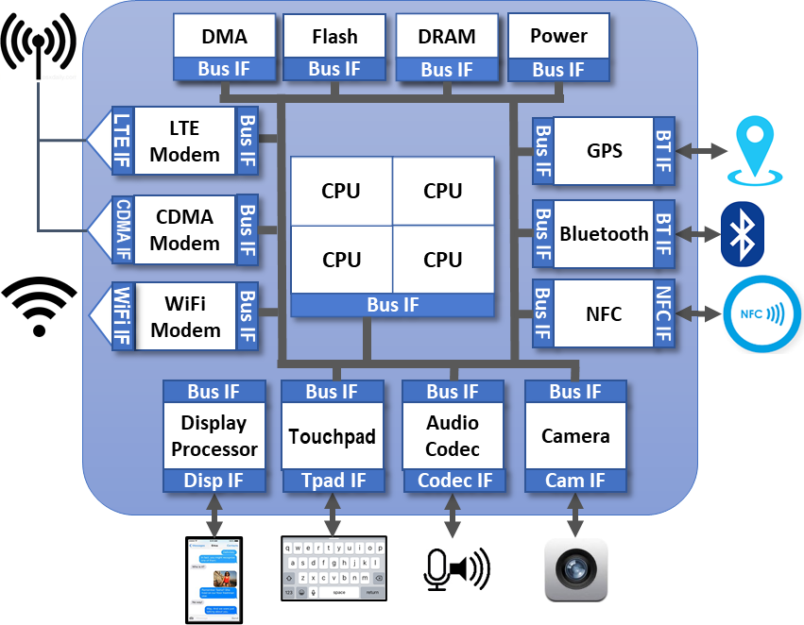
SoC Verification With Embedded Processors
Manually coded test usually in C
No randomization for better coverage
Manually coded IP libraries
No reuse from IPs
Must procedurally model test space
Video data can come from various sources
There are N DMA channel
Graphics needs to power up before using it
Power management sequence

Slide 11
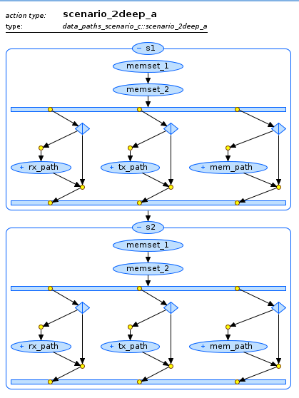
What If We Could Apply Automation to SoC Verification?
Single Specification – Multiple tests
Formally describe test space to help tool generate tests conforming to system constraints
Distributed test based on single specification
Reuse intent on processor
Automated partitioning and coordination
Constrained-random to find bugs at the scenario level
Notes:
So what if we could take the lessons we learned from UVM at the block level and apply them to SoC verification?

Slide 12
Stimulus at a Higher Level
UVM Sequences define sets of transactions
Transaction contents randomized
Transaction flow not explicitly randomized
Difficult to randomize between sequences
Scenarios define sets of behaviors
Define critical verification intent
Define rules to support critical intent
Simple PSS specification defines multiple scenarios
UART receive
Modem receive
a=1
a=2
a=3
DMA
Xfer
mem copy
b=1
b=2
b=3
Comp/ Decomp
execute
Notes:
One key to Portable Stimulus is to raise the level of abstraction above the transaction level. What do I mean by that? Well, let's take a look at a typical transaction-level sequence in UVM. The sequence generates transactions of a specific type, and for this example let's suppose that the transaction has two data fields, A and B. Inside the body method, we create a transaction of the desired type, randomize it and send it to the driver. Note that there can be constraints in the transaction itself or we can add constraints in-line when we randomize it. Let's assume for this example that we wind up with 3 separate possible values each for A and B.
<click>
That means that there are 9 unique combinations of A and B, or 9 unique transactions. Of course, when we run this test, it will take much more than 9 iterations to reach all of these combinations. Even though this is a simple example, it illustrates what we mean by a transaction-level test. The difference between one test and another is determined by differences in the contents of a particular transaction. When those transactions are transmitted through the driver, they cause different things to happen in the device under test. We can build sequences like this into higher-level sequences and eventually write virtual sequences to try to coordinate activity between sequences, but it still comes down to randomizing values of transaction parameters. Instead, we want to be able to think of scenarios, where we focus on the actual behaviors that we want to execute.
<click>
Suppose we have a system that does data compression and decompression. <click> It needs data to work on, so maybe there's a mem copy action to provide the data. And maybe the data comes in originally through some sort of modem receive action. <click> The system might also support DMA transfers from a UART to provide the data. <click> And maybe it can DMA from the modem as well. We now have a graph of possible scenarios here, based on the actions that the design supports and notice that we're not really worrying yet about exactly how these actions happen. But there's a bit more going on here.
<click>
If we think about test intent, let's consider the case where the operations we really care about are the mem copy to the compressor action. Looking at the graph of possible scenarios, we can see that the Modem receive action has to happen so that there's actually some data to copy, so given the scenario space, we don't have to fully specify every action. The tool can analyze the graph and determine which supporting actions must be executed to support the desired test intent.
<click>
Instead, what if we wanted to test the DMA transfer into the compression engine?
<click>
In this case, the data could be received on either the uart or the modem, so either action would support the required test intent. If the test generator randomly chose one of these actions, we now have the ability to bring the power of constrained randomization to the scenario level.
<click>
Each of the resulting scenarios is valid, and because we can analyze the solution space, we can ensure that each required scenario gets generated.
<click>
and since each operation may occur with different configuration or data variants, each of these can be generated for each behavioral scenario, guaranteeing that we fully cover the stimulus space.

Slide 13
Portable Stimulus Brings Constrained-Random to Scenario Generation
PSS partial specification defines critical verification intent
Don't have to "code and hope"
More intuitive and straightforward than SV functional coverage
Rules allow tool to infer additional actions
Allows random generation of scenarios
Each guaranteed to be legal
Constrain specific actions
Constrain scheduling relationships between actions
Notes:
Scenario-based vs path-based – SB is better
Could do intelligent solver to eliminate duplication; not part of PSS standard
Could add to tools later
Using Portable Stimulus on the other hand, a tool like Questa inFact integrates Functional Coverage into the test generation process. You still use Functional Coverage points to define the critical states,
<click>
but because the Portable Stimulus specification is DECLARATIVE, inFact can analyze the graph of possible scenarios, identify the ones that will actually hit the coverage point and generate those tests first.
<click>
This gives you the maximum coverage in the fewest tests. Notice how by analyzing the graph we can actually generate tests to hit the coverage points in all possible combinations.
<click>
Then you can run all the other tests to completely cover the graph. Since the activity graph is declarative, inFact can generate every possible path through the graph so you're guaranteed not only to hit your coverage points,
<click>
but also any additional states to uncover those hidden bugs.

Slide 14
Key Aspects of Portable Stimulus
Capture test intent
Partial scenario description
Composable scenarios
Formal representation of test space
Automated test generation
Target multiple implementations
Separate test intent
from implementation
High-coverage test generation across the verification process with much less effort
Notes:
The most important aspect of Portable Stimulus is that it let's you capture your test INTENT. As you'll see, PSS is a declarative language that let's you define a set of rules that represent what's legal when it comes to verifying your design.
It let's you define the specific behaviors or operations that you want to verify as a partial specification of your scenario
and let's you compose higher-level scenarios from lower-level ones as you go from block to system-level designs.
And from these partial specifications of intent, and the rules defined for your system, we build up a formal representation of your test space.
From this formal representation, tools can then automatically generate tests
on multiple target platforms that implement the behaviors you defined in your scenarios with the proper scheduling.
So, we're separating the specification of Test Intent, which is the model that you write, from the implementation of that intent, which can be automated by a tool.
So, as you'll see, PSS let's you create high-coverage tests throughout the verification process as you move from block to system and from simulation to emulation to prototyping, and because you can generate these multiple implementations automatically from the same model, the overall process takes much less effort.

Slide 15
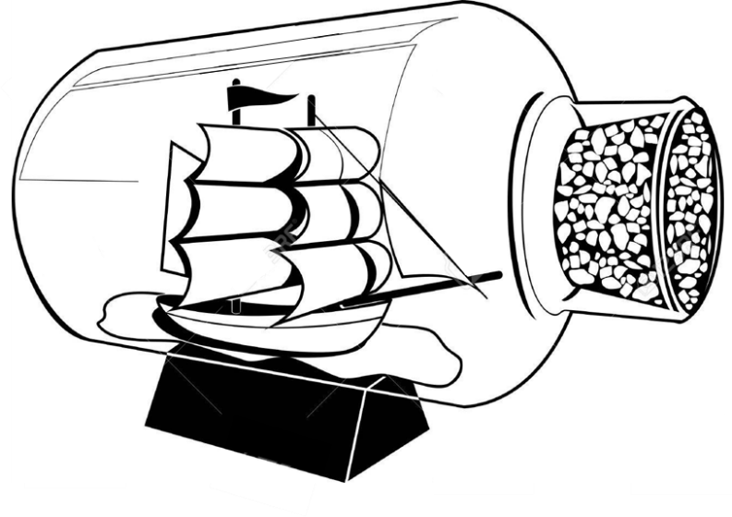
What is a Portable Stimulus Model?
The Abstract Model
What does it do
The Realization Layer
How does it do what it does
Notes:
So what do we mean by a Portable Stimulus model?
The first part of a PSS model is what I refer to as the "Abstract Model", which is the specification of your verification intent: What are the behaviors I need to verify? And we specify these at the abstract level, like "send a packet from here to there" or "do a DMA transfer." I don't want to have to think yet about how I'm actually going to implement the behaviors, because
that's the Realization Layer. As you'll see, there is a very distinct difference between the two, and this is how Portable Stimulus can do what it does. We intentionally kept the Abstract Model at the behavior-scheduling level, and in the Realization Layer, for a given target platform, whether it's UVM or C or whatever..., you specify the implementation details for that behavior. So this separation is what allows PSS to be portable across different implementation languages.

Slide 16
So What's the Point?
Activity defines critical behaviors
May define partial specification
Tools will infer additional elements to complete the scenario
Other parts of the model define how behaviors interact
Instantiated components define available actions
Flow object bindings constrain inference choices
Resources constrain scheduling options
Notes:
So, what's the point of all this?
We have the ACTIVITY that defines your critical behaviors.
And this is what we mean by a "partial specification" of the things that you want to make sure happen,
and then the tool is going to INFER a set of additional elements to complete the scenarios. If I include an action that requires an input of a specific type, it is up to the tool to find another available action that can provide that particular data flow object.
And it is the other parts of the model that define what is available and the rules by which they will interact.
The instantiated components define the set of actions available,
and the flow-object bindings of those actions constrain what actions can be inferred. If I have an action that requires a buffer, I can only infer an action that supplies a buffer of a compatible type.
And the available resources may present further scheduling constraints since I can only infer actions that fit given the number of resources available in my system.
So basically, a PSS model gives you a big box of legos, and you can pick and choose from them to build your critical intent, and let the tool comb through the box to find the right pieces to build the rest of your scenarios.

Slide 17
The Rubber Meets the Road
The Abstract Model must be implemented on different targets
Atomic Actions → target code
Target code modeled in exec blocks
Generator assembles target code according to Activity schedule
Notes:
Obviously, the next step is to actually implement the abstract model on the target platforms. This is what we call the Realization Layer
For each atomic action, we're going to define an EXEC block, and this is going to specify the target code to define the implementation of the behavior on a particular platform.
And then the generator will assemble each of the exec block contents into a test on your target platform where each behavior executes according to the schedule defined in the activities of the abstract model.

Slide 18
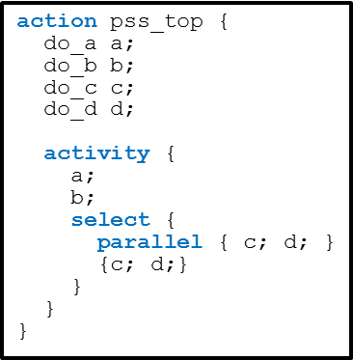
PSS Generalized Tool Flow
Gen-time or Run-time
Scenario model + Constraints
Constraint Solver
Solved Model
Test Generator
PSS Compiler
PSS Model
UVM
Sequences
Transaction
Sequences
C-test
Sync
AXI
VIP
TB
AXI
VIP
AXI
VIP
CPU
DMAC
DMAC
UART
VIP
UART
DDR MEM
UART
VIP
UART
DDR MEM
UVM Testbench
SoC Testbench
Notes:
The general tool flow starts with a description of your portable stimulus intent in what we refer to as the DSL, or Domain-Specific Language. This is typically what is referred to as "PSS" and is a declarative language that allows us to define a scenario model and a set of constraints, including data constraints and scheduling constraints between the different behaviors represented in the model.
We have also defined a C++ library that is able to generate the same model. Executing the C++ code generates the same model as compiling the DSL code.
Once you have the scenario model, you solve all of the constraints to produce the Solved Model, which is the formal representation of all the legal scenarios defined by the original intent you specified in your model.
The test generator then takes that solved model and creates from it the implementation of the test intent on your target platform.
If you're targeting a UVM environment, it will generate a set of UVM sequences and virtual sequences to coordinate the behaviors in your UVM environment. It's important to note that it will NOT generate the UVM environment, so PSS is not a REPLACEMENT for UVM. Rather , UVM is one of the likely targets for PSS test generation.
You can also generate C code from the model. It's the same scenario, just now implemented in a different language. And, more importantly, if you have some of the code running in C on a processor model, and some running as UVM sequences on verification IP in your test environment, the tool can create whatever hooks are necessary to still ensure that the behaviors running in different languages in your mixed environment still are coordinated to implement the same scenario from your original intent model.
The solving of these constraints can be done either at gen-time, where you would generate a set of tests – one for each scenario – that can later be compiled or run in your verification environment, or at run-time, where the generated code may include a generic sequence that, at the right time, will call into the Portable Stimulus tool, to find out the next thing to do. Either generation scheme is valid, and tools don't necessarily have to do both to be PSS-compliant, but either way, you wind up with a target-specific implementation of your original intent that executes on your target platform.

Slide 19
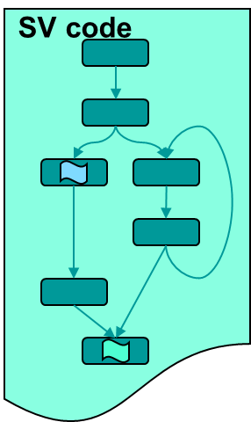
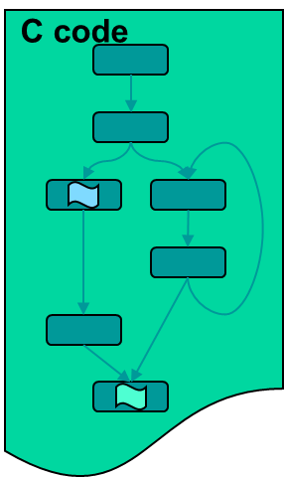
Generated Code Scheduled According to Activity
action
SV/UVM
C Code
exec
action
exec
action
action
exec
exec
action
exec
Notes:
UVM is a primary target for PSS.
PSS is not a replacement for UVM

Slide 20
Generated Code Scheduled According to Activity
action
SV/UVM
SV/UVM C Code
C Code
exec
action
exec
action
action
exec
exec
action
exec

Slide 21
Generated Code Scheduled According to Activity
action
SV/UVM C Code
exec
action
exec
action
action
exec
exec
action
exec

Slide 22
Agenda
Where are we here?
Display Controller Example
Memory & Cache Examples
SoC Level Example
Summary: IP to SoC & Post-Silicon

Slide 23
Overview
Purpose of this section:
Demonstrate the application of PSS to a typical IP verification problem
Explain the meaning and use of PSS resource pools and claims
Highlight a key advantage of modeling scenarios in PSS compared to SystemVerilog
Structure of this section
A verification challenge – exercising data paths in a display controller
Modeling the scenario space in SystemVerilog and its limitations
Modeling the scenario space in PSS – the general solution

Slide 24
Display Controller Example Description
6 processing pipes:
Pipes 0..2 for video
Pipes 3..5 for graphics
4 overlay engines:
LCD0, LCD1, LCD2, and TV
5 interface engines
DSI_A, DSI_B, DP_A, DP_B, and HDMI
DC
Pipe0
DSI_A
Pipe1
LCD0
DSI_B
Pipe2
LCD1
DP_A
Pipe3
LCD2
DP_B
Pipe4
TV
HDMI
Pipe5

Slide 25
Display Controller Example Description (cont’)
Each engine can process one data stream at a given time
1..4 streams processed concurrently
Datapath rules:
Video pipes cannot feed overlay engine LCD1
Graphics pipes cannot feed overlay engine LCD0
LCD0 can only feed DP_A
LCD1 can feed DSI_A or DSI_B
LCD2 can feed DSI_A, DSI_B or DP_B
TV can feed DP_A or HDMI
DC
Pipe0
DSI_A
Pipe1
LCD0
DSI_B
Pipe2
LCD1
DP_A
Pipe3
LCD2
DP_B
Pipe4
TV
HDMI
Pipe5

Slide 26
Modeling Data Streams in SystemVerilog
typedef enum {VID, GFX} pipe_kind_e;
typedef enum {LCD0, LCD1, LCD2, TV} overlay_kind_e;
typedef enum {DSI_A, DSI_B, DP_A, DP_B, HDMI} interface_kind_e;
class process_stream extends uvm_object;
rand int pipe_id;
rand pipe_kind_e pipe_kind;
constraint pipe_kind_c {
pipe_kind == VID -> pipe_id inside {0,1,2};
pipe_kind == GFX -> pipe_id inside {3,4,5};
}
rand overlay_kind_e overlay_kind;
rand interface_kind_e interface_kind;
...
endclass
DC
Pipe0
DSI_A
Pipe1
LCD0
process_stream
DSI_B
Pipe2
LCD1
pipe_id
DP_A
overlay_kind
Pipe3
LCD2
DP_B
interface_kind
Pipe4
TV
HDMI
Pipe5

Slide 27
Capturing Datapath Rules in SystemVerilog
process_stream
pipe_id
overlay_kind
class process_stream extends uvm_object;
...
constraint pipe2overlay_c {
pipe_kind == GFX -> overlay_kind != LCD0;
pipe_kind == VID -> overlay_kind != LCD1;
}
constraint overlay2interface_c {
overlay_kind == LCD0 -> interface_kind == DP_A;
overlay_kind == LCD1 -> interface_kind inside {DSI_A, DSI_B};
overlay_kind == LCD2 -> interface_kind inside {DSI_A, DSI_B, DP_B};
overlay_kind == TV -> interface_kind inside {DP_A, HDMI};
}
...
endclass
Datapath rules:
Video pipes cannot feed overlay engine LCD1
Graphics pipes cannot feed overlay engine LCD0
LCD0 can only feed DP_A
LCD1 can feed DSI_A or DSI_B
LCD2 can feed DSI_A, DSI_B or DP_B
TV can feed DP_A or HDMI
interface_kind
Key Message Here

Slide 28
Modeling Parallel Streams in SystemVerilog
process_multi_stream
class process_multi_stream extends uvm_object;
rand process_stream streams[];
constraint num_streams {
streams.size inside {[1:4]};
}
constraint resource_unique_c {
foreach (streams[i]) {
foreach (streams[j]) {
if (i != j) {
streams[i].pipe_id != streams[j].pipe_id;
streams[i].overlay_kind != streams[j].overlay_kind;
streams[i].interface_kind != streams[j].interface_kind;
}
}
}
}
...
endclass
Between one and four concurrent streams
streams[0]
pipe_id = 1
overlay_kind = LCD2
Pipes, overlays, and interfaces must be different for different streams
interface_kind = DSI_A
streams[1]
pipe_id = 2
overlay_kind = LCD0
interface_kind = DP_A
streams[2]
(SV/UVM code overheads – constructor, allocating arrays, uvm_object_utils…)
pipe_id = 2
overlay_kind = LCD1
interface_kind = DSI_B

Slide 29
But How to Generalize?
What have we achieved thus far?
Constraint model expresses relations between multiple concurrent streams
But this is just one specific scenario..
What are we still missing?
Start / stop streams while processing of others is in progress
Balance workload across engines with tasks of different features/durations
Create random/complex schedules of streams
…
The SystemVerilog model does not capture the true nature of the problem – tasks contending for limited resources

Slide 30
Modeling Resources in PSS
component display_c {
enum pipe_kind_e {VID, GFX};
resource pipe_r {
rand pipe_kind_e kind;
constraint {
kind == VID -> instance_id in [0..2];
kind == GFX -> instance_id in [3..5];
}
}
pool [6] pipe_r pipe_pool;
enum overlay_kind_e {LCD0, LCD1, LCD2, TV};
resource overlay_r {
rand overlay_kind_e kind;
constraint instance_id == (int)kind;
}
pool [4] overlay_r overlay_pool;
enum interface_kind_e {DSI_A, DSI_B, DP_A, DP_B, HDMI};
resource interface_r {
rand interface_kind_e kind;
constraint instance_id == (int)kind;
}
pool [5] interface_r interface_pool;
}
Resource object type, can include attributes and constraints
DC
pipe_pool
Pool contains N instances of a resource type
interface_pool
overlay_pool
Pipe0
Built-in attribute ‘instance_id’ uniquely identifies the instance within a pool
DSI_A
Pipe1
LCD0
DSI_B
Pipe2
LCD1
DP_A
Pipe3
LCD2
DP_B
User-defined enum attributed used to associate meaningful names with instances
Pipe4
TV
HDMI
Pipe5

Slide 31
Modeling a Single Data Stream
DC
Resources can be locked by actions, excluding other concurrent use
pipe_pool
component display_c {
...
action process_stream {
lock pipe_r pipe;
lock overlay_r overlay;
lock interface_r interface;
exec body {
drive_stream(pipe.instance_id,
overlay.instance_id,
interface.instance_id);
}
}
}
interface_pool
overlay_pool
process_stream
Pipe0
DSI_A
Pipe1
LCD0
DSI_B
Pipe2
LCD1
DP_A
Pipe3
LCD2
DP_B
Pipe4
TV
HDMI
Pipe5

Slide 32
Capturing Datapath Rules
pipe_r
process_stream
overlay_r
action process_stream {
...
constraint pipe2overlay_c {
pipe.kind == GFX -> overlay.kind != LCD0;
pipe.kind == VID -> overlay.kind != LCD1;
}
constraint overlay2interface_c {
overlay.kind == LCD0 -> interface.kind == DP_A;
overlay.kind == LCD1 -> interface.kind in [DSI_A, DSI_B];
overlay.kind == LCD2 -> interface.kind in [DSI_A, DSI_B, DP_B];
overlay.kind == TV -> interface.kind in [DP_A, HDMI];
}
}
Datapath rules:
Video pipes cannot feed overlay engine LCD1
Graphics pipes cannot feed overlay engine LCD0
LCD0 can only feed DP_A
LCD1 can feed DSI_A or DSI_B
LCD2 can feed DSI_A, DSI_B or DP_B
TV can feed DP_A or HDMI
interface_r

Slide 33
Driving Parallel Streams
Parallel activities are guaranteed mutually exclusive resource assignments for locked resources
action process_multi_stream {
rand int in [1..4] num_streams;
activity {
parallel {
replicate (num_streams) {
do process_stream;
}
}
}
}
pipe
1
pipe
2
pipe
4
process_stream
process_stream
process_stream
overlay
LCD2
overlay
LCD0
overlay
LCD1
interface
DSI_A
interface
DP_A
interface
DSI_B

Slide 34
Creating Arbitrary Schedules
action random_schedule {
rand int in [2..20] num_streams;
activity {
schedule {
replicate (num_streams) {
do process_stream;
}
}
}
}
Schedule all actions in a way that avoids resource conflicts
pipe
5
pipe
1
process_stream
12
overlay
LCD1
process_stream
12
overlay
LCD2
pipe
0
interface
DSI_A
interface
DP_B
process_stream
60
overlay
TV
action my_scenario_26 {
activity {
parallel {
do process_stream with { size == 60; };
do random_schedule with {
forall (p: process_stream) {
p.size == 12;
}
};
}
}
}
interface
HDMI
pipe
5
pipe
4
process_stream
12
overlay
LCD0
process_stream
12
overlay
LCD2
One long stream concurrent to multiple short streams
interface
DP_A
interface
DSI_A

Slide 35
Summary
PSS supports high-level modeling constructs, resource pools/claims among others
These constructs naturally capture dependencies across behaviors in the design/test
Thus, non-trivial flows and schedules can be easily described or randomized
In contrast, SystemVerilog (and other verification languages) support only constrained randomization of data, hence modeling non-trivial flows/schedules is harder

Slide 36
Agenda
Where are we here?
Display Controller Example
Memory & Cache Examples
SoC Level Example
Summary: IP to SoC & Post-Silicon

Slide 37
Agenda
Problem #1: DDR Memory Controller Page Management
Problem #2: Traversing Cache Coherency state transitions
Problem #3: Combine Problem #1 and Problem #2 in same scenario
Scenario Modeling challenges with SV
Modeling Executors, Memory, and Basic Read/Write tests
Solution #1: Model DDR Page Management in PSS
Solution #2: Model Cache Coherency state traversal in PSS
Solution #3: Combining DDR Page Management and Cache Coherency scenarios

Slide 38
Many Possible Approaches to solving problem
Each of Problem #1 or Problem #2 in isolation can be solved more simply
This tutorial section shows two different approaches to creating sequences of operations and how they can be combined for cross coverage

Slide 39
The Problems
Problem #2: Cache Coherency state traversal
CPU
CPU
CPU
CPU
CPU
CPU
CPU
CPU
…
L1
L1
L1
L1
L1
L1
L1
L1
L2
L2
Cache-Coherent Switching Fabric
L3 Cache / Snoop Filter
Problem #1: DDR Memory Controller page management
Memory Controller
Memory Controller
PCIE
Ethernet
Offload
DDR
DDR

Slide 40
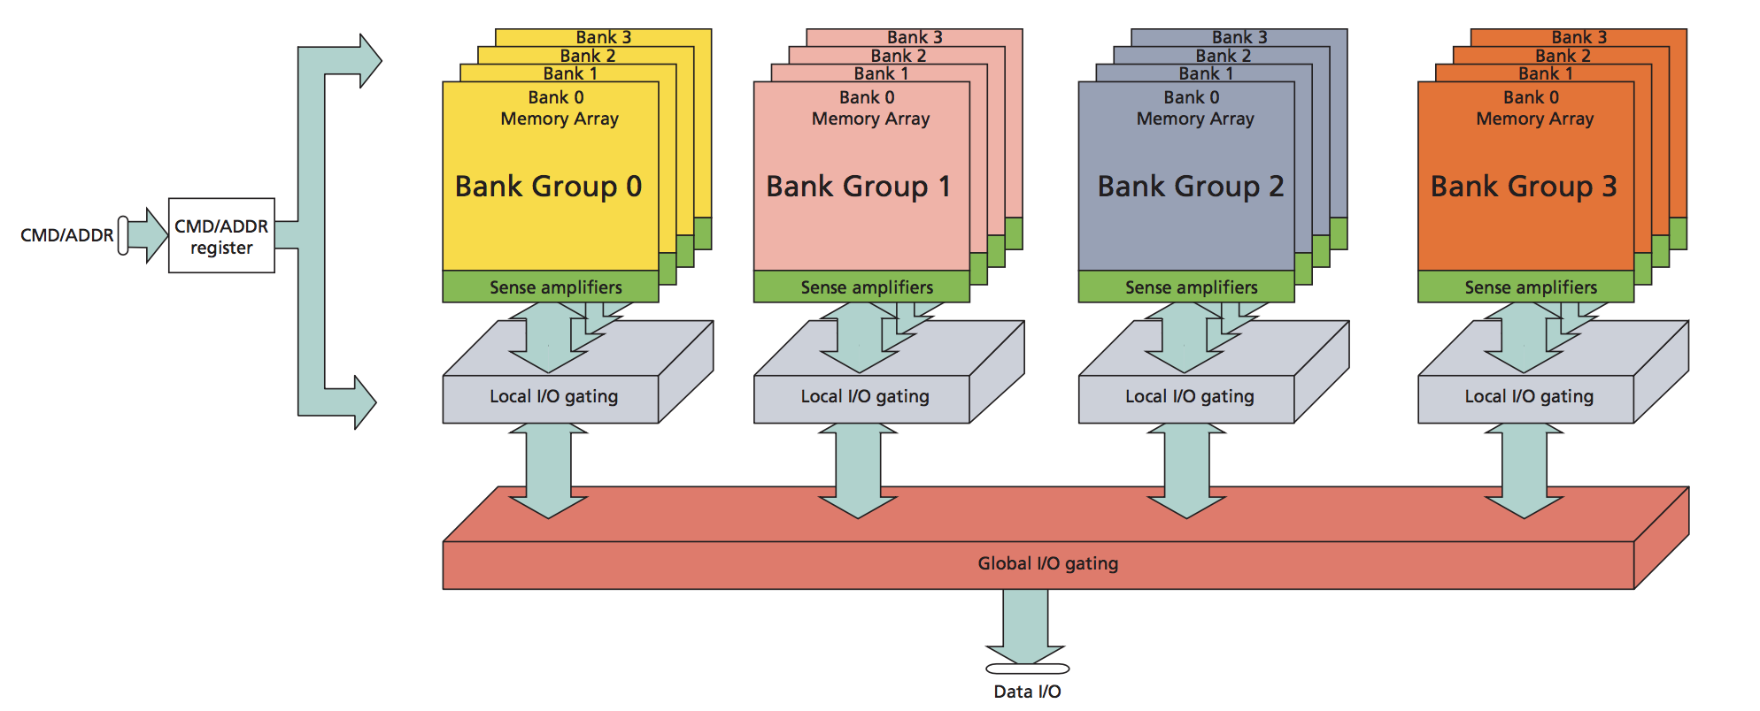
Problem #1: DDR Page management
DDR is organized in Pages
Identified by group, bank, row, column
Access in same page is fast
But memory controller may need to interleave refresh
Access to different page in same bank is slow
Objective: generate sequences of read/write addresses to stress memory controller page management

Slide 41
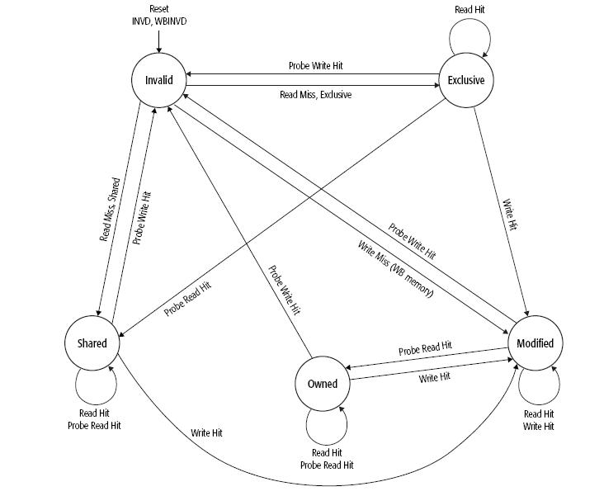
Problem #2: Cache Coherency State traversal
SoC’s have multi-level caches
Each cache level may have different coherency protocols
Objective: Generate sequences of operations scheduled on correct cores to traverse all coherency transitions

Slide 42
Problem #3: Combing Problem #1 & #2
Traversing cache states must access DDR memory at various times
DDR read/write operations have different timings based on pattern of address and page management.
Objective: Generate sequences of operations scheduled on correct cores to traverse all coherency transitions while stressing DDR Page management

Slide 43
Scenario Modeling Challenges with SystemVerilog
Both Problem #1 DDR page management and Problem #2 Cache coherency state transitions requires sequences of related operations scheduled across different cpu cores.
This is difficult to model natively in UVM/SystemVerilog
PSS provides elegant solutions to such problems

Slide 44
Basic Read/Write tests
Student Takeaway: Quickly create random read/write tests
Define how many executor cores are in the system
Define available system memory
Define basic read/write operations
Define random address generator
Put it all together

Slide 45
Configuring Executors & System Memory
Declare how many core are available in system
package config_pkg {
const int NUM_CORES = 4;
}
struct core_traits_s : executor_trait_s {
rand int in [0 .. config_pkg::NUM_CORES - 1 ] core_id;
}
component cores_c : executor_group_c<core_traits_s> {
executor_c<core_traits_s> cores [config_pkg::NUM_CORES];
exec init_down {
foreach (c : cores[i]) {
c.trait.core_id = i;
add_executor(c);
}
}
}
Each executor has a “trait” with its id
Array of cores with trait
component pss_top_rand_addrs_c {
transparent_addr_space_c<> sys_mem;
exec init_up {
transparent_addr_region_s<> region;
region.size = ( 1 << 40 );
region.addr = 0x80000000;
(void)sys_mem.add_region(region);
}
Initialize Each core id
Declare available system memory

Slide 46
Basic Read/Write Operations: State Object
State Object will keep track of next memory address to operate on
state addr_s {
rand bit[64] addr;
rand transparent_addr_claim_s <> claim;
constraint claim.addr == addr;
constraint claim.size in [1,2,4,8];
}
Also stores a memory claim
Constrained to the next desired address
Constrained to native read/write sizes

Slide 47
Basic Read/Write Operations
Input state object
component mem_ops_c {
action write_a {
input addr_s inp;
rand executor_claim_s<core_traits_s> core;
rand bit [64] data;
exec body {
addr_handle_t h = make_handle_from_claim(inp.claim);
match (inp.claim.size) {
[1]: write8(h, data[7:0]);
[2]: write16(h, data[15:0]);
[4]: write32(h, data[31:0]);
[8]: write64(h, data[63:0]);
}
}
}
action read_a {
input addr_s inp;
rand executor_claim_s<core_traits_s> core;
bit [64] data;
exec body {
addr_handle_t h = make_handle_from_claim(inp.claim);
match (inp.claim.size) {
[1]: data[ 7:0] = read8(h);
[2]: data[15:0] = read16(h);
[4]: data[31:0] = read32(h);
[8]: data[63:0] = read64(h);
}
}
}
} // mem_ops_c
Claims a random cpu core
Get handle on claim
Do write operation

Slide 48
Random address generator and instantiation
component rand_addrs_c {
action rand_addrs_a {
output addr_s out;
}
}
component rand_addr_test_c {
rand_addrs_c rand_addrs;
mem_ops_c mem_ops;
pool addr_s addr_p;
bind addr_p *;
action rand_addr_test_a {
activity {
do rand_addrs_c::rand_addrs_a;
select {
do mem_ops_c::write_a;
do mem_ops_c::read_a;
}
}
}
}
Instantiate and bind
Output an unconstrained random address
Generate next address
Do read or write

Slide 49
Basic Memory Tests
…
…
component pss_top_rand_addrs_c {
transparent_addr_space_c<> sys_mem;
exec init_up {…}
cores_c cores;
rand_addr_test_c rand_addr_test[10];
action entry_a {
activity {
schedule {
replicate (100){
do rand_addr_test_c::rand_addr_test_a;
}
}
}
}
}
Declare available system memory & cores
rand_addrs_a
rand_addrs_a
addr_s
addr = 0x3425
addr_s
addr = 0xabf1
Instantiate
read_a
write_a
…
rand_addrs_a
rand_addrs_a
Schedule actions
addr_s
addr = 0x3792
addr_s
addr = 0x9af2
write_a
write_a
…
…

Slide 50
Solution #1: DDR Page Management
CPU
CPU
CPU
CPU
CPU
CPU
CPU
CPU
…
L1
L1
L1
L1
L1
L1
L1
L1
L2
L2
Cache-Coherent Switching Fabric
L3 Cache / Snoop Filter
Solution #1: DDR Memory Controller page management
Memory Controller
Memory Controller
PCIE
Ethernet
Offload
DDR
DDR

Slide 51
Solution #1: DDR page management
DDR is organized in Pages
Identified by group, bank, row, column
Access in same page is fast
But memory controller may need to interleave refresh
Access to different page in same bank is slow
Objective: generate sequences of addresses to stress memory controller page management

Slide 52
Modeling DDR Memory Bank Address Sequences
Student Takeaway: Modeling address sequences with state objects
component ddr_page_addrs_c {
state ddr_page_s {
rand bit [ 2] group;
rand bit [ 2] bank;
rand bit [16] row;
rand bit [10] column;
rand bit [64] addr;
constraint addr[18: 9] == column;
constraint addr[34:19] == row;
constraint addr[36:35] == bank;
constraint addr[38:37] == group;
}
pool ddr_page_s ddr_page_p;
bind ddr_page_p *;
State Objects allow sequencing constraints via prev variable
DDR page identification
Resolved address
memory type specific constraints
create pool and bind

Slide 53
Modeling DDR Memory Bank Address Sequences
action ddr_same_page_a {
output ddr_page_s ddr_page;
constraint c {
ddr_page.group == ddr_page.prev.group ;
ddr_page.bank == ddr_page.prev.bank ;
ddr_page.row == ddr_page.prev.row ;
ddr_page.column == ddr_page.prev.column ;
};
}
action ddr_same_bank_a {
output ddr_page_s ddr_page;
constraint c {
ddr_page.group == ddr_page.prev.group ;
ddr_page.bank == ddr_page.prev.bank ;
( ddr_page.row != ddr_page.prev.row ||
ddr_page.column != ddr_page.prev.column );
};
}
Hit on same page:
fast, but may need refreshes
Dictionary of other address picking strategies
Hit on same bank, different page: page switching is slow
action ddr_next_col_a {
output ddr_page_s ddr_page;
constraint c {
ddr_page.group == ddr_page.prev.group ;
ddr_page.bank == ddr_page.prev.bank ;
ddr_page.row == ddr_page.prev.row ;
ddr_page.column ==
(ddr_page.prev.column + 1) & 0x3ff ;
};
}

Slide 54
Modeling DDR Memory Bank Address Sequences
action select_strategy_a {
activity {
select {
[8]: do ddr_same_page_a;
[1]: do ddr_next_col_a;
[1]: do ddr_same_bank_a;
...
}
}
}
action constrain_addr_a {
input ddr_page_s ddr_page;
output addr_s out;
constraint out.addr == ddr_page.addr;
}
} // component ddr_page_addrs_c
Pick next address, 80% biased to staying on same page
Output addr from state
component ddr_test_c {
ddr_page_addrs_c ddr_page_addrs;
mem_ops_c mem_ops;
pool addr_s addr_p;
bind addr_p *;
action ddr_test_a {
activity {
do ddr_page_addrs_c::select_strategy_a;
do ddr_page_addrs_c::constrain_addr_a;
select {
do mem_ops_c::write_a;
do mem_ops_c::read_a;
}
}
}
}
Instantiate & bind
Pick addr and do read or write

Slide 55
Modeling DDR Memory Bank Address Sequences
component pss_top_ddr_addrs_c {
cores_c cores;
ddr_test_c ddr_test[10];
transparent_addr_space_c<> sys_mem;
exec init_up {...}
action entry_a {
activity {
schedule {
replicate (100){
do ddr_test_c::ddr_test_a;
}
}
}
}
}
Instantiate
ddr_next_col_a
ddr_same_page_a
Declare available system memory
ddr_page_s
ddr_page_s
constrain_addr_a
…
constrain_addr_a
addr_s
addr_s
Schedule actions
read_a
write_a

Slide 56
Solution #2: Cache Coherency State traversal
Problem #2: Cache Coherency state traversal
CPU
CPU
CPU
CPU
CPU
CPU
CPU
CPU
…
L1
L1
L1
L1
L1
L1
L1
L1
L2
L2
Cache-Coherent Switching Fabric
L3 Cache / Snoop Filter
Memory Controller
Memory Controller
PCIE
Ethernet
Offload
DDR
DDR

Slide 57
Solution #2: Cache Coherency State Transitions
SoC’s have multi-level caches
Each cache level may have different coherency protocols
Objective: Generate sequences of operations scheduled on correct cores to traverse all coherency transitions

Slide 58
Modeling Cache Coherency State Transitions
Student Takeaway: Modeling coherency sequences with action inferencing
component coherency_c {
enum cl_state_e {INVALID, EXCLUSIVE, MODIFIED, OWNED, SHARED};
state cl_state_s {
rand cl_state_e cl_state;
constraint initial -> cl_state == INVALID;
rand int home_core_id;
rand int count;
constraint initial -> count == 0;
}
pool cl_state_s cl_state_p;
bind cl_state_p *;
action reset_counter_a {
output cl_state_s out;
constraint out.count == 0;
}
Track target cache state
Action to reset count
“Home” core_id for scenario
Test length counter
Instantiate & bind

Slide 59
Modeling Cache Coherency State Transitions
abstract action transition_base_a {
input cl_state_s inp;
output cl_state_s out;
constraint out.count == inp.count +1;
constraint out.home_core_id == inp.home_core_id ;
}
Input & output the state
Track scenario length
Track “home” core id
action invalid_to_exclusive_a : transition_base_a {
constraint transition {
inp.cl_state == INVALID;
out.cl_state == EXCLUSIVE;
}
activity {
do mem_ops_c::read_a with {
core.trait.core_id == this.inp.home_core_id; };
}
}
action exclusive_to_invalid_a : transition_base_a {
constraint transition {
inp.cl_state == EXCLUSIVE;
out.cl_state == INVALID;
}
activity {
do mem_ops_c::write_a with {
core.trait.core_id != this.inp.home_core_id; };
}
}
} // coherency_c
Prev/Next State
Read from “home” core
Write from “other” core

Slide 60
Modeling Cache Coherency State Transitions
component pss_top_coherency_simple_c {
cores_c cores;
rand_addrs_c rand_addrs;
mem_ops_c mem_ops;
coherency_c coherency;
pool addr_s addr_p;
bind addr_p *;
transparent_addr_space_c<> sys_mem;
exec init_up {...}
action entry_a {
activity {
do rand_addrs_c::rand_addrs_a;
do coherency_c::exclusive_to_invalid_a
with { out.count == 20; };
}
}
}
…
Instantiate & bind
exclusive_to_invalid_a
cl_state_s
state = INVALID
core_id = 2
count = 18
Declare available system memory
invalid_to_exclusive_a
Generate next random addr
cl_state_s
state = EXCLUSIVE
core_id = 2
count = 19
Infer sequence of 20 transitions
exclusive_to_invalid_a

Slide 61
Modeling Cache Coherency State Transitions
Define all transitions
component coherency_c {
...
action invalid_to_modified_a : transition_base_a { ... }
action invalid_to_owned_a : transition_base_a { ... }
action invalid_to_shared_a : transition_base_a { ... }
action exclusive_to_modified_a : transition_base_a { ... }
action exclusive_to_shared_a : transition_base_a { ... }
...
action state_selector_a {
rand int count;
activity {
select {
do exclusive_to_invalid_a with {out.count == this.count;};
do modified_to_invalid_a with {out.count == this.count;};
do owned_to_invalid_a with {out.count == this.count;};
do shared_to_invalid_a with {out.count == this.count;};
}
}
}
}
`count` variable will be constrained from above
Always end in invalid state so that following scenarios can reuse address

Slide 62
Modeling Cache Coherency State Transitions
component coherency_test_c {
rand_addrs_c rand_addrs;
mem_ops_c mem_ops;
coherency_c coherency;
pool addr_s addr_p;
bind addr_p *;
action coherency_test_a {
rand int count;
activity {
do rand_addrs_c::rand_addrs_a;
do coherency_c::reset_counter_a;
do coherency_c::state_selector_a
with {count == this.count;};
}
}
}
Instantiate & bind
`count` variable will be constrained from above
Pick rand address & reset scenario length counter
Infer random sequence of coherency transitions

Slide 63
Modeling Cache Coherency State Transitions
component pss_top_coherency_c {
cores_c cores;
coherency_test_c coherency_test[10];
transparent_addr_space_c<> sys_mem;
exec init_up {...}
action entry_a {
activity {
schedule {
replicate (100) {
do coherency_test_c::coherency_test_a
with {count == 20;};
}
}
}
}
}
Instantiate
…
…
…
…
invalid_to_exclusive_a
Declare available system memory
invalid_to_exclusive_a
invalid_to_exclusive_a
invalid_to_exclusive_a
exclusive_to_modified_a
exclusive_to_modified_a
exclusive_to_modified_a
exclusive_to_modified_a
modified_to_owned_a
modified_to_owned_a
modified_to_owned_a
modified_to_owned_a
owned_to_invalid_a
Force a chain of 20 coherency transitions
owned_to_invalid_a
owned_to_invalid_a
owned_to_invalid_a
Each inference chain of random transitions reuses one random address

Slide 64
Solution #3: Combing Solution #1 & #2
Traversing cache states must access DDR memory at various times
DDR read/write operations have different timings based on pattern of address and page management.
Objective: Generate sequences of operations scheduled on correct cores to traverse all coherency transitions while stressing DDR Page management

Slide 65
Combining Problem #1 and Problem #2
Student Takeaway: Composition of scenarios
component coherency_ddr_test_c {
ddr_page_addrs_c ddr_page_addrs;
mem_ops_c mem_ops;
coherency_c coherency;
pool addr_s addr_p;
bind addr_p *;
action coherency_ddr_test_a {
rand int count;
activity {
do ddr_page_addrs_c::select_strategy_a;
do ddr_page_addrs_c::constrain_addr_a;
do coherency_c::reset_counter_a;
do coherency_c::state_selector_a
with {count == this.count;};
}
}
}
Instantiate & bind
`count` variable will be constrained from above
Pick DDR bank address
reset scenario length counter
Infer random sequence of coherency transitions

Slide 66
Combining Problem #1 and Problem #2
component pss_top_coherency_ddr_c {
cores_c cores;
coherency_ddr_test_c coherency_ddr_test[10];
transparent_addr_space_c<> sys_mem;
exec init_up {...}
action entry_a {
activity {
schedule {
replicate (100) {
do coherency_ddr_test_c::coherency_ddr_test_a
with {count == this.count;};
}
}
}
}
}
…
Instantiate
…
…
…
invalid_to_exclusive_a
invalid_to_exclusive_a
Declare available system memory
invalid_to_exclusive_a
invalid_to_exclusive_a
exclusive_to_modified_a
exclusive_to_modified_a
exclusive_to_modified_a
exclusive_to_modified_a
modified_to_owned_a
modified_to_owned_a
modified_to_owned_a
modified_to_owned_a
owned_to_invalid_a
owned_to_invalid_a
owned_to_invalid_a
owned_to_invalid_a
Force a chain of 20 coherency transitions
Each inference chain of random transitions reuses item from DDR address sequence

Slide 67
Summary
Problem #1: Modeled DDR page address sequences using state variables
Problem #2: Modeled Coherency State transitions using action inferencing
Problem #3: Combined problem #1 & #2 using model composition
Difficult and time consuming to model this in SV or C/C++
Elegant solutions in PSS

Slide 68
Agenda
Where are we here?
Display Controller Example
Memory & Cache Examples
SoC Level Example
Summary: IP to SoC & Post-Silicon

Slide 69
Agenda
Chaining SOC Scenarios – Recap from DVCON 2020 – 5 Minutes
Modeling DMA Pipelining Scenario – 10 Minutes
Generalizing Modeling IP Pipelining Scenarios – 5 Minutes
Modeling Chaining/Pipelining SOC Scenarios – 5 Minutes

Slide 70
Multiple IP Scenario Intent
CHAINING SCENARIO
CPU WRITE
MEMORY
DMA TRANSFER
MEMORY
DISPLAY SHOW
DMA TRANSFER
MEMORY
CPU READ
SIMPLE SOC
DISPLAY
CPU
DMA
MEMORY

Slide 71
A Block-to-System Portability and Productivity – Recap from DVCON 2020
Verification productivity goal #2: Composing multiple Stimulus Chaining from different IP Stimulus
DMA
DRAM
Flash
Power
UVM Agent
UVM Agent
UVM Agent
UVM Agent
UVM Agent
UVM Agent
UVM Agent
UVM Agent
Bus IF
Bus IF
Bus IF
Bus IF
LTE Modem
GPS
Bus IF
Bus IF
CPU
CPU
Bus IF
External VIP
Bus IF
CDMA Modem
dma
Ext IFIF
LTE
Bus IF
Bluetooth
CPU
CPU
Bus IF
Bus IF
Bus IF
WiFi Modem
Bus IF
NFC
Memory VIP
Bus IF
Bus IF
Memory VIP
Bus IF
Bus IF
Bus IF
Bus IF
Display
Processor
Touchpad
Audio Codec
Camera
Block
System
Notes:
This is the proposed first usage example.
Starting at the block level:
Identify basic 'modem' actions

Slide 72
System Level Definition
extend component pss_top {
// RTL Agents
dma_c dma;
lte_c lte;
display_c display;
…
// Execution agents
pool [4] execution_agent_r cpu;
pool [1] lte_vip_r lte_vip;
…
}
extend component pss_top {
// Address Space
contiguous_addr_space_c<mem_trait_s> mem_addr_space;
addr_region_s<mem_trait_s> dram_region;
addr_region_s<mem_trait_s> flash_region;
exec init {
dram_region.trait.kind = DRAM;
mem_addr_space.add_region(dram_region);
mem_addr_space.add_region(flash_region);
}
}

Slide 73
Chaining Stimulus from Multiple IP through Memory Buffers
Common Flow Object Type to Declare Output Buffer
Chaining Structures: Sequential, Parallel, Graphs
Usage of Storage Allocation for Data Integrity
Chaining Coverage

Slide 74
Common Flow Object Type to Declare Output Buffer
package common_target {
buffer data_buffer {
rand addr_space_pkg::addr_claim_s<mem_trait_s> mem_seg;
}
abstract action mem_copy_a {
input data_buffer buf_in;
output data_buffer buf_out;
}
}

Slide 75
IP Owner’s Stimulus
Memory
DRAM
Flash
LTE Modem
Source:
External VIP ingress to Memory
Memory2Memory:
(a) Memory to External VIP egress.
(b) External loop back VIP ingress to Memory.
Sink:
Memory to External VIP
GPS
CDMA Modem
Bluetooth
DMA
DRAM
Flash
Power
Bus IF
Bus IF
Bus IF
Bus IF
WiFi Modem
NFC
LTE Modem
GPS
Bus IF
Bus IF
CPU
CPU
CDMA Modem
Bluetooth
Bus IF
CPU
CPU
Bus IF
Sink:
Memory to External VIP
Source:
External VIP to Memory
WiFi Modem
NFC
Bus IF
Bus IF
Bus IF
Audio Codec
Display
Processor
Touchpad
Camera
Bus IF
Bus IF
Bus IF
Bus IF
Display
Processor
Touchpad
Audio Codec
Camera
DMA
Memory2Memory:
DMA Transfer
Memory2Memory:
Read Memory
Write Memory
CPU

Slide 76
IP Owner’s Action
LTE Modem
action <device-name>_source_a {
output data_buffer ctb_out;
…
}
action <device-name>_mem2mem_a :
mem_copy_a {…}
GPS
CDMA Modem
Bluetooth
DMA
DRAM
Flash
Power
Bus IF
Bus IF
Bus IF
Bus IF
WiFi Modem
NFC
LTE Modem
GPS
Bus IF
Bus IF
CPU
CPU
CDMA Modem
Bluetooth
Bus IF
CPU
CPU
Bus IF
action_<device-name>_sink_a {
input data_buffer ctb_in;
…
}
action <device-name>_source_a {
output data_buffer ctb_out;
…
}
WiFi Modem
Bus IF
NFC
Bus IF
Bus IF
Audio Codec
Display
Processor
Touchpad
Camera
Bus IF
Bus IF
Bus IF
Bus IF
Display
Processor
Touchpad
Audio Codec
Camera
DMA
action core_mem2mem_a :
mem_copy_a {…}
action core_mem2mem_a :
mem_copy_a {…}
CPU

Slide 77
Sequential Chaining
action sequential_chaining_a {
activity {
// Source
select {
[10] : do lte_source_a;
[20] : do cdma_source_a;
[10] : do camera_source_a;
}
// Memory2Memory
replicate (2) {
select {
do core_mem2mem_a;
do dma_mem2mem_a;
do bluetooth_mem2mem_a;
}
}
// Sink
do display_sink_a;
}
}
Flow in RTL Block Diagram
Action Traversal Flow
LTE Modem
lte_source_a
DRAM
data_buffer
dma_mem2mem_a
DMA
DRAM
data_buffer
DMA
dma_mem2mem_a
DRAM
data_buffer
Display
Processor
display_sink_a

Slide 78
Parallel Chaining
extend component pss_top {
action entry {
schedule {
replicate (5) {
do sequential_chaining_a;
}
}
}
}
chaining_agent_c[0]
chaining_agent_c[1]
LTE Modem
CDMA Modem
DRAM
DRAM
DMA
DMA
DRAM
DRAM
DMA
CPU
DRAM
DRAM
Display
Processor
Audio

Slide 79
Chaining Combinations Coverage
action sequential_chaining_a {
rand source_e source_id;
rand mem2mem_e mem2mem_id0, mem2mem_id1;
rand sink_e sink_id;
rand int size;
activity {
// Source
select {
[10] : do lte_source_a with {
size == this.size;
this.source_id == LTE_SOURCE;
}
[20] : do cdma_source_a with {
size == this.size;
this.source_id == CDMA_SOURCE;
}
[10] : do camera_source_a with {
size == this.size;
this.source_id == CAMERA_SOURCE;
}
}
// Memory2Memory
…
// Sink
…
}
}
covergroup chaining_cg {
source: coverpoint source_id;
mem2mem_0: coverpoint mem2mem_id0;
mem2mem_1: coverpoint mem2mem_id1;
sink: coverpoint sink_id;
size: coverpoint size;
cross chain: source,
mem2mem_0,
mem2mem_1,
sink_id,
size;
}

Slide 80
Controlling and Covering the interleaving of streaming scenario’s
Simple stream example with interleaving
DMA Pipeline (2 steps)
Move (Denoted Mx, where x is, the transfer number the step belongs to)
Wait (Denoted Wx), consumes time depending on the attributes (e.g. size).
Controlling and Covering such scenarios in a modular and portable framework is needed for many Verification/Validation tasks
Scenario 0, uses the most DMA channels, could find corner case bugs
0 | 1 | 2 | 3
M0 | M0 | M0 | M0
M1 | W0 | M1 | M1
M2 | M1 | M2 | W1
W0 | W1 | W2 | M2
W1 | M2 | W1 | W0
W2 | W2 | W0 | W2
Using single controller (e.g. embedded core, AXI bus), need to manage the interleaving N DMA stream transfers.
For example, On the left we show 4 possible scenarios for 3 DMA transfers.
Scenario 3, would work if only 2 DMA channels were available
Scenario 2, may provide best performance results, for specific DMA transaction types

Slide 81
Naive implementation of DMA interleaved stream scenario’s in SV
Algorithm is not efficient in providing different scenario’s
while (j<NOF_SCENARIOS) begin
// Randomly pick a new step at a time, accounting for transfer steps that
// have already been picked. There is no obvious set of constraints that
// can guarantee: (1) Exactly 2 steps will be picked for each transfer
// (2) first step will appear before second step for all transfers.
while (i<NOF_TRANSFERS*2) begin
if (available(move) and available(wait))
step = $random % 2; // 2 available steps
else if (available(move))
step = 0;
else
step = 1;
scenario_step[i].type=step;
scenario_step[i].transfer_id=get_available_transfer_id(step);
i++;
end
if (!exists(scenario_step) begin
add_scenario(scenario_step);
j++;
end
end
Controlling the scenarios, requires changes in functions used in pseudo code
Would need to have a different implementation if number of steps grew.
Cannot mix with other stimulus using some of the same resources
Cannot port code to embedded C implementation, need to rewrite
Controlling, Adjusting, Mixing, Covering, Porting, scenarios in PSS is done in a declarative way

Slide 82
Modeling DMA stream interleaving in PSS
action move_a {
input state_s in_s;
output state_s out_s;
rand int transfer_num;
constraint out_s.move[transfer_num] == 1'b1;
constraint {
foreach(out_s.move[i]) {
out_s.wait[i] == in_s.wait[i];
if (i != transfer_num) {
out_s.move[i] == in_s.move[i];
}
}
}
}
action wait_a {
input state_s in_s;
output state_s out_s;
rand int transfer_num;
constraint out_s.wait[transfer_num] == 1'b1;
constraint {
foreach(out_s.wait[i]) {
out_s.move[i] == in_s.move[i];
if (i != transfer_num) {
out_s.wait[i] == in_s.wait[i];
}
}
}
}
Marks that MOVE was done
package dma_pkg {
const int NOF_TRANSFERS = 4;
state state_s {
rand bit move [NOF_TRANSFERS] ;
rand bit wait [NOF_TRANSFERS] ;
constraint initial -> {
foreach (move[i]) {
move[i] == 0;
wait[i] == 0;
}
}
}
}
Constrains other state values not to change
Marks that WAIT was done
Initializes state object fields
Constrains other state values not change

Slide 83
Scheduling DMA steps with interleaving enabled
state_s
move:00
wait:00
NOF_TRANSFERS=2
component dma_c {
import ip0_pkg::*;
pool state_s state_p;
bind state_p *;
action dma_transfer_a {
rand int transfer_num;
move_a M;
wait_a W;
activity {
M with {transfer_num == this.transfer_num; }
W with {transfer_num == this.transfer_num; };
}
}
action all_dma_transfers_a {
dma_transfer_a DT[NOF_TRANSFERS];
activity {
schedule {
replicate (i:NOF_TRANSFERS) {
DT[i] with {transfer_num == i;} ;
}
}
}
}
}
move_a
state_s
move:01
wait:00
Schedule operator will interleave M, W across multiple transfers
move_a
state_s
move:11
wait:00
state_s
move:11
wait:01
wait_a
state_s
move:11
wait:11
wait_a
‹#›

Slide 84
Easy to over constrain
action move_a {
input state_s in_s;
output state_s out_s;
rand int transfer_num;
constraint out_s.move[transfer_num] == 1'b1;
constraint {
foreach(out_s.move[i]) {
out_s.wait[i] == in_s.wait[i];
if (i != transfer_num) {
out_s.move[i] == in_s.move[i];
}
}
}
}
action wait_a {
input state_s in_s;
output state_s out_s;
rand int transfer_num;
constraint out_s.wait[transfer_num] == 1'b1;
constraint {
foreach(out_s.wait[i]) {
out_s.move[i] == in_s.move[i];
if (i != transfer_num) {
out_s.wait[i] == in_s.wait[i];
}
}
}
}
extend action wait_a {
constraint countones(in_s.move) == NOF_TRANSFERS;
}
Waits can only start if all the moves are done

Slide 85
Pipelining resources across streams that interleave
How to model stimulus for IPs that pipeline tasks into multiple sub-tasks and require interaction with stimulus.
Modeling multistep stimulus models for IP, that enables interleaving the different sub-tasks
Modeling resources that are shared across different streams when relinquished at different stages of the pipeline
Coverage of interesting interleaving scenarios, when there are multiple in-flight tasks
Examples
DMA IP that has multiple channels resources, with sub-tasks to move and wait for completion. Same channel needs to be used for a DMA transfer for both MOVE and WAIT.
DISPLAY IP that has PIPE, OVERLAY and INTERFACE resources, with sub-tasks to handle each resource.

Slide 86
Pipelining Stimulus – PSS Modeling
Usage of schedule operator together with state flow objects in model to enable generation and characterization of pipelining scenarios
Name actions as:
stream_step_<i>_a
Where <i> is 0 to the Number of sub-tasks, minus 1, required for the stream (e.g. DMA has 2 sub-tasks, DISPLAY has 3)
Usage of resource object needed for each sub-task
Modeling and Sampling Covergroups to characterize the interleaving of a generated test
Add additional constraints over input state objects to control pipelining

Slide 87
Modeling 3 step DISPLAY pipeline
component display_c {
action stream_step0_a {
input state_s in_s;
output state_s out_s;
rand int transfer_num;
lock display_engine_step0_r engine_l;
constraint out_s.step0[transfer_num] == 1'b1;
constraint {
foreach(out_s.step0[i]) {
out_s.step1[i] == in_s.step1[i];
out_s.step2[i] == in_s.step2[i];
if (i != transfer_num) {
out_s.step0[i] == in_s.step0[i];
}
}
}
covergroup {
step0: coverpoint in_s.step0_b;
step1: coverpoint in_s.step1_b;
step2: coverpoint in_s.step2_b;
all: cross step0, step1, step2 {
ignore_bins interleaving = all with (
((step0 | step1) == step0) &&
((step1 | step2) == step1)
);
}
} cg;
}
}
Lock resource based on step, for display first resource is PIPE, second is OVERLAY and third is INTERFACE
package display_pkg {
resource display_engine_step0_r {}
resource display_engine_step1_r {}
resource display_engine_step2_r {}
state state_s {
rand bit step0 [NOF_TRANSFERS] ;
rand bit step1 [NOF_TRANSFERS] ;
rand bit step2 [NOF_TRANSFERS] ;
rand bit [NOF_TRANSFERS] step0_b;
rand bit [NOF_TRANSFERS] step1_b;
rand bit [NOF_TRANSFERS] step1_b;
constraint {foreach([step0[i]) {
step0_b[i] == step0[i];
step1_b[i] == step1[i];
step2_b[i] == step2[i];
}}
constraint initial -> {
foreach (step0[i]) {
step0[i] == 0;
step1[i] == 0;
step2[i] == 0;
}
}
}
Sample cross of the states at every step, goal is to achieve all interleaving's characterized by this cross. See slide below for more details

Slide 88
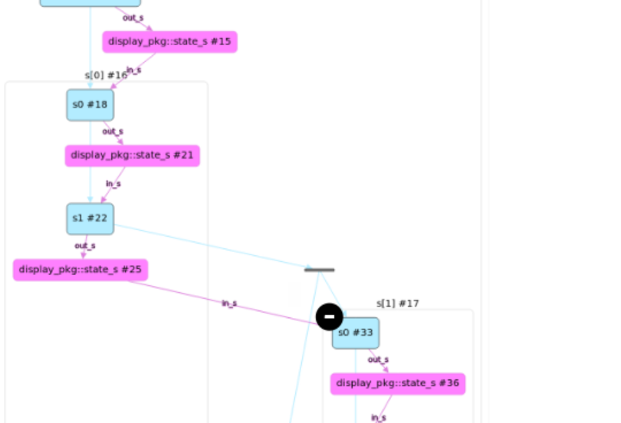
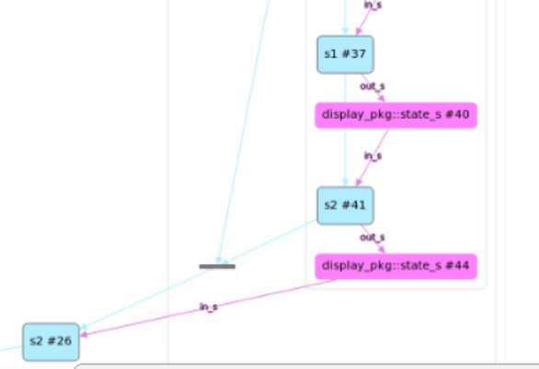
Scheduling steps interleaved
component display_c {
import display_pkg::*;
pool state_s state_p;
bind sample_state_p *;
action stream_a {
rand int transfer_num;
stream_step0_a s0;
stream_step1_a s1;
stream_step2_a s2;
activity {
s0 with {transfer_num == this.transfer_num;}
s1 with {transfer_num == this.transfer_num;}
s2 with {transfer_num == this.transfer_num;}
}
}
action all_stream_a {
stream_a s[NOF_TRANSFERS];
activity {
schedule {
replicate (i:NOF_TRANSFERS) {
s[i] with {transfer_num == i;} ;
}
}
}
}

Slide 89
Modeling multiple pipelined interleaved streams, where resources are shared when they relinquished from their step
extend component soc_c {
import display_pkg::*;
pool [6] display_engine_step0_r display_engine_step0_p;
bind display_engine_step0_p *;
pool [4] display_engine_step1_r display_engine_step1_p;
bind display_engine_step1_p *;
pool [5] display_engine_step2_r display_engine_step2_p;
bind display_engine_step2_p *;
action all_ip_all_tasks_a {
activity {
schedule {
replicate (i:DISPLAY_STREAMS) {
do display_c::all_stream_a with {comp == pss_top.soc.display[i];};
}
}
}
}
}
}
Pools of DISPLAY resources can be shared over multiple controllers, when a controller relinquishes a resource, another can acquire, no need to wait for the completion of the stream that had the resource.
‹#›

Slide 90
Applying resource constraints from display example to generic stream interleaving pipeline pattern
package display_pkg {
enum pipe_kind_e {VID, GFX};
extend resource display_engine_step0_r {
rand pipe_kind_e kind;
constraint {
kind == VID -> instance_id in [0..2];
kind == GFX -> instance_id in [3..5];
}
}
enum overlay_kind_e {LCD0, LCD1, LCD2, TV};
extend resource display_engine_step1_r {
rand overlay_kind_e kind;
constraint instance_id == int(kind);
}
enum interface_kind_e {DSI_A, DSI_B, DP_A, DP_B, HDMI};
extend resource display_engine_step2_r {
rand interface_kind_e kind;
constraint instance_id == int(kind);
}
}
extend action display_c::stream_a {
constraint pipe2overlay_c {
s0.engine_l.kind == GFX -> s1.engine_l.kind != LCD0;
s0.engine_l.kind == VID -> s1.engine_l.kind != LCD1;
}
constraint overlay2interface_c {
s1.engine_l.kind == LCD0 -> s2.engine_l.kind == DP_A;
s1.engine_l.kind == LCD1 -> s2.engine_l.kind in [DSI_A, DSI_B];
s1.engine_l.kind == LCD2 -> s2.engine_l.kind in [DSI_A, DSI_B, DP_B];
s1.engine_l.kind == TV -> s2.engine_l.kind in [DP_A, HDMI];
}
}

Slide 91
Coverage of interleaving scenario
covergroup {
step0: coverpoint in_s.step0_b;
step1: coverpoint in_s.step1_b;
all: cross step0, step1
{
ignore_bins interleaving = all with (((step0 | step1) != step0)
);
}
} cg;
move | wait
1111 | 0000
1111 | 0011
0011 | 0001

Slide 92
SOC Scenarios combining pipeline tasks from multiple IPs
component riscv_c {
ip0_c ip0;
ip1_c ip1;
action all_ip_all_trx_a {
activity {
parallel {
do ip0_c::all_simple_a;
do ip1_c::all_simple_a;
}
}
}
}
Interleaving scenarios of different IP run independent of each other

Slide 93
Chaining all Pipelining
action simple_a {
input buf in_buf;
output buf out_buf;
rand int transfer_num;
simple_step_0_a s0;
simple_step_1_a s1;
simple_step_2_a s2;
activity {
s0 with {transfer_num == this.transfer_num; }
s1 with {transfer_num == this.transfer_num; };
s2 with {transfer_num == this.transfer_num; };
}
}

Slide 94
Generated Graph Example
Init_a
buf
state_s
move:000
wait:000
sc:0
NOF_TRANSFERS=3
NOF_TAGS=2
state_s
move:000
wait:000
sc:0
NOF_TRANSFERS=3
NOF_TAGS=2
simple_step_0_a
tag_id:0
simple_step_0_a
tag_id:0
state_s
move:001
wait:000
sc:1
state_s
move:001
wait:000
sc:1
simple_step_0_a
tag_id:1
simple_step_0_a
tag_id:1
state_s
move:011
wait:000
sc:2
state_s
move:011
wait:000
sc:2
simple_step_1_a
simple_step_1_a
state_s
move:011
wait:001
sc:2
state_s
move:011
wait:001
sc:2
buf
simple_step_1_a
simple_step_1_a
state_s
move:011
wait:011
sc:2
state_s
move:011
wait:011
sc:2
simple_step_0_a
tag_id:1
simple_step_0_a
tag_id:1
state_s
move:111
wait:011
sc:3
state_s
move:111
wait:011
sc:3
simple_step_1_a
simple_step_1_a

Slide 95
Summary of Chaining and Interleaving Scenarios
Showed how to take IP models and simply apply to SOC, using the chaining example.
Showed how to get fine grained control over interleaving /pipelining stream scenario using schedule together with state flow object.
For interleaving/pipelined stream example, showed how PSS declarative constructs are used and how it would be very difficult or impossible to do it declaratively in SV.
Showed how easy it is to combine different types of SOC scenarios, for example combining chaining and interleaving/pipelining stream scenarios.

Slide 96
Agenda
Where are we here?
Display Controller Example
Memory & Cache Examples
SoC Level Example
Summary: IP to SoC & Post-Silicon

Slide 97
PSS Summary
Formal IP test space specification
Can be created early in IP lifecycle as a documentation of test space
Formal system scenario documentation
Can be created at SoC architecture definition time
Quick composition of complex multi-IP test scenarios
Automated handling of state, resource and scheduling dependencies in test
Partial test scenario
Create test without deep understanding of complete SoC
Test generation time and runtime coverage reports
Coverage for power state transitions, functional modes etc.
Tests are portable
From IP (UVM/SystemC) to embedded processor on SoC to post-silicon

Slide 98
Formal test space specification
Display controller base PSS model defines its test space completely
Workhorse action can be used to build IP or SoC test scenarios
Rudimentary knowledge of display needed to create SoC tests
component display_c {
pool [6] pipe_r pipe_pool;
pool [4] overlay_r overlay_pool;
pool [5] interface_r interface_pool;
pool display_state_s display_state;
// Initialization
action init_display {
output display_state_s display_state;
}
action display_base {
input display_state_s display_state;
constraint display_state.initial != true;
}
// Workhorse action
action process_stream : display_base {
lock pipe_r pipe;
lock overlay_r overlay;
lock interface_r interface;
}
}
extend component pss_top {
display_c display_0;
display_c display_1;
action soc_scenario {
activity {
schedule {
do display_c::process_stream;
do display_c::process_stream;
};
};
};
}

Slide 99
Conclusion
PSS is a declarative, formal, portable test specification leading to automated generation of platform-specific tests
PSS 2.0 is here and production ready
Great ideas for PSS 2.1 and beyond
Come join us to shape the PSS future

Slide 100
Thank you! Any questions?

