Slide 1
Obscure face of UVM RAL: To tackle verification of error scenarios
Subhash Pai, Analog Devices
Lavanya Polineni, Analog Devices

Slide 2
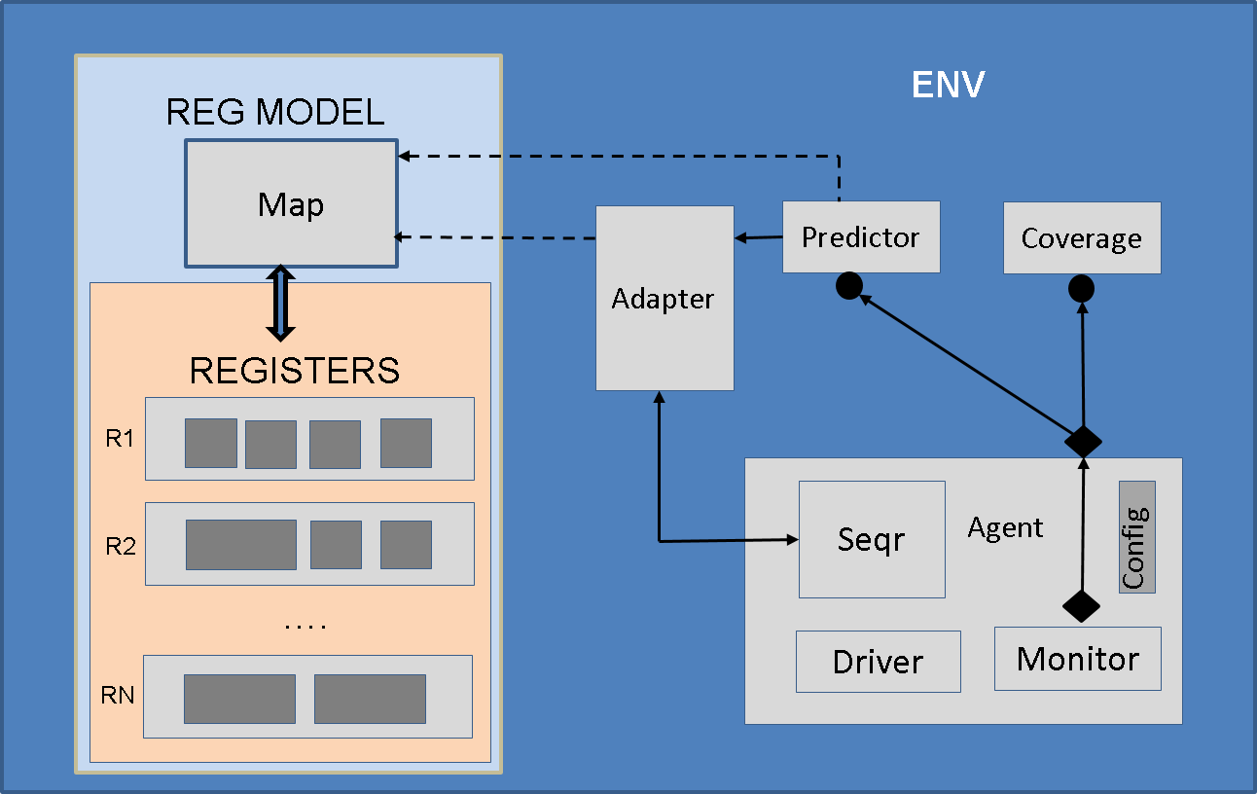
Register Verification
Access all DUV registers
Might need to provide additional data e.g. device address
Error scenarios like
Write into read only registers
Access non-existent registers
Protocol violations e.g. framing error
Device in error state

Slide 3
UVM RAL
UVM RAL advantages
Allows protocol independent test cases
Easy handling of register changes
Standardized way to access registers
Use of UVM RAL for typical non-error scenarios is well understood and is widely used.

Slide 4
Register Verification
Use of UVM RAL for error scenarios is not well understood
How do we model DUV response for error scenario?
How do we pass error information via UVM RAL API to driver?
Error stimulus has two traditional approaches
Transaction/Sequence item based
Configuration Object based
DUV response for error is normally handled with custom register models

Slide 5
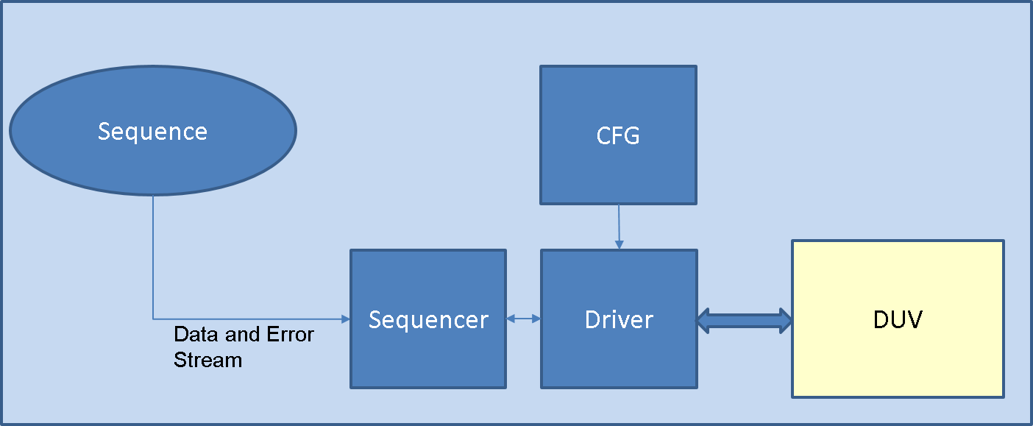
Transaction Method for Error Stimulus
Use transaction based sequence for register error scenarios
Sequence item captures reg addr, data and error but has a major limitation: No UVM RAL
Code maintenance issues
Difficult to re-use/Portability issues

Slide 6
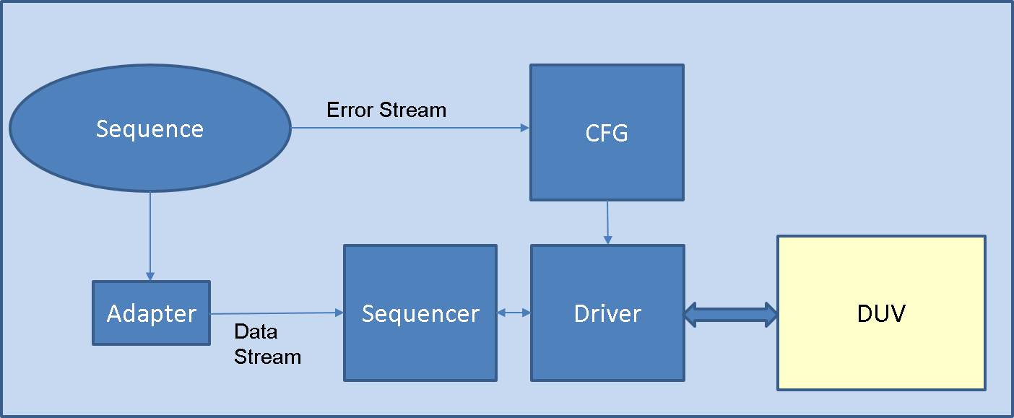
Config Method for Error Stimulus
Use configuration object for passing error.
User can use UVM RAL API for error cases.
Use of Config object for passing error has drawbacks
Mixing of Concerns
Config object meant to capture static or quasi-static data .Error is dynamic in nature.
Transaction data now present in two streams viz. sequence item and configuration object
Mapping these two streams gets complicated for complex protocols e.g. pipelined and buffered transactions

Slide 7
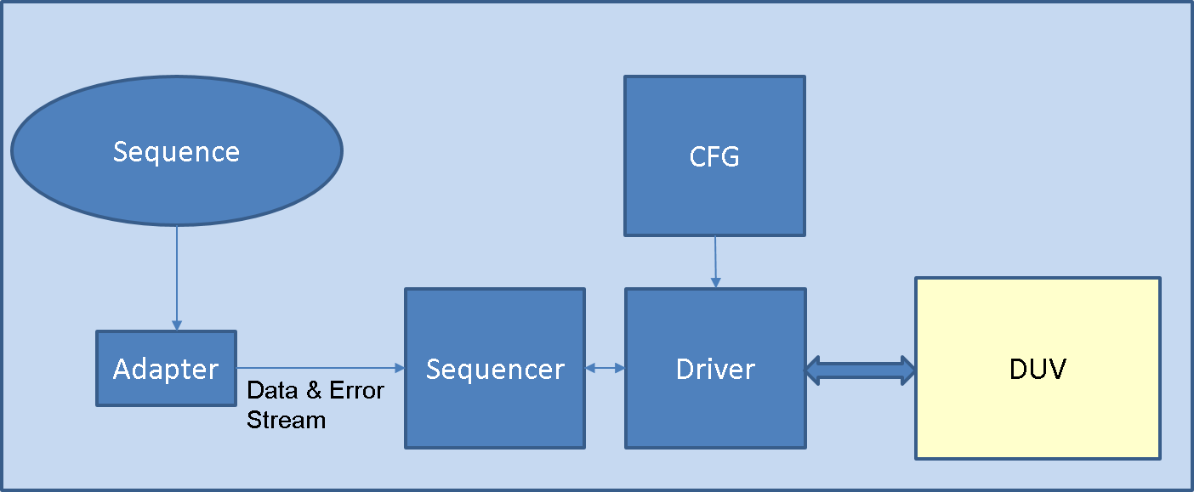
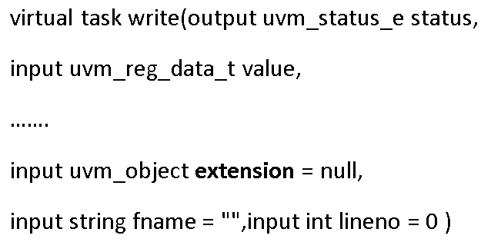
Extension Approach
Use extension argument of UVM RAL (read/write/update)
Extension argument used to transfer protocol specific data for RAL
Use the same mechanism to pass error information
Advantages
Use of RAL API allows easy code maintenance, re-use
Error and transaction data is captured in a single stream

Slide 8
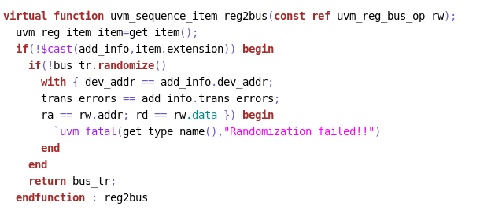
Extension Argument
Error passed as extension
Extension arg received by adapter
Error info passed to the seq item

Slide 9
Comparison of Error Stimulus
Feature | Seq Item | Config Obj | Extension Arg
UVM RAL API | No | Yes | Yes
Single Stream for Data and Error | Yes | No | Yes
Separation of Concerns | Yes | No | Yes
Stimulus

Slide 10
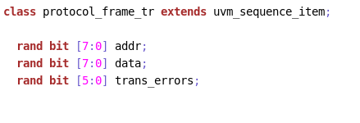
Capturing Error Info
Use of enum for error capture would limit user to single type of error
Use multiple variables each representing one type of error
Or
Create a single variable, each bit representing one type of error
Each bit represents one type of error
Different types of errors

Slide 11
DUV Response for Error
DUV Error Response
DUV ignores transaction and no response is sent
DUV ignores transaction and error response is sent
DUV accepts transaction and error response is sent
Maintain old reg value
Use transaction value

Slide 12
Modeling DUV Error Response
When DUV response is UVM_NOT_OK, UVM RAL resets the mirrored value of reg fields to zero.
No longer can rely on RAL model to perform data comparison.
Changing UVM library code to handle this limitation is highly undesirable
Creation of custom register models is cumbersome, error prone and needs careful review
This issue can be resolved with proposed UVM register callback approach!

Slide 13
Callback Approach for Error Modeling
No need to change UVM library
Needs minimal change to verification environment
Callbacks are often used to model quirky registers
Derive callback from uvm_reg_cbs
Override post_predict function
Register callback with fields
Update callback properties based on Txn Error

Slide 14
Callback Fields
Callback will have two fields
error_condition
update_reg

Slide 15
Callback Definition
Error condition
field retains
previous value
field value updated
to bus value

Slide 16
Callback Registration
Callback instantiation
Callback registration

Slide 17
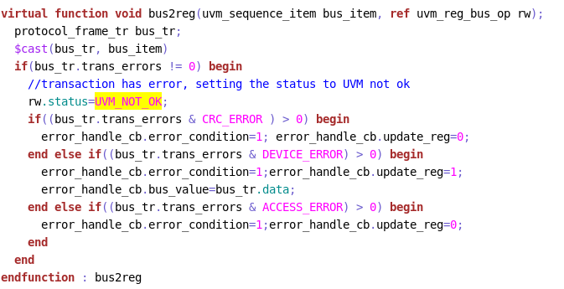
Updating Callback
Error transaction
No response from DUV, maintain old value
DUV sends err response ,
updates to DUT value
Violation of access policy, maintain
Old value

Slide 18
Summary
We recommend use of UVM RAL for Error Scenarios
Use extension argument for Error Stimulus
Use callback for modeling DUV response
Greatly reduces effort for verification of reg error scenarios
No need to modify UVM library code or write custom models
Easy to integrate into existing environment
Callback code is generic and easily Re-usable for any protocol

Slide 19
Questions

