Slide 1
Novel approach for SoC pipeline latency and connectivity verification using Formal
Deepak Mohan, Senior Engineer,
Senthilnath Subbarayan, Senior Staff Engineer, Sandeep Kumar, Principal Engineer
Qualcomm

Slide 2
Agenda
Motivation
Introduction
Problem Statement
Proposed Methodology
Implementation
Implementation Advantages
Implementation Results
Conclusion
Q & A

Slide 3
Motivation
Increase in design size and complexity.
Short Time to Market.
Overall verification window should be reduced.
Verification flow should be scalable.
Critical bugs should be caught at the earliest.
SOC complexity
Gate count
2019
2020
2021
2022
Gate Count vs Time

Slide 4
Introduction
What are pipelines?
Design elements introduced between SoC blocks to meet the timing requirements based on physical design feedback.
Key pipeline specifications are,
Pipeline latency (Delay)
Finite State Machine ( based on AHB, AXI etc ..)
PIPELINE
BLOCK A
BLOCK B
SoC
Interface

Slide 5
Problem Statement
Latency verification for SoC pipelines is done during late stages of functional verification and thus right shifts critical bugs.
Sideband signal coverage of SoC pipeline is also done during late stages of functional verification.
For large number of SoC pipelines, latency verification and sideband signal coverage at early stages of DV can be laborious and time consuming.
Manual work is not scalable and prone to errors.

Slide 6
Proposed Methodology
Proposed approach consist of
Automated Pipeline Utility which consumes connectivity, pipeline specification and generates CSV files , clocks, resets, and the constraints required for each pipeline.
Formal connectivity checker application.
Pipeline specification (.xls)
Connectivity CSVs in required format
Automated Pipeline Utility
Formal Connectivity checker application
Clock, resets and any other constraints required for pipeline
Connectivity specification(.xls)
Commands file with required tool options

Slide 7
Implementation
Pipeline SPEC
Extracts the pipeline specification data.
Pipeline Specification
Connectivity SPEC
Extracts the connectivity information.
Generates CSV
Generates CSV files using the information extracted above and interface specification.
Connectivity Specification
Generates constraints
Generates any constraints based on design hierarchy, if required, in specific format.
Generates clocks and resets
Generates clock and reset information for the formal connectivity checker, in specific format.
Output CSV
Automated Pipeline Utility

Slide 8
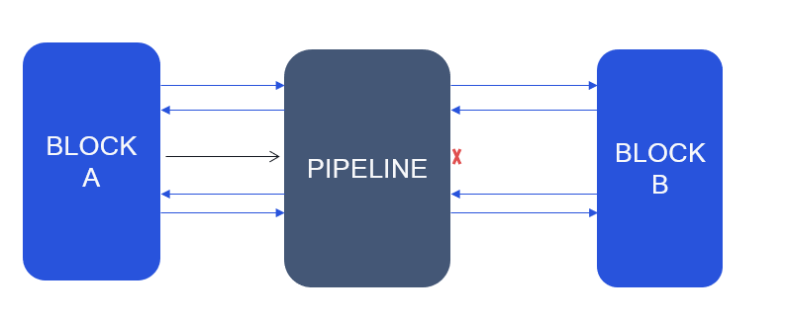
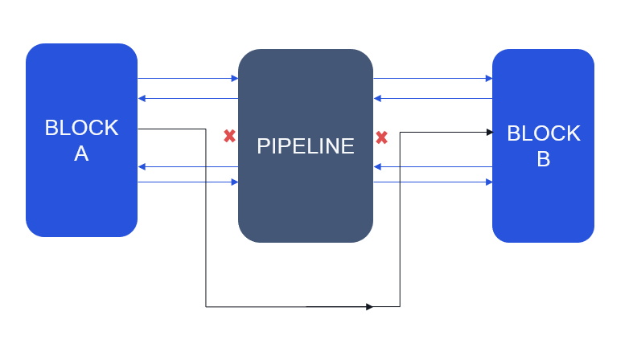
Implementation Advantages
Early pipeline latency verification.
Early sideband signal coverage.
Detects open ports in pipeline connectivity.
Detects signals which are not passing through the pipelines.
Connectivity verification through pipeline.
Open connections
Connections not going through pipeline

Slide 9
Implementation Result
Developed utility enables reduced verification environment setup time.
Enables early detection of pipeline latency and connectivity bugs in multiple projects.
Further, the utility is scalable on both dimensions :
horizontally : w.r.t number of pipelines,
vertically : Different levels of design implementation.
* Assuming 100-200 SoC pipelines

Slide 10
Implementation Result : An Example
If not caught early, this issue will be only found during performance verification stage (late stage of functional verification).
Pipeline based on AXI4 Protocol
Processor
Awqos
Awqos (OPEN)
Awqos
(TIED OFF)
NOC
Awqos

Slide 11
Conclusion
SoC pipeline latency and connectivity verification flow using Formal technique enables left shifting of,
Pipeline latency verification,
Pipeline sideband signal coverage.
The proposed flow is scalable across design hierarchies.
Automated Utility reduces the environment setup time with a single click deployment.
Removes scope of manual errors in generating connectivity checkers.
Overall, the proposed flow reduces time/effort with increased verification quality.

Slide 12
Thank you. Questions ?

