Slide 1
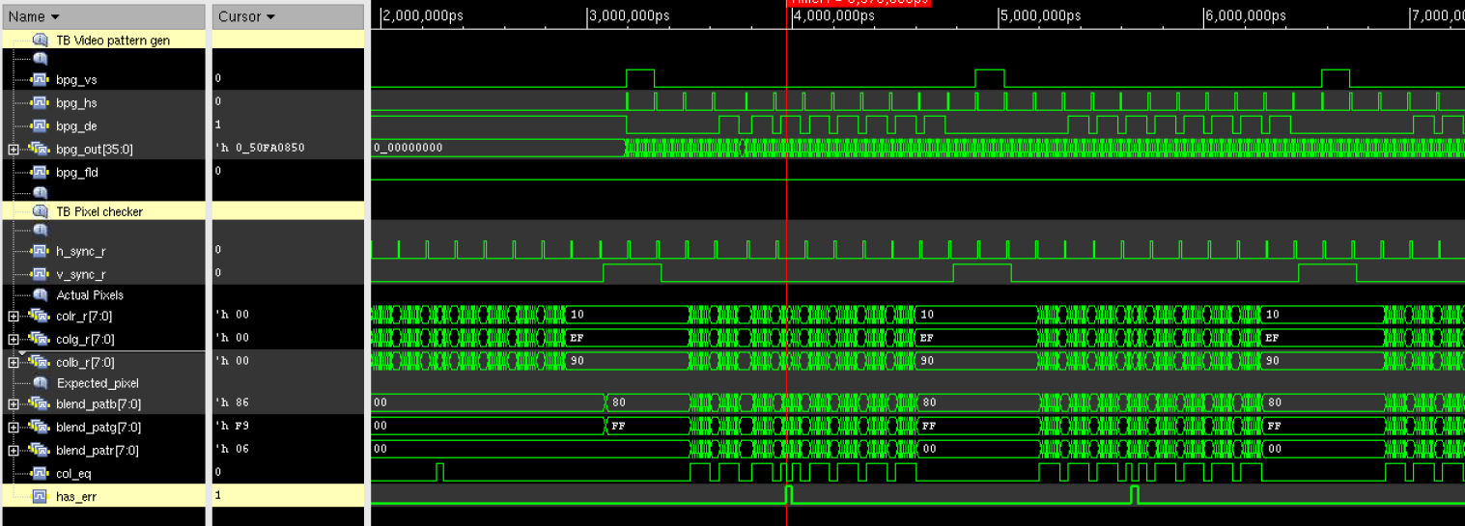
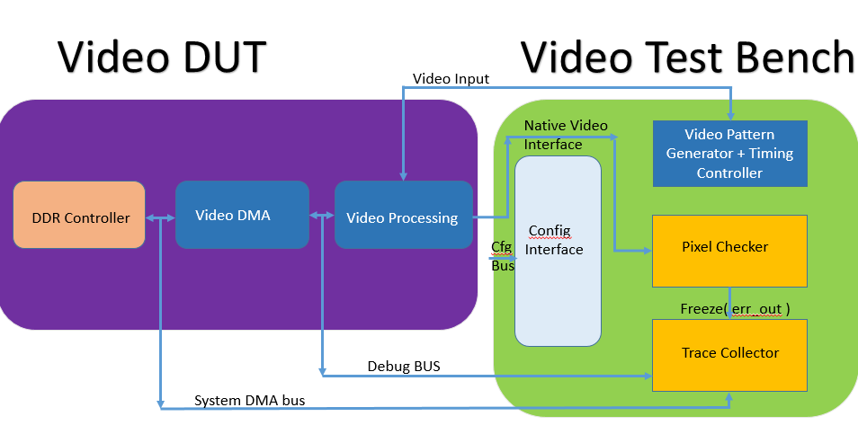
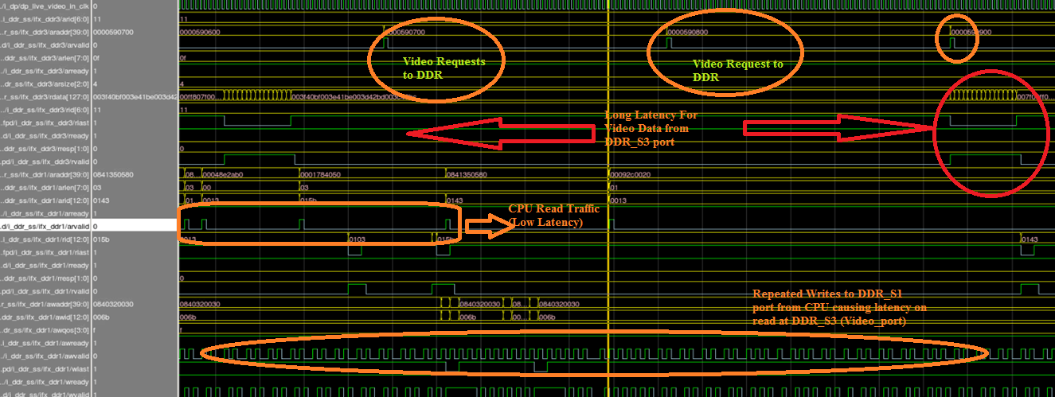
Methodology for Hardware Software Co-verification of Video Systems on Pre and Post Silicon
Vinesh Peringat, Balajee Premraj, Venkatesh Merugu
XILINX
INTRODUCTION
OBJECTIVES
Video Systems’ HW-SW Co-Validation is highly critical on Emulation platform to make sure that the SoC thus designed would meet its intended “end” application.
The main challenge in Functional Verification is “time” taken to execute Video tests on simulation platform and the lack of capability to produce the real world application scenarios.
Problems with traditional Display Systems Validation:
Test bench need to save huge amount of Video frames needing lots of memory(GBs of data) to do offline frame checking.
Creating pixel accurate IP model results in increased complexity of test bench, and is a duplication for IP Verification effort.
“Frame checksum/CRC” option just helps to identify whether there is a problem or not, but doesn’t help really to root cause the defect.
Creating custom loop back interface to memory (for Capture/Display interface) option violates the use-case validation if the end goal is just to capture/display frames.
Visual check by connecting a Display monitor is less effective as only few resolution(s) can be checked, and the data (pixel) integrity is not checked.
1. Simple and Efficient Test bench on Emulation Platforms (and Silicon) to find System level RTL defects, “repeatable failures” and quick root cause of defects.
2. Doesn’t need huge memory to store Video Frames (not even to the extent of storing Video lines) to do Pixel accuracy checking(“Idea is just to do on the fly Video Processing and Checking”).
3. “Approximate” pixel checking approach is used to make sure that the data integrity is intact without much loss of coverage. (Human eye is less sensitive to color changes in “LSBs” and this proves to be very effective for YCbCr frames).
4. Ideal platform for use-case validation (or) Application verification, where in systems are stressed with Concurrent chains (several CPUs and DMAs) operating in tandem.
5. Testing Frame buffer switching, testing Video arithmetic engines(Alpha blend, CSC, pixel scaling etc.), re-generating a specific system level traffic condition to replicate a failure are the “interesting” advantages that this methodology explores.
FLOW DIAGRAM
RESULTS
The System thus proposed has the entire SoC design emulated on XILINX FPGAs or Mentor Graphics Veloce Emulation platform(or Silicon with FPGA Test Bench) along with Video Test bench shown as below.
Test bench components include a Pixel checker, Video Pattern Generator and Timing Controller, a Configuration interface and Trace collector (to store snapshot of interesting signals when pixel errors are detected).
Idea is same Test bench components can be reused for “silicon regression testing” !
Finally, the concurrent threads, (which are the building blocks for use-cases) are developed and executed on the target system using actual software (driver APIs).
RESULTS
CONCLUSION
Scenario:
- Four CPUs (ARM Cortex A53s) are executing random instructions from DDR.
- System DMA/SD/Ethernet masters reading and writing to DDR.
- Video stream @ resolution 1080P @60fps.
Once in a while, the Video access to DRAM sees more latency and display FIFO underflows, thereafter, the Video Test bench records pixel errors with interesting traces. The waveform thus recorded shows that stream of repeated writes on DDR_S1 port blocks DDR_S3 port. (Key info to system designer is to tune QoS to prioritize the Video reads to DRAM to prevent such underruns)
Key Takeaways:
Focus on Display Use case Validation and avoid duplicating IP Verification effort.
Software (APIs) are co-verified with actual Hardware on Pre-silicon environment.
3. Find system level bugs like Display Underruns, Overflows, deadlocks and Livelocks
etc. in presence of heavy CPU and DMA traffic.
Measure Quality of Service(QoS) for Video traffic on DDR/ High speed memory and
identify potential system bottlenecks.
Future work: Deployment on Non - Video related use cases like Audio/USB/Ethernet.
REFERENCES
US 8020126 (Links and chains verification and validation methodology for digital devices). http://www.google.co.in/patents/US8020126
Publication on “Streamlining HW-SW Architecture Development, Verification and Validation” from Qamrul Hasan 2012 IEEE 11th International Conference.
VELOCE Emulation systems with Isolve Multimedia Analyser from Mentor graphics. http://www.mentor.com/products/fv/emulation-systems/
Xilinx’s ASIC prototyping and emulation methodology. http://www.xilinx.com/applications/asic-prototyping.html
Authors can be reached at (vineshp, balajee, vmerugu)@xilinx.com

