Slide 1
Making Formal Property Verification Mainstream: An Intel® Graphics Experience
M Achutha KiranKumar V
Bindumadhava S S
Abhijith A Bharadwaj

Slide 2
AGENDA
Why?
Need for FV Deployment Drive
How?
VPG FV Deployment Planning and Execution
What was Achieved?
Results of FV Deployment

Slide 3
Need of FV Deployment Drive
Formal needs no introduction:
Established 100% state space coverage
NO/Minimal Bug Escapes
High Verification Confidence
Testbench Free Verification
Various dedicated Apps for Specific problems:
RTL Equivalence Sequential Check, Connectivity, X verification, Security, Low power, etc
Still…
Why are the FV adoption rates are still low?
Why was the dedicated FV deployment drive in VPG needed?

Slide 4
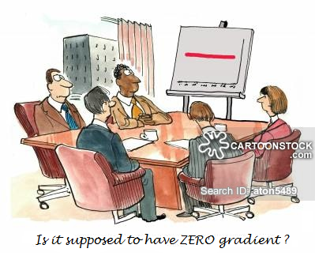
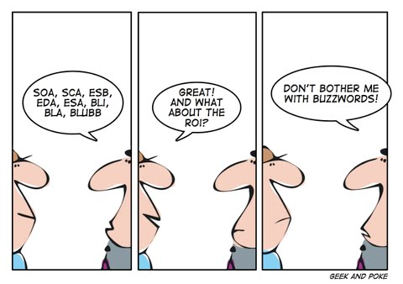
Need of FV Deployment Drive
Common FV Roadblocks:
FEAR:
MYTH: FV is only meant for PhDs
MYTH: Will drain my time/resources
No Progress Metrics
No intermediate check-points
ROI:
TRUTH: What eventually matters?: ROI
How to compare with DV results?

Slide 5
AGENDA
Why?
Need for FV Deployment Drive
How?
VPG FV Deployment Planning and Execution
What was Achieved?
Results of FV Deployment

Slide 6
VPG FV Deployment Drive

Slide 7
VPG FV Deployment Drive

Slide 8
VPG FV Deployment Drive:
Survey
Immediate needs for most of the users:
Automated setup/property_coding
Assertion Libraries for common design components
Dedicated Trainings
Local Contact Points

Slide 9
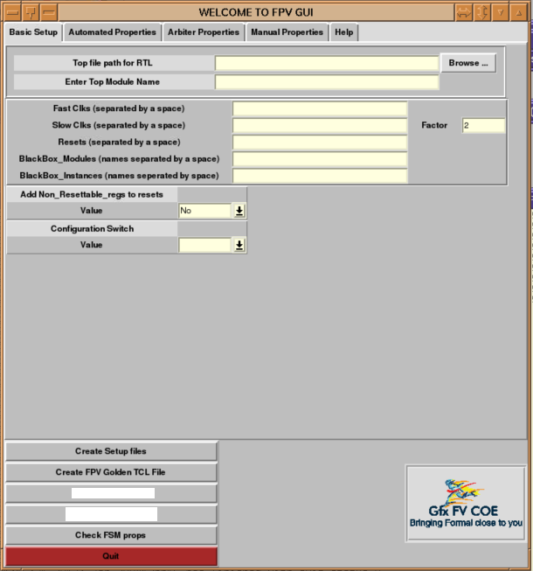
VPG FV Deployment Drive: Preparation Phase
GUI creation
Provided a quick setup
interface to new users
One stop shop for all formal
flows
Easy way of generating all
collaterals for formal

Slide 10
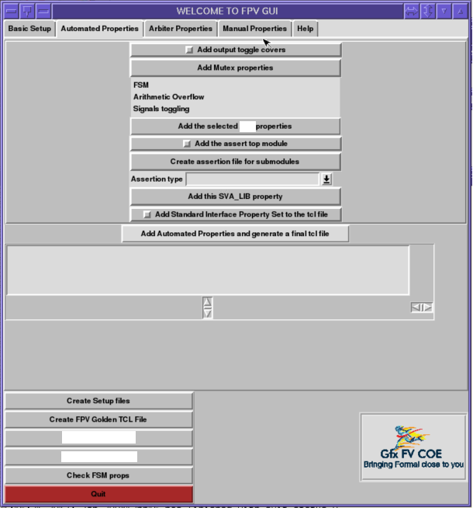
VPG FV Deployment Drive: Preparation Phase
Cookie-cutter Property
Templates
Automated properties

Slide 11
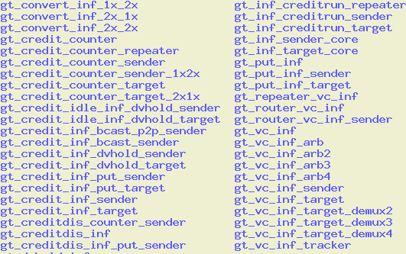
VPG FV Deployment Drive: Preparation Phase
Cookie-cutter Property
Templates
Automated properties
Standard Interfaces

Slide 12
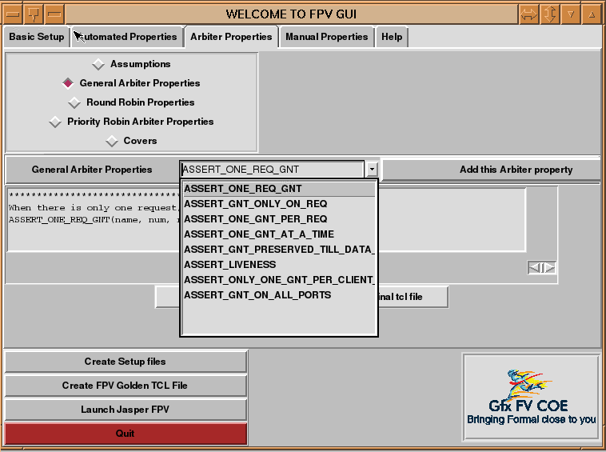
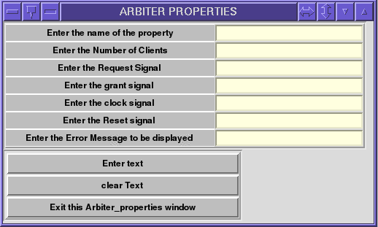
VPG FV Deployment Drive: Preparation Phase
Cookie-cutter Property
Templates
Automated properties
Standard Interfaces
Arbiter Properties

Slide 13
VPG FV Deployment Drive

Slide 14
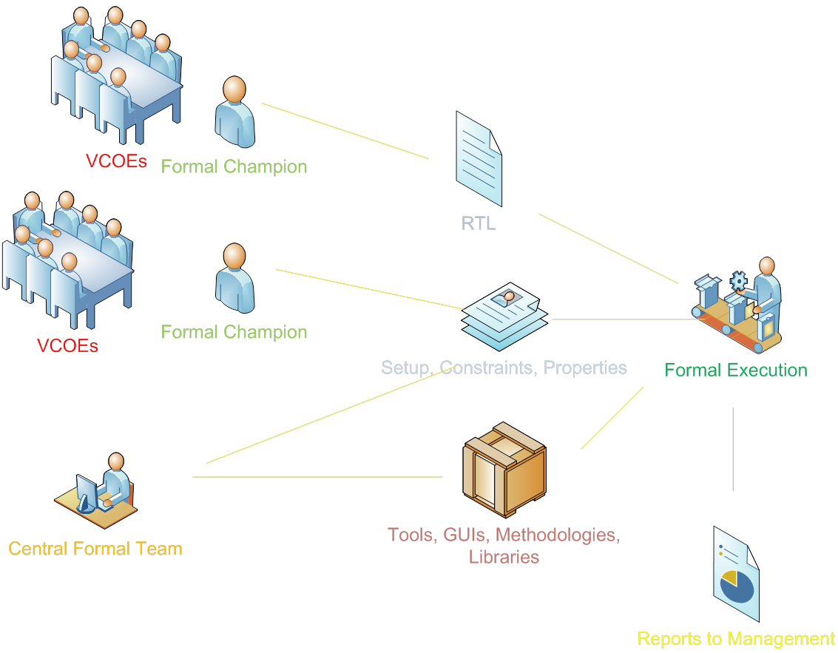
VPG FV Deployment Drive: Training Phase
Identifying Local Experts
FV champion from each cluster
Immediate support
Setting-up Self Help Materials
Dojos
FAQs
Training Dungeons
2-week rigorous training

Slide 15
VPG FV Deployment Drive

Slide 16
VPG FV Deployment Drive: Test Planning Phase
Clear Goal Definitions
Assigning FV problem to correct category
FV Problem
Full Proof
Only Bug Hunting
Equivalence Check

Slide 17
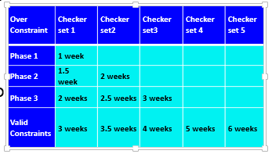
VPG FV Deployment Drive: Test Planning Phase
Progress Continuum
Defining measurable sub-goals
Allows progress to be graded w.r.t. time
Decided % completions to be achieved for each Val Milestone

Slide 18
VPG FV Deployment Drive: Test Planning Phase
Activity Ownership
Designer needs to monitor FV completion for his unit

Slide 19
VPG FV Deployment Drive

Slide 20
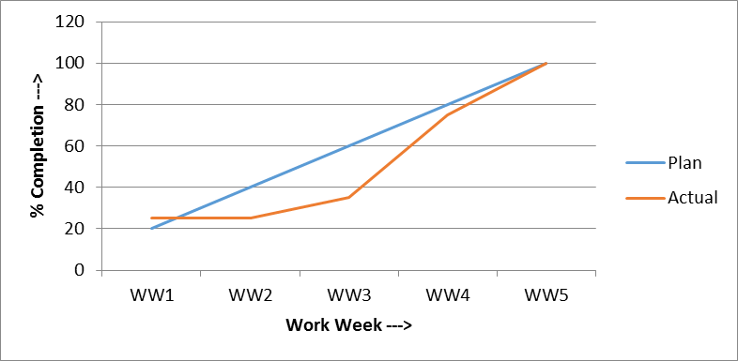
VPG FV Deployment Drive: Execution & Closure
Execution and Tracking
Round-the-clock support extended to FV owners after dungeons
Weekly FV progress tracked and published
Deep Bug Exploration
Abstractions, different engine settings
Lots of Covers added
Coverage and Closure
Line and branch coverage obtained
Properties added for holes

Slide 21
VPG FV Deployment Drive

Slide 22
VPG FV Deployment Drive: Communicate Results
ROI calculation standard was established
ROI numbers calculated for activity and compared against DV
Parameter | Depiction
Number of engineers worked on the problem | NE_F
Average bandwidth/engineer | BW_F
Number of weeks spent on effort | Ww_F
Total time spent in hours | Ts_F = Bw_F ª Ww_Faª 40^{b}
Project schedule in weeks | Pw_F
Scaled engineering costs | CE_F = Ts_F/(Pw_F ª 40)
Machines used for computations | Mc_F
Runs/week | Rw_F
Number of days of run | Dw_F
Total machine-days/week | Tm_F = Mc_F ª Rw_F ª Dw_F
Project machine-days/week | Pm_F
Scaled machine costs | Cm_F = Tm_F/Pm_F
Coverage (% cover points hit) | Covtot_F
Bugs found by the method | NB_F
ªAssuming eight hours/day for a five-day work week = 40 hours/week. ^{b}Machine runs are not limited to a working day but for the whole week
ROI Parameter | Formal | Dynamic | Relative
Bugs% found by FV | NB_F/(NB_F+NB_D) | NB_D/(NB_F+NB_D) | NB_F/NB_D
Total coverage achieved | Covtot_F | Covtot_D
Bug - engineering cost ROI | BEC_F = NB_F/CE_F | BEC_D = NB_D/CE_D | BEC_F/BEC_D
Bug - machine cost ROI | BMC_F = NB_F/Cm_F | BMC_D = NB_D/Cm_D | BMC_F/BMC_D
Coverage - engineering cost ROI | CEC_F = Covtot_F/CE_F | CEC_D = Covtot_D/CE_D | CEC_F/CEC_D
Coverage - machine cost ROI | CmC_F = Covtot_F/Cm_F | CmC_D = Covtot_D/Cm_D | CmC_F/CmC_D

Slide 23
VPG FV Deployment Drive

Slide 24
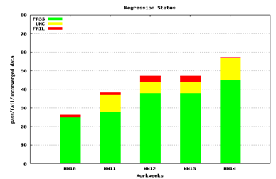
VPG FV Deployment Drive: Check-In & Regress
FV cannot be done once & forgotten
RTL in constant churn
Regressions to be enabled to find bugs due to changes

Slide 25
AGENDA
Need for FV Deployment Drive
Why?
VPG FV Deployment Planning and Execution
How?
Results of FV Deployment
What was Achieved?

Slide 26
Results of VPG FV Deployment
Quality of reception:
80+ engineers became FV experts
15 bugs caught within 2 weeks of activity
It uncovered many scenarios in the beginning for which the Fulsim tests came very late. it has given very high confidence that new RTL has achieved the original health.
FV is awesome; I write code, run FV before even committing it to my local repo, and get it clean.
If it wasn't for this tool, I'd be building micro-testbenches before the ULT is ready.
FV is the prime mode of validation for one of my unit. While DV gave me a bill of 6-8 weeks, we verified all the DCN changes in less than 2 weeks using FV
Found couple of dozen bugs even before DV was up and helped clean the RTL
On a FV Quality bug hit:
Hitting this bug in functional random env would have taken a long time and the bug is fatal enough to cripple the feature.
Achutha KiranKumar V M, Intel Corp.
26

Slide 27
Results of VPG FV Deployment
Quality of Bugs:
85+ bugs caught in 12 weeks (activity was started after half way through DV drive)
Most of the bugs caught fell in corner-case category
A
B
32-bit Internal Counter (CI)
If CI = 32’h8001_000; ABBB seq at I/P received
|-> CO = (CI – 2)
Expected Value = 32’h8000_FFFE
CO
Actual Value = 32’h8001_FFFE

Slide 28
Results of VPG FV Deployment
ROI:
Weighted ROI of 220x compared to DV
Some activities gave as much as 138x w.r.t. engg costs; 3692x w.r.t. machine costs

Slide 29
CONCLUSION
FORMAL VERIFICATION IS NOW FORMALLY IN THE PROJECT!!

Slide 30
Questions

