Slide 1
MIPI M-PHY Analog Modeling in verilog-AMS (Wreal) and verification using SV/UVM-MS methodology
Mallikarjuna Reddy Y, Project Lead, T&VS
Venkatramana Rao K, Sr Engineer, T&VS
Somanatha Shetty A, Delivery Head, T&VS

Slide 2
AGENDA
INTRODUCTION
MIXED-SIGNAL VERIFICATION
ANALOG BLOCKS MODELING
M-PHY PURPOSE AND FEATURES
PLL CASE STUDY
M-PHY END-TO-END VERIFICATION
ISSUES AND CHALLENGES
RESULTS
REFERENCES

Slide 3
INTRODUCTION
Need for mixed-signal designs for consumer products growing rapidly
Smart phones,
LEDs (TVs, bulbs etc.,)
Digital cameras and watches
Storage devices
And other High end technology devices
Mixed signal designs verification and time to market are becoming more and more challenging

Slide 4
Mixed-Signal Verification
Mixed-signal verification involves many different levels of abstraction
Transistor-level simulation with Spice remains the gold standard for analog IP verification
Provides high accuracy
Very slow until extremely selectively
To achieve reasonable simulation speeds, mixed-signal teams employ analog behavioral modeling
five to 100 times faster than Spice
The actual speedup varies widely depending on the application and the level of detail in the model

Slide 5
Mixed-Signal Verification Contd..
As design complexity increases,
The cost of simulations increases in a non-linear fashion
For full-chip verification, the cost becomes too high (prohibitive)
It is no longer possible to meet all verification goals.
Results in chip re-spins and delays.
The block verification process
Does not cover possibilities, when the block is integrated in the SoCs.
In the absence of top-down verification plan, these errors typically caught at the later stages of verification which further impacts time to market delay.

Slide 6
Mixed-Signal Verification Contd..
A mixed-signal simulation involves the following three functions:
solving the analog part of the design using a system of nonlinear differential equations which are continuously varying over time.
Solving the digital part of the design by processing a time sorted collection of events over discrete time intervals
Perform-signal synchronization based on the events and variables owned by either simulations kernel that are in the sensitivity list of the other kernel.

Slide 7
Analog Behavioral Modeling
Verilog-AMS(electrical): A mixed-signal modeling language can be defined for both analog and digital behavior, offering both continuous-time and event-driven modeling semantics.
Verilog-AMS(Wreal): The continuous-time subset of Verilog-AMS, aimed at analog design.
VHDL-AMS: similar in concept to Verilog-AMS, this language provides analog and mixed-signal extensions.
Verilog : Behavioral modeling is also done for analog blocks with limitations.
System Verilog: Extension of verilog with added real data types and other advanced features.
Behavioral Modeling
VHDL
Verilog
VerilogAMS
SV/SysC
VHDLAMS
VerilogAMS electrical
VerilogAMS Wreal

Slide 8
Analog Behavioral modeling Contd ..
The wide range of accuracy and performance that is possible for Verilog-AMS and VHDL-AMS behavioral models.
Pure digital simulation can only represent an analog signal as a single logic value, but it might be sufficient for connectivity checks in mixed-signal SoCs.
Real number modeling (RNM) with the “real” and “wreal” data types, which make it possible to represent analog signal values in digital simulations.
Wreal/RNMs are the most effective way to abstract AMS functionality for full chip simulation.

Slide 9
Analog Behavioral modeling Contd..
Important factor is the effort required to set up a simulation .
Spice simulations run slowly, they’re relatively easy to set up.
The time required to create a high-quality analog behavioral model, however, can range from hours to days, or even weeks.
RNM is restricted to a signal-flow approach, it doesn’t require analog convergence, and there’s no new language to learn.
Consequently, the real/wreal modeling effort is less than that for Verilog-AMS (electrical) or VHDL-AMS.

Slide 10
Analog Behavioral modeling Contd..
Blocks can be modeled at different levels of abstraction.
Verilog-AMS (wreal)/RNM: at a high level
Verilog-AMS (electrical): more intermediate level
Spice netlist from schematics: very low level
Blocks can be combined, using appropriate abstractions, to allow for various level of focus on specific areas of the system or for block-based, macro-based or full-chip verification.
Verification is performed to verify both functional intent and to ensure desired specification and performance levels are being met.

Slide 11
PURPOSE OF MIPI M-PHY
A serial interface technology with high bandwidth capabilities particularly developed for mobile applications
This requires wide bandwidth, low-pin count (serial) and highly power-efficient (network) interfaces
M-PHY is the successor of D-PHY, requiring less pins and providing more bandwidth per pin (pair) with improved power efficiency.

Slide 12
MIPI MPHY FEATURES
Burst mode of operation for improved power efficiency
Multiple transmission modes with
different bit-signaling
clocking schemes for different bandwidth, better power efficiency over a large range of data rates
Multiple power saving modes
STALL, SLEEP, HIBERN8, DISABLED, UNPOWERED
allow optimization of power consumption,
offering different recovery times
Symbol coding (8b10b) for spectral conditioning, clock recovery, and in-band control options for both PHY and Protocol level.

Slide 13
MIPI M-PHY FEATURES Contd..
Multiple transmission speed ranges/rates per BURST mode to
scale bandwidth to application needs
For mitigation of interference problems.
Clocking flexibility: able to operate with independent local reference clocks at each side, but suitable to exploit the benefits of a shared reference clock
Optical friendly: enables
low-complexity electro-optical signal conversion
optical data transport inside the interconnect between MODULEs
Distance: optimized for short interconnect (<10 cm)
Can be extendable to a meter with good quality interconnect
Even further with optical converters and optical waveguides.

Slide 14
M-PHY Block diagram
Digital(RTL)
PLL
TX
RX
CAL
BIAS

Slide 15
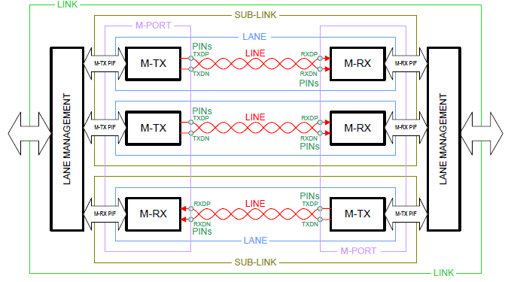
LINK, LANE configuration

Slide 16
Analog PHY
Pure Analog blocks :- PLL, BIAS, Calibration etc., are modeled in Verilog-AMS
TX
PLL
RX
CAL
BIAS

Slide 17
PLL Block (Stand-alone verification)
Mphy_clk2
Mphy_od
mux
REF_CLK
Input divider
(PLL_M)
PFD
CP&FILTER
VCO
CLK0
Feed Back divider
(NPC+NSC)
Pre divider
(PRE_FDIV)

Slide 18
PLL CASE STUDY
All internal blocks are modeled in Verilog AMS (Wreal)
Critical Blocks were PFD, CP&FILTER, VCO
Mapping the equivalent voltage value for the UP and DN signal from the PFD block.
Verified different modes of PLL .
Power down Condition:
When PLL_PDB is low, outputs are reset.
Normal Operation:
In normal operation, PLL_PDB is high

Slide 19
PLL CASE STUDY contd..
All the inputs of the PLL dividers which are in digital were driven/controlled by UVM TB.
Fixed stimulus e.g., Analog stimulus for analog pins were assigned in the uvm tb_top.
Fixed input frequencies were given from UVM Test Bench and verified.
Similarly input frequencies randomly selected in the range 19.2MHz to 104Mhz to get different output range of frequencies.
Different input dividers were selected randomly from UVM TB to get desired frequencies.
For Frequency output: The equation logic was incorporated in the monitor which is further passed to score board to compare the actual and expected, for “pass”/”fail” criteria.

Slide 20
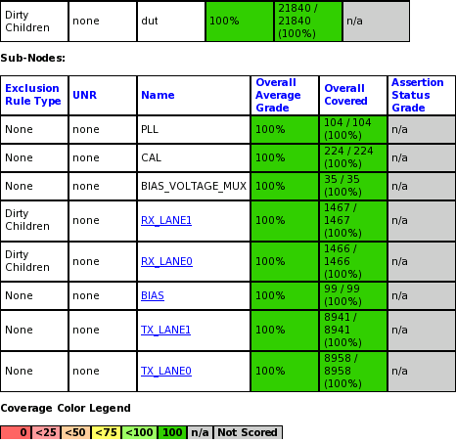
PLL Results
we have achieved 100% functional coverage for stand-alone verification.
We have achieved code coverage close to 100%

Slide 21
End to End Verification
Digital controls were controlled through attribute/ register .
To verify the TX path, transmitted the data after setting the MODE and GEAR through registers from RMMI TX driver and captured the DPDN TX data at the DPDN Agent.
To verify the RX path, setting the MODE and GEAR through registers from RMMI RX driver and the data is transmitted from DPDN driver & RMMI RX agent will capture the data
The data integrity is checked in the scoreboard
Real values are converted to bits ($realtobits)
Real values are propagated as analog signals using uvm_real
HS_BURST and PWM_BURST Transfers were verified

Slide 22
RX, TX transactions
RX_Rmmi
8b/10bi8bit/10bit Decoder
Analog RX
10bit symbol data
TX_Rmmi
8b/10bit Encoder
Analog TX
8bit symbol data

Slide 23
Portion of run script
irun -uvm -TIMESCALE 1ns/1ns -v93 -messages -sv -linedebug -svseed $user_seed -licqueue \
irun -64bit -uvm -timescale 1ns/1ps \
+mixedlan -dpiheader svdpi.h -nowarn TRNEGDEL \
+wreal_res_info \
-wreal_resolution sum \
-access rwc \
-linedebug \
#-f ./flist.f \
-f ../compile/mphy_analog_model_compile_list_WREAL.fl \
-f ../compile/mphy_rtl_compile_list.fl \
-f ../compile/mphy_wreal_tb_compile_list.fl \
+UVM_TESTNAME=$testcase_name \

Slide 24
ISSUES AND CHALLENGES
HS_BURST & PWM_BURST both were enabled simultaneously (which is not recommended), and we could see HiZ on Analog TX where it should be ‘1’ or ‘0’.
Data conversion (8bit/10bit) was not happening properly, issue with 8bit /10 bit encoder, later it was resolved by designer.
Connectivity bug in analog were found by modeling when compared both schematic results and model results.

Slide 25
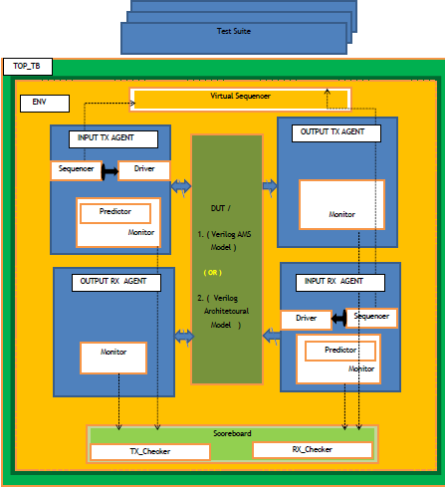
TB BLOCK DIAGRAM

Slide 26
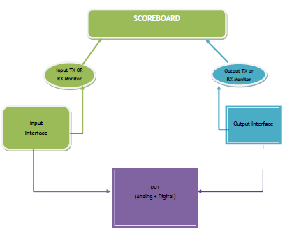
SCORE BOARD DIAGRAM

Slide 27
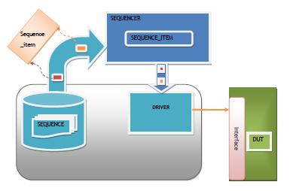
SEQUENCE FLOW

Slide 28
ASSERTIONS/CHECKERS
Example
always@(posedge clk)
assert((1.68 < = top.VDDH_SUPPLY)&& (top.VDDH_SUPPLY<= 1.8))
else $error (“supply > 1.8”)
always@(posedge clk)
assert((0.68 < = top.VDDH_SUPPLY)&& (top.VDDH_SUPPLY<= 0.8))
else $error (“supply > 0.8”)
Support for wreal in PSL: wreal net type represents a real-valued physical connection between structural entities in some vendor implementation of the verilog AMS language.
Expressions involving such wreal type objects that are explicitly declared can appera within PSL assertions in boolean expressions, clocking expressions ans as actual arguments in property and sequence instances.
wreal mywreal1, mywreal2;
reg clk;
// psl assert always ((mywreal1 > 1.68; mywreal2 < 1.8))@(posedge clk);
Analog events in assertion clocking:
verilog-AMS (electrical) analog event functions cross and above are supported as clocking events in PSL assertion.
Electrical sig1, sig2, sig3;
reg a, b;
//psl assert always ((V(sig1)>0.0;a) |=> (V(sig2)<0.3;b)) @ cross (V(sig3)-0.0));

Slide 29
ASSERTIONS/CHECKERS Contd..
Threshold_checker: Checks that analog signal remains within a given high and low threshold. Can perform this check synchronously or asynchronously.
Frequency_checker : Checks that analog signal frequency is within a given tolerance.
Stability_checker: Checks that analog signal remains below or above a given threshold. Can perform this check synchronously or asynchronously.

Slide 30
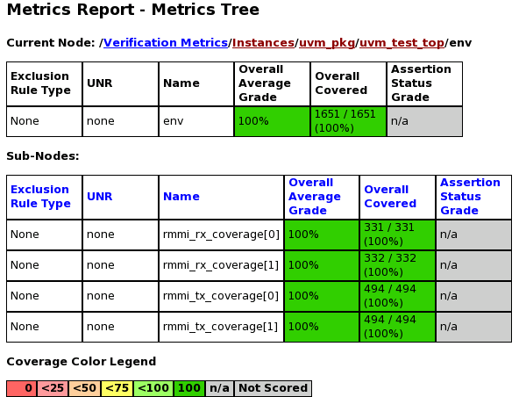
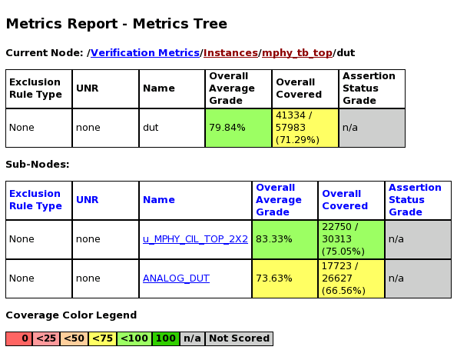
Results
End to end Results:
MPHY_TOP:
code coverage: 79.84%
functional coverage: 100%

Slide 31
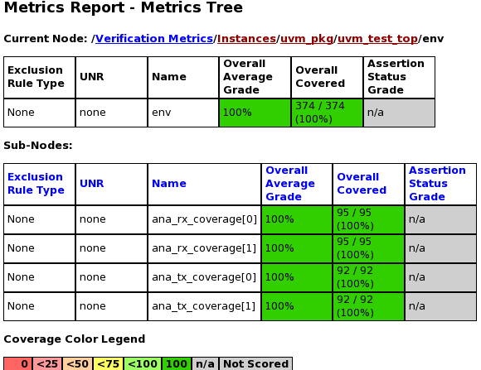
Results Contd..
MPHY_ANA_TOP Results:
Code coverage: 73.63%
Functional Coverage: 100%

Slide 32
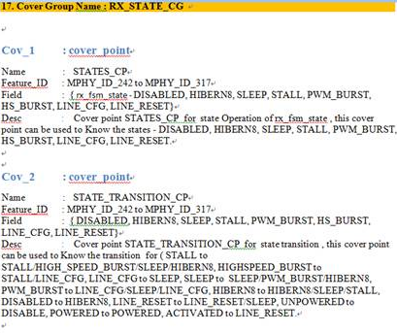
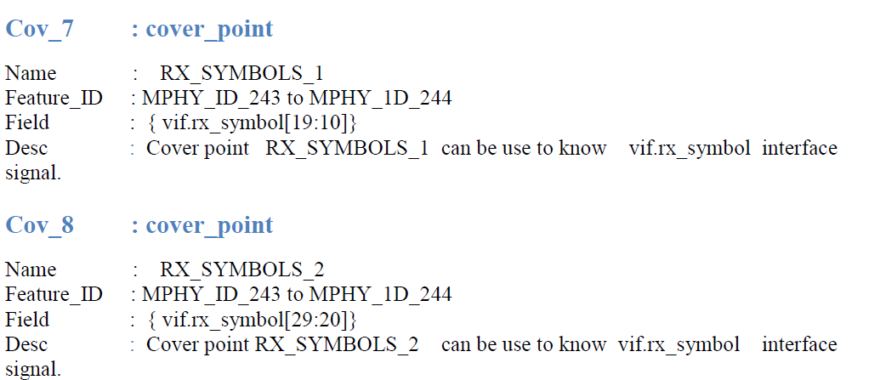
Coverage group and Cover points

Slide 33
Acknowledgements
We would like to thank Ranganath Polimera, Thyagarajula Naidu Gurajala, Anoop MS and Ramprasad Banakar for their vital contribution, help and support during the project execution.

Slide 34
References
www.mipi.org
www.accellera.org
www.cadence.com

Slide 35
Questions?
Thank you for your Interest and Time

