Slide 1
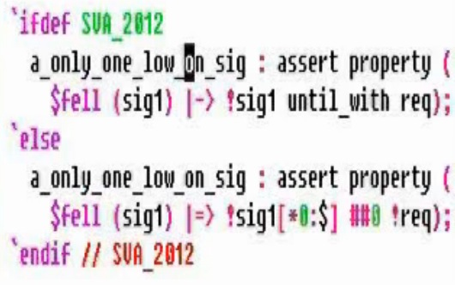



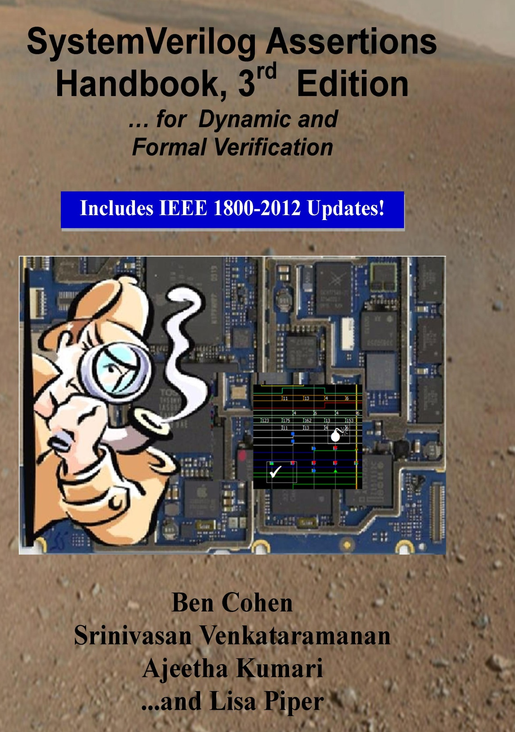
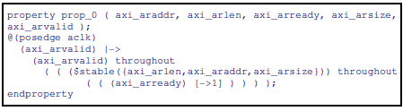

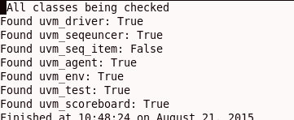

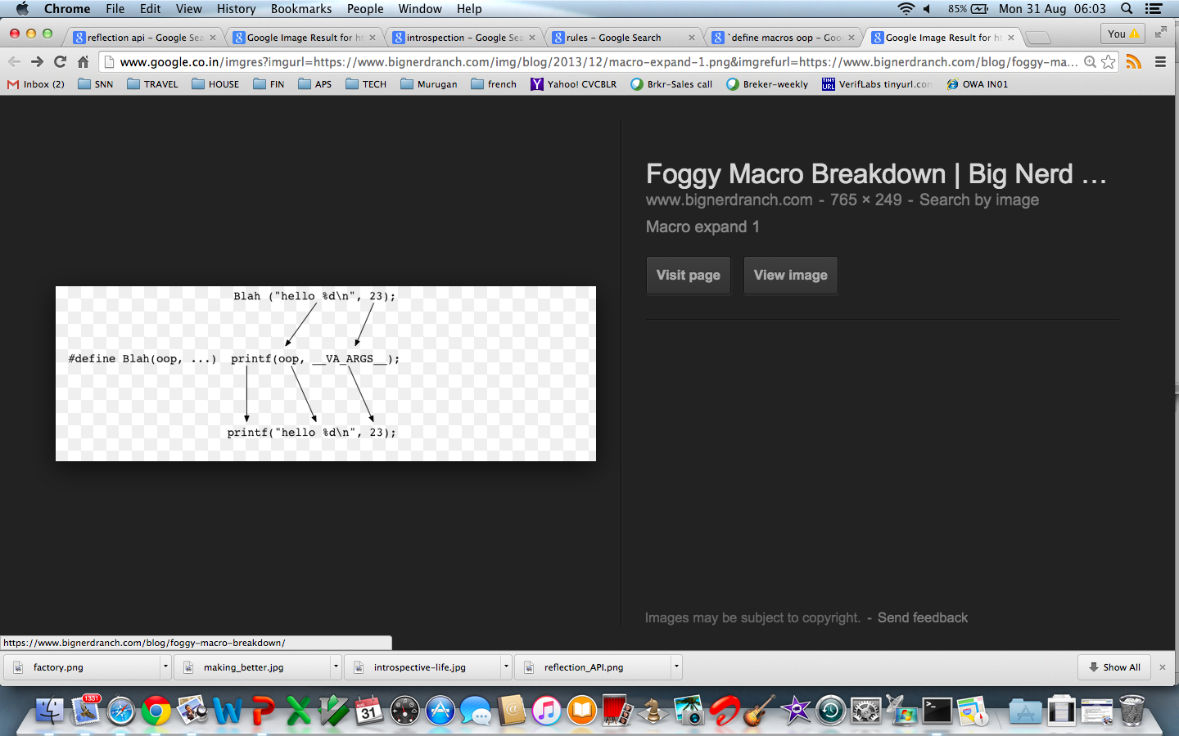



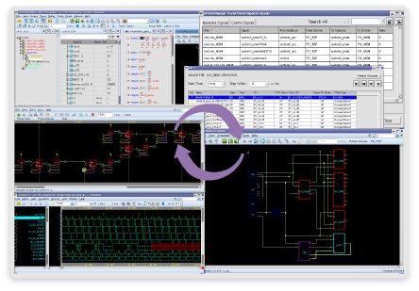


Increase productivity with Reflection API in Design Verification
Shivayogi.V.kerudi¹, Vijay Mukund Srivastav¹, Vani S¹, Dr. Brad Quinton²
shivayogi.kerudi@gmail.com, vijay@cvcblr.com, vani@cvcblr.com, bradq@invionics.com
¹VerifWorks, a CVC venture, ²Invionics
REQUIREMENTS
Quality check on DV code – SVA & UVM
Debug automation through interoperable scripting
SVA LINTER
Input file
Output
OBJECTIVES
In Verification: Use reflection API to identify:
Adherence to UVM gudelines:
  Factory, macros, phasing etc.
Performance friendly coding patterns
  UVM objections
  SVA coding styles that kill
Reusability:
  Formal Verification (Model Checking) compatibility
  Emulation friendly code
Design Debug: Introspect dump files via interoperable, standard API
Extracting values of selected nodes, scopes from a wave dump
Comparing a set of nodes and/or scopes between golden and modified design representations
Traverse the design hierarchy and do this process iteratively across the entire design
UVM LINTER
Design Debug - Hierarchical Black-boxing Methodology - HBM
Input
Output
class s2p_driver extends uvm_driver #(s2p_xactn);
RTL
Apply what-if analysis
If the inputs to “IP3” were same as in RTL model – will the outputs match?
  Yes? → IP3 is clean
  No? → IP3 is a culprit
Apply this recursively
Uses Verdi’s open debug API (NPI)
class s2p_sequencer extends uvm_sequencer #(x2p_xactn)
UVM compliance
Factory rules
Macros
IP2
class s2p_env extends uvm_env;
IP1
class s2p_base_test extends uvm_test;
IP3
✔
class s2p_scoreboard extends uvm_scoreboard;
class s2p_agent extends uvm_agent;
uvm_active_passive_enum is_active;
s2p_sequencer sequencer;
s2p_driver driver;
s2p_ser_mon ser_monitor;
s2p_scoreboard m_scoreboard;
s2p_fcov s2p_fcov_h;
GL
IP1
IP2
✖
IP3
RESULTS
Automate debug process:
Hierarchical Black-boxing Methodology – application of Debug API
Testcase extraction from a dump is another application
Automate the common, lower level tasks.
Huge productivity benefits up to 10X on the debug phase of the project.
Reflection API:
Available in: Verilog VPI, VHDL VHPI, E (IEEE 1647)
SystemVerilog, UVM – not yet fully defined
Invionics’s Invio provides Python API today in production
Debug API – Novas NPI
“Apps” developed on top of these APIs:
SVA Linter
UVM Linter
HBM – Hierarchical Black-boxing Methodology
SVA Linter:
1.Performance friendly SVA
2. Rules for Formal, Emulation compatibility
3. Python API for user defined rules
UVM Linter:
Foolproof way to “qualify” or “certify” the UVM code
Factory, uvm_config_db, phasing, macros, objections etc.
Being able to “reflect” on the given UVM code - DVAudit sessions
Useful to evaluate VIPs
REFERENCES
Reflection API in computer programming -Wikipedia.org
Proc. of the IJCAI’95 Workshop on Reflection and Metalevel Architectures and their Applications in AI. pp. 29–38. August 1995
3. An Introduction to Reflection-Oriented Programming Jonathan M. Sobel Daniel P. Friedman
4. Accellera UVM standard - http://accellera.org/activities/working-groups/uvm
5. VerifWorks – http://www.verifworks.com
6. Invionics – http://www.invonics.com
EDA productivity tools: DVCreate – SystemVerilog, UVM
Low Power: DVC_LP
SVA, UVM Linters
FPGA Verification (Bluepearl Software)
Paripath library characterization
support@verifworks.com, http://www.verifworks.com
CVC Pvt.Ltd.,
#422, Vibhu Complex, 2nd Floor,
27th Main, Sector I, HSR Layout
Bangalore 560102, Karnataka, India
ph: +91-80-42134156, +91-9620209226,
fax: +91-80-42134156
info@cvcblr.com, www.cvcblr.com

