Slide 1
Harnessing SV-RNM Based Modelling and Simulation Methodology for Verifying a Complex PMIC designed for SSD Applications
Vijay Kumar, Shrikant Pattar, Yaswanth Chebrolu, Vinayak Hegde
Samsung Semiconductor India Research

Slide 2
Acknowledgements
Manish Parmar, Manish Goel, Balajee Sowrirajan of Samsung Semiconductor India Research for their continuous guidance, motivation and support
DaeHoon Han of Samsung Electronics for all the technical support, review and guidance towards completing the verification activity on time
Nandeesh Pattanashetty, Sundararajan A, Arumugan A, Yaswanth Sai Darimadugu of Cadence Design Systems for their round the clock support in using Cadence tools, and help resolving issues in a time bound manner

Slide 3
Objective and Motivation _{(1/2)}
Power Management Integrated Circuits (PMICs) more pronounced these days in analog-centric ICs, owing to their inherent capabilities
DC-DC conversion as in Buck Converters
Dynamic Voltage Scaling (DVS)
Ability to transition through various modes, viz., active, standby and sleep modes ^{[1][2]}
Broadly classified depending on their end application
System-on-Chip (SoC) PMIC, Display PMIC, Memory PMIC or Interface PMIC
Few other application-specific ones also exit
Owing to their complexity and constraints, each category comes with its own challenges during the design and the verification phases
Some of the common challenges across various classes of PMIC include
Simulation performance (measured as runtime), a predominant factor at transistor level (TL) abstraction
One buck converter typically takes 1 to 1.5 days to simulate with commercial simulators available in the industry, and with the most optimum SPICE settings
Addition of appropriate assertions and checkers to check for various functionalities
Power-on and power-off behavior, single/multi-byte write and read from I2C, enabling & disabling of power modes, and testing the protection logic
Pin connectivity checks involving passing values between Analog and Digital (RTL), wherein the value supplied on one side is checked for propagation on the other side to ensure there are no pin mismatches
Induced either due to improper spec or human-induced error during design

Slide 4
Objective and Motivation _{(2/2)}
A Memory PMIC, typically used for Solid State Drives (SSD) applications usually consists of one or more buck converters along with other key analog blocks
Core analog block to generate the reference and bias voltages for other blocks
Current limiting circuits, housekeeping blocks, and voltage level detectors
On-chip LDO, High-Frequency Oscillator (HFO), POR and reference level detector, along with ESD protection circuits
Presence of buck converter channels mandates the need for checking their default voltage regulation values
By writing onto huge set of register banks (typically hundreds), which gives rise to the need for automation scripts
Register map information to be leveraged for the purpose, and SystemVerilog Assertions (SVA) to be created for automating the default voltage checks across all registers
Need for achieving good coverage by checking voltage regulation values of all buck converter channels
For different data bytes written from I2C
Gives rise to the need for incorporating constrained randomization using randomize() method
Minimum, default and maximum output value checks to be covered
Need to come up with a Mixed-Signal Verification (MSV) flow that addresses the above requirements

Slide 5
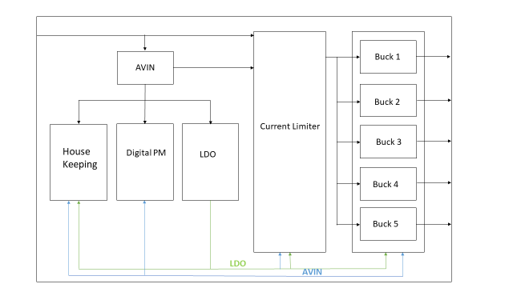
Memory PMIC architecture
Reference and Bias Generator
Buck Converter Channels
Other Key Analog Blocks

Slide 6
Main Features of the PMIC
Each buck converter (channel) is designed to provide a slew of capabilities using I2C interface
DVS, forced discharge mode, power good (PG) function & power-off
Independent PMIC reset, viz., all channel outputs return to default values as per the external address setting at the same time without PMIC power off/on
One Time Programmable (OTP) features, viz., Start up Delay Time, RSTO Delay Time and RSTO threshold
Protection capabilities, viz., Over Voltage Protection (OVP), Over Load Protection (OLP), Short Circuit Protection (SCP) & Thermal Shutdown (TSD)
Channels are disabled under these fault condition scenarios

Slide 7
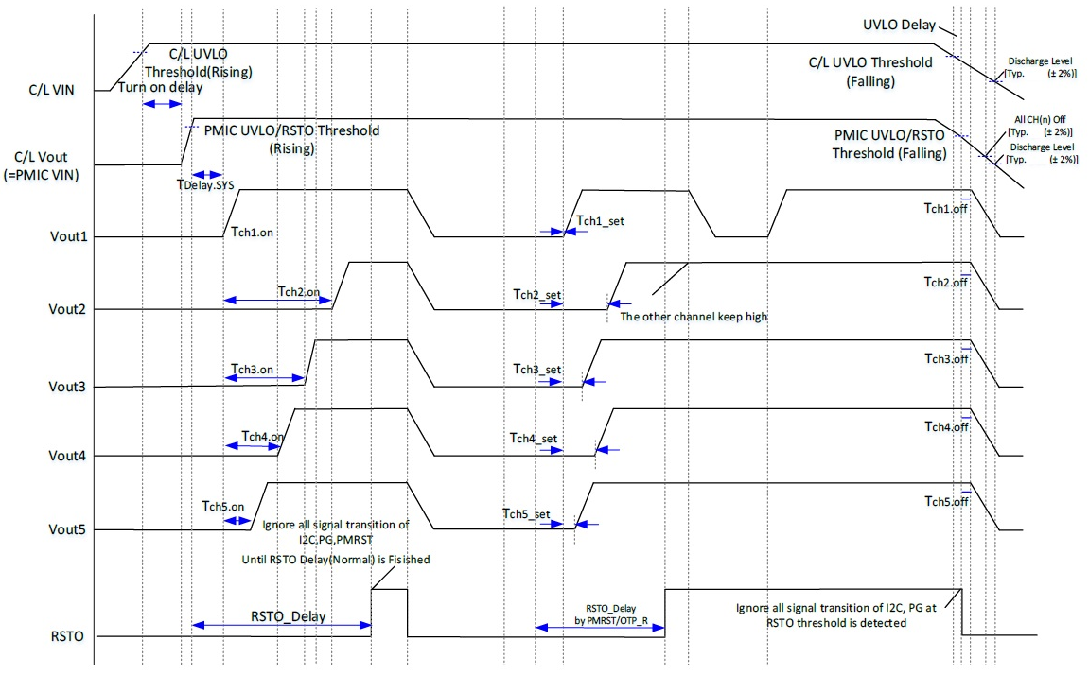
SEQUENCE OF OPERATION

Slide 8
PROPOSED FLOW IMPLEMENTATION _{(1/2)}
Simulation runtime has always been predominant in analog-centric ICs, leading to longer verification times
Verilog-A behavioral models ^{[3]} for analog blocks in lieu of their TL abstractions
Requires SPICE simulator, so simulation is still time-step driven unlike logic simulators that are purely event-driven
Prone to discontinuities in signal waveforms → convergence issues during simulation ^{[3][4]}
Artefacts in modelling style → performance deterioration if proper techniques such as transition filters, bound step, etc., are not implemented
Accuracy depends on the person who is modelling
SystemVerilog (SV) Real Number Modelling (RNM) → An alternative and better approach
Analog blocks modelled using SV “real” built-in nettype
Makes use of powerful SV IEEE 1800-2009 features, viz., real number variables, input/output real ports, assign statements to real variables, and SV Assertions (SVA) including real variables ^{[6][7][8]}
Considering the above aspects, authors worked on creating a Mixed-Signal Verification (MSV) framework for the Memory PMIC

Slide 9
PROPOSED FLOW IMPLEMENTATION _{(2/2)}
Identify Blocks to be Modelled
Model Update
Needed?
Yes
A
Create HED Configuration
No
Develop Models
A
Extract Netlist
Update Design
Validate Models
B
Integrate models and RTL
C
Compile and Simulate
C
Top-level integration checks only (No need of SPICE level accuracy)
Real to Logic and Logic to Real conversions using appropriate connect rules ^{[12][13]}
Automatically Inserted Connect Modules (AICMS) from the tool installation directory
Matches with
Schematic?
Yes
No
No
Results Good?
Refine Models
B
Yes
Finish

Slide 10
AUTOMATION AND COVERAGE _{(1/4)} Register Bank Default Values (Steps Followed)
Developed a Python script that takes as its input the register map information provided by the designer
Key data such as register name, range and the default (reset) value of the register passed as inputs to the script
Creates a SV file that defines a module and declares local logical variables for each register name
Maps these variables to the actual register names in the design
Using $xm_mirror() ^{[11]} utility available in the logic simulator
This is followed by SV Assertions (SVA) in the module → Compare the values of each field in the simulation against the default values in the register map
Assertion violation messages are printed if there are mismatches

Slide 11
AUTOMATION AND COVERAGE _{(2/4)} Register Bank Default Values (Code Implemented)
Address | Register Name | Range | Reset Value
0x00 | CH1_OUT | [6:0] | 0x01
0x02 | CH2_OUT | [6:0] | 0x02
0x03 | CH3_OUT | [6:0] | 0x03
0x04 | CH4_OUT | [6:0] | 0x04
0x05 | CH5_OUT | [6:0] | 0x05
//Declarations
logic CH1_OUT;
logic CH2_OUT;
//Mirroring
If (reg_value_check=1)
mirror(`MAIN_CH1_OUT -> CH1_OUT);
mirror(`MAIN_CH2_OUT -> CH2_OUT);
end
//Assertion
if (CH1_OUT == 0x01) true => Do nothing
False => Display mismatch
if (CH2_OUT == 0x02) true => Do nothing
False => Display mismatch

Slide 12
AUTOMATION AND COVERAGE _{(3/4)} Channel Voltage Regulation Values
Used the SV randomize() method to write random values to the buck registers from I2C
Corresponding output voltages checked automatically using the formula based checker task
Below steps were followed by using the randomization technique
Write random code to register from I2C
Calculate the expected buck voltage by formula
Compare the expected and actual buck voltage values
Function | Address | Code | Value
CH1_VOUT | 0x00 | 0x00 | 1.2V
 |  | 0x01 | 1.19375V
 |  | 0x02 | 1.1875V
 |  | … | …
 |  | 0x40 | 0.8V
 |  | 0x70 | 0.5V

Slide 13
AUTOMATION AND COVERAGE _{(4/4)} Channel Voltage Regulation Values
A. Write random code to register from I2C
i2c_wdata.randomize();
`WRITE_S (`SLAVE_ADDR, `CH1_VOUT, i2c_wdata);
B. Calculate the expected buck voltage by formula
expected_vout = ((offset -/+ (dvs_step*dvs_code)) < min_volt) ? min_volt:((offset -/+ (dvs_step*dvs_code))> max_volt)? max_volt: (offset -/+ (dvs_step*dvs_code));
C. Compare the expected and actual buck voltage values
if(actual) != (expected)
`uvm_error(“Actual value does not match with the expected value”);
else
`uvm_info("Actual value matches with the expected value”);

Slide 14
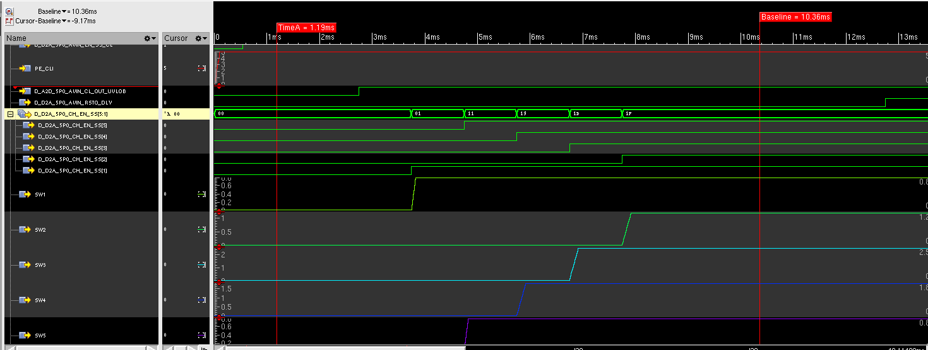
DMS Simulation Results _{(1/4)} CHx Enabled from I2C and POR Assertion
RSTO asserted
CHx EN Signals
CH1-CH5 enabled and output regulation

Slide 15
DMS Simulation Results _{(2/4)} Standby Mode Entry & Exit
STDBY Mode Entry
STDBY Mode Exit
Standby Mode Registers
BTN1_IN pulled low

Slide 16
DMS Simulation Results _{(3/4)} Active -> Standby -> PMRST -> Standby -> Active
Active -> Standby -> PMRST En -> Standby -> Active
Active, Standby & PMRST Registers
BTN1_IN pulled low

Slide 17
DMS Simulation Results _{(4/4)} CHx Enable & Disable from I2C
CHx Enable & Disable from I2C
BTN1_IN pulled low

Slide 18
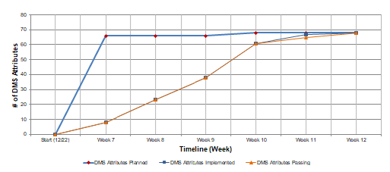
SUMMARY
68 test cases were completed on time with this approach spanning across various scenarios
Power-on and power-off
Write and read from I2C interface
Dynamic Voltage Scaling
Protection Logic
Standby mode entry & exit
Pin connectivity checks between analog and digital
25 SV-RNM models were developed and validated against the schematic
6 weeks TAT for the whole activity

Slide 19
CONCLUSION & FUTURE SCOPE
We thus created a true mixed-signal configuration of the Memory PMIC chip
RTL for digital and SV RNM (behavioural) models for analog blocks
Models developed and validated against the schematic
Simulated the configuration using purely event-driven logic simulator
Huge performance benefit compared to SPICE simulations with TL abstraction (100-1000x)
Avoided potential issues such as non-convergence and finding the right tolerance settings needed for SPICE simulation (time-step driven)
Came up with register check scripts using Python for verifying the default values loaded onto the huge set of register banks
Enabled randomization to write I2C data onto register banks to check the channel default regulation values, thus achieving good coverage
Completed the verification activity on time with this methodology and ensured first-pass silicon success
Future scope is to automate regression of the model validation activity, and to move from SV real to SV EEnet based modelling
To account for voltage, current and impedance in the models

Slide 20
Thank You!! Questions??

