Slide 1
Generic Verification Infrastructure around Serial Flash Controllers
Harsimran Singh, Design Engineer
Snehlata Gutgutia, Design Engineer
Chanpreet Singh, Design Engineer

Slide 2
Agenda
Overview
Commands of Flash Vendors and their variety
Typical Verification Infrastructure
Command Library as the Root class to multiple testbench components
Aspects that catalyze the debug
Self Check capability of testbench
Command Segmentation
Jitter due to PVT Variation
Summary, Results & Take Aways

Slide 3
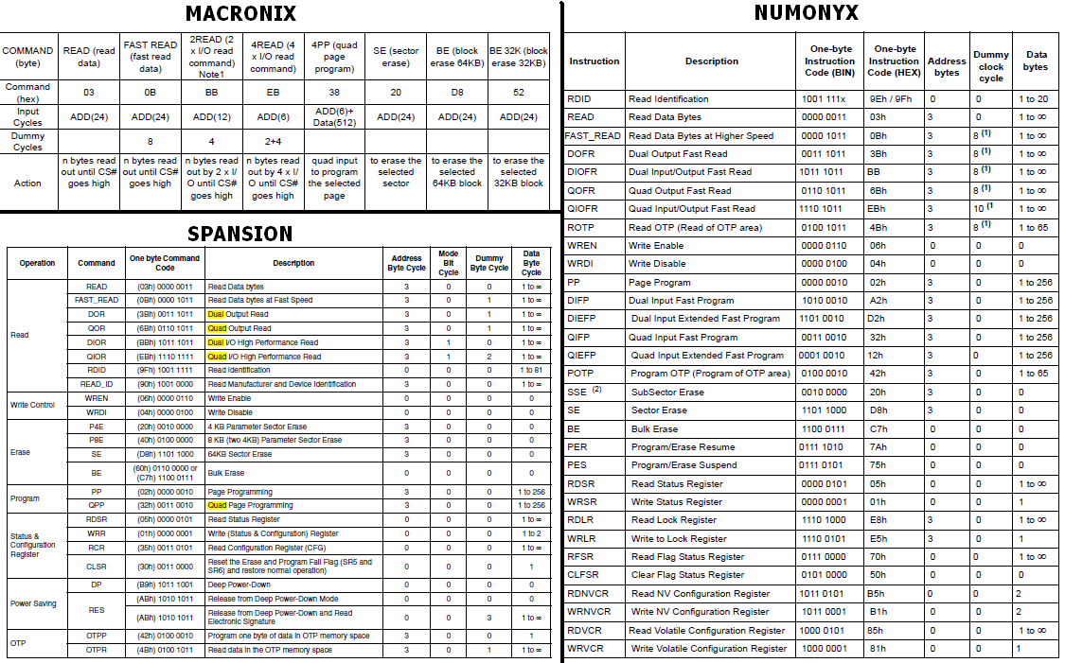
Flash Commands of different Vendors
References:
http://www.macronix.com/Lists/Datasheet/Attachments/2476/MX25L6465E,%203V,%2064Mb,%20v1.4.pdf
http://www.spansion.com/Support/Datasheets/S25FL128S_256S_00.pdf
https://www.micron.com/~/media/documents/products/data-sheet/nor-flash/serial-nor/n25q/n25q_128_3_volt_with_boot_sector.pdf

Slide 4
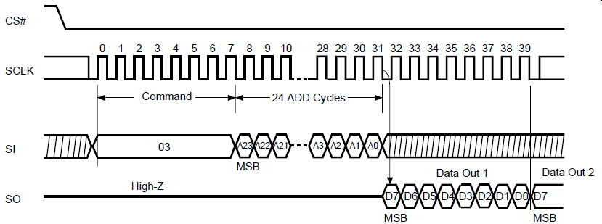
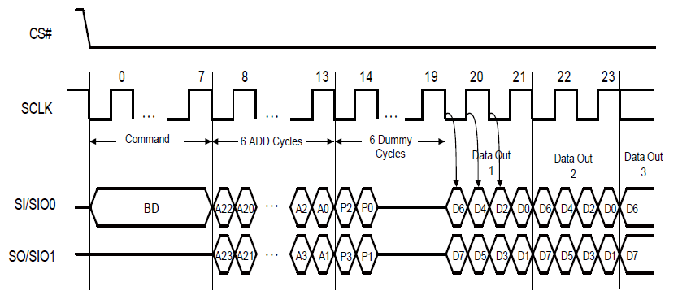
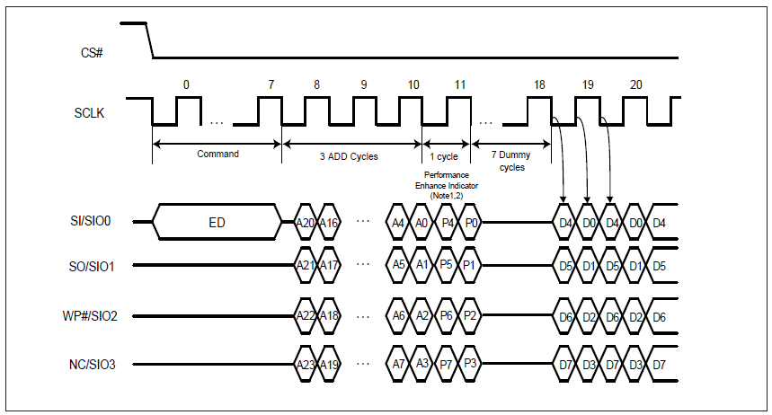
Variety among Commands
Single I/O
Dual I/O
Quad I/O

Slide 5
Typical Verification Infrastructure
Data Mismatch Error Messages for Debug
Error Messages for Debug
DUV
Flash
Controller
I/F Flash
Flash 1
I/F A
Master
Flash 2
I/F Flash
I/F B
I/F Flash
Flash n

Slide 6
Command Library as the Root Class
Flash Commands class
Sequences of Flash commands class
Monitors A
Response Checker
Data Comparator
Driver class reuses Flash Command class and Flash Command Sequence class
Monitors B
DUV
Flash
Controller
I/F Flash
Flash 1
I/F A
I/F B
Flash 2
Flash n

Slide 7
Placing a Debug hook at Flash Interface
Flash Commands class
Sequences of Flash commands class
Response Checker
Data Comparator
Debug hook
Raw Data Monitor
(Reuses Flash Command class)
Monitors A
Response Checker (Reuses Flash Command class and Flash Command Sequence class)
Driver class reuses Flash Command class and Flash Command Sequence class
Monitors B
DUV
Flash
Controller
I/F Flash
Flash 1
I/F A
I/F B
Flash 2
Flash n

Slide 8
Self Check capability
Flash Commands class
Sequences of Flash commands class
Response Checker
Data Comparator
Debug hook
Raw Data Monitor
(Reuses Flash Command class)
Monitors A
Response Checker (Reuses Flash Command class and Flash Command Sequence class)
Driver class reuses Flash Command class and Flash Command Sequence class
Monitors B
DUV
Flash
Controller
I/F Flash
I/F A
I/F B

Slide 9
Command Segmentation
Main
Command
Phase
(Read/Write/Erase)
Read/Write
Address
Phase
Secondary
Information
(Mode/Performance)
Data Phase

Slide 10
Jitter due to PVT Variation
Flash Commands class
Sequences of Flash commands class
Debug hook
Raw Data Monitor
(Reuses Flash Command class)
Response Checker
Data Comparator
Monitors A
Response Checker (Reuses Flash Command class and Flash Command Sequence class)
Driver classes reuses Flash Command class and Flash Command Sequence class
Monitors B
Pads introducing Jitter
Debug
Hook
DUV
Flash
Controller
Flash 1
I/F A
I/F B
Flash 2
Flash n

Slide 11
Summary, Results and Take-aways
Effort saving
Plug-and-Play
Faster debug
Future Extensible
Functional-layer generators easy to Reuse
Module and Command independent growing Environment
Creates opportunity for good quality design by pulling in significant execution time
It may help audience identify characteristics of a System that can lead to an optimum verification strategy or a testbench architecture

Slide 12
Questions

Slide 13
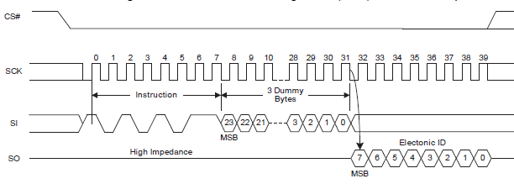
Monitor & Checker
Monitors fetches the raw data from DUT to Flash Model interface at each clock and write it to checker in unpacked format
Checker unpack the data received from the Generator
On basis of the mode of the phase, compares the unpacked data from generator to data from monitor
Additional Checking can compare end to end actual data written and data read from the flash

