Slide 1
Ensuring Quality of Next Generation Automotive SoC: System’s Approach
Pankaj Singh,
Infineon Technologies, Singapore
DVCON, India 2015
Acknowledgement: Harnisch Jens, Sasidharan Prasanth and All Others

Slide 2
Agenda
Next Gen Automotive SoC
  Increased S/W content and H/W complexity
  Main focus/Challenges: Quality and Safety
Demand for System or Holistic Verification View point to ensure Quality
  C-Model/ VP
  Marrying the VP & RTL verification Environment
  Application based Customer scenarios from System’s perspective
Safety Aspect of Verification
  Direct Fault injection Approach
  Post Si validation scenario
  Extending Fault injection to C-model
Acknowledgement/References
Conclusion

Slide 3
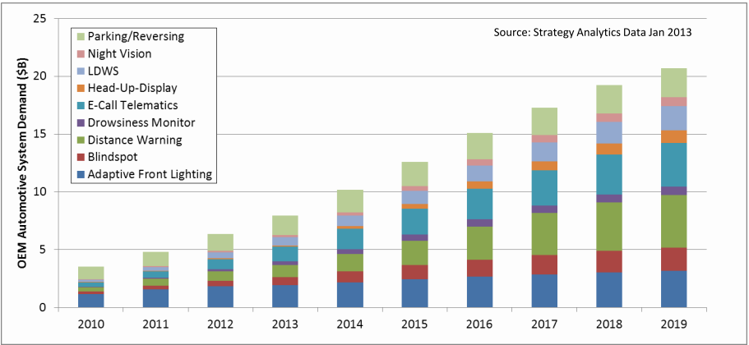
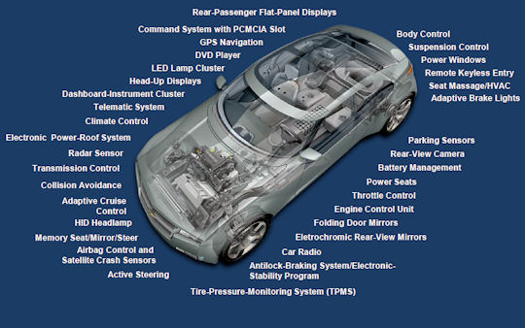
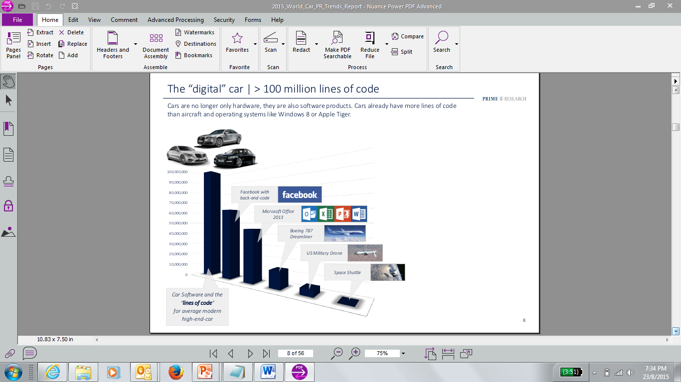
Next Gen Automotive SoC
New Features, Increased SW content, Interaction between different components
Increase in Complexity.
Concerns :
Quality and
Safety

Slide 4
Demand for System or Holistic Verification View point to ensure Quality
C-Model /Virtual System Platform
Marrying the VP and RTL verification Environment: Maximize Synergy and Promote Reuse.

Slide 5


Known Usage/Benefits of C-model/VPS
Cost of Design Errors
  Early software development
Requirements
Design
Implementation
Test
Manufacture
  Architectural Exploration
  Performance Analysis
Design Error Manifestation & Elimination
Modeling
No Modeling
Requirements
Design
Implementation
Test
Manufacture
Cumulative Costs
No Modeling
Modeling
BUT
Requirements
Design
Implementation
Test
Manufacture

Slide 6
How Do you Ensure?
C-model Accuracy
  Functionality & Timing
Synergize and Maximize Reuse
  C-model and IP Co-simulation
  Testcase and infrastructure Reuse
  Early SW Development

Slide 7
C-Model : Accuracy and Reuse
Bus/Inter-connect
Specification
Processor
Specification
Feedback on spec ambiguities
Fix model issues
Feedback on spec ambiguities
Test Plan
Automated Regression Test
Test Plan
Automated Regression Test
Model development
model development
Bus Waveform Trace
RTL simulation trace generated in-house or provided by semi
Test-bench
Control
RTL
Simulation
(testbench+bus)
Target binaries & control scripts
Target binary Code
Tests of
Semi
RTL Model
Simulation
Detailed Waveform Trace
RTL processor
simulation trace
Functional instruction
set simulator trace
Test
case
System
Tests
RTL
Simulation
(processor+bus)
Automated Comparison
Pass/Fail Analysis
Random
Tests
Functional
Instruction Set Simulator
model stimuli
Processor Model
Synopsys
Fast & Accurate Bus,
Interconnect Model
Detailed Bus/Interconnect Trace
Bus transfer timing (request,
grant, complete)
Access type (read, write, fetch,
load)
Transferred data & number of bytes
Automated Comparison
Pass/Fail Analysis
Directed
Tests
Random
Tests
Synopsys
Fast & Accurate Processor
Model
Scriptable
Bus Traffic Generator
Directed Tests
Detailed Processor Trace
Instruction Timing , op-code, address, mnemonics etc.
Address translation (TLB, MMU related details)
Register values, stalls etc.
Cache misses, hits, ways etc.
Bus transfer details
Signal access details for system tests, e.g. interrupts
Bus Protocol Checker
Components of semi supplier
Integrity check based on:
Used protocol (AHB, AXI, APB etc.)
Bus clock, width settings
Type of transaction
Verifies all timing points
Enables customer model
verification
Components of semi supplier
Fix model issues
Synopsys components
Synopsys components

Slide 8
C-Model : Synergize and Maximize Reuse
Spec
Development
of CModel
SystemC block level
testing
CoMET system level \
testing
Coming from Concept
ά
β
Release
Release
ά
β
CModel as Reference
model for RTL IP
SoC tests -
early development
Executable Spec
CModel integration
Reuse of SoC test
infrastructure
Engg Samples
Develop & test for the lead device
Update to common source for Device 1
Update to common source for Device 2
C Model
Develop & test for all devices
Test on Device-1
Test on Device 2

Slide 9
Marrying the VP & RTL verification Env: Maximize Synergy & Promote Reuse
Use of Common Software :
Use of common Verification
Testbench : SystemC
Virtual Prototype (c-model, VP tools)
Application Software /
High Level Driver /
Testcase
User Level
Vadc
LIN/UART/SPI
Dma
Software/
LowerLevel
Drivers
SoC Verification
(SystemC
based)
VADC
ASCLIN
DMA
Hardware
Accuracy
Performance
Sub-System Verification
IP HVL (e, SV) Verification
8

Slide 10
Sub-System Testbench Architecture
Marrying the VP & RTL verification Env: Maximize Synergy & Promote Reuse
Basic SystemC Testbench
DUT
Clock
Clock
Generator
Software
Execution
Reset
Pulse
Generator
P0
P1
P2
Bus
Bus
BFM
ISS
P3
P4
P5
ISS
Proxy
SC_THREAD(s)
e.g. run()
for Inbox
Mon
Mon
BFM
BFM
TestbenchXxx
(Cluster)
Peripheral specific
Monitors/BFMs
Message
Router
9

Slide 11
Marrying the VP & RTL verification Env: Maximize Synergy & Promote Reuse
SoC Testbench Architecture
Software
Execution
Basic SystemC Testbench
DUT
Clock
Clock
Generator
CPUx
Reset
Pulse
Generator
P0
P1
P2
CPUx
Proxy
P3
P4
P5
SC_THREAD(s)
e.g. run()
for Inbox
Mon
Mon
BFM
BFM
TestbenchXxx
(Cluster)
Peripheral specific
Monitors/BFMs
Message
Router
10

Slide 12
Marrying the VP & RTL verification Env: Maximize Synergy & Promote Reuse
C-Model Testbench Architecture
Software
Execution
Basic SystemC Testbench
DUT (C-Model)
Clock
Clock
Generator
ISS
Reset
Pulse
Generator
P0
P1
P2
ISS
Proxy
P3
P4
P5
TLM
TLM
SC_THREAD(s)
e.g. run()
for Inbox
BFM
BFM
TestbenchXxx
(Cluster)
Peripheral specific
Monitors/BFMs
Message
Router
11

Slide 13

BUT
What Else on Quality Besides Compliance to Specification ?

Slide 14
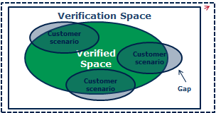

SoC Verification Quality: Application based Customer scenarios from System’s perspective
To minimize the gap, use cases are discussed with Concept, Application Engineering team
Full modules’ FSM active test
(application test)
Negative test
Inter-ference check
Start up flow transactions
Multi-modules interactions
Multi Subsystem/ Module Interactions check
Basic functionality
with actual clock, reset, IR etc.
Expected uC Behavior check for external inputs
Integration correctness (connectivity)
Safety Aspects check
SoC Verification

Slide 15
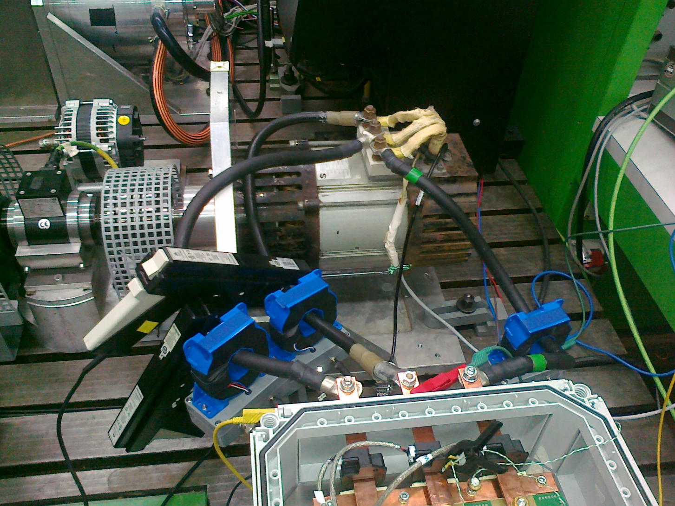
Application based Customer scenarios from System’s perspective : Application Components
Mechanical Torque + Speed measurement
Electric motor
Electrical current
+ voltage measurement
Inverter + ECU
Power source
Safety hardware

Slide 16
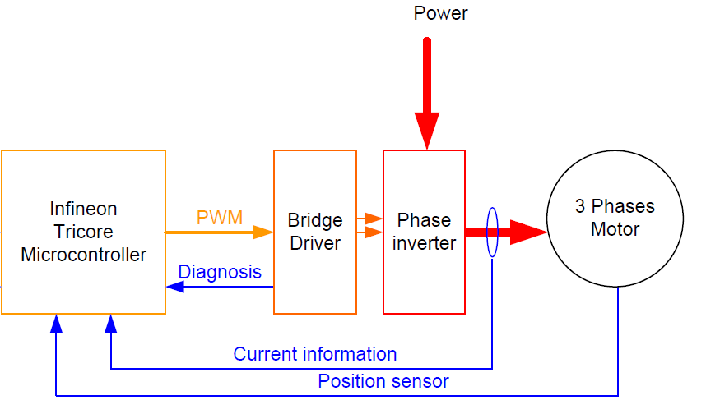
Application based Customer scenarios from System’s perspective: Different Views
H/W
S/W
Applied VSP

Slide 17
Next Gen Automotive: Safety Aspect of Verification

Slide 18




Next Gen Automotive: Safety Concern
Risk of failure due to malfunction Of electronic components is high
WASHINGTON (Reuters) - Safety advocates say two recent fatal accidents involving recalled GM Co cars provide evidence
that the automaker should advise owners to take vehicles off the road until they are repaired.
In both incidents airbags failed to deploy, which is one sign of an accident related to the faulty ignition switch
behind GM's 2.6 million vehicle recall.
“Maintaining the Quality is Key”
“Ensuring Safety is Paramount”
Notes:
Last thing you want to see if News paper headlines on car quality

Slide 19
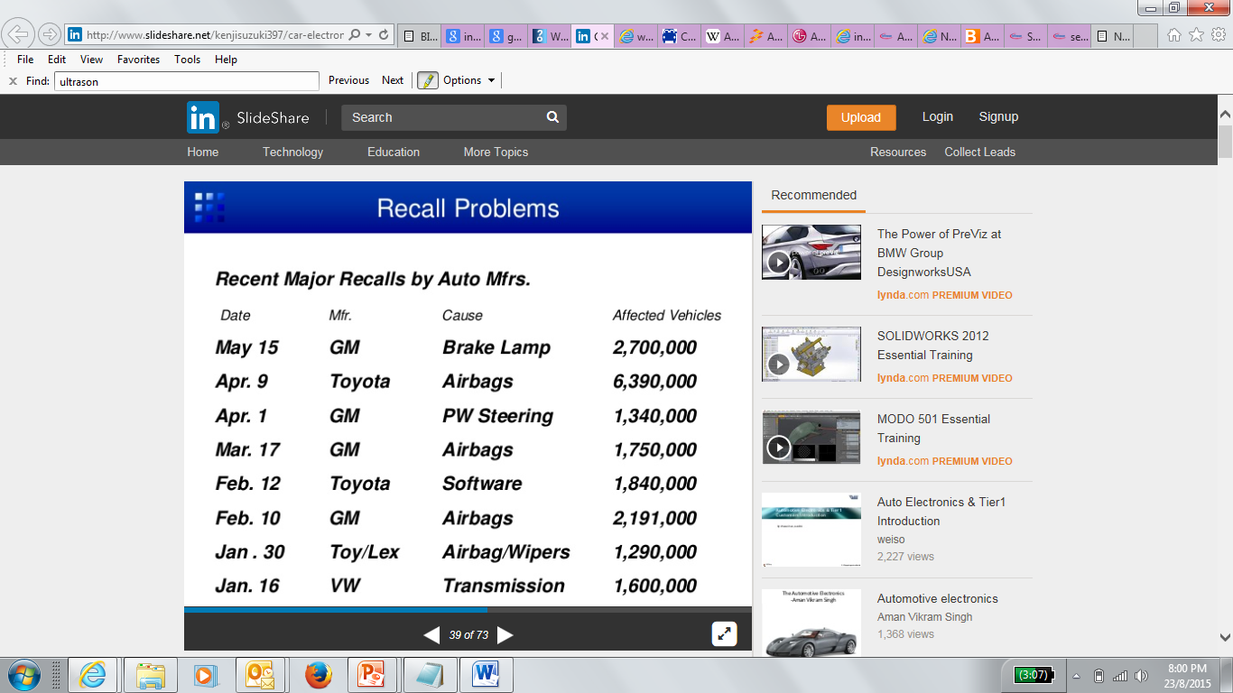
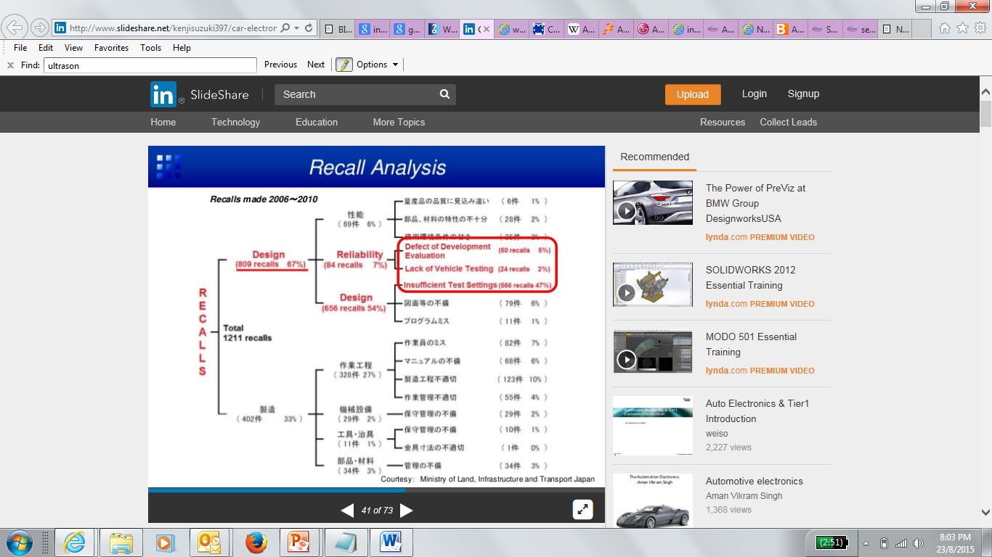
Next Gen Automotive: Safety Concern
“Design defects are major source of failures/recalls”
“Traditional Verification is not sufficient to achieve Quality goals

Slide 20
Next Gen Automotive: Safety Aspect of Verification
SoC Safety Verification
  Statistical /Randomized Approach
  Directed Fault Injection Approach
Post-Si validation
Extending Fault injection Approach: Introducing fault injection in C-model

Slide 21
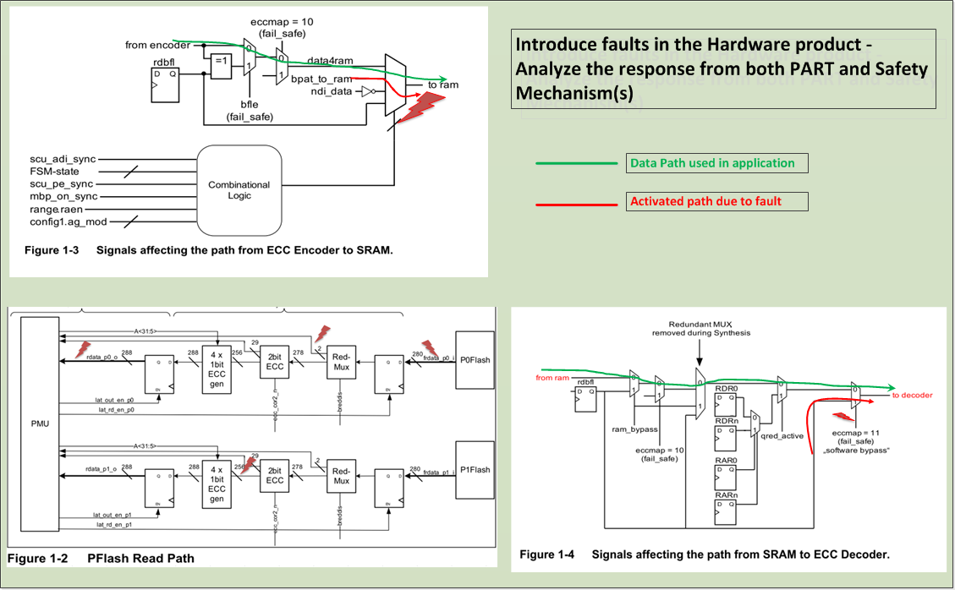
Safety Aspect of Verification [Directed Fault Approach]

Slide 22
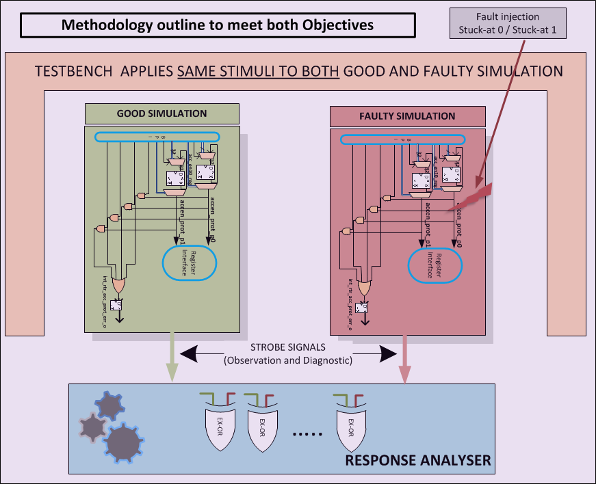
Safety Aspect of Verification [Directed Fault Approach]

Slide 23
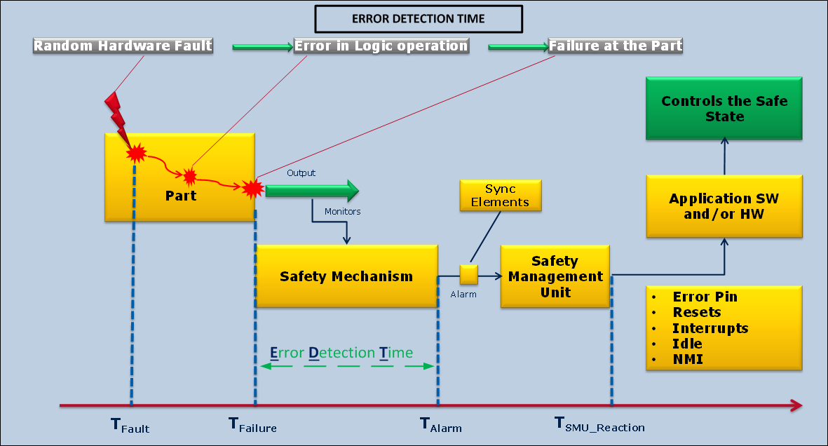
Safety Aspect of Verification [Directed Fault Approach]

Slide 24
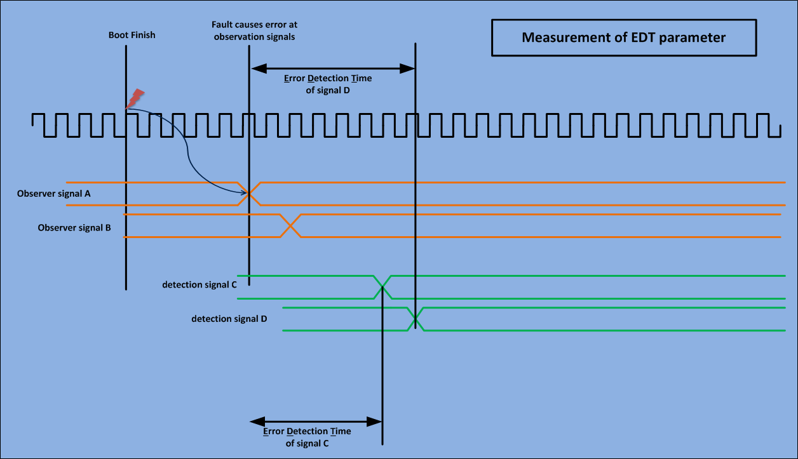
Safety Aspect of Verification [Directed Fault Approach]

Slide 25
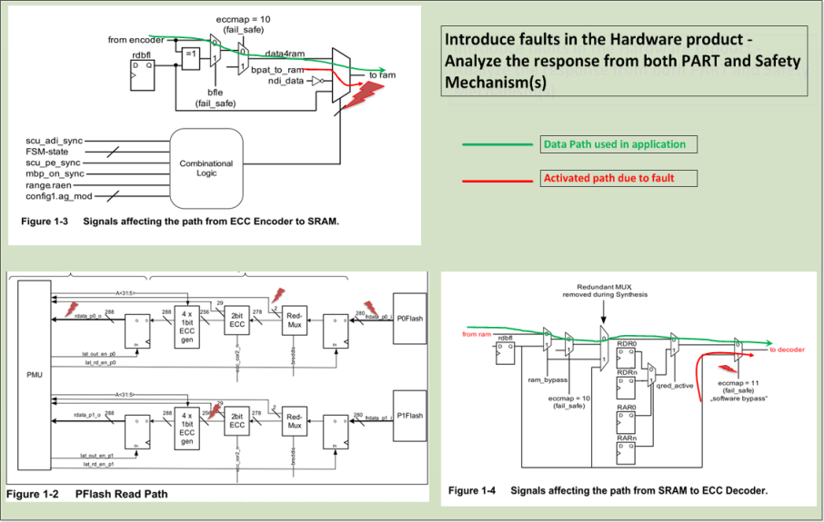

Safety Aspect of Verification [Directed Fault Overview]

Slide 26
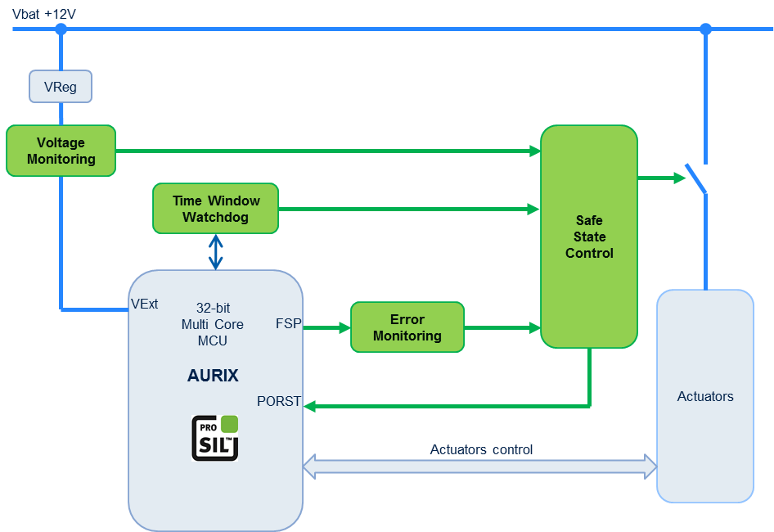
Safety Aspect of Verification [Post-Si Validation Scenario] External Safety
  Detect dependent failures which cause the function as well as the diagnostic to fail (e.g. failure on clock or power supply)
  Recommended reaction:
  Trigger ECU safe state, µC RESET
  The FSP indicates an internal failure of the MCU, therefore the other outputs of the MCU cannot be trusted when the FSP is in fault state.
  Recommended reaction:
  Trigger ECU safe state, µC RESET
  Detect under and over voltage of the external supply to avoid malfunctions or permanent damage to the MCU
  Recommended reaction:
  Shut-down power supply rails to avoid damages; µC RESET, trigger ECU safe state
  In case of failure condition, Safe State Control triggers RESET of µC and brings the application into a safe state (e.g. shut-down, phase separation, etc.)
Note: the green blocks represent functions to be allocated to external devices, not hardware components.

Slide 27

Extending Fault injection : Introducing fault injection in C-model
User
Fault-Injection Modules
SCFIT Simulation Kernel
Fault-Injection Processes
Fault-Injection Objects
http://www.coldmoonsoftware.com/HappyUser2.png
Python API
GDB
SystemC
Environment
SCFIT
SC Module
System Top
SystemC Simulator
Verification Environment

Slide 28
Acknowledgements/ References
High Speed Models for Automotive Microcontrollers:
Verification of the TriCore AUDO FUTURE TC1797 Virtual Prototype. DAC Infineon Synopsys Poster.
  Jens Harnisch, Albrecht Mayer, Robert Schwencker, Kesavan Prasanna, Sasidharan Prasanth, Diamantino Goncalves, Martin Schnieringer
Development of an Electrical Motor Control based on a VSP. SNUG, Germany 2012.
  Dian Nugraha, Jens Harnisch, Kesavan Prasanna K, Albrecht M, Sasidharan P, Radovan V
ATV17 Power Supply TLF35584 Handling. Tomislav Garaca
C-Model Verification. Sasidharan Prasanth
Directed-Fault Injection, IFAP Innovation Week Poster.
Kiran Kumar Bandlamudi , Ranga Kadambi, Gaurav Jain, Goh Wei Chuan,Karthik K, Punnaiah, Shivasmon, Praveen, Ashish
  ATV17 Power Supply TLF35584 Handling. Tomislav Garaca
  Runtime Fault Injection Tool for Executable SystemC Models. DVCON14
  B.-A. Tabacaru,M. Chaari, W. Ecker, T. Kruse
  Application Based Verification. Sesha, Hironori Tanaka
  Thanks to Sesha Pammi, Sasidharan Prasanth, Singh Simranjit, Harnisch Jens, Ajay Goyal and Kiran Kumar Bandlamudi .

Slide 29

Conclusion
  Next Generation Automotive SoC are Complex with lot of Electronic (H/W) and increasing Software content.
  Ensuring Quality and Safety are key to success in global arena.
  We need to go beyond traditional Approach of Verification

