Slide 1
Enhancing The Effectiveness of a Constrained Random Test Suite Using Supervised Machine Learning Algorithm
Ponnambalam Lakshmanan,ADI
Rajarathinam susaimanickam,ACEIC

Slide 2
Agenda
Background
Machine Learning and its Flavors
Supervised Machine Learning – Workflow
Decision Tree
Absolute Score and Relative Score
Proposed Methodology
Results
Summary and Future work

Slide 3
Background
Multiple challenges in closing verification
Regression and Coverage closure
Multiple minor RTL changes close to tape-out
Lots of random regressions with repeated seeds
Catching hidden bugs quickly beyond 95% coverage is always tricky
Generation of correct stimulus and non repetitive tests is really important to address these issues faster

Slide 4
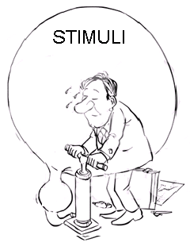
Background
Functional coverage closure using CDV is achieved by
Classical Constrained Random using SV and UVM
Graph based Stimulus Generation – Requires separate tool.
Ranking feature from tool to optimize the regression test suite
But are we generating the right stimuli?

Slide 5
Machine Learning
“The ability to learn without being explicitly programmed” – Arthur Samuel
It is never meant to make “perfect” guesses but to make guesses that are good enough to be useful.
Why now?
Large Data – Low computing power
Autonomous generation of stimulus
Spot patterns – Make connections –
Need help in making decisions

Slide 6
Ingredients of Machine Learning Process
Data sets:
Input Attributes - Features based on which output is predicted
Target Attributes - Output that we want to predict
Types of data set - Training, Validation and Test
Algorithm: Program which provides a model suitable for prediction based on training
Model: Created by training the algorithm with a relevant training data set
Analogy
Data Set
Algorithm
Model
Shape Predictor
Shapes
Predictor Generator
Color Predictor
Colors

Slide 7
Flavors of Machine Learning Algorithms
Supervised Machine learning :
Training Data set with known Input and Output is used to train the model
Unsupervised Machine learning:
There is no Target attribute, it clusters population in different groups
Semi-supervised Machine learning:
Mix of Supervised and unsupervised
Reinforced Machine learning:
Learns its behavior based on feedback from the environment and uses trial and error method to continually train itself

Slide 8
Supervised Machine Learning - Workflow
Build Model
Build Model
Training Set
80%
Data Set - Known Input and Output
Model not ready for prediction – Analyze and Tune
20%
Validate Build Model
Validate Build Model
Validation Set
Model ready for prediction
Test Data Set – Known Input – Unknown Output
Validated Model
Output - predicted

Slide 9
Decision Tree
Why Decision Tree Algorithm ?
Ability to handle both numerical and categorical data
Mirrors human decision making more closely than other approaches
Easy to observe a decision from the created model
Choosing the best attribute out of the predictor variables
Entropy H(S) – Is the measure of amount of uncertainty in a given Data set (S)
Information Gain IG(A)– Is the measure of difference between Entropy before and after the Data set (S) is split on Attribute (A). Denotes how much is the reduction in uncertainty by splitting S based on A

Slide 10
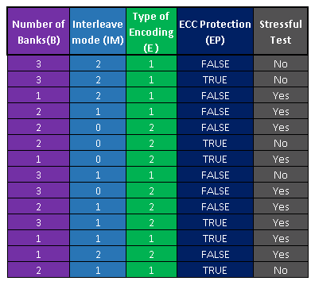
Decision Tree - Example
Input Attributes
Target Attribute
Entropy:
S – The current Data set for which entropy is being calculated
X – Set of classes in S
p(x) – The proportion of the number of elements in class x to the
total number of elements
Information Gain:
H(S) – Entropy of the Set S
T – The subsets created from splitting set S by attribute A
p(t) – The proportion of the number of elements in t to the
total number of elements in set S
H(t) – Entropy of subset t
Training Data Set
Numerical Data
Symbolic Data

Slide 11
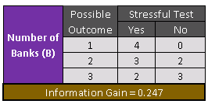
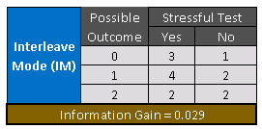
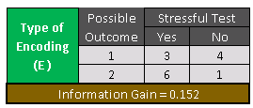
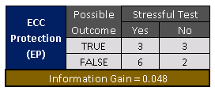
Decision Tree - Example
Entropy(Stressful Test) =Entropy (5,9) = 0.94
Maximum IG selected as Root Node

Slide 12
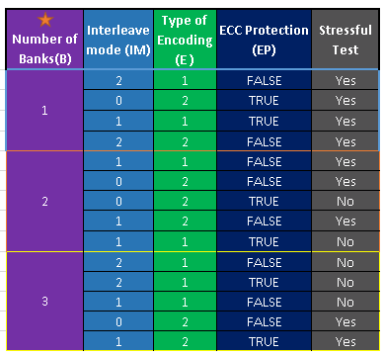
Decision Tree - Example
Root Node
Number of Banks
2
1
3
Branch Nodes
ECC Protection
Type of Encoding
Stressful Tests - Yes
FALSE
TRUE
1
2
Stressful Tests - Yes
Stressful Tests - No
Stressful Tests - No
Stressful Tests - Yes
Leaf Nodes

Slide 13
Absolute Score
Absolute Score:
Consolidated coverage is used as the Target Attribute for the Decision Tree predictions.
Identifies tests with unique and higher coverage hits

Slide 14
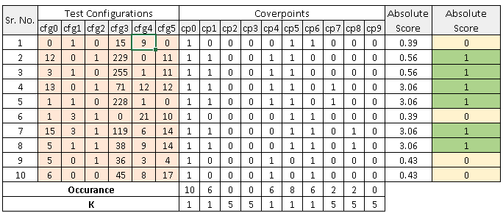
Absolute Score
Input Attributes
Target Attribute
Occurrence
Test configurations with rare coverage hits are provided good absolute score

Slide 15
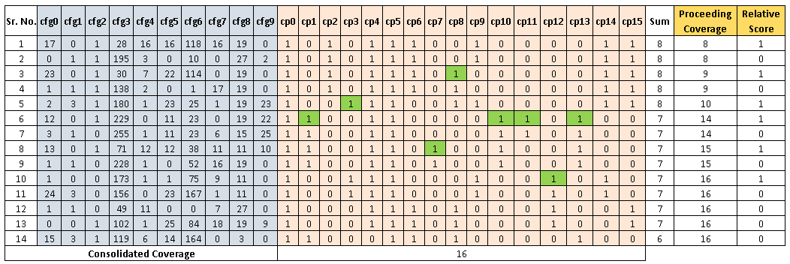
Relative Score
Grades tests based on their contribution towards overall coverage – Used to eliminate repetitive tests
Relative Scoring
Test configurations are sorted based on coverage hits
Proceeding Coverage increases if an uncovered bin is covered
Relative Score is 1 if there is an increase in Proceeding Coverage

Slide 16
Proposed Methodology
Methodology involves 6 steps, out of which 5 steps are to be run iteratively
Steps involved
Initial Regression
Accumulate Data after Regression
Tests predicted by Decision Tree
Tests shortlisted by Relative Score
Random Tests
Regression and Monitor
Iterated till desired Coverage is reached

Slide 17
Training Data set
Initial Regression - Nominal number of random test configurations to generate Training Data set
Data set = Test configuration + coverage
A. Initial Regression
B. Accumulated Data set after regression

Slide 18
First Set of Tests
Decision Tree predicts the Absolute score of random test configurations
C. TEST PREDICTED BY DECISION TREE
Test configuration
Training data set (Test config + Coverage)
C.1. Constrained Random Test configuration - exclusive of training data
C.2. Absolute Score
New Random Test config
DT data set (Test config
+ Absolute Score)
DT Ready for
Prediction
C.3. Decision Tree Algorithm
Top scoring tests
C.4. FIRST SET of Tests – Tests selected by Decision Tree

Slide 19
Second Set of Tests
Grading Tests based on its coverage number
Eliminates redundant test configurations
D. TESTS SHORTLISTED BY RELATIVE SCORE
Training data set (Test config + Coverage)
D.1. Sort – Test configuration with
Greater Coverage hits
D.2. Relative Score
Test configurations scored relative to one another
D.3. SECOND SET of Tests –
Tests having good relative score

Slide 20
Third Set of Tests
Few pure random test configurations - Compensates for the lag in prediction accuracy
E. RANDOM TESTS
Test configuration
E.1. Constrained Random Test configuration - exclusive of training data
Random test configuration
E.2. THIRD SET of Tests – Random Test configuration

Slide 21
Monitor
Test Suite = Predicted tests + Shortlisted tests + Random tests
Monitor Functionality- Observes coverage progress
Over constrained
Stumbled on a Bug
Model to be re-trained
Predicted tests + Shortlisted tests + Random tests
F.3. Monitor
Coverage
+Results
F.2. Regression
F.1. Final Test Suite
F. MONITOR

Slide 22
Proposed Methodology
A. Initial Regression
B. Accumulated Data set after regression
C. TEST PREDICTED BY DECISION TREE
D. TESTS SHORTLISTED BY RELATIVE SCORE
E. RANDOM TESTS
Test configuration
Training data set (Test config+ Coverage)
Training data set (Test config+ Coverage)
Test configuration
E.1. Constrained Random Test configuration - exclusive of training data
C.1. Constrained Random Test configuration - exclusive of training data
C.2. Absolute Score
D.1. Sort – Test configuration with
Greater Coverage hits
New Random Test config –
DT must be ready
DT data set (Test config
+ Absolute Score)
Random test configuration
Test Config + Coverage fed back for better prediction
D.2. Relative Score
Ready for Prediction
C.3. Decision Tree Algorithm
Test configurations scored relative to one another
Top scoring tests
D.3. SECOND SET of Tests –
Tests having good relative score
E.2. THIRD SET of Tests – Random Test configuration
C.4. FIRST SET of Tests – Tests selected by Decision Tree
F.3. Monitor
Coverage
+Results
F.2. Regression
F.1. Final Test Suite
F. MONITOR

Slide 23
Results: Coverage Comparison
Catches Bug much earlier

Slide 24
Results: Performance Comparison
31% - Reduction in Tests
40% - Reduction in Tests

Slide 25
Summary and Future Work
Key Highlights
Drastic reduction in the number of final tests used for regression
Helps catching bugs much early in the verification cycle
Accelerates Functional Coverage closure time
What's next?
Explore unsupervised, semi-supervised and reinforcement algorithms
Identify other areas where Machine Learning could be deployed

Slide 26
Questions

