Slide 1
Efficient and Faster Handling of CDC/RDC Violations
Ashish Kumar Gupta
BROADCOM LIMITED

Slide 2
Clock Domain Crossing and Reset Domain Crossing…
Dynamic Verification Tools limited due to number of vectors
Based on Structural Analysis rather than stimulus.
Meta-stability
Glitches in data and clock path
Re-Convergence issue
Correct FIFO implementation
Correct reset implementation and de-assertion

Slide 3
Static / Structural Verification Challenges
Defining correct Constraints (separating False Violations from real ones)
In-depth design understanding
Software-Hardware partitioning
Huge run-times typically 10-12 hours for design of 20 million instances
Large memory requirement for running CDC tools
Large number of violations during runs without constraints -usually more than 1 lakh for a chip having approximately 15 million gates
Third-Party / Analog IP’s Handling
Legacy Coding Styles

Slide 4
Hierarchical CDC/RDC Flow
Advantages:-
SoC Level CDC/RDC can be started early even before IP is matured Verified
Can reuse IP level constraints and waivers
Run-time and memory requirement reduces.
Disadvantages:-
Input coming from combination if different domains makes abstract port definition difficult
Violations related to inter-module crossing may get missed
Different IP’s use-case in Different SoC’s.
IP owners may have limited knowledge about SoC use-case

Slide 5
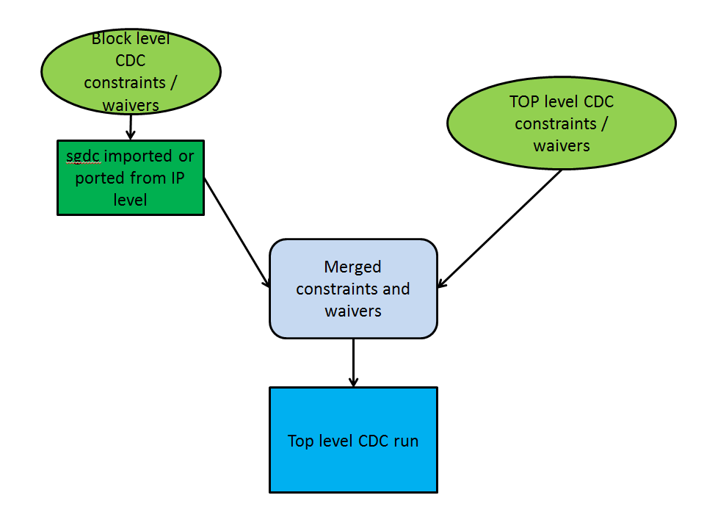
Hierarchical CDC/RDC Flow

Slide 6
Combining Flat & Hierarchical Flow
Can make use of Benefits of both Flow to achieve complete coverage and faster closure of CDC/RDC Violations
Third Party IP’s like ARM cores, NIC, etc. can be declared as ip_blocks.
Analog IP’s, memories can be defined using abstract ports instead of using libs to improve on run-time.

Slide 7
CDC Flows Comparison
 | Flat Flow | Abstract Flow | Suggested Mixed Hierarchical CDC flow
Analysis Coverage | Full | -Dependent on assumptions made by IP owner on functional modes and top level implementation. -Isolation related issues may be missed. | Full
Run Time | Highest (3 hours) | Low (1 hour 05 minutes). Abstract model used for 5 instances. These accounts to around 30 % of SOC digital logic. | Higher than abstract flow but gives higher coverage (without quasi-static and set-case analysis- 3 hours, with quasi-static and set-case analysis-1 hour 40 minutes)
Memory | Highest | Low | High
IP Waiver Migration | All waivers at top level | Not Required | Required
IP constraint Migration | All constraints defined at top level | Abstract port needs to be provided along with clock association | Required (Less effort)

Slide 8
About the paper
Classifying Violations to clean false violations
Guidelines to write constraints and waivers at IP level
Results and Conclusion

Slide 9
Classifying Violations to clean False Violations
Based on Software programming or sequencing or device modes
Related to CDC unfriendly Structures
Related to POR, power sequence, low-power related implementation
Based on commonly used Structures like FIFO’s etc
Based on commonly used SoC Implementation/Protocols
Related to Third Party and Analog IP’s

Slide 10
Based on Software programming or sequencing
Quasi-static (stable) signals: Reset, configuration registers, OTP bits, interrupts etc.
Mutually exclusive or Unrelated signals:
interrupts / clock enables etc. when combined and synchronized CDC tool will give glitch violations.
fifo_full, fifo_empty or threshold combined and synchronized to generate single interrupt.
RX/TX paths or high speed/ low speed path but only one can be active at a particular time.

Slide 11
Related to POR, power sequence, low-power related implementation
Asynchronous resets like POR:
Clock gated or same clock propagating during POR de-asserted.
Clock gated while entering and exiting from low power mode or same clock propagating during save-restore mode.

Slide 12
Related to POR, power sequence, low-power related implementation cont..
Reset De-assertion or reset sync related.
POR reset need not be synchronized in the design for reason its gated or same clock is propagating.
Clock to IP is by default OFF and needs to be enabled by Software.
Same reset going to multiple IP’s from different vendors/groups through separate reset synchronization logic can be waived for Coherency.

Slide 13
Related to POR, power sequence, low-power related implementation cont..
CDC false paths for Power-down, Standby mode or save-restore related logic.
Paths generated through isolation enable. In low power implementation clock to the IP is stopped before entering low power mode and recovered after exiting from low power mode.

Slide 14
Related to POR, power sequence, low-power related implementation cont..
Low-power req
Clock enable
Iso/ Ret enable
Power enable

Slide 15
Based on commonly used Structures like FIFO’s, Memories etc
FIFO read happening after FIFO threshold level is reached.
Single port memories have only 1 clock and if black-boxed read path gets associated to that clock.

Slide 16
Related to Third Party and Analog IP’s
Synchronization structures of multiple IP’s or multiple instances of IPs having same source.
Generic / Third Party IP blocks not to be checked for internal violations can be declared ip_block.

Slide 17
Related to Third Party and Analog IP’s cont..
Third party IP’s need to be checked for generics/parameters. So black-boxing such IP is not recommended.
Violations should be waived using regular expression search based on source flop and destination flop hierarchy.

Slide 18
Based on commonly used SoC Implementations / Protocols
Debug related logic implementation related. (JTAG/TAP controller/DAP):
Set of signals that can be send to GPIO for debug purposes or stored in user DR to be read through JTAG interface.
SOC’s having internal JTAG master can get either TCK or internal clock.

Slide 19
Based on commonly used SoC Implementations / Protocols cont..
IOMUX related issues.
The functionality of PAD selected by Software before the data path is enabled.
GPIO’s in output mode will see input path from PAD to IP by Virtue of PAD design.

Slide 20
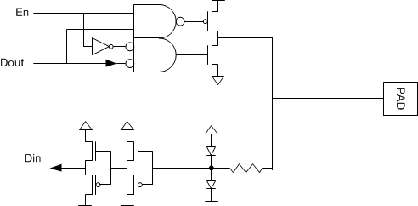
Based on commonly used SoC Implementations / Protocols cont..

Slide 21
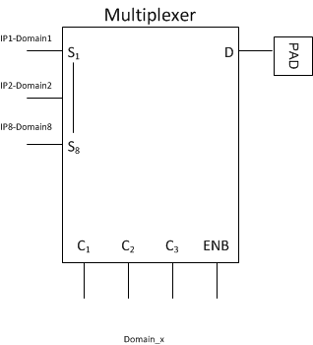
Based on commonly used SoC Implementations / Protocols cont..

Slide 22
Based on commonly used SoC Implementations / Protocols cont..
CDC false paths through NIC / Crossbar:
Bus master Driving multiple slaves but slaves cannot communicate with each other.
One master cannot interact with particular slave but NIC shows data paths which is controlled by slave select.

Slide 23
Related to CDC unfriendly Structures
Reset used to mask data path during reset phase to avoid any toggling.
Using RTL based multiplexing with reset in data paths.
Using RTL based synchronizers instead of standard cell synchronizers for clocks and resets.
Using non-standard way of handshaking tool is not able to recognize Qualifier/handshake structures.

Slide 24
Efficient IP constraining and Violation Waiving
Writing IP waivers that can be ported easily into Top level.
Use .* for number of sources and use regular expression search instead of exact search.
Waive based on source and destination flop and using regular expression search for clock and reset.
Use quasi-static wherever applicable instead of waiving particular violation message.

Slide 25
Efficient IP constraining and Violation Waiving cont..
Writing IP waivers that can be ported easily into Top level.
Use some internal node or port for cdc false path instead of domain name.
If there is bus or two-dimensional array of quasi-static signal port use “.*” instead of giving exact index to reduce number of waivers.
Define qualifier instead of waiving messages so that even if there is change in combo logic the constraint remain applicable.

Slide 26
Results and Conclusion
False-type /Description | Violation reduced after applying constraints / waivers
Quasi-static (stable) signals | approx. 16% reduction (14.3K errors and 0.7K warnings)
cdc_false_path, qualifier not found , set-case analysis based on functional mode. | approx. 44% reduction (50K errors and 1.8K warnings)
Non-standard asynchronous design. Custom cells for Clock gating, synchronizers etc. | approx. 1.6% reduction (1.5K errors but there is increase in around 150 warnings)
IOMUX related set_case_analysis and exclusive or unrelated | approx. 0.2% reduction (180 errors and 10 warnings)
Dynamic asynchronous-interfaces or FIFO read path | approx. 0.5% reduction (400 errors)
Third party IP’s use. Waiving violations whose source and destination is inside IP example NIC | approx. 0.2% reduction (150 errors)
Debug related logic implementation related | approx. 0.7% reduction (500 errors and 100 warnings)
Asynchronous resets like POR and CDC unfriendly design. Reset used to mask data path during reset phase and synchronous reset used in design and reset de-assertion and sync related | approx. 15.3% reduction (14.7K errors and 150 warnings)
Waiving violations using regular expression | Number of waivers line reduced by more than 90 % when using regular expression based search patterns. (Appending 150 Line in waiver file waived messages 5100 messages).

Slide 27
Questions
What are limitations of Hierarchical Flow?
Why IP waivers cannot be ported directly?
Why not use reset synchronizers for all resets?

