Slide 1
Efficient Regression Management with Smart Data Mining Technique
Tejbal Prasad
Design Engineering Architect
Cadence Design Systems

Slide 2
Problem Statement
With the increasing complexity of design, every design has multiple modes and features ​
Knowing the holistic status of project is a very challenging task across different modes.​
There will be known failure because of testbench issues, incomplete features, known design & VIP bugs etc. ​
Filtering these known failure to focus on the real issues is a cumbersome job, often done manually and error prone. ​
Need an automated way of managing these failures. ​
Often regressions are run on cloud (without GUI access). So, need an automated way to replicate top category unique failures after filtering known failure patterns.

Slide 3
Proposed Solution

Slide 4
Holistic Status of Project
Verification team's biggest effort goes in making sure that the existing status remains intact while making progress on the new features​
Conventional way is to check regression status along with the functional coverage. ​
However functional coverage enabled regression has a few drawbacks.
Longer regression run time (usually takes couple of days)​
~4x scratch area compared to non-coverage enabled regression​
Often run into issues like coverage merge not happening properly
On the other side we still want to know the latest status of the design
Across different modes & features supported by design​
Ensure that there is no breakage in the matured modes & features

Slide 5
Holistic Status of Project : Smartly Structured VSIF
To overcome this, we organized the VSIF’s smartly with common random test list​
Each Major Feature became a random test
All random tests are mode agnostic​
All tests are kept in a common test list
Each Major Mode of the design became a group​
Inside each group we call the same random test list
With this restructuring, a glance of regression we get a holistic picture of design health across various modes and features
Agnostic of coverage or non-coverage regression
Save time by running non-coverage enabled regression & still get overall health of the project

Slide 6
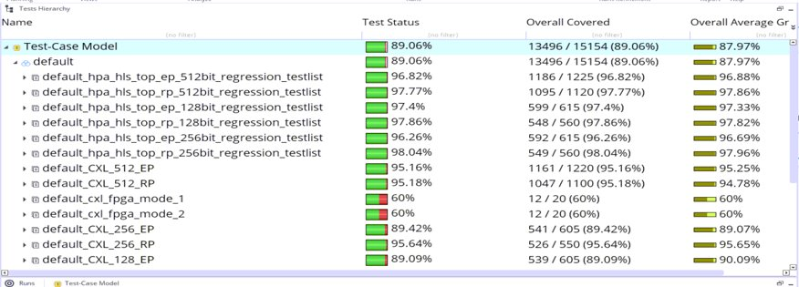
Holistic Status of Project : Smartly Structured VSIF
Each group here represent one major mode of the design​
Just by looking at this regression status we can identify which mode requires attention.

Slide 7
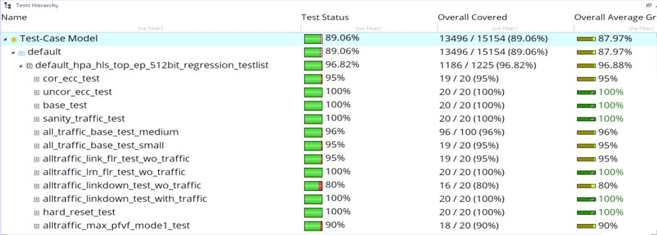
Holistic Status of Project : Smartly Structured VSIF
Each test inside the group represent one feature of the design​
Again, here just by looking at regression status we can identify which feature requires attention.

Slide 8
Smart Data Mining: Known Issue Tracker(KIT)
At any point of time there will be known failures in regression​
Testbench weakness​, RTL & VIP bugs, Incomplete RTL feature, Tool issues ​
Usually, these failures are managed manually​
Its cumbersome, error prone and time-consuming process​
We solved this problem by developing a Python script​
It is tightly integrated with vManger​
It filters out the known failures from the regression result ​
It is plugged-in inside Jenkins regression setup ​
It populates all the information automatically after regression completion

Slide 9
Smart Data Mining: Structured Known issue list
​ ​ | TEST_NAME​ | GRP_NAME​ | TEST_STATUS​ | RUN_DIR​ | FIRST_FAILURE_DESC​ | ANALYSIS​
1​ | alltraffic_link_flr_test_wo_traffic​ | ALL​ | FAIL​ | run_3686​ | inconsistent_internal_data_structure_in_pciecfg.cpp_24626_pc​ | VIPSR_5544331​
2​ | alltraffic_linkdown_test_with_traffic​ | ALL​ | FAIL​ | run_3692​ | Tried_to_decrement_the_passive_credit_count_on_channel​ | VIPSR_1200001​
3​ | ALL​ | ALL​ | FAIL​ | run_2​ | TX__FATAL_MalformedTlp__TL_TLP_MF_INVALID_TAGSCAL​ | JIRA_CXL1234​
4​ | ALL​ | cxl​ | FAIL​ | run_125​ | TX__NONFATAL_UnsupportedRequest__TL_TLP_USERTAG_2__​ | VIPSR_46532491​
5​ | loopback​ | ALL​ | FAIL​ | run_286​ | cfg_0_0____TL_CFG_UNKQID_4__​ | TB_ISSUE_LOOPB
6​ | ALL​ | ALL​ | FAIL​ | run_1945​ | PL_SRIS_SKP_TX_NONE__​ | VIPSR_11​
We track each known failure with Test Name, Group Name & Failure signature

Slide 10
Smart Data Mining: Structured Known issue list
Handling Generic Failures ​
TEST_NAME - “ALL” ​
Failures independent of Test​
GRP_NAME - “ALL” ​
Failures independent of Group​
​Partial Substring Matching​
E.g. In place of test name “pl_loopback_test_wo_traffic” and “pl_loopback_with_traffic” we can use just “loopback” ​
​E.g. In place of “cfg_0_0____PL_SRIS_SKP_TX_NONE__” & “cfg_1_2____PL_SRIS_SKP_TX_NONE__” use “PL_SRIS_SKP_TX_NONE” in FIRST_FAILURE_DESC​
​
​ ​ | TEST_NAME​ | GRP_NAME​
1​ | alltraffic_link_flr_test_wo_traffic​ | ALL​
2​ | alltraffic_linkdown_test_with_traffic​ | ALL​
3​ | ALL​ | ALL​
4​ | ALL​ | cxl​
5​ | loopback​ | ALL​
6​ | ALL​ | ALL​

Slide 11
Smart Data Mining: Known Issue Tracker (KIT)
KIT Script is developed to Auto populate the known failure after vManager regression is over. ​
Three inputs:​
Existing Failure Analysis Table in CSV format​
Session Directory Path ( with -session option ) ​
Output Directory Path ( Optional with -op_dir option) ​
Parses each run of the regression and makes an intermediate csv​
Where it captures the status of each test run, its status & 1st failure signature​
Failure signature matching along with Test Name and Group Name ​
Dumps out the failure signature table in different flavor after filtering or populating the known failures

Slide 12
Smart Data Mining: Known Issue Tracker (KIT)
Output of the Script: ​
​
​
​
*L0* is for Level 0 report sorted with failure count wrt just failure signature​
*L1* is for Level 1 report sorted with test name and failure signature​
*L2* is for Level 2 report sorted with test name, Group Name and failure signature​
Similarly, N0, N1 & N2 reports are for the same granularity after filtering the known failures. ​
​

Slide 13
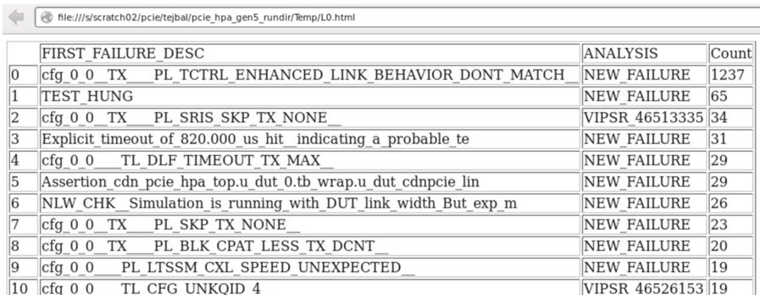
Smart Data Mining: Known Issue Tracker (KIT)
L0.html will contain the updated status with prefilled existing analysis & it will be grouped only wrt First Failure description

Slide 14
Smart Data Mining: Known Issue Tracker (KIT) ​
L1.html – Adds Test Name
L2.html – Adds Test Name & Group name

Slide 15
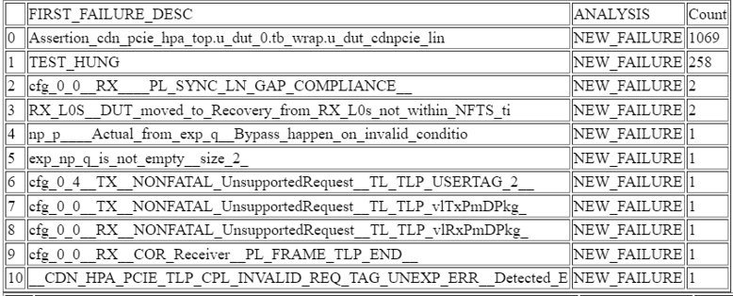
Smart Data Mining: Known Issue Tracker (KIT)
N0.html - Contains only new Failures signature sorted wrt failure count of First Failure Description

Slide 16
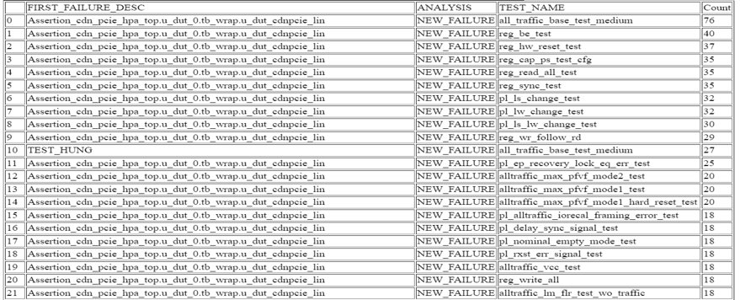
Smart Data Mining: Known Issue Tracker (KIT) ​
N1.html - Adds Test Name

Slide 17
Smart Data Mining: Known Issue Tracker (KIT)
N2.html - Adds Test Name & Group name

Slide 18
Auto Failure Re-Creation
Routine work to replicate any failure​
Pick the right failure​
Filter out the known issues and focus on the New Failures most likely the one that will give the best ROI ​
Take the run command​
Enable dump and enhance message verbosity ​
Use same version of verification environment & run the test ​
It sounds like a daily job of each verification engineer ​
Limited GUI access in Cloud​

Slide 19
Auto Failure Re-Creation
Additional script to collect & copy below information from the cloud to local server​
Run command of each failing test​
N0 report from KIT ​
Design version information​
At the local server side, we use the design information to get to the same design version and pick top 10 failures from the N0 report and recreate them with dump.
We pick the top 10 failures from the New Failure List and recreate them
$: head status_full.N0.csv​
,FIRST_FAILURE_DESC,ANALYSIS,Count​
0,Assertion_cdn_pcie_hpa_top.u_dut_0.tb_wrap.u_dut_cdnpcie_lin,NEW_FAILURE,141​
1,cfg_0_0__RX__NONFATAL_UnsupportedRequest__TL_TLP_vlRxPmDPkg_,NEW_FAILURE,5​
2,Register__local_ep_model_h.PCIe_Link_0_local_ep_ip_cfg_ctrl_,NEW_FAILURE,4​
3,cfg_0_0__TX__NONFATAL_UnsupportedRequest__TL_TLP_vlTxPmDPkg_,NEW_FAILURE,3​

Slide 20
Auto Failure Re-Creation
After running the script this will run one failure of each type by matching the signature pattern​
$: ls AUTO_RERUN/* -d​
AUTO_RERUN/run_1816.exp_p_q_is_not_empty__size_1_​
AUTO_RERUN/run_3742.Register__local_ep_model_h.PCIe_Link_0_local_ep_ip_reg_bank_​
AUTO_RERUN/run_5497.Assertion_cdn_pcie_hpa_top.u_dut_0.tb_wrap.u_dut_cdnpcie_lin​
AUTO_RERUN/run_5613.cfg_0_0__RX__NONFATAL_UnsupportedRequest__TL_TLP_vlRxPmDPkg_​

Slide 21
Auto Failure Re-Creation
Run Command inside each auto rerun carries the information about the test name, group name & Actual regression log path​
$: cat run_1816.exp_p_q_is_not_empty__size_1_/run_cmd ​
## Regression PATH : /s/scratch02/pcie/pciedip/hpa2_link_top_nightly_rundir/results/vmanager/hpa2_link_top_nightly.pciedip.22_03_01_04_31_00_8748/chain_0/run_1816/local_log.log​
## TEST NAME : pl_ptm_test​
## GRP NAME : default_hpa_hls_top_ep_128bit_regression_testlist​
​
​make -f $HPAMF TLBYPASS=1 UVM_VERBOSITY=UVM_DEBUG TEST=cdn_pcie_cxl_base_test
VM_SEED_MODE=1 SEED=989410900 COV=0 CONFIG=hpa2_ga_config CUSTOMER_CONFIG=default TB_MODE=DUT_VIP run DUMP=1 TRACE=1 RAND_CFG=1 CFG_POLICY=cdn_pcie_strap_128bit_random_policy INITIAL_BRINGUP_CONSTR=1 IDE=0 REGR_RUN_ARGS=" +ALL_TRAFFIC=1 "
​

Slide 22
Conclusion
Smartly Structured VSIF:​
Organizes the regression framework for daily Triage.​
Avoids missing a feature across various modes of the design.​
One can see the health of each feature across various modes.​
KIT Script: ​
This filters out the noise in the regression result automatically.​
As the filtering is done by the script so it no more manual, time consuming or error prone. ​
Auto Failure Rerun:​
This eases out the chores for each verification engineer​
Now instead of assigning a failure signature, one will get dump & log of failing scenario​
Increases the focus & productivity of the team ​

Slide 23
Thank You

