Slide 1
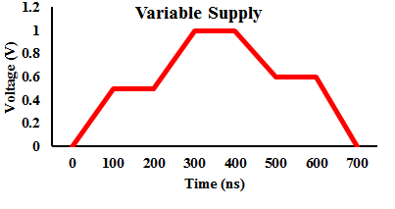
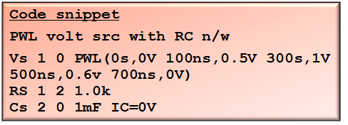
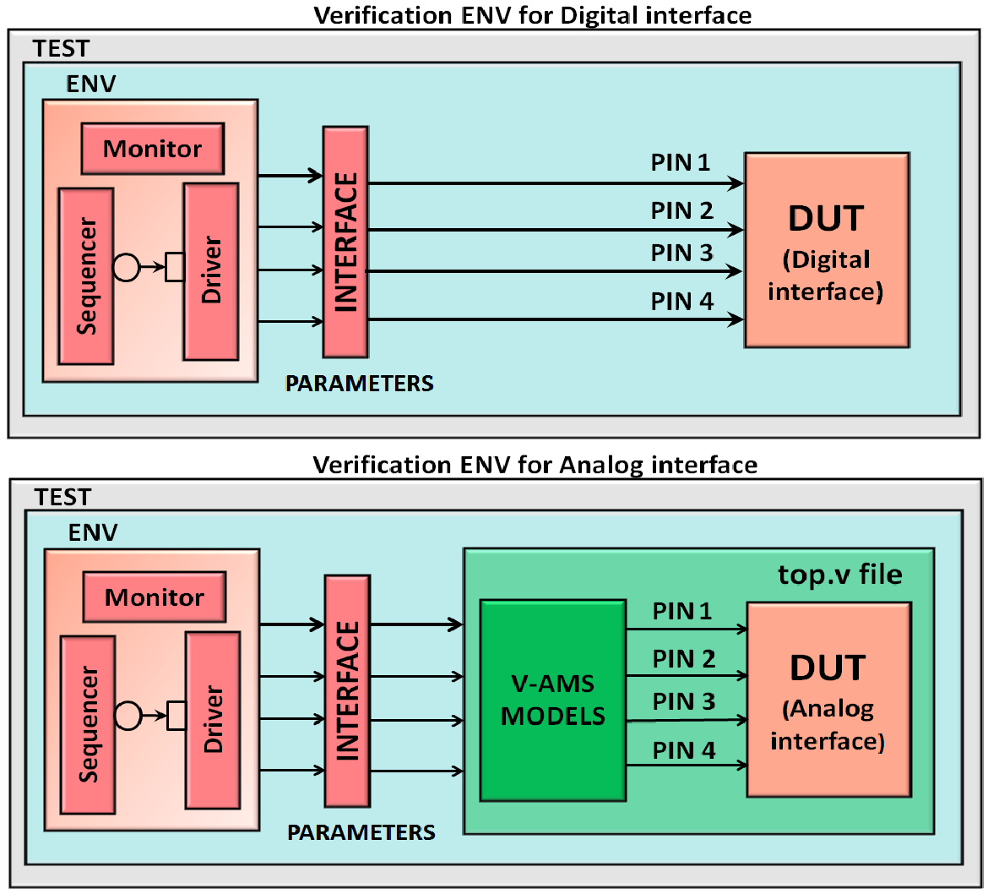
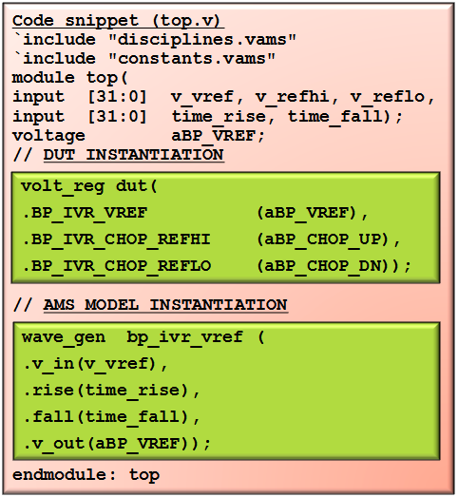
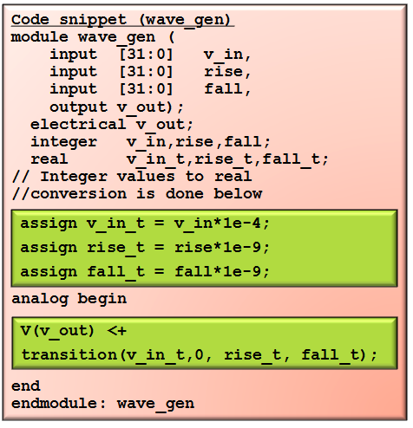
Driving Analog Stimuli from a UVM testbench
Satvika Challa, Amlan Chakrabarti
AMD India Pvt Ltd, Bangalore
INTRODUCTION
PROBLEM STATEMENT & PRIOR WORK
Design of high-performance complex SoCs in low power envelopes is causing both analog and digital designs to increase in complexity. This intensifies the need for more robust verification of these designs. Many methods are adopted in the industry for verifying digital designs. Constrained random verification helps in creating lots of scenarios that help to uncover bugs in the early stages of digital design development. Analog blocks such as ADCs and voltage regulators need a similar kind of verification environment to ensure the quality of design. Conventional circuit simulations fail to address this need as the driven stimulus is static in nature. Effects of noise on supply and abrupt changes in voltage sources have to be observed to evaluate the performance of the design. Self-checking and highly automated testbenches generating analog stimuli are required for this purpose.
In this paper a Universal Verification Methodology (UVM) based SystemVerilog (SV) testbench is used to drive analog stimuli (which are continuous signals) to the Design-Under-Test (DUT). Verilog-AMS models were developed for the analog components in the DUT. The objective is to bring in randomization in the generation of analog stimulus through parameters passed from the UVM testbench. The concept of constrained random verification of digital design is adopted, to dynamically control analog stimuli through the TB.
Driving continuous signals on an analog interface from a SystemVerilog testbench has traditionally been a challenge compared to a digital interface. Analog ports are of electrical discipline which can take voltage or current levels. For example, to drive a voltage signal which sweeps from 0 to 1.8 V with some random slew rate, we cannot do this through a simple SystemVerilog testbench since:
SystemVerilog does not support electrical discipline.
Driving real values through interface is another limitation.
Though there are methods to drive analog signals in which the values are static, there are no known methods where these values can be randomized and dynamically changed during the simulation.
Traditionally such voltage levels are provided through the SPICE deck in the form of PWLs. Since the values driven are static, this method blocks the scope for randomization.
PROPOSED SOLUTION & IMPLEMENTATION
We propose a UVM-based SystemVerilog testbench with Verilog-AMS models for constrained random verification where analog stimuli can be randomized and also changed dynamically.
Self-checking voltage and current checkers can be implemented by probing output load signals.
RESULTS
CONCLUSIONS
Staircase Waveform
Method to dynamically change analog stimuli through a UVM testbench.
Library of Verilog-AMS models with various parameters to control the shape of the waveform.
PWL, triangular, and stair-case voltage waveforms generated which can be dynamically controlled from a UVM testbench.
Self-checking voltage and current checkers implemented by probing the analog ports.
Robust verification of analog blocks when compared to traditional circuit simulation techniques.
4-Phase Triangular Waveform
Category | Bug Description
Incorrect regulator output | Regulator output not settling to twice the reference voltage.
Incorrect functioning of switcher strength counters | When the switcher strength counters are ramped up, large spikes are observed on the switcher outputs.
REFERENCES
[1] UVM Cookbook. [Online]. Available: www.verificationacademy.com. Retrieved July, 2014.
[2] http://www.designers-guide.org [Online] Retrieved July, 2014.
[3] Verilog-AMS LRM, Accellera, Version 2.3.1, June 2009.
[4] CustomSim™ XA User Guide, Synopsys, Version H-2013.03, March 2013.
[5] W Anderson, S Sivakumar , V Akkaraju, K Aoua, “Analog Mixed-Signal Verification Using UVM,” SNUG BOSTON, 2012.
[6] K Kundert, O Zinke, “The Designer’s Guide to Verilog-AMS,” pp. 205-209, June 2004.
Waveform for incorrect regulator output
We would like to acknowledge our colleagues Warren Anderson, Pouya Ashtiani, Govinda Raju, and Sachin Sudhakar Kulkarni at AMD for their valuable suggestions during this effort.
© 2015 Advanced Micro Devices, Inc. All rights reserved. AMD, the AMD Arrow logo, and combinations thereof are trademarks of Advanced Micro Devices, Inc. Other product names used in this publication are for identification purposes only and may be trademarks of their respective companies.

