Slide 1
MDLL & Slave Delay Line performance analysis using novel delay modeling
Abhijith Kashyap, Avinash Shambu, Kalpesh Shah

Slide 2
Outline
Introduction
Problem Definition
Existing approach and proposed solution
Case study using integrated MDLL + SDL setup
Analysis
Design refinement
Summary and Conclusions
Notes:
Abstract or Outline for the presentation

Slide 3
Introduction
Master Delay locked loop (MDLL)
Continuously tracks changes in VT and provides a PTV compensated code
Takes a reference clock and measures its period in terms of delay taps
Slave Delay Line (SDL)
Instantiates 1 delay line
SDL delays its input clock by the amount specified by the code from MDLL
MDLL
MDLL_CLK
DL1
DL2
UPDT
CODE
SDL_CLK
Slave Delay Line
SDL_CLK_DLY
DL

Slide 4
Problem Definition
DLLs are PTV dependent and transient changes affect the behavior of the loop.
Need to model OCV and Supply Noise impact on delay elements in functional verification (RTL) of MDLL and Slave Delay Line (SDL)
Need to find corner cases not covered by traditional verification
MDLL may update a wrong code to SDL
MDLL entering a infinite loop condition, without further tracking and update

Slide 5
Typical Model for verification
Delay Line
CLK GEN
CLK1
Phase
Detector
CLK_REF
CLK2
t_{f}
t_{f}
t_{f}
t_{f}
Delay Tap
Select (Code)
LOCK
UP
CONTROL
CODE
DOWN
UPDT
MDLL
Traditional Delay Line modeling and Verification
Each Delay Element with a fixed delay ‘t_{f}’
Every element in this model behaves identical (gives the same delay)
‘t_{f}’ modeled as Verilog parameter and hence a constant
MDLL will always give a fixed output code for a given input condition
Using this model of delay line will not verify MDLL under OCV and Supply noise condition

Slide 6
Proposed Solution - Overview
Initial RTL and PD Database
With first cut architecture
Spice Characterization
DL being the critical block is characterized at different PTVs
Noise model based on Spice Data
Arrive at a Noise model which can be implemented in Verilog.
RTL Simulations and DB refinement
Silicon Ready DB
Based on Simulations, modify the Delay line / RTL to meet specification.
Silicon Data
Update Noise models
Final RTL
Final Database
Usage of noise components at multiple frequencies to analyze impact
Repeat from step 2 till required
Database with extensive verification is ready for Silicon
Analyze and correlate Silicon data with Spice characterization
Correlate with assumed noise models
To match the Silicon data as closely as possible
Simulate with new noise models
Minor changes to architecture depending on results
Production quality database

Slide 7
New models for verification
Delay Line
CLK GEN
CLK1
Phase
Detector
CLK_REF
t_{v}+t_{f1}
t_{v}+t_{fn-1}
t_{v}+t_{fn}
CLK2
Delay Tap
Select (Code)
LOCK
UP
CONTROL
CODE
DOWN
UPDT
MDLL
Dynamic Delay Line Model
Each Delay element modeled with a fixed delay component ‘t_{fn}’ and a variable delay component ‘t_{v}’
With ‘t_{f1}’ to ‘t_{fn}’, delay variation (due to OCV) between individual elements is modeled
With ‘t_{v}’, delay variation due to noise is modeled
‘t_{fn}’ & ‘t_{v}’ modeled as Verilog real data type

Slide 8
Modeling the Delay elements
Data from Spice Simulation of delay element used to set ‘t_{fn}’
Setup for a particular corner condition
Run mismatch (Monte-Carlo) simulations
For ever delay code (tap), delay difference between input and output of the delay line is tabulated
Average, Min and Max values obtained from this simulation is used to set ‘t_{f1}’ to ‘t_{fn}’
$$t_{f}=avg ±rand(avg−Min :Max −avg)$$
Example illustrated below
t_{f1}= avg+2
t_{f2}= avg-1
t_{f3}= avg-5

Slide 9
Modeling the Delay elements
Data from Spice Simulation of delay element used to set ‘t_{v}’
Setup for a particular corner condition
Model the supply variation in spice
Use single sinusoid on supply, with different noise amplitude
Measure delay variation with respect to applied noise
Derive a linear relationship for amplitude(A) of delay change with respect to noise amplitude
Using the above, delay variation
$t_{v }=\sum_{i}{A_{i}.sin⁡(2πF_{i}T)}$where F is noise frequency, T is simulation time
This represents the transient behavior of delay elements

Slide 10
Modeling the Delay elements
Supply variation
Delay Variation (A_{i})
DE

Slide 11
Case Study
MDLL_CLK
MDLL
t_{v}+t_{f1}
t_{v}+t_{f2}
t_{v}+t_{fn-1}
t_{v}+t_{fn}
DL1
DL2
UPDT
CODE
Delay Line - Internals
SDL_CLK
Slave Delay Module
SDL_CLK_DLY
DL
MDLL and SDL were hardened IPs in 28nm technology
Expected to provide delays over a large range : 1.7ns to 4.5ns
Jitter performance critical as this was clocking a high speed media interface
The code on SDL always produces a quarter cycle shift w.r.t its input clock period
The relation between MDLL_CLK and SDL_CLK is always 2:1

Slide 12
Spice data for delay element
PTV | Code | Delay | Delay/Element | Variation/Element | Percent variation of delay
S_-40_1.029 | 2 | 84.22 | 21.055
S_-40_1.071 | 2 | 77.64 | 19.41
 |  |  |  | 1.645 | 8%
No effect on frequency on delay variation :
Frequency in the interested range
Effect of frequency seen only after 2.5GHz +
Linear variation w.r.t supply noise :
4% supply variation ⬄ 8% delay variation
1x variation on supply leads to 2x delay variation

Slide 13
Verification Setup
The verification environment initializes each elements delay
‘tf1’ to ‘tfn’ => models OCV
‘tv’ => models supply noise
The supply noise is modeled as a sinusoid with below components
1 MHz, 64 MHz and 200 MHz : Chosen based on clock frequencies on the supply line
1 MHz Noise Amplitude > 64 MHz Noise > 200 MHz Noise : Decoupling capacitors would filter the noise to an extent
Experiments done by enabling/disabling each noise component independently
Using this, cycle - cycle delay is measured between pos-edges of SDL_CLK and SDL_CLK_DLY and plotted

Slide 14
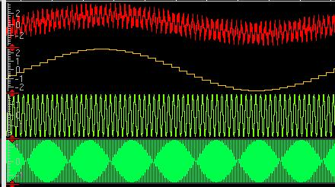
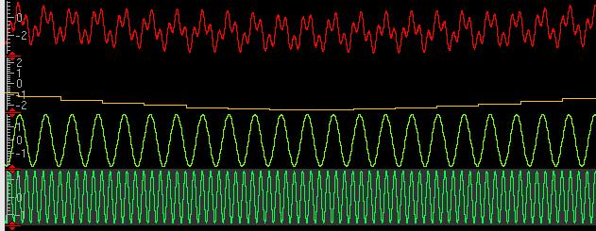
Supply noise models
Final Noise Waveform
Mapped to ‘t_{v}’ of delay elements
1 MHz Component
64 MHz Component
200 MHz Component
Final Noise Waveform
Mapped to ‘t_{v}’ of delay elements
1 MHz Component
64 MHz Component
200 MHz Component

Slide 15
Results
Output w/o jitter (Noise Src OFF)
Output w/ jitter (Noise Src ON)
Notes:
Tables or Graphs on results
Waveform dumps
Comments on these results

Slide 16
Results
Notes:
Tables or Graphs on results
Waveform dumps
Comments on these results

Slide 17
Results
Notes:
Tables or Graphs on results
Waveform dumps
Comments on these results

Slide 18
Results
Notes:
Tables or Graphs on results
Waveform dumps
Comments on these results

Slide 19
Analysis
The table captures the amount of jitter (peak-peak) seen on the Slave Delay Line with various noise components
The jitter observed on Slave Delay Line has contribution from two sources – Noise source & MDLL code variation
Notes:
Tables or Graphs on results
Waveform dumps
Comments on these results

Slide 20
Inferences and design changes
Main inference is that MDLL code changes do not respond appropriately in noisy conditions.
The loop response has to be dampened to reduce jitter
Design changes introduced :
Introduced an average logic in MDLL
The average logic averages MDLL code over multiple samples before updating Slave Delay Line
Verification is re-run on the new database
Notes:
Tables or Graphs on results
Waveform dumps
Comments on these results

Slide 21
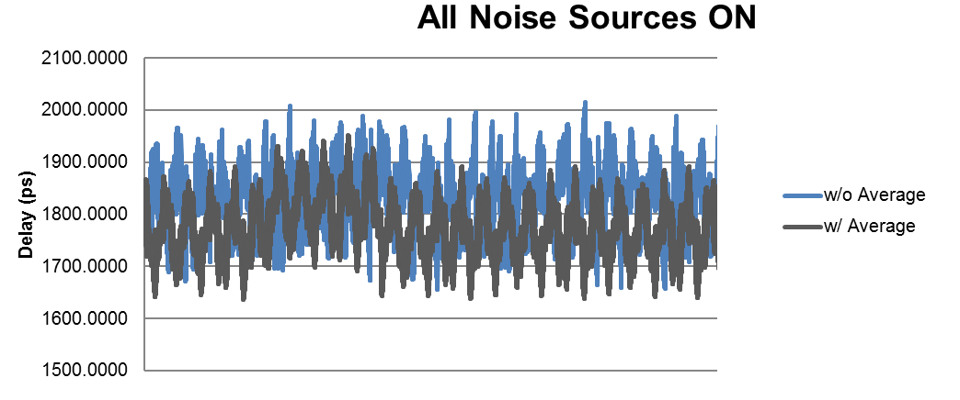
Results after design change
The average logic on MDLL’s code results in less delay variation on the Slave Delay Line
Notes:
Tables or Graphs on results
Waveform dumps
Comments on these results

Slide 22
Summary of the proposed solution
Traditionally delay lines used are modeled using a fixed delay step
In reality, delay elements show variation due to Static and Dynamic conditions
Using the proposed model helps in verifying of MDLL + SDL with OCV and Supply noise on delay elements
Impact of various noise models can be analyzed
This ultimately leads to a more robust verification of the MDLL + SDL
Gives an early feel of Jitter performance & helps to identify solution for improved performance
In this particular case, adding average logic helped in improving the jitter performance
Notes:
Tables or Graphs on results
Waveform dumps
Comments on these results

Slide 23
Novelty of the Proposed Solution
Using Verilog's ability to change path delay dynamically to model a more realistic Delay Line. Will work with existing test environments
A faster way to integrate Spice data and verify MDLL and SDL
Spice simulation is only done on delay elements, not on the complete MDLL and SDL
Helps in verifying MDLL’s behavior under OCV and Supply noise
All this at RTL stage – makes analysis, debug & fix very easy

Slide 24
Scope for further work
A frame work for verifying AVS and DVFS can be developed
Similar methodology for digital circuits having sensitivity to transient changes in PTV.
A method to have variable delay (over that annotated using SDF) implemented at GLS can be explored. Currently there is no way to vary delay dynamically after SDF annotation

Slide 25
Questions

Slide 26
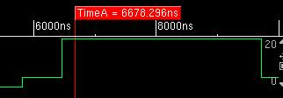
Other Noise Patterns Used
Voltage Ramp Up w/ abrupt changes during transition
Voltage Ramp Down w/ abrupt changes during transition
Voltage Step Up-Down
Voltage Step Down-Up
Triangular waveform with abrupt random changes during ramp
Notes:
Tables or Graphs on results
Waveform dumps
Comments on these results

