Slide 1
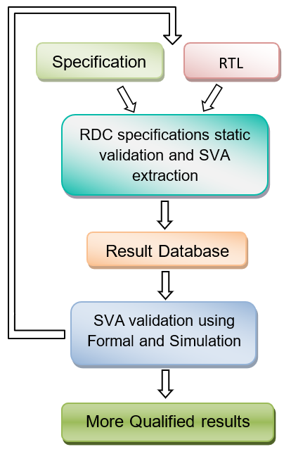
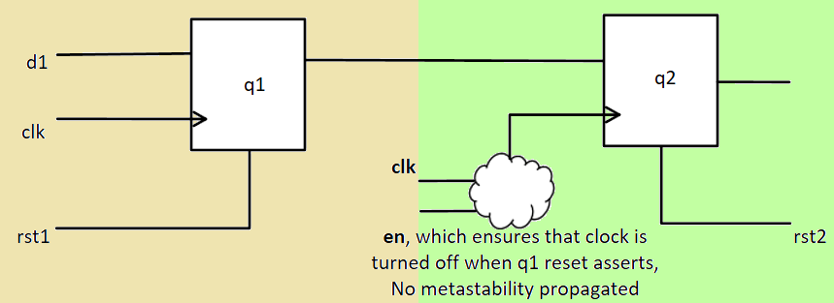
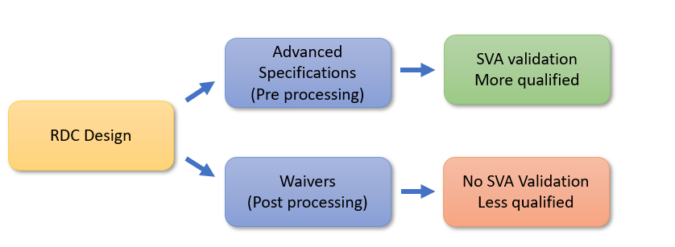
Advanced specification driven methodology for quick and accurate RDC signoff
Sai Jagadeesh Ambati, Sulabh Kumar Khare, Atul Sharma
Introduction
Advanced Specifications Driven Methodology
Modern SoC designs with complex architectures challenge traditional reset design and verification methods due to multiple asynchronous reset sources
Accurate resetting is crucial to prevent metastable data and reset domain crossing (RDC) issues in all operation modes
This poster proposes an advanced specification-driven methodology using static analysis and debug environment-based techniques to detect and verify reset domain crossings in large SoC designs
This 3-step approach avoids ad-hoc reset methods and enables faster RDC closure, identifying critical issues while preventing false bug reports to the designer
Step 1: RDC design properties as specifications and verification plan
Step 2: RDC design and verification
Step 3: RDC results validation using SVA
Benefits:
Systematic approach for designing and verifying the reset architecture
Correlation between the design properties and verification efforts
More accurate and qualified results
Step-1: RDC design properties as specifications and verification plan
Step-2: RDC design and verification
RDC Design Requirements Specification:
Clock and reset domains
Reset ordering
Clock and Data isolation
Metastability Mitigation in RDC: Involves specific design properties like
Transmitting register at reset value when reset asserts
Receiving register clock off during transmission
Advanced specifications :
Leveraging Established Design Principles for RDC design to evaluate safe crossings effectively
Aligning specs with design signals and objects.
Processing the specifications along with RDC static verification
Reporting the crossings with matching specifications as safe evaluations
Step-3: RDC result validation using SVA
Results and Summary
Behaviour Monitoring:
Executable statements actively validate design behaviour in simulation or formal verification
Accurate validation, ensuring design specs, error detection, and improved reliability
This approach significantly reduces rdc noise without using waivers, ensuring a more accurate assessment
Implemented on In-House Designs ranging from Ip to SoC : Used Rx clock off and Tx at reset value properties in RDC verification
Table below presents filtered and validated RDCs, aiding in issue identification and design compliance validation
Efficient and Accurate Verification: Examining Rx and Tx properties ensures optimal functionality
Improved Performance and Functionality: The methodology enhances the verification process for better results
@(posedge transmitter_reset)
(1'b1) |-> (transmitted_data == reset_value);
REFERENCES
[1] Yossi Mirsky, “Comprehensive and Automated Static Tool Based Strategies for the Detection and Resolution of Reset Domain Crossings”, DVCON
[2] Chris Kwok, Priya Viswanathan, Ping Yeung, “Addressing the Challenges of Reset Verification in SoC Designs”, DVCon US,
[3] 2015 Akanksha Gupta, Ashish Hari, Anwesha Choudhary, “Systematic Methodology to Solve Reset Challenges in Automotive SoCs”, DVCON Europe 2019
[4] IEEE P1800/D8 Draft Standard for SystemVerilog—Unified Hardware Design, Specification, and Verification Language. IEEE Computer Society, New York, 2008.

