Slide 1
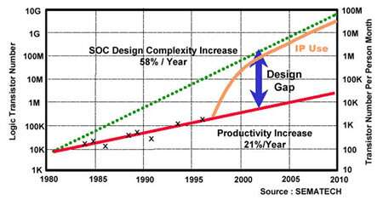
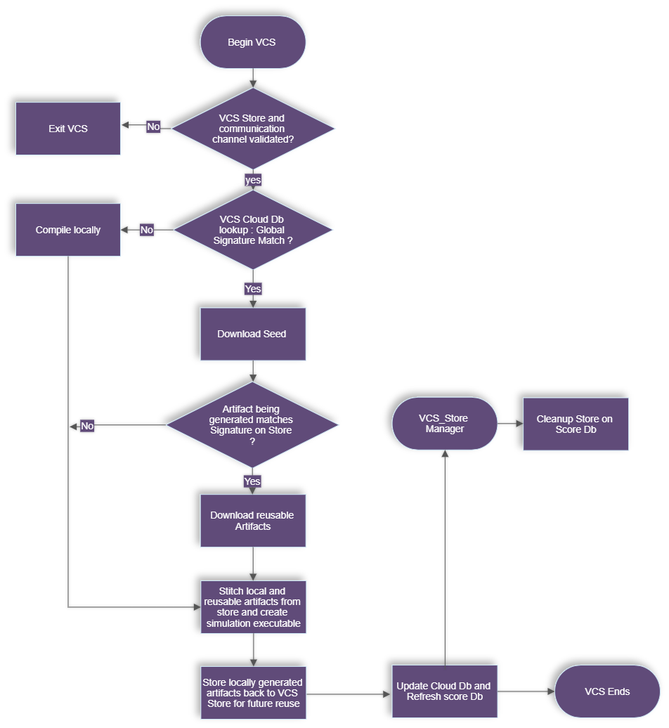
Faster Elaborations with Cloud Storage
Shobhit Shukla
Amit Kumar
Problem Statement/Introduction
Proposed Methodology/Advantages
Elaboration (for Simulation) shows similar Productivity Gap
Increasing the number of cores does not give scaling beyond X cores
Since most design parts do not change daily, there are duplicate copies of the same data floating around taking up Storage space
Central Repository of Elaborated data
Every elaboration checks what it can reuse from the store ensuring maximum reuse without complicated setups
Cloud Support for efficient sharing
VCS Store
Processing
LOW
Enables high amount of Reuse of unchanged parts of the design
Storage
OPTIMUM
No Duplicate Data across users / network
Sharing
HIGH
VCS Store can be on NFS or any remote/cloud storage (GCS, AWS, Azure, sftp, DropBox etc.
Only one copy of data is maintained in the store at all times
Processing HIGH
Storage HIGH
Sharing LOW
Implementation Details/Diagram
Implementation Details/Flow Chart
Check Storage Specific Connection Parameters
CL
O
U
D
C
O
N
N
E
C
T
I
O
N
L
A
Y
E
R
Rclone
VCS Cloud DB
VCS Store: Lookup Db
Use AI to decide Partition’s score and cleanup
Azcopy
VCS Reusable Artifacts
VCS Store: Score Db
Consolidated Signature of the Compiled Artifacts
GsUtil
VCS Compiled meta data
VCS will download applicable seed from cloud store & setup local cache.
VCS will download relevant artifacts whose signature matches with artifacts of current compile.
VCS will upload newly compiled artifacts back to cloud store for future re-use & update VCS cloud Db .
VCS will clean up artifacts on cloud store based on Db score
Use Parallel Cores
Store Analysis + VCS Elaboration
Simulation Executable
(Simv)
Cache set up from cloud Store
+
Newly generated compile artifacts
+
Downloaded re-usable artifacts.
Stitch Phase
Results
Conclusion
Performance Numbers Generated On a Customer Design
vcs –vcs_store=STORE_URL …
The Store URL is based on the storage you plan to use. For example:
For NFS Storage, the URL would be -vcs_store=file:/some/nfs/area/
For GCS, the URL would be -vcs_store=gs://bucket/project
Data Transfer to/from cloud for 20 compiles
2X
savings
Designed for maximum reuse leading to minimum Elaboration Time
Optimal Data Storage and Transfer across variety of Local, Remote and Cloud Storages
AI managed Storage - The model learns over time and keeps storage size optimal
Simplest use model , no complicated setups
* For one design , one user per month Source: AWS Pricing Calculator
3X
savings
* For one design , one user per month Source: AWS Pricing Calculator
REFERENCES
https://solvnetplus.synopsys.com/s/global-search/%40uri#q=vcs%20user%20guide&t=All&sort=relevancy
https://calculator.aws/#/

