Slide 1
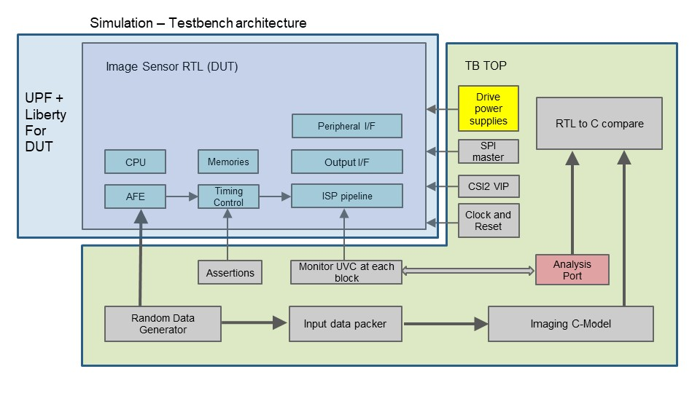
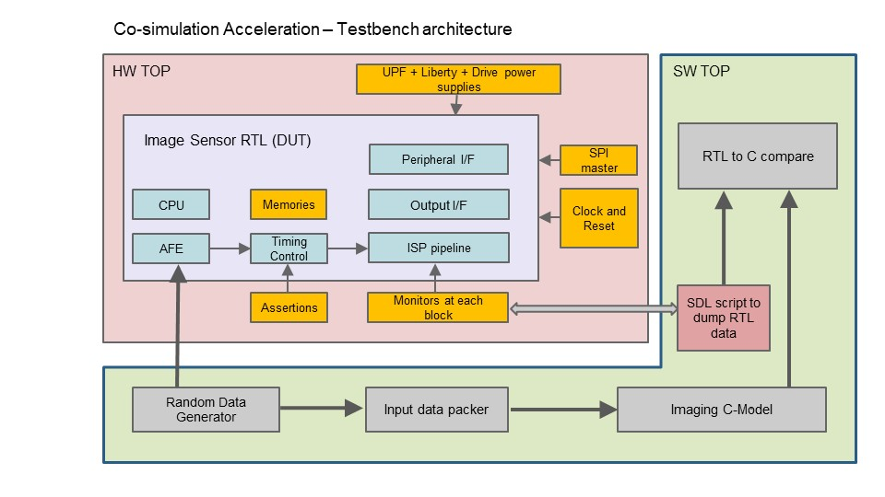
Securing design confidence for Low power and Functional features of Image Sensor SOC - Reuse of UVM simulation testbench on HW acceleration platform
Vivek Kumar, Manish Mallan, Karthik Majeti
Problem Statement/Introduction
Proposed Methodology/Advantages
Rapidly changing Camera Sensor market - resolution & feature upgrade every 6-8 months. Camera Sensor Pipeline includes - Analog Front, ISP pipeline, High Speed PHY (CSI2 with DPHY/CPHY), CPU Subsystem, 8-10 power domains.
Functional Verification challenges of a Camera Sensor(any typical Multimedia design):
High Pixel resolution & Long ISP chain -> Higher runtimes -> Iterative scoreboard bringup (C vs RTL sanity)
Product Firmware validation
Power Aware(PA) validation on RTL stipulates checking power strategy of design, viz. power transitions, state corruption/retention, FW/HW power controls.
Challenges Specific to Power Aware Verification:
Typical Run times >> 1day for 1 testcase -> Limits multimode power transition and only small size frame run -> More possible critical bugs.
Time taken per debug cycle is more.
Firmware can not use FPGA to run power aware simulations.
This poster demonstrates integrating a Palladium hardware emulator based simulation acceleration flow in an SV-UVM based testbench environment. We target porting all the power transition checks, isolation & retention checks, and scoreboard data checks to emulator to ensure functional correctness with power aware enabled on the emulator.
By passing power intent (UPF, liberty, isolation etc) file in compile time, the compiler inserts instrumentation logic to generate power-aware emulator database similar to simulation setup.
We propose to make following updates to SV-UVM based testbench for running hardware based sims.
Reuse the testcases, monitor, assertions & generic scoreboard logic
Integrate IEEE 1801 constructs for low power DV.
Minimizing time spent in software - reduce HW/SW interactions
Enable waveform support – to debug the issues. Also, the dump should be fast and allow probes on power elements of the design.
Support product firmware validation - for both function & power intent.
Implementation Details/Diagram
Implementation Details/Flow Chart
CHANGES FOR PORTING SIMULATION TB SETUP TO EMULATION
Scoreboard & Data monitors:
Data monitor on ISP IPs – Transaction Based Acceleration.
Data monitor on CSI2 High Speed I/F – Use Accelerable VIP(AVIP).
Assertions: Portable as is.
Power intent integration/compilation:
Compile time switches to input UPF & Liberty files
For any modules that are stubbed for emulation, may need compile switches to ignore.
Reuse simulation logic to control DUT supplies
Emulation run flow:
Run power transition sims with actual product firmware/custom C code -> scoreboard, power transition, isolation & retention checkers are active to catch any issue.
In waveform, view power loss & state corruption.
Power aware emulator database can be run without enabling Low Power also. Run as a normal sim by disabling through emulator switches -> allows narrowing rootcause of issue to functionality or power intent.
Fig [1]
Fig [2]
Results Table
Conclusion
Impact on development cycle
PRS validation closure: 12-14 weeks -> 8 weeks (settings cleanup, scoreboard validation, assertions for functionality)
Emulator replicates simulation functionally, thus ensuring no scope for additional uncertainties during debug phase.
Low Power Validation/Power Aware Validation
Simulation 24 hrs+ -> Emulation <1hr
On emulation corruption modeling differs from sim in few aspects -> Understand them well to leverage emulator capabilities.
Emulator database with PA switches -> larger gate count vs non-PA emulator db due to instrumentation for enabling PA on emulator. Some impact observed on runtime.
Post Silicon Validation in HP3 – World’s first mass produced 200MP Sensor
>200 sims ran on emulation to support queries on settings and issues.
~80% reduction in effort for reproduction & closure.
The run-time challenges due to large resolution and gate count can be mitigated by porting the testcases, sequences and checkers to emulator - They are crucial to catch any bugs that got introduced due to power intent of the design.
Ensuring bug-free product firmware is also important. Emulation on Palladium helps support faster validation of firmware to check it honors all power intent.
Performance gains of the order of 50x. Careful partitioning allows hardware to run for up to 95% of the time.
The strategy can be scaled to other similar multimedia designs.
Having IEEE 1801 constructs supported on Emulator platforms allows verification engineers to have more capabilities on disposal for uncovering critical silicon bugs.
Faster time to market, that allowed us to be pioneers of ultra high resolution class of sensors -> Help overcome schedule challenges.
REFERENCES
UVM Community (accellera.org) https://accellera.org/community/uvm
https://www.cadence.com/en_US/home/solutions/low-power-solution/power-aware-verification-methodology.html
https://www.cadence.com/en_US/home/tools/system-design-and-verification/emulation-and-prototyping/palladium.html

