Slide 1
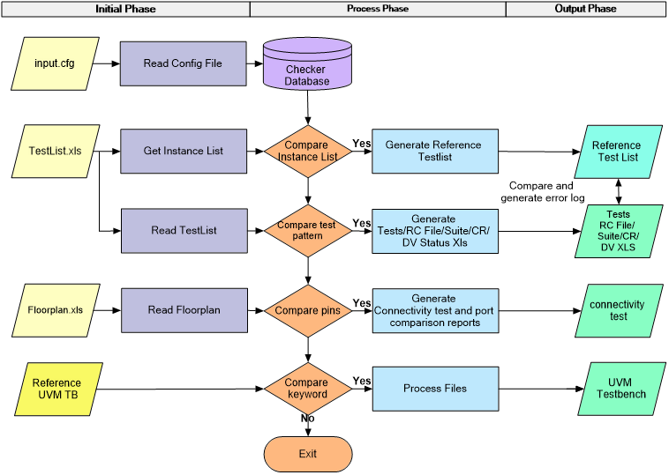
A RECONFIGURABLE AND FULLY AUTOMATED
SRAM ENVIRONMENT GENERATION FLOW FOR ROBUST VERIFICATION AND TO ACCELARATE DV CLOSURE
Vinay Swargam (vinay.s9@samsung.com),
Lakshmana Kumar Arumugasamy (lakshmana.a@partner.samsung.com),
Sriram Kazhiyur Sounderrajan (sriram.k.s@samsung.com)
Manual Creation of UVM TB
Update TB w.r.t Specification
Testcase generation for different algorithms
Generate Testsuite/DV Status/RC File/Checker etc.
Review excess/missing testcases
Regression and Coverage Closure
Problem Statement/Introduction
Proposed Methodology/Advantages
SRAM Test Chip
Technology Nodes 3nm/4nm/5nm
200+ Memory Instances
60+ Algorithms
Different Memory Compilers
Various Sign-off Corners
Multiple Test modes
Legacy Flow
SRAM UVM TB Auto Generation
Review Generated UVM TB
Regression and Coverage Closure
SRAM Generator Benefits
Zero Manual Error
Quick Bringup
Reuse TB Components
Faster Coverage Closure
Reduced
Development Time
Faster Debug
Project Timelines
Regression Issues
Auto kill of long run tests
Regression time spanning over 14-16 days
Extra Resource
Test/Checkers/Coverage/ Connectivity development
Multiple Iterations for Coverage Closure
Test vector generation and Review
Gaps in vector-list/floorplan
Delay in Input collaterals
Unplanned RTL Releases
3-4 Projects in Parallel
Shorter Project Timelines
Support for Silicon Debug
Limited regression slots
Current Flow
VSIF generation based on Dynamic runtime calculation → Adaptive LSF
Profiling and simulator performance optimization → 2.3x improvement in sim speed
Testbench optimisation → Execution of only target memory
Ranking of testcases → Faster coverage closure with minimal no.of tests
Save-Restore → Initialization + Specified Algorithm Execution
Implementation Details/Diagram
Execution Flow
Automated
SRAM Testbench Generator
SRAM
UVM TB
Input Phase
Process Phase
Output Phase
Golden Reference
CONFIG
Configurable UVM TB
Assertions/Coverage/Testcases
Priority based Testsuite Generation (RTL/NTL/PnR)
RC Files
Negative Checks
Memory Stress Test
Truthtable and Connectivity Test
Test List
Floorplan
Regression Suite
DV Status
Results Table
Conclusion
Methodology | Testbench Development Time (Days) | Project TAT (Days) | x factor of Debug Time
Existing Methodology | 25-30 | 63-95 | 6x
Current Methodology | 1-2 | 17-26 | x
Time
With help of the current methodology the verification cycle has shortened by 5x with same set of resources
Speed
2.5x improvement in simulation speed has helped in effective utilization of licenses and closing of 4 projects in parallel
Scope
The automation flow can be extended to IP’s like MRAM, OTP, SER and SC
Profile Summary | Automated | Manual | Comments
Test Run Time | 01:24:21 | 03:19:25 | Test Run Time
Summary Counts (Total Hits) | 4041363 | 6341331 | System Verilog Constructs
CPU usage | 60.0sec | 78.1sec | CPU usage in seconds
Total CPU usage | 67.60% | 89.70% | % CPU utilization
Type of Metrics | %hits | %hits | %hits - The percentage of the total hits detected in the activity
RTL/Design | 10.7 | 10.7 | % of total hits detected in the RTL
TB/ SV | 0.7 | 5.2 | % of total hits detected in the TB

