Slide 1
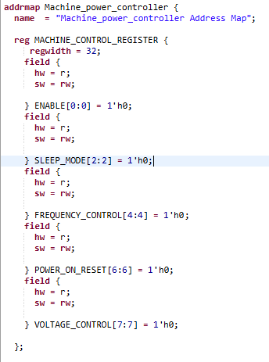
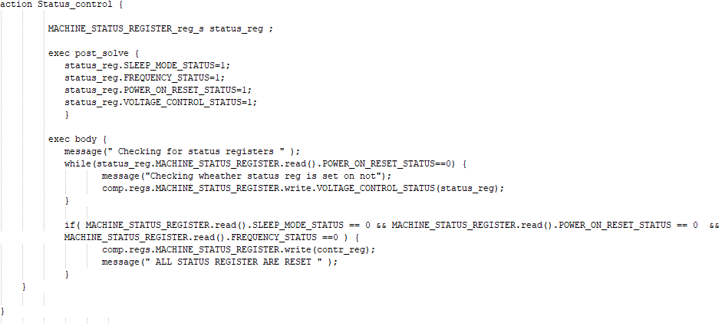
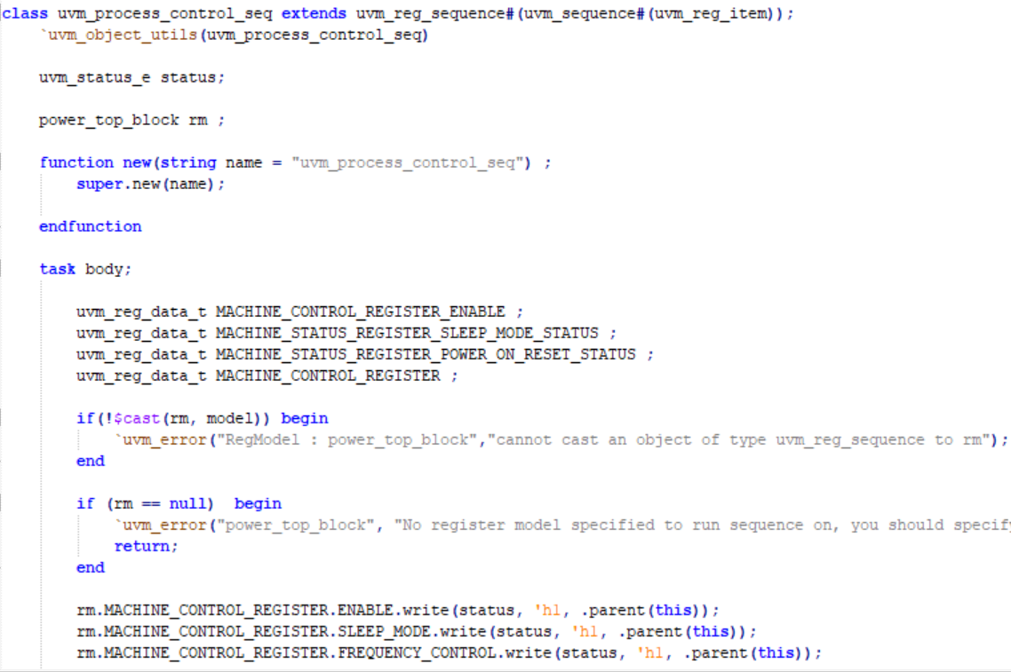
Automatic Generation of Implementation Layer for Embedded System using PSS and SystemRDL
SUDHIR BISHT - NIKITA GULLIYA
Problem Statement / Introduction
Proposed Methodology / Advantages
Portable Test and Stimulus Standard (PSS) establishes a unified representation of stimulus and test scenarios.
It caters to various users at different integration levels and configurations.
Growing design complexity and performance requirements necessitate automation and adaptability.
Flexibility in handling changes across applications helps reduce design costs and improve Return on Investment (ROI).
Shorter market windows require enhanced productivity and early bug identification through HW / SW co-simulation.
Lack of common sequences hampers collaboration, knowledge transfer, and slows down development.
PSS enables SoC / IP teams to reduce verification and validation time significantly.
Automatic generation of UVM and sequences facilitates exhaustive testing of memories and register maps.
PSS and SystemRDL provide valuable assistance in generating unified test and programming sequences for UVM and Firmware from the specification.
Test sequences can be defined in PSS, Excel, or Python GUI (IDS-NG), allowing flexibility for users.
Unified test sequences are automatically generated, covering verification to validation process.
The objective is to describe and generate programming and test sequences for a device, from early design stages to post-silicon validation.
Sequence creation is centralized using a single specification, supporting multiple output formats (SV / UVM, PSS, C, CSV, Matlab, PDF, HTML) for different SoC teams.
Portable Sequences for multiple IPs are allowed, ensuring synchronization with register descriptions in standard formats (IP-XACT, SystemRDL, RALF) or using the IDesignSpec™ integrated flow.
Implementation Details / Diagram
Implementation Details/Flow Chart
SystemRDL offers advantages over PSS for defining register specifications, especially for special registers like interrupts and counters.
It allows applying multiple properties to precisely define the functionality of registers, enhancing their description and behavior.
SystemRDL supports parameterization, enabling flexible and reusable designs by customizing bus widths, address spaces, and clock frequencies.
Overall, SystemRDL simplifies the process of creating register specifications and improves design flexibility compared to PSS.
The PSS code snippet showcases sequence specifications. It includes a component block that refers to the defined register specification.
The extend keyword is used to import and instantiate the register specification.
The sequence specification contains actions for each register, defining verification intent with activities and scheduling constraints.
Exec blocks within the sequence specify pre_solve and post_solve functionality. The pre solve block can access non-random attribute fields, while the post_solve block sets non-random attribute values based on randomly-selected values.
INPUT RDL
INPUT PSS
Results Table
Conclusion
PSS compiler and GUI generator has been developed for generation of various outputs from above golden custom sequence specification such as:
System Verilog / MATLAB output for Validation
UVM output for Verification
C output for Firmware
CSV output for ATE
HTML / Flowchart for documentation
The complexity of modern SoC has raised the requirement for HW / SW co-simulation to catch the bugs from the early design stage. There is a lack of common set of sequences which can be shared across the teams. The approach discussed in this Poster on PSS and SystemRDL which will help design teams to generate unified test and programming sequences in UVM and Firmware from the specification.
The register information can be in standard format like PSS / SystemRDL. Users can define the test sequences in PSS [or Excel, Python GUI (NG)], and then generate the unified test sequences from verification to validation.
The tests generated are UVM sequences for simulation and firmware sequences for HW / SW co-simulation and post silicon validation like start-up sequence, read-write operation shutdown sequence, low power mode sequence etc.
It has been explained through application on a machine power controller example.
C SEQUENCES
UVM SEQUENCES
REFERENCES
PSS 2.0 documentation: https://www.accellera.org/downloads/standards/portable-stimulus
SystemRDL documentation: https://www.accellera.org/downloads/standards/systemrdl
Interacting with Devices via PSS Registers: https://bitsbytesgates.com/
IDesignSpec GDI: https://www.portal.agnisys.com/release/docs/ids/CopyrightNotice.html
IDS-Validate: https://www.portal.agnisys.com/release/docs/validate/IDS-Validate1.htm

