Slide 1
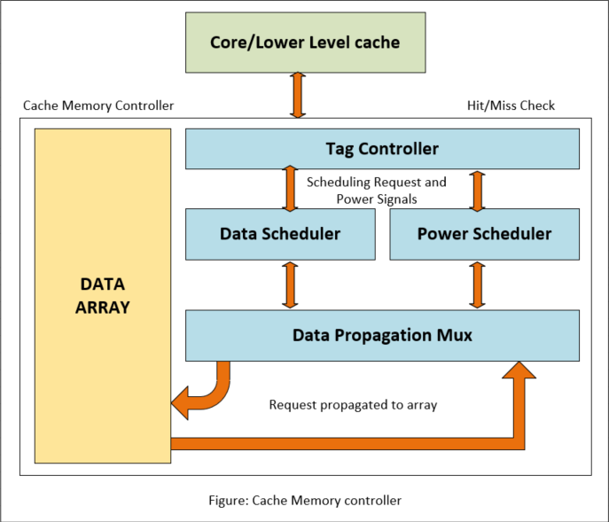
Formalize the Cache: Formal Verification Techniques to Verify Different Cache Configurations
Sudhanshu Srivastava, Rupali Tewari, Aman Vyas, Sachin Kumawat
Intel Technology India Private Limited
Cache Performance and Validation
Proposed Methodology/Advantages
In the emerging technologies, the cache memory controller plays a crucial role as it handles the interactions between CPU and cache memory. Its main features include powerup control, request scheduling, response latency and make sure that the routing performance is met to prevent any data loss and other data integrity issues.
To minimize performance loss due to area, power and latency multiple different configurations are supported.
As a result, 12 different types of asymmetricity emerged in the memory array, leading to 12 distinct cache memory configurations with varying timing and power requirements.
The problem statement centers around finding effective solutions to manage and optimize these asymmetric configurations, ensuring efficient performance while adhering to the given constraints of chip area, power, and routing.
The design encounters difficulties related to timing and overall system complexities. For validating the design, formal validation techniques were applied accordingly.
Validation Techniques |  | Description
Assertions | Logic-based | Verifies direct properties like scheduling conflicts and power conditions
 | Assertions with logic | Verifies minimum timing criteria for scheduling and power signals, using additional logic.
 | Forward progress checkers | Confirms read response correctness
 | Spurious checkers | Ensures absence of unscheduled responses
Covers and Ranged covers | Covers | Creates scenarios to estimate timing rules for power control and response latency.
 | Ranged Covers | Provide range estimates for expected behavior and generate meaningful traces.
Parameterized Tasks | Task-based approach | Validates all the configuration with different parameter values using separate tasks.
Methodology/Challenges
Implementation Flow
Design validation process addressed timing and performance challenges with varied complexity in design rules.
Formal property implementations were used to validate different configurations.
Logic-based assertions verified direct properties, such as avoiding simultaneous scheduling of requests or inactive charge pump requests.
Forward progress checkers ensured correct read response latency.
Spurious checkers prevented unscheduled read responses.
Covers and Ranged Covers were powerful tools used to create scenarios and set bounds for expected behavior.
A Task-based approach validated 12 configurations, each with different parameters, effectively managing complexity.
Stage 1.a
FV modelling and assertion for minimum power constraints
Stage 2
Wrote covers to get the design scenarios satisfying minimum power constraints
Expected performance
Scheduling request based on minimum power constraints
Run stage 2 in FPV
PASS
FAIL
Schedule request as per 12 cache configuration
Stage 1.b
Checkers to ensure the request is scheduled as per the configurations
Stage 3
Add range covers to identify the next possible minimum power timing in the design
To identify the best possible performance
Analyze the cover traces to identify which configuration has power timing performance issue
Feedback given to improve architectural power performance
Request duplication based on data block power specification
Stage 1.c
Assertions for power checks based on data block power timing specification
Stage 4
Task based approach with 12 configuration parameters taken for each of the 12 tasks
Run stage 4 in FPV
PASS
Run stage 1 in FPV
FAIL
Power specification met
Design Bug
Update the range for failed configuration and rerun
PASS
FAIL
Results Table
Conclusion
Objective
Bugs Discovered
Premature power down of a data block observed.
Validate power requirements of 12 different configuration of Ips.
Numerous bugs discovered including three major ones.
Data block powered down earlier than required as per the spec.
Incorrect response data from the cache.
Expected response after 22 clock cycles but arrived after 18 clock cycles.
Resulted in data loss and corruption.
Potential for significant performance loss if bug remained unaffected.
In this paper, we have presented a comprehensive exploration of Formal Verification techniques that are specifically targeted towards the verification of power-up control and timing constraints related to request and response latency.
Our systematic approach ensures an exhaustive verification process, enabling the identification of not only shallow bugs but also deeper-bound bugs that may exist within the design.
By employing these Formal Verification techniques, we have not only been successful in identifying bottlenecks and hard-to-find issues but have also been able to achieve timely sign-off, ensuring efficient and effective verification of the IPs under consideration.
We strongly recommend the adoption of these formal techniques for IPs where asymmetry may be present, as outlined in this paper.
Our findings clearly demonstrate the effectiveness of the proposed solution in detecting and addressing bottlenecks, hard-to-find issues, and ultimately achieving timely sign-off, thus enhancing the overall verification process.
REFERENCES
[1] Formal Verification: An Essential Toolkit for Modern VLSI Design by Erik Seligman, Tom Schubert, M V Achutha Kiran Kumar
[2] IEEE Std 1800™-2017, IEEE Standard of System Verilog – Unified Hardware Design, Specification, and Verification Language.
[3] T. Patel, “Using Formal Sign-Off to Deliver Bug-Free IPs”, Oski Decoding Formal Club, Dec 2019

