Slide 1
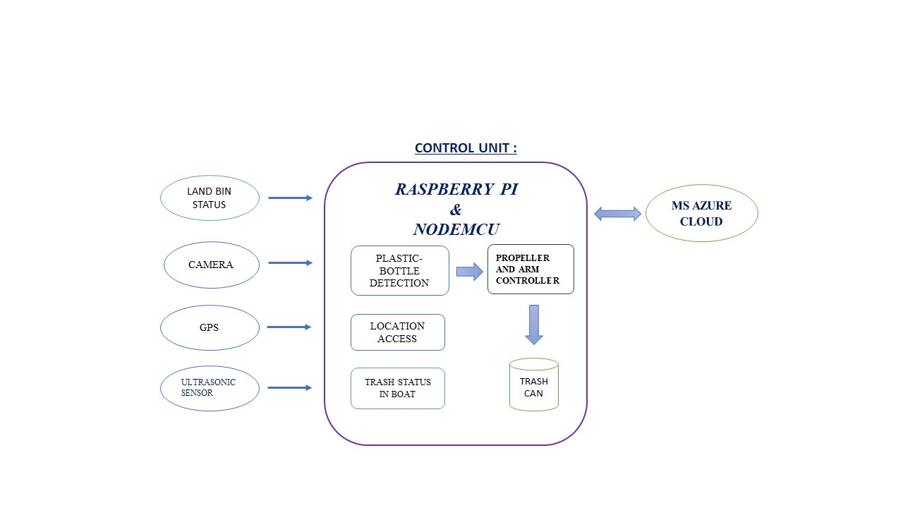
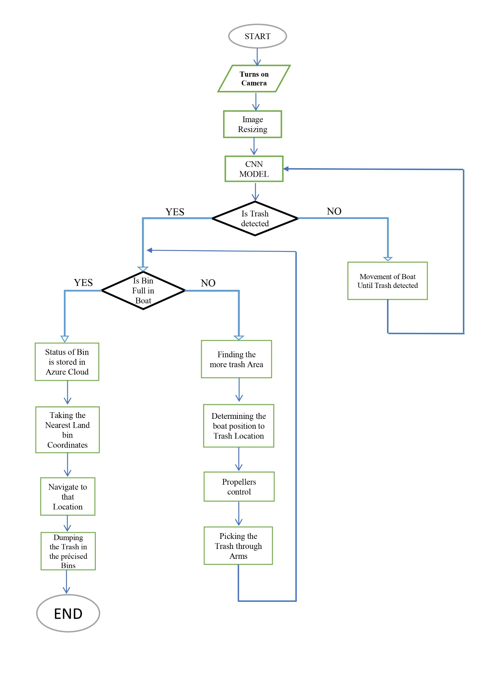
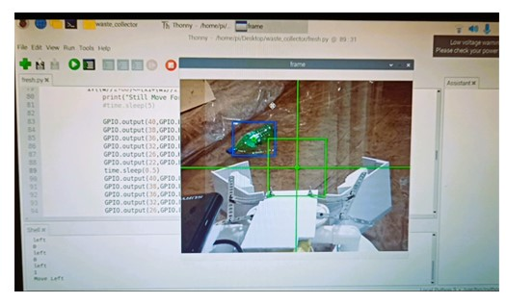
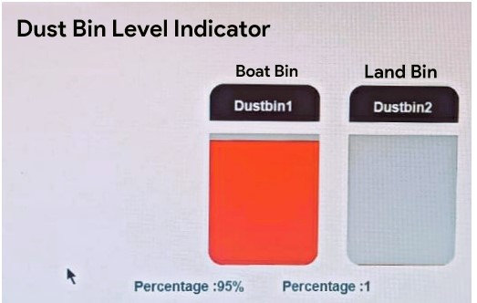
AUTOMATED FLOATING TRASH COLLECTING BOAT
KARAMALAPUTTI RAHUL
GANDHAM NAGARAJU
Problem Statement/Introduction
Proposed Methodology/Advantages
Plastic contamination of aquatic ecosystems has grown to be a serious problem for both humans and aquatic species. According to previous studies, nearly 300 million metric tonnes of plastic waste are floated on water bodies. As the global population continues to grow and urbanization intensifies, the amount of litter and debris polluting our rivers, lakes, and oceans has reached alarming levels.
To keep our water bodies, clean and healthy, we need effective technology. Due to this, we have designed a prototype that will enable us to safely collect the plastic that is dumped in water bodies and transport it to recycling facilities.
Using an efficient propulsion system, the boat moves autonomously through the water, targeting areas with high concentrations of floating trash. It follows predefined routes or adapts its path based on real-time data and environmental conditions.
By combining cutting-edge technology, efficient autonomous waste collection mechanisms, and autonomous navigation systems, our solution represents a significant advancement in sustainable environmental conservation efforts, promoting cleaner water bodies and protecting marine life.
The proposed model consists of distinctive functional blocks for plastic bottle detection, collection, and dumping near the precise bins, which are located on land. Each functional block works as follows:
The floating waste is detected through the DNN Yolov4 tiny algorithm, which has low weights and can handle low memory usage. Using these algorithms gives better accuracy and more speed in the detection process.
Based on the detection of the bottles and their centroids taken into consideration, we can count the trash where more trash is available, and the propellers rotate, which drives the boat to pick up the trash in the water resources precisely.
It always checks if the trash bin is full or not through readings from an ultrasonic sensor, and this status data is sent to Microsoft Azure IOT Central through a Raspberry Pi by using the MQTT protocol, and land bin status is sent through a NodeMCU (ESP8266) module.
Through GPS, it fetches the current coordinates of the boat and predefined destination coordinates for trash dumping to the nearest bins located along river shores. On the river's shores, their coordinates are sent to Azure IOT Central . For the user interface, we have developed the website that shows the bin level in the boat, the land bin level, and the location. These prototypes save time, money, and allow for more efficient system integration.
Implementation Details/Diagram
Implementation Details/Flow Chart
Results Table
Conclusion
DETECTION & COLLECTION OF TRASH:
BIN STATUS IN AZURE CLOUD:
The Automated Floating Trash Cleaning Boat represents a significant leap forward in the fight against waterway pollution.
The automated floating trash cleaning boat, powered by solar panels, aims to reduce ocean trash pollution and harm marine life by detecting and collecting trash using sensors, autonomous operation, and scalable design.
Our solution offers a sustainable and efficient approach to preserving our precious aquatic ecosystems. By harnessing AI and machine learning, these boats can continuously improve their performance and contribute to a cleaner and healthier marine environment. The widespread adoption of such innovative solutions is crucial for the preservation of water bodies.
Through this poster, we aim to raise awareness about the boat's potential and encourage further collaboration and innovation in the field of environmental conservation and cost-effective solutions.
REFERENCES
Design and fabrication of water surface garbage cleaner:
https://www.researchgate.net/publication/343602644_Design_and_fabrication_of_water_surface_garbage_cleaner_machine_using_non_conventional_energy
Article development of water trash collector:
https://www.researchgate.net/publication/345132249_ARTICLE_DEVELOPMENT_OF_WATER_TRA SH_COLLECTOR

