Slide 1
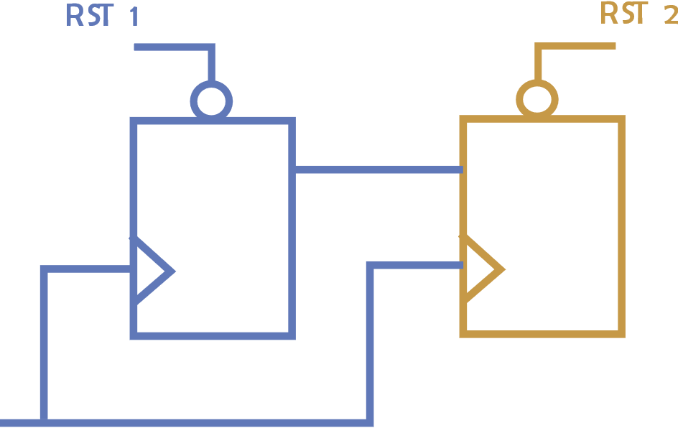
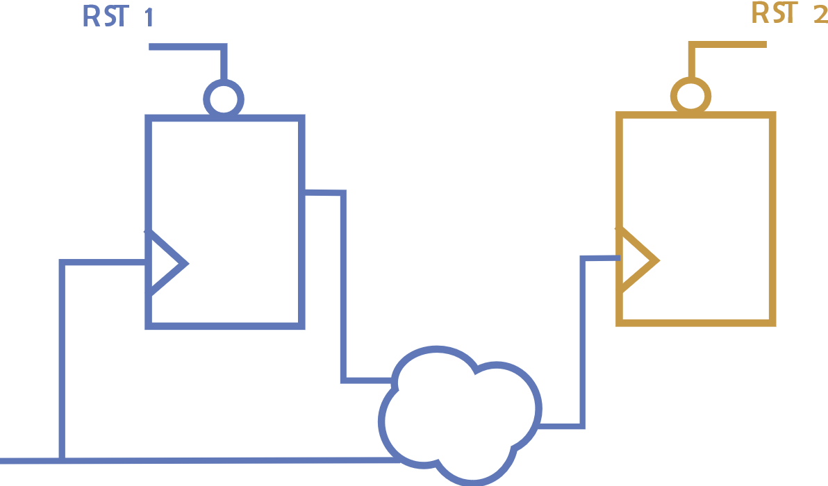
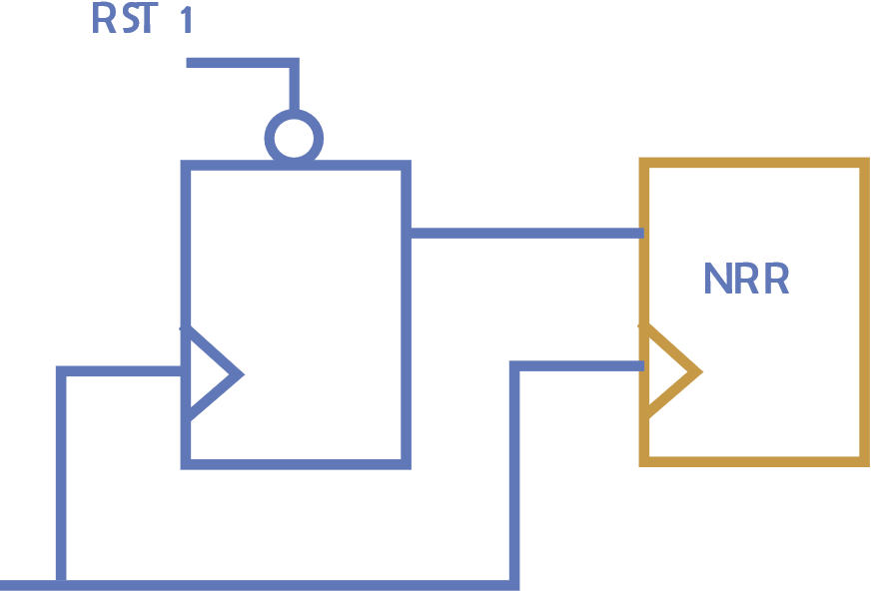
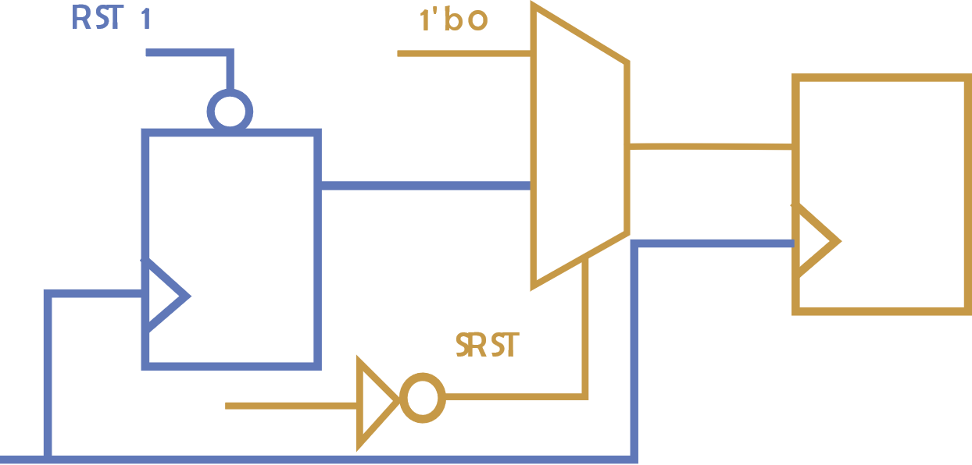
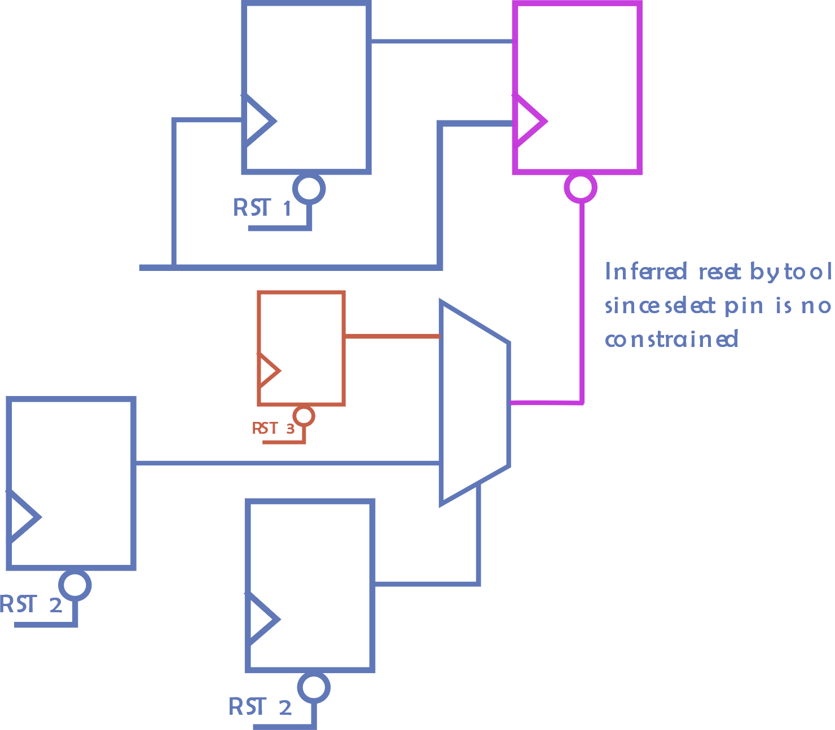
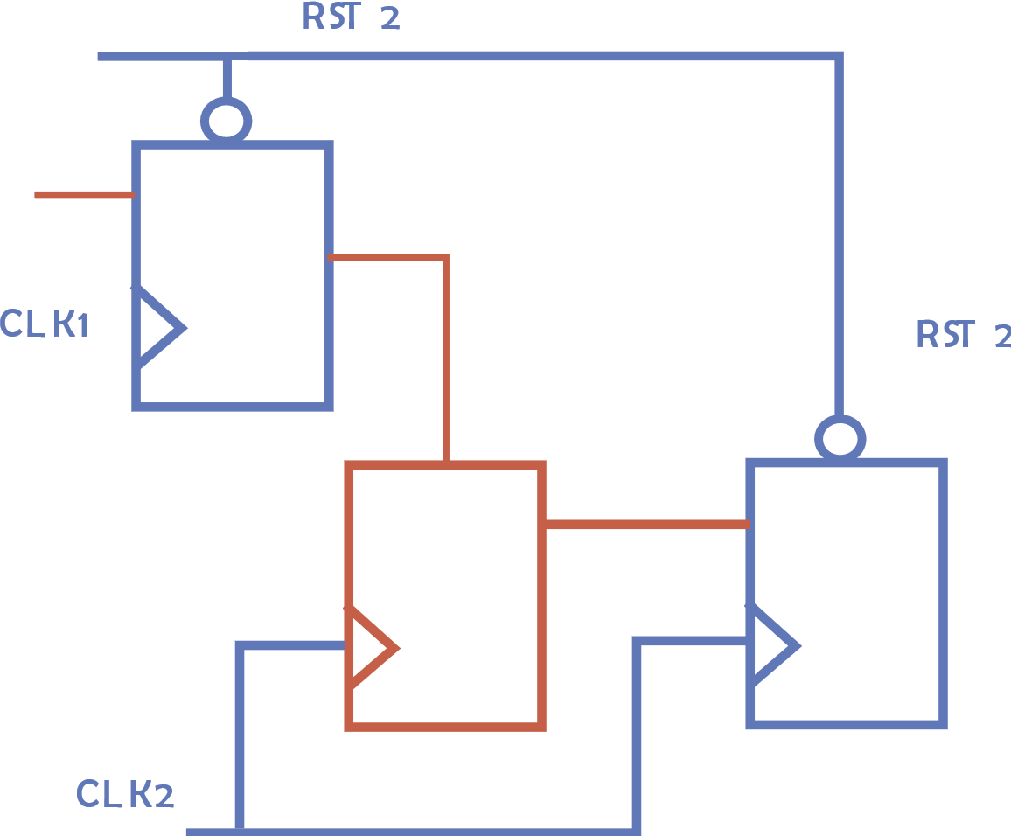
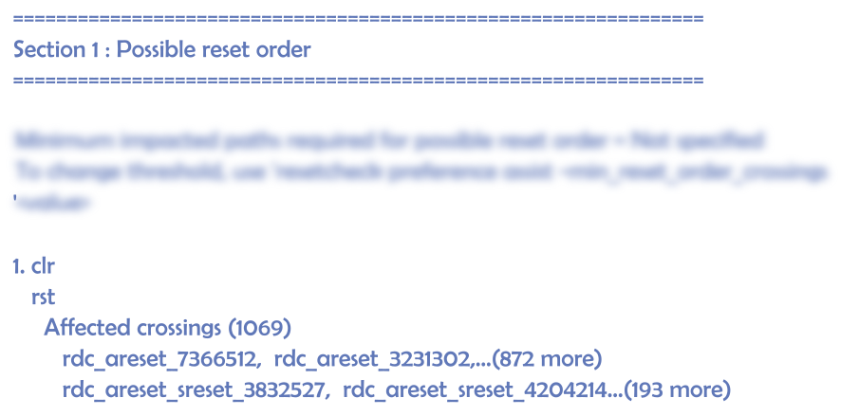
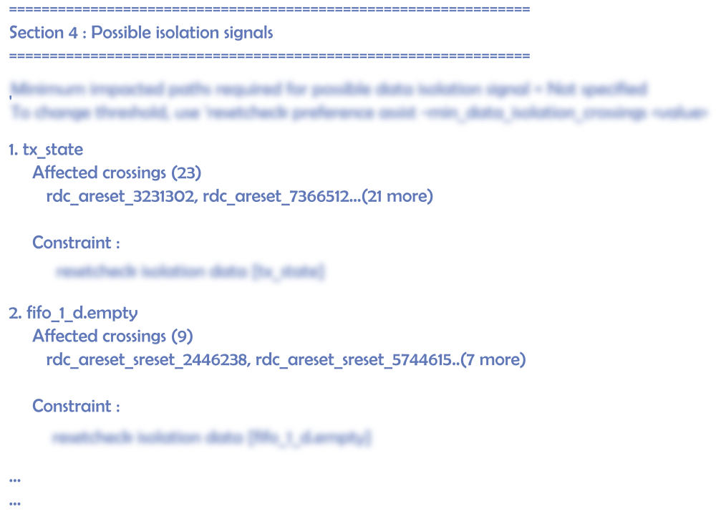
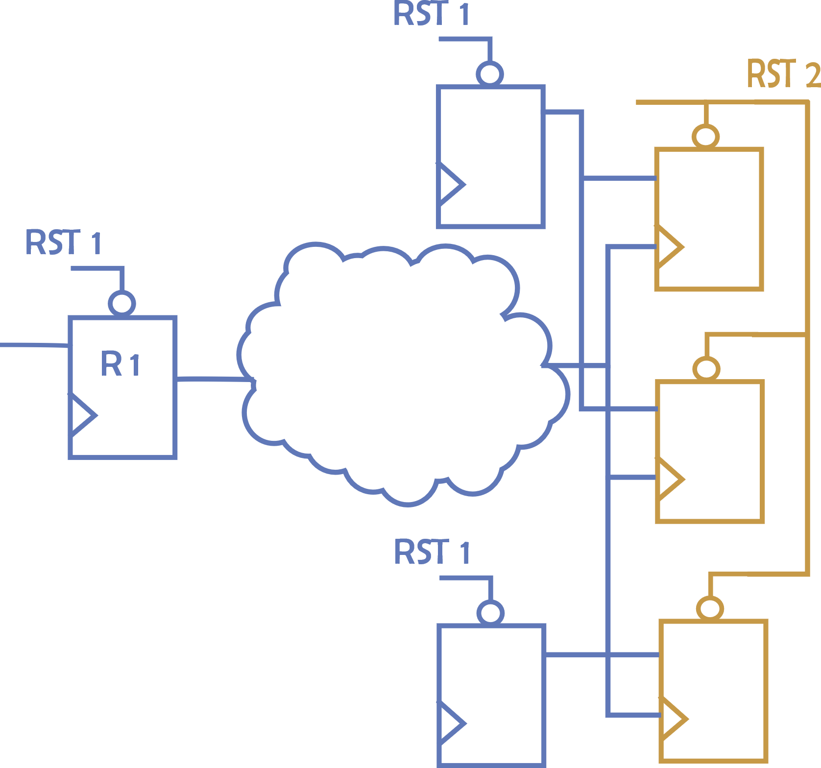
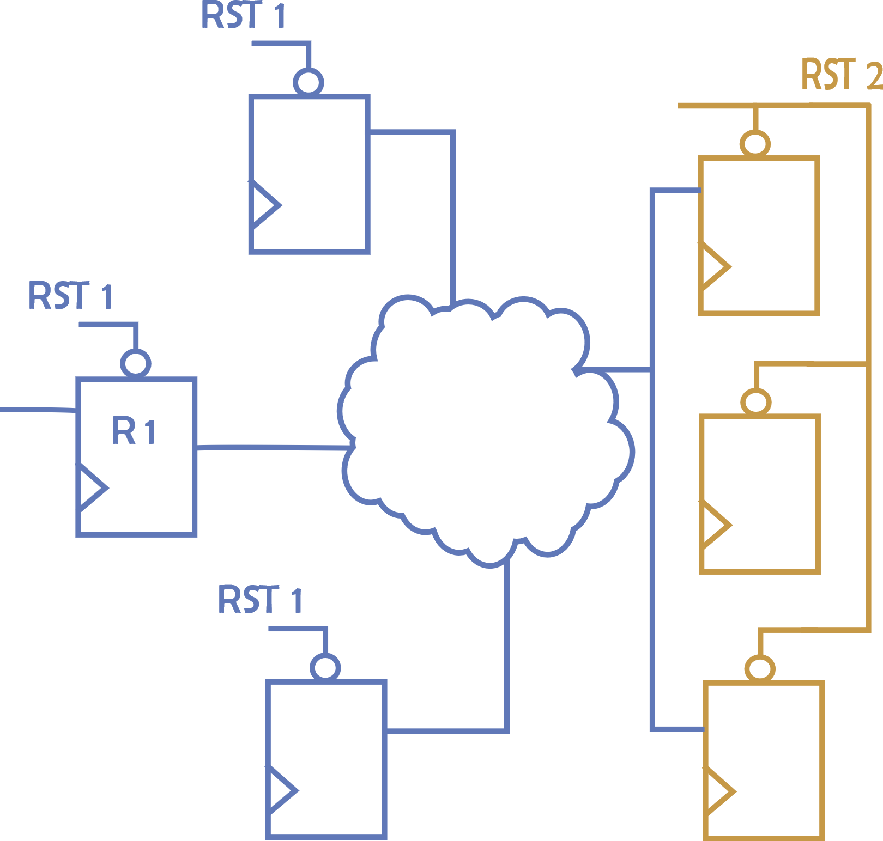
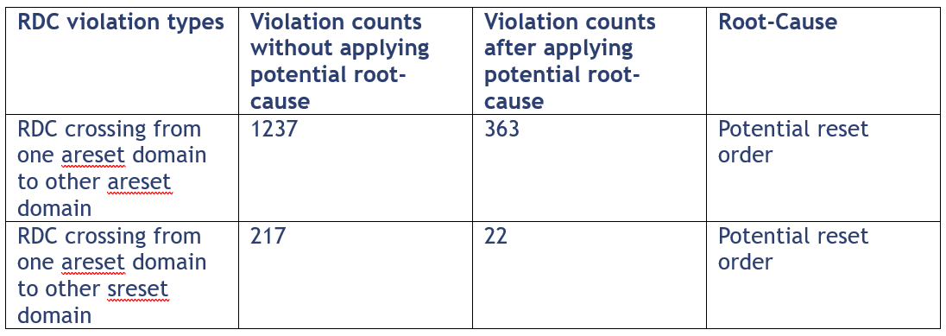
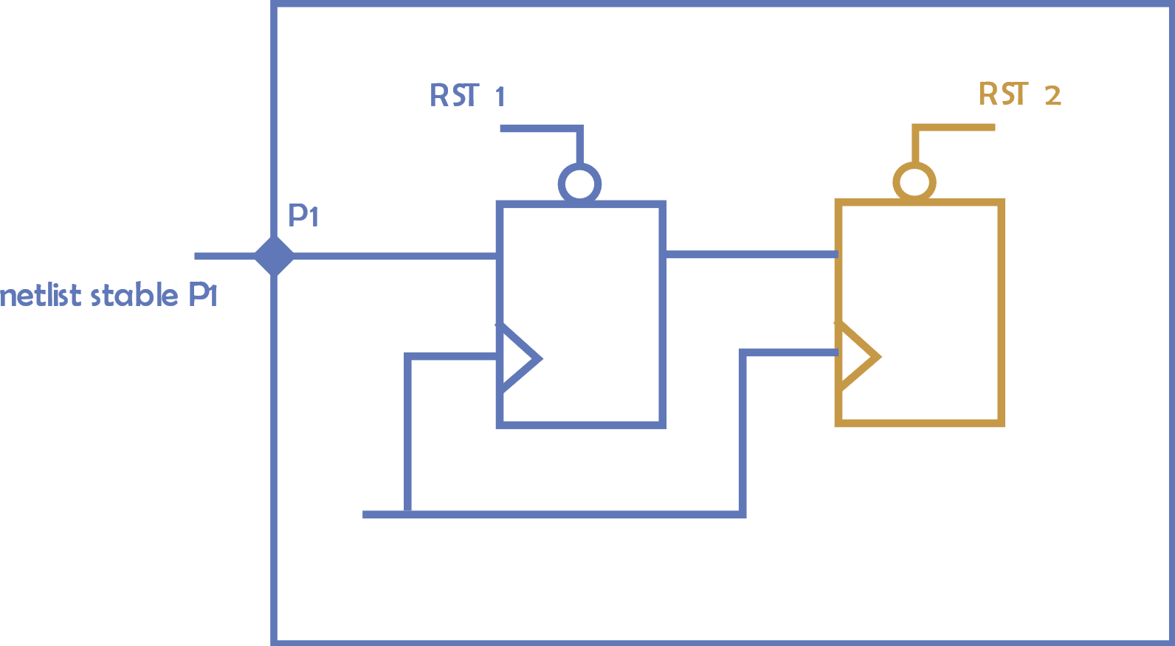
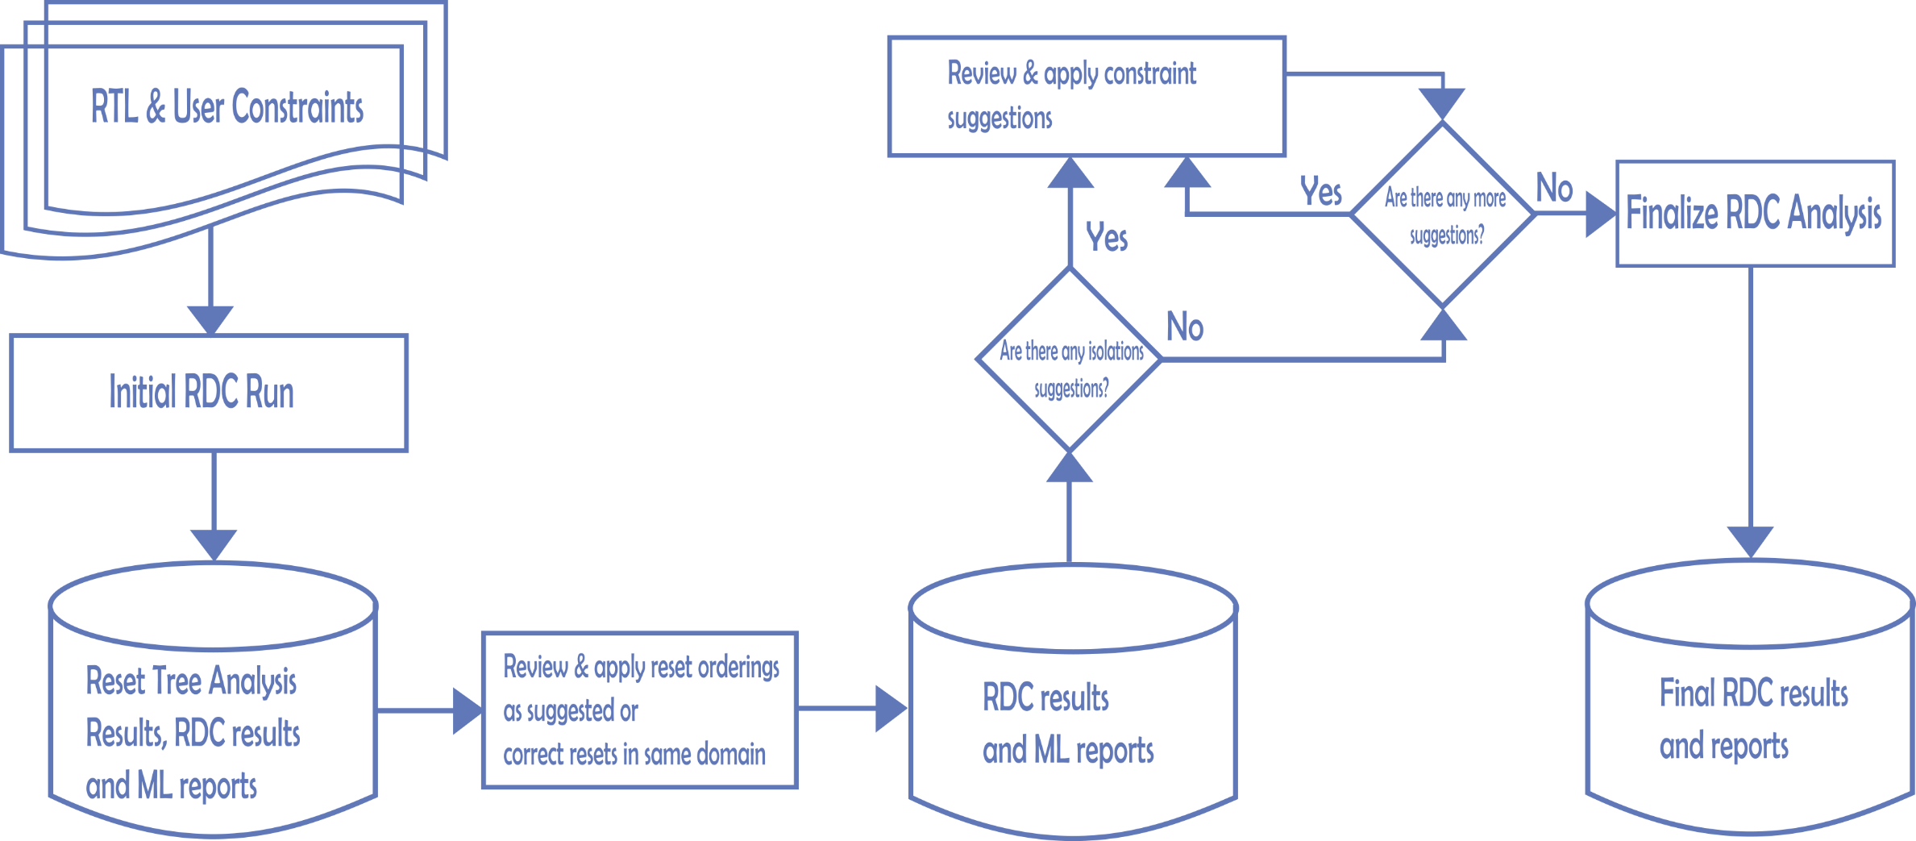
Efficient methodology to uncover common root causes for RDC violations using intelligent data analytics
Siemens EDA, manish.bhati@siemens.com
Siemens EDA, rajagopal.anantharaman@siemens.com
NXP Semiconductors, inayat.ali@nxp.com
Introduction
Challenges
Complex SoCs, like designs from automobile or aerospace industry, not only involve multiple clock domains, but even more complex reset architectures leading to many RDC domains. Resets are important part of any design as these lead a design to a known state. Designs involving functional safety may have many independent reset signals which may be used to reset selectively a part of the design, while rest of the design may be in the functional mode. This will lead to interactions between reset signals and data signals across reset domain boundaries. RDC signals can lead to functional issues and thus should be caught early in the design cycle.
Static verification tools often come with standard methodologies and goals for RDC verification. But improper constraints, assumptions and configurations in RDC analysis can lead to huge number of violations which are nothing but noise in the static analysis. For false violations verification engineers apply waivers. This adds to another burden of waiver management. It is often desired that the tools should have a methodology which has an automated data analysis or machine learning solution which can detect the issues in the setup and give corrective suggestions to verification engineers to eliminate noise.
This paper investigates on how machine learning/data analytic algorithms can significantly lower the noise. This paper also tries to uncover a methodology for root cause analysis by employing some intelligent data analytics and machine learning features which the static analysis tools should employ.
RDC issues have common root causes. Designers often see many RDC violations spread across different block hierarchies like IPs, tiles and subsystems. RDC analysis efforts increase when these blocks are further integrated at SoC level. Designers see millions of violations and often rely on waivers for false violations. Its often found that many violations have common root causes as the crossings are governed by common signals controlling various RDC crossings. Figure below show some of the various categories of RDC violations identified by the static analysis tools. These can be classified as RDC which can happen on datapath, clockpath and resetpath.
Simple RDC Crossing
RDC Crossing on clockpath
RDC Crossing due to non-resttable regsiter
RDC Crossing from async reset to sync reset
RDC Crossing on resetpath
RDC Crossing due to source of Tx reset in different clock domain
Machine learning and Data Mining
Improvements after tool suggestion
The data mining and ML aspect of RDC analysis helps in identifying correct constraints and improve the RDC setup leading to better quality of RDC results. Table below depicts some non-trivial constraints used during RDC analysis and some ML recommendations given by the tool.
Following data shows results after applying tool* suggestions by analyzing various root causes.
Types of Constraint Specification | Solution & RDC Setup Recommendations
Reset Grouping | Suggest suitable reset groupings to control noise
Reset Ordering | Suggest suitable reset orders for RDC paths
Port Reset Domains | Suggest potential port reset domain information
Isolation Signals | Suggest suitable isolation signals
Stable Signals | Suggest potential registers at reset values from RDC point of view
* Results with Questa RDC tool
Proposed Methodology
Conclusion
We propose a methodology which includes constraint suggestions given by the tool based on various machine learning algorithms. For any successful RDC/CDC analysis, it should first have a clean reset and clock tree. The methodology is iterative in a sense that it first gives preference to cleaning reset tree by identifying reset orders and resets in same domain as suggested by ML algorithms. With clean reset tree we next identify any clock and data isolation signals and apply the constraints. The process literately looks for any other suggestions like Tx registers at reset value. Applying these constraints will lead to RDC result with less noise and real RDC issues. See figure below.
Machine learning is imperative now in almost all engineering flows. Design and verification engineers had worked hard in analyzing over pessimistic static analysis results. This leads to lot of waivers and a waiver migration overhead. Also chances of a bug escaping cannot be ruled out. Machine learning and data analytics capabilities help engineers focus on real issues as the result is less noisy and constraints are applied properly.
We have proposed a methodology which incorporates ML/Data Analytics results along with RDC analysis results. This helps engineer to fine tune the constraints and have less noisy and accurate results.
REFERENCES
Arpita Agarwal, Inayat Ali, Manjunatha Srinivas, Kurt Takara, Abdul Moyeen, Leveraging Superior Data Analytic Techniques to Achieve Faster Clock Domain Crossing Verification Closure, DVCON India 2022
Inayat Ali, Abdul Moyeen, Mentor, Manish Bhati, Manjunatha Srinivas, Bringing Reset Domains and Power Domains Together – Confronting Issues Due to UPF Instrumentation

