Slide 1
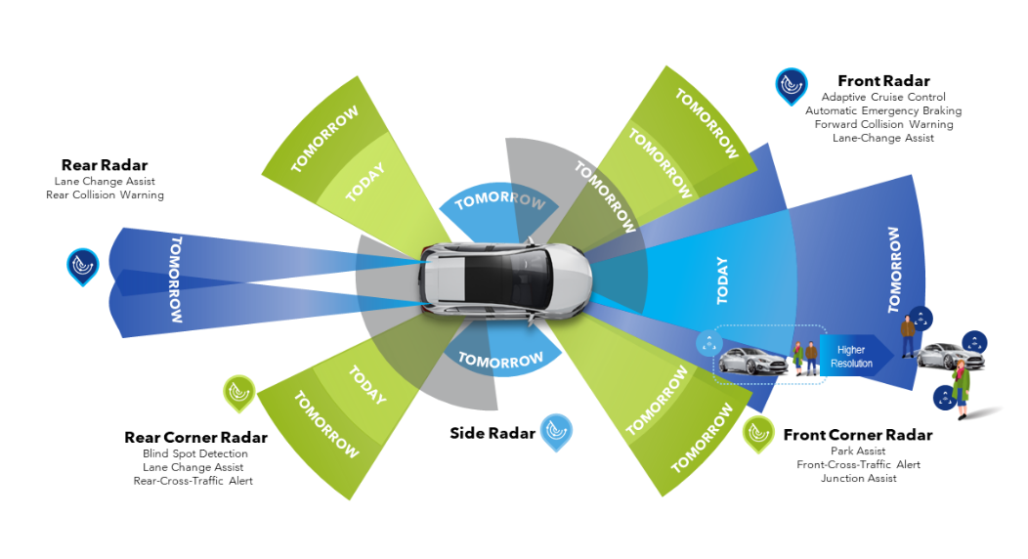
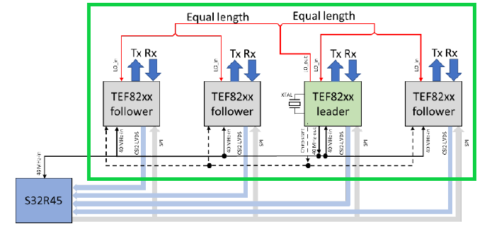
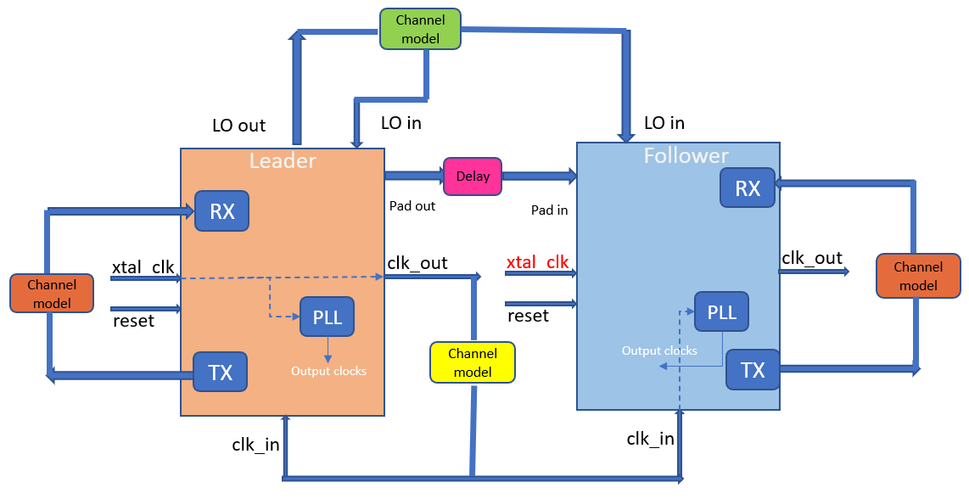
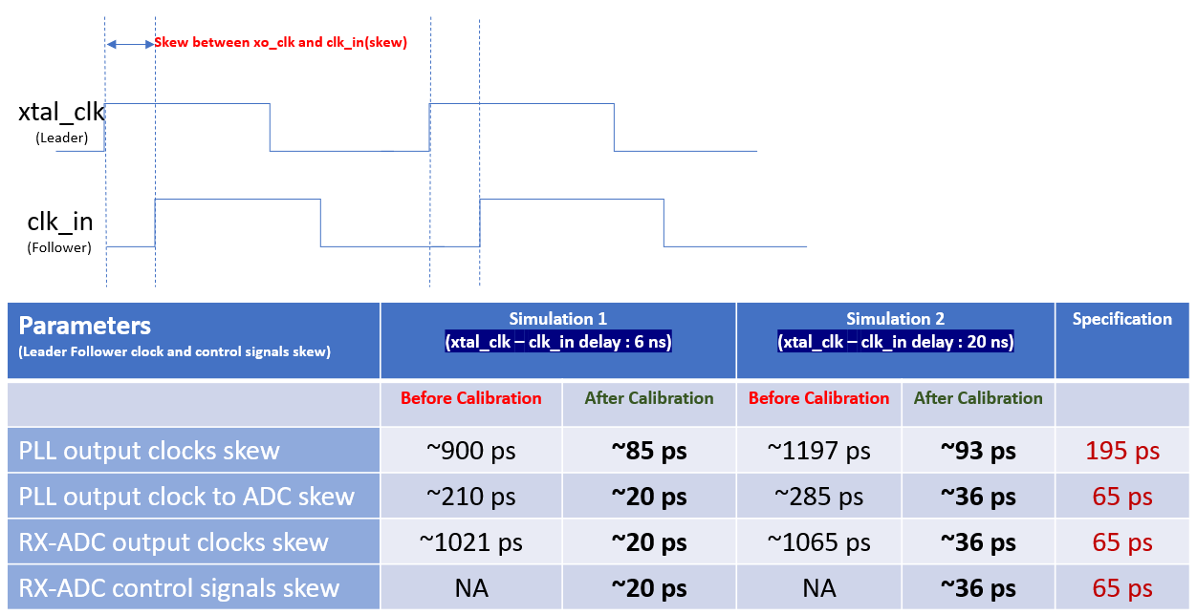
Design verification of a cascaded mmWave FMCW Radar
Shweta Pujar, Vijay M, Sainath Karlapalem
Dharani Sharavanan, Kavya P S, NXP Semiconductors Pvt. Ltd.
Introduction
Verification Methodology
RADAR sensors have become a popular choice for Advanced Driver Assistance Systems (ADAS) in cars.
Cascaded RADAR sensors are widely used to enhance the signal to noise ratio and angular resolution in Imaging RADAR systems.
In a cascaded RADAR system one sensor acts as a leader and rest as followers.
Fig 1. NXP Automotive Radar. Source - www.nxp.com.
Verification problem of a cascaded transceiver system was decomposed into following levels:
IP/Subsystem level: Proving the calibration hardware algorithm with a range of clock skew values.
SoC level: Hardware software co verification with calibration firmware routine executed by the MCU and signal chain from chirp generation to processing of RADAR data.
System level: Compensation of PCB delays and inter sensor communication from powerup till RADAR data cube transmission for use case scenarios.
In order to verify a cascaded transceiver for a single follower topology for the above-mentioned requirements, a two-fold approach was followed.
Fig 2. Cascaded transceiver topology. Source [2].
Implementation Details
Implementation Details
Subsystem level:
The subsystem level verification involved cascading of two instances of the mixed signal radar frontend subsystem.
Testbench Infrastructure Included:
Behavioral models for mixed signal components.
Phase difference checkers for clocks, chirp and radar output timing signals.
Multiple instances of register model, monitors and adapters were created for multicasting/broadcasting.
Multiple instances of channel models emulating various delay aspects of signals such as peak to peak, amplitude, phase.
Jitter creation for reference clock.
Gate level simulation of this setup was also carried out for all corners.
Fig 3. ADC Output
SoC and System level:
The system on chip verification environment included cascaded instances of the mixed signal radar frontend subsystem along with the CPU subsystem.
Testbench Infrastructure Included:
A testbench configuration switch is used to enable selective logic stubbing.
Testbench code memory was modified to handle transactions from two MCU interfaces.
Pad connections between leader and follower.
Seamless code reuse from subsystem level.
Multiple instances of channel model were incorporated.
MATLAB checkers for SNR and frequency for each sensor are included.
Fig 4. Single follower configuration with delay elements
Results
Conclusion and Future Work
A comprehensive verification of the cascaded RADAR system for a single follower was achieved by following the two-fold approach.
Fig 5. Calibration results for two simulation examples.
Issues that were found in this verification effort :
In gate level simulation at subsystem level the phase difference of the PLL clock after calibration between leader and follower was beyond the permissible limits. This was due to an issue with the PLL model.
At SoC level a phase mismatch at the PLL outputs with respect to reference clock occurred even before calibration. This also was due to issue in PLL model.
A cascaded RADAR system is the practical application of RADAR sensor for short/mid/long range or beam forming applications.
It is critical to ensure the chirp generation is synchronous in all cascaded devices to guarantee the correctness of the received data on all devices which is further used for object detection/classification.
By emulating the pad and board delays in digital verification and extending the single sensor testbench to help support a cascaded design, verification of a critical feature of the RADAR sensor was achieved.
Future Work:
MATLAB checks implementation for phase difference between leader and follower.
Gate level simulation at SoC level.
Improving the elaboration and run times at SoC level.
Currently TX is connected to RX. Enhancement needed in channel model to include actual road scenarios and weather conditions.
REFERENCES
Sainath Karlapalem, Shashank Venugopal, Scalable, Constrained Random Software Driven Verification, 2016 17th International Workshop on Microprocessor and SOC Test and Verification, IEEE Xplore: 20 March 2017
F.G. Jansen, F. Laghezza, S. Alhasson, P. Lok, L.M.A. van Meurs, R. Geraets, O. Paker, J. Overdevest, Simultaneous Multi-Mode Automotive Imaging Radar Using Cascaded Transceivers, 18th European Radar Conference
I. Bilik et al., "Automotive multi-mode cascaded radar data processing embedded system," 2018 IEEE Radar Conference (RadarConf18), Oklahoma City, OK, USA, 2018, pp. 0372-0376, doi: 10.1109/RADAR.2018.8378587
https://www.nxp.com/products/radio-frequency/radar-transceivers-and-socs/high-performance-77ghz-rfcmos-automotive-radar-one-chip-soc:SAF85XX

