Slide 1
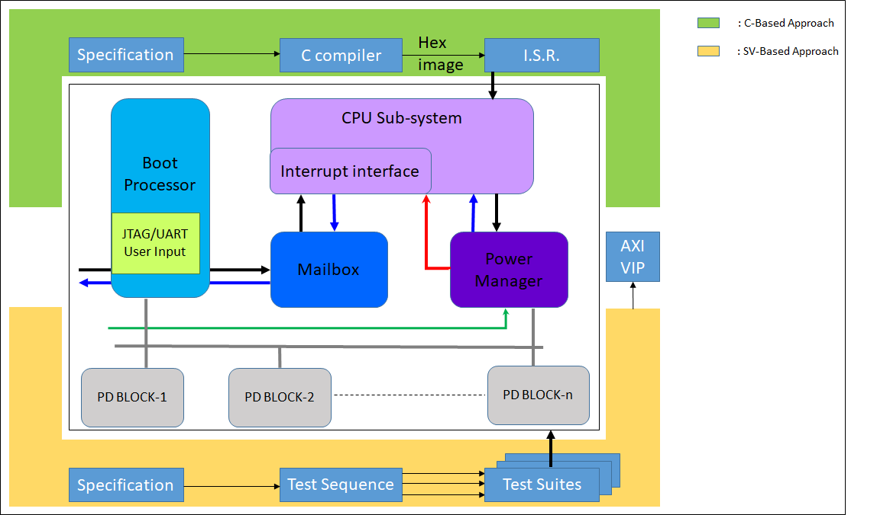
Highly Flexible and Robust System Level HW-SW Power Management Verification based on RISC-V
Subramanian Ravichandran (ramanian.r@samsung.com)
Sekhar Dangudubiyyam (sekhar.d@samsung.com)
Samsung Semiconductor India Research, Bangalore, India
Introduction
Proposed Methodology/Advantages
With newer technologies and complex designs coming into the picture in semiconductor industry, time consumed for research and development, and product development is increasing day by day. This has created a necessity for the Design and Verification Engineers to come up with a solution that decreases the Turn Around Time significantly as well as achieve the Verification targets.
Boot mode pins
Cold Boot Seq.
ISR N
RISC-V
ISR 1
ISR 2
ACK / INTERRUPT
Config. Bus
PIN Reset Release
Clock Mgmt. Unit Reset Release
RISC-V Core Reset Release
BLK 1 Reset Release
BLK 2 Reset Release
BLK 3 Reset Release
.
.
BLK N Reset Release
BLK CPU Reset Release
Verification of HW-SW based Power Manager that is being handled by RISC-V processor in a complex SoC involves a lot of challenges and requires a variety of testbench stimuli for exhaustive coverage. Here, we discuss about a highly flexible and robust testbench environment that has a two-fold method that enhances and accelerates the verification cycle without compromising on the quality
Power Manager
HOST
Mailbox
Reset Seq.
RISC-V
Power
Manager
BLK A
BLK B
Clock Seq.
CLIC
BLK C
Power Seq.
HW FSM controlled
Controlled by RISC-V SW
256 interrupt lines
Custom boot sequence flow
Priority handler check from priority table
User defined power down entry/exit sequence
(Isolation, Clamp value check, on-the–fly overrides, etc)
Concurrent interrupt handling
Observability through JTAG
Customized verification of custom retention scope
Implementation Details/Diagram
BLK1 sleep_request
Interrupt Handler
BLK1 power_down_entry/exit
Multiple
Interrupt
Lines
BLK1 clock_gating
BLK N sleep_request
BLK N power_down_entry/exit
Priority Encoder
BLK N clock_gating
C - based approach: In C based approach we have first generated a hex image of the Interrupt Service Routine (ISR). The ISR is then fed to a Tightly Integrated Memory (TIM) of RISC-V CPU. This helps in providing low-latency access to the instruction memory. Whenever an Interrupt Request (IRQ) comes from Power Manager to RISC-V, the corresponding ISR will be serviced to power-up/power-down the respective block or IP.
SV – based approach: In SV based approach commonly used verification methodologies have been used to generate test suites from test sequences. We have used AXI transactors for achieving faster turnaround time. When the testbench sees an IRQ, it calls the common power-up/power-down APIs which depict the processor’s ISR behaviour.
Each of the 256 Interrupt pins to the RISC-V has a dedicated functionality and the testbench has a corresponding ISR routine for each of them.
Multiple Combinations of Software Workloads are fed to the Interrupt Handler by the Power Manager to check the behavior of Priority Encoder (The priority can also be SW controlled)
Complete randomization of IRQ inputs and the sequence is flexible enough to allow the user to dictate the no. of IRQs to be sent and the priority configuration of the Interrupt Handler
Applications
Results and Conclusion
HW-SW Hybrid Co-Sim TB Architecture
Different interrupts with different priority levels.
Dynamic On-Chip reset generation & controllability
Random Power down entry/exit
System Power gating modes
Smart Isolation overrides
Generic and Scalable Two-fold Testbench Architecture
Multi level re-use from Sub-system to SoC, DV to SW ( Driver Development) and across projects
Faster Closure on DUT coverage using different Interrupt groups with varieties of SW workloads
Ease of Power Estimation vector generation with different PST combinations
Custom Interrupt Groups
Boot, Reset & Clock
Power Mgmt.
The Implementation of the HW-SW Hybrid Co-Sim TB Architecture has been successfully validated with Varieties of SW workloads targeting various priority levels of Interrupt Handling by RISC-V along with Concurrent power-down entry and exit of multiple blocks in the SoC where the stimulus has been easily ported from Sub-System Environment to SoC Environment
REFERENCES
[1] Si-Five E20 Manual v1p0 : https://static.dev.sifive.com/SiFive-E20-Manual-v1p0.pdf
[2] Power Management Unit Technical Reference Manual

