Slide 1
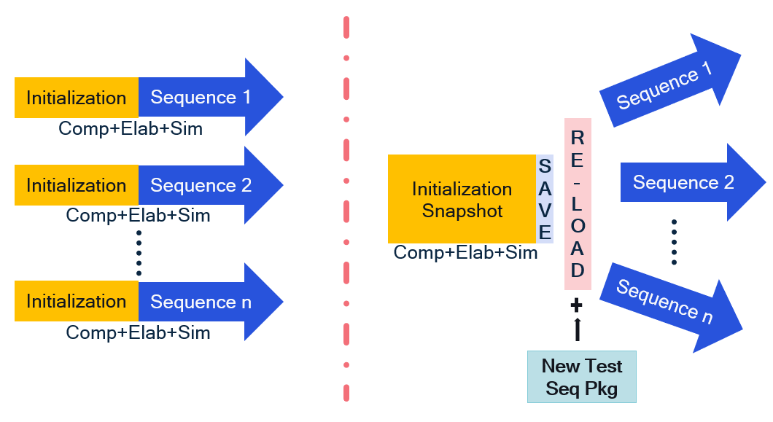
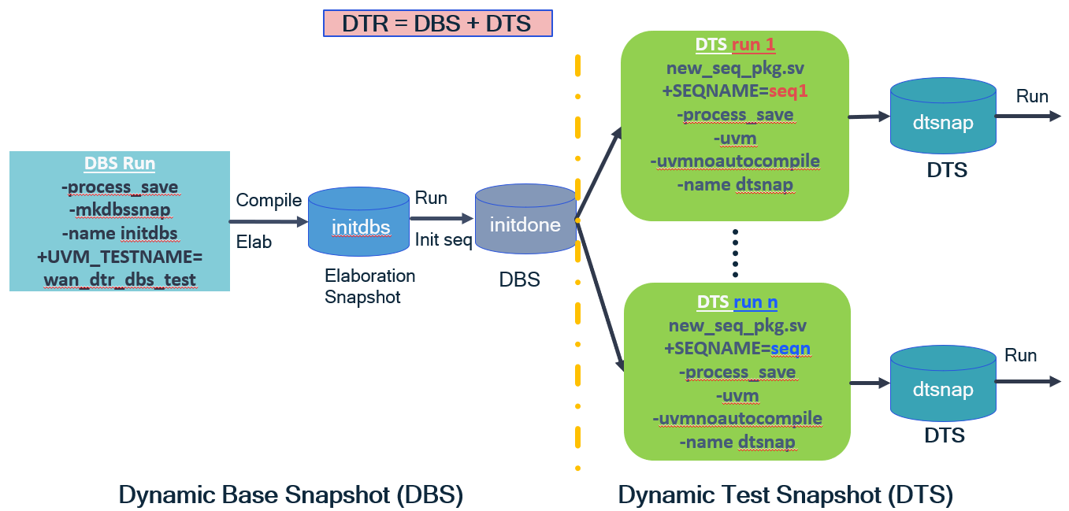
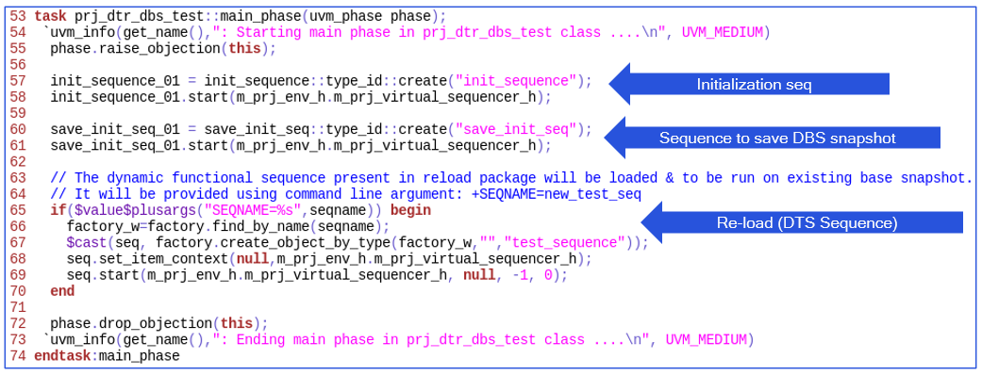
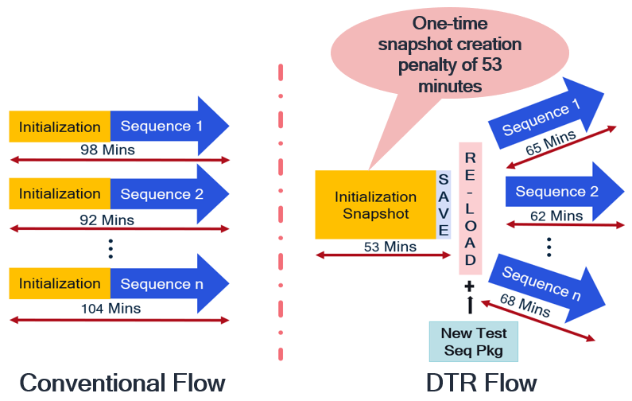
Accelerating SOC Verification, Reducing Simulation Turnaround Time & Diskspace Optimization using Dynamic Test Reload (DTR)
Prashant Hota & Shekhar Jha
Qualcomm India Private Limited
Problem Statement/Introduction
Proposed Methodology/Advantages
Because of increasing complexity of SOC’s - total number of SOC testcases & simulation time, both keep increasing.
For SoC-level tests, commonly used sequences such as booting & initialization, must be performed before actual functional testing of target blocks. These common sequences:
are typically repeated for all subsequent SOC tests.
takes relatively longer time than actual functional sequences.
Any change in SOC tests, result in re-simulation of common sequences as well, which increases turnaround time.
Longer simulation time result in increased license usage and NRE.
Dynamic Test Reload (DTR) creates a single snapshot for common sequences, which is then used to run actual functional sequences.
It can import a new System Verilog package (containing uvm_sequences) into an existing snapshot during re-load (while running functional sequences).
It provides the flexibility not to include all functional sequences while generating initialization snapshot.
Only dynamic objects (like uvm_sequences) can be added during re-load.
Add only the required functional sequences and create the initialization snapshot. Remaining or new functional sequences can be added during re-load.
Conventional Flow Proposed Flow (DTR)
Implementation Details/Diagram
Implementation Details/Flow Chart
Test Class Implementation:
Results Table
Conclusion
Functional RTL Simulation
Average % Time saved (per testcase) = (98 – 65) * 100/98 = 34%.
CALIBRATION GLS-PA Simulation
In calibration simulations, time saving is more than mission mode simulations due to longer initialization sequence.
Average % Time saved (per testcase) = (1077 – 17) * 100/1077 = 98%.
Simulation speed gain = 1077/17 = ~63X.
Reduces disk space usage by 1 – 2 TB.
~98% simulation time reduction & ~63x simulation speed gain for SOC Calibration Gates-PA simulation.
~30% reduction in disk space usage per project.
~34% simulation time reduction for SOC RTL Mission mode functional simulation.
Overall ~20 man-days saving per project.
Significant reduction in Simulation Turnaround time (TAT).
Longer the run time of common sequences (bootup/initialization), higher the saving.
More the number of SOC testcases, higher the saving.
It can help in periodic save to recover from any fatal situation viz. server crash, disk space outage etc.
Possible End users
Any team using UVM Environment for Module/SoC Verification.
REFERENCES
Accellera “Universal Verification Methodology (UVM) 2.0 User’s Guide”

