Slide 1
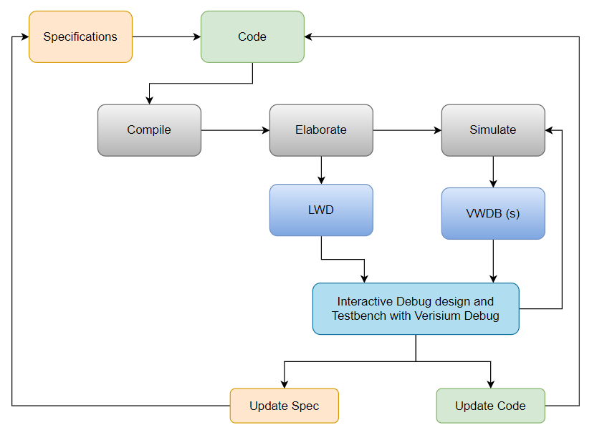
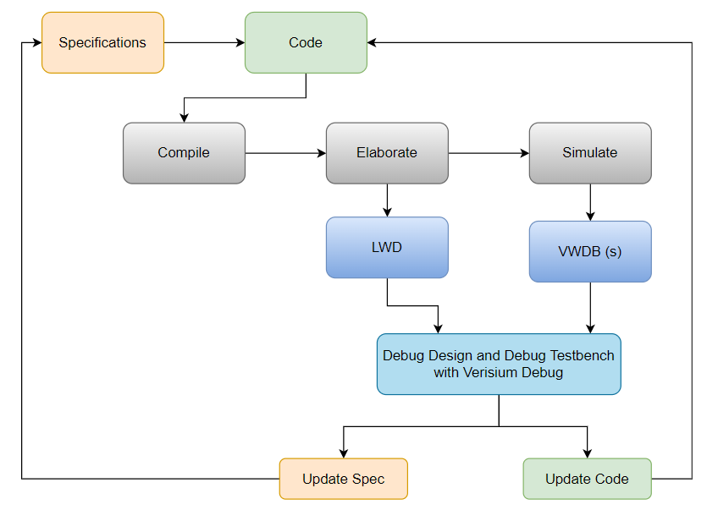
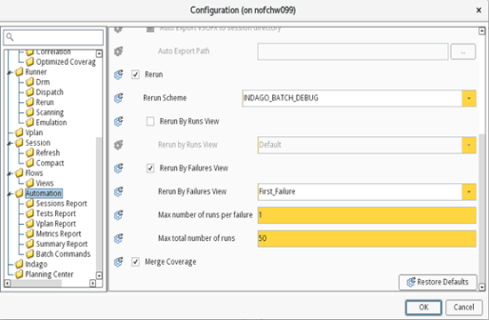
How to make debug more efficient in day-to-day life using Verisium Debug
Kiran Kumar Indrakanti
Sai Asrith Tabdil
Problem Statement/Introduction
Interactive Debug
Regression stability is extremely uncertain in full-random UVM world
~70% of the effort goes into debug of every verification engineer.
Manual reproduction of failures is not guaranteed, inefficient.
Debug is unproductive with the larger probing database
With the help of smart tools like Verisium Debug and Verisium Manager, the above problems can be easily addressed.
Verisium Debug is a powerful debug tool comes with the following key features
Smart log
Automatic root cause analysis
Powerful and easy searches
Extensive debug features for randomization and assertions.
2 modes of operation: Post Processing and Interactive modes.
Verisium Debug can be integrated with other tools for additional benefits.
Verisium Debug with Verisium Manager provides automating the reproduction of regression failure.
Debug while simulation in progress.
Breakpoint insertion and Step by step debug
Provides live information on Call Stacks and Active Threads
Best for Test hangs debugs
Post Processing Debug
Automatic Failure reproduction
Manual reproduction of failure is time consuming and inefficient.
Delays in the debug delays the regression stability, causes project execution delay.
Verisium Debug integrated with Verisium Manager enables automated flow for failure reproduction.
Verisium Waveform Database (VWDB) probing in Xcelium enables faster probing with a much smaller memory and database size footprint.
One-stop solution for any simple/complex failure debugs.
Complete test flow is recorded, helps for static analysis
No intelligence required to insert any break points
Avoids multiple iterations of simulations
Automatic Failure reproduction
Conclusion
Verisium Manager can be configured in GUI or through the TCL script
Verisium Manager Configuration in tcl :
config automation.auto_rerun -set true
config automation.auto_rerun_scheme -set "INDAGO_BATCH_DEBUG"
config automation.auto_rerun_by_view -set false
config automation.auto_rerun_by_failures_view -set true
config automation.auto_rerun_failures_view -set "First Failure"
config automation.auto_rerun_by_failures_max_runs_per_failure -set 1
config automation.auto_rerun_by_failures_total_max_number_of_runs -set 50
Vmanager –init <tcl path>
Effective utilization of the latest tools and features improves the debug efficiency.
Verisium Debug provides many advanced features for debugging
Interactive debug is most powerful for test hang debugs.
Post Processing is one-stop solution for any simple/complex failure debugs.
Verisium Manager integration with Verisium Debug eliminates the manual effort and guarantees the failure reproduction.
Verisium Manager provides fine control on number of failures and types of failures to be reproduced.
Manually Configuring Verisium Manager
Using the TCL script
REFERENCES
https://support.cadence.com/apex/techpubDocViewerPage?path=VDebugGUIUG/VDebugGUIUG23.06/VDebugGUIUGTOC.html

