Slide 1
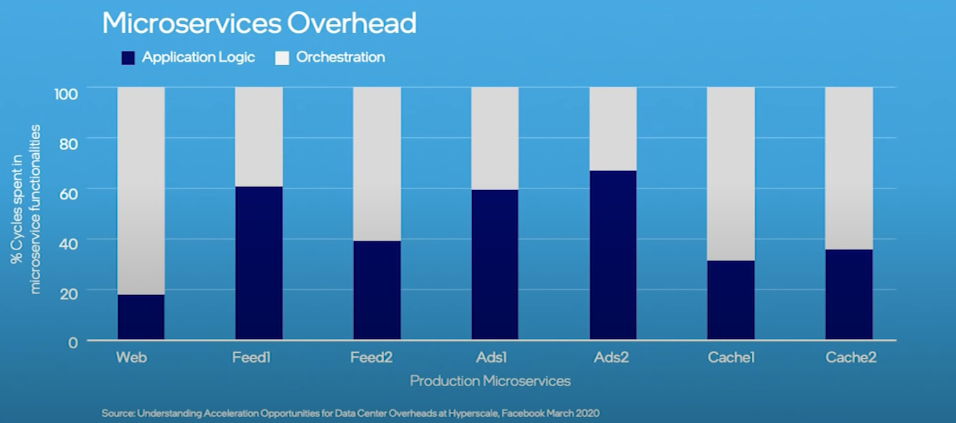
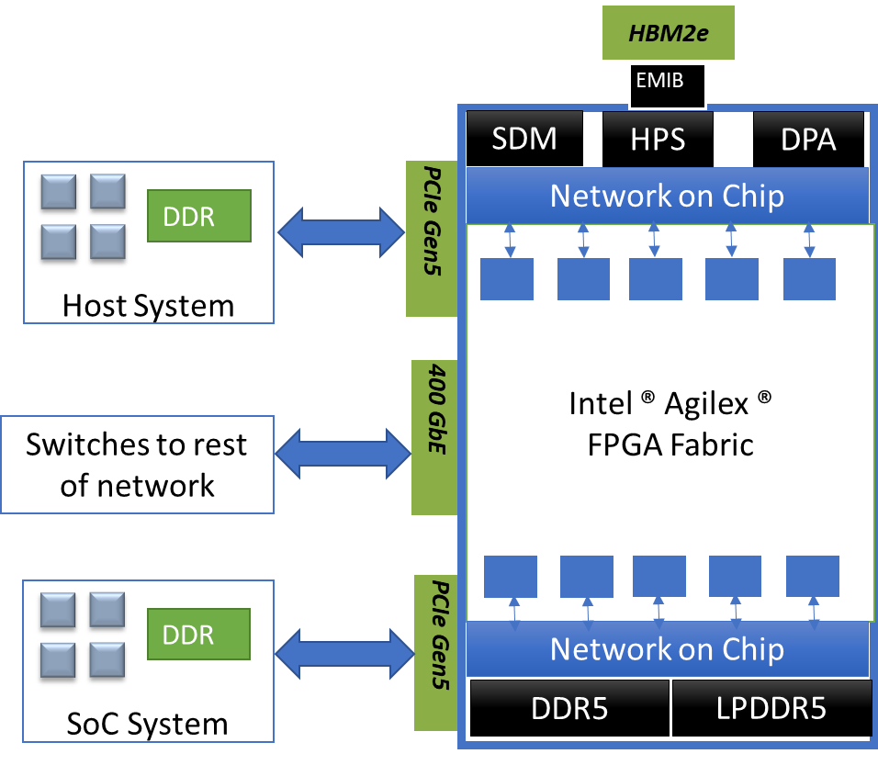
Novel Model First Approach to Shift-Left
Soft-Logic RTL Development on Intel Agilex FPGA for Data Centre IPU Design
Pravat K Nayak, Intel India (pravat.kishor.nayak@intel.com)
Vikrant Kapila, Intel Singapore (vikrant.kapila@intel.com)
Pushpa Naik, Intel India (pushpa.naik@intel.com)
Niketkumar Sharma, Intel India (niketkum@intel.com)
Introduction
Proposed Methodology
Datacenter architecture evolved from monolithic to microservices.
Data from Facebook shows huge overheads of workloads consuming CPUs.
A pre-RTL solution is proposed to address shift-left of FPGA soft-logic development for Intel® FPGA Agilex® customers. It enables parallel development of Intel FPGA based IPU and customer soft-logic.
There are numerous industry and academia tools and technologies which enables shift-left for definition and optimization of System Architecture for power & performance. They don’t address shift-left of FPGA soft-logic development for FPGA based data center solution.
The methodology presented in this poster addresses the requirements by deploying SystemC based functionally accurate IPU models, SystemC-to-RTL transactors and reference Virtual Platform for Intel FPGA IPU.
We have demonstrated applicability of methodology and modeling framework using a case study featuring design of next generation SmartNIC solution based on Intel IPU.
Our proposed methodology is generic and can be applicable across heterogeneous architecture based FPGAs.
Intel introduced Data Center scale FPGA based Infrastructure Processing Unit(IPU) based on heterogeneous architecture that includes various hardened blocks such as embedded SRAMs, NOC, transceivers, accelerators etc.
Significant challenge in parallel co-design & development of Intel heterogeneous FPGA based IPU and customer soft-logic workload to be mapped on FPGA.
Implementation Details
Diagram
Customer maps custom-soft logic on Intel Agilex® FPGA fabric and deploys it connecting to Host, SoC and Network as SmartNIC to serve networking and storage flows in data center.
Created SystemC based functional model of the Intel Agilex® FPGA, depicted in Figure 1. The FPGA model includes hardened complex networking pipelines such as the configurable Data Path Accelerator (DPA).
Developed cycle accurate SystemC-RTL transactors to enable RTL co-simulation. It enabled customers' RTL team to work on their programmable soft logic RTL simultaneously with the actual RTL of the hardened accelerator within the FPGA.
In addition to this, our internal pre-silicon verification team utilized the model as a golden reference to reduce functional verification effort and achieve high accuracy in verifying the RTL of FPGA device subsystems e.g. DPA.
Results
Conclusion
The solution enabled a significant advancement in the customer's RTL development timeline, accelerating it by 6 months or more.
Uncovered over 10+ major functional issues with the command structures and interfaces used for these interactions 6+ months ahead of RTL availability of FPGA device.
Analyzed around 30 different networking and storage flows from customer with varying traffic characteristics such as packet size mix, traffic burst, traffic class, etc. which instilled confidence in the proposed hardened accelerator present within the FPGA.
Observed that decoupling IPXACT from RTL level micro architecture into system level architecture would help further as the modeling activities starts much before RTL level micro architecture begins.
The paper presented a methodology and modeling framework that enables shift-left for soft-logic RTL development for Intel Agilex® FPGA devices.
The effectiveness of this approach is demonstrated by a SmartNIC case study to accelerate the soft logic RTL development by 6 months while the RTL development of FPGA device RTL was still under progress. The framework while enabling accelerated time to market for customer, enabled a close collaboration between Intel and customer to refine and optimize interaction between FPGA and customer soft logic.
It is important to highlight that 10+ major issues which we discovered early in design cycle were found very late in design cycle of similar previous generation devices leading to either delay in product or failure to realize certain functionality due to functional incorrectness.
Future work will focus on making use of the same model within design software like Quartus Prime to speed up functional simulation
REFERENCES
Synopsys, "Silicon Design & Verification - Virtualizer," 2017. [Online]. Available: https://www.synopsys.com/verification/virtual-prototyping/virtualizer.html. [Accessed April 2023]
A. P. a. J. C. T. Holmes, "SoC Development and Prototype with VDK," in 16th International Workshop on Microprocessor and SOC Test and Verification (MTV), Austin, Texas, 2015
D. T. K. a. D. H. K. Vikrant Kapila, "Case-Study: Generating a Workload Model of the Chrome Browser from Android Execution Traces for Early Analysis of Power and Performance Trade-Offs," in Intel DTTC, 2017
Google, "Google Cloud Platform," 2022. [Online]. Available: https://cloud.google.com. [Accessed April 2023]
A. P. S. M. D. C. a. A. D. Daniel Firestone, "Azure Accelerate Networking: SmartNICs in in Microsoft Research," Microsoft, USA, 2018
Microsoft, "Microsoft Azure," 2022. [Online]. Available: https://azure.microsoft.com. [Accessed April 2023]

