Slide 1
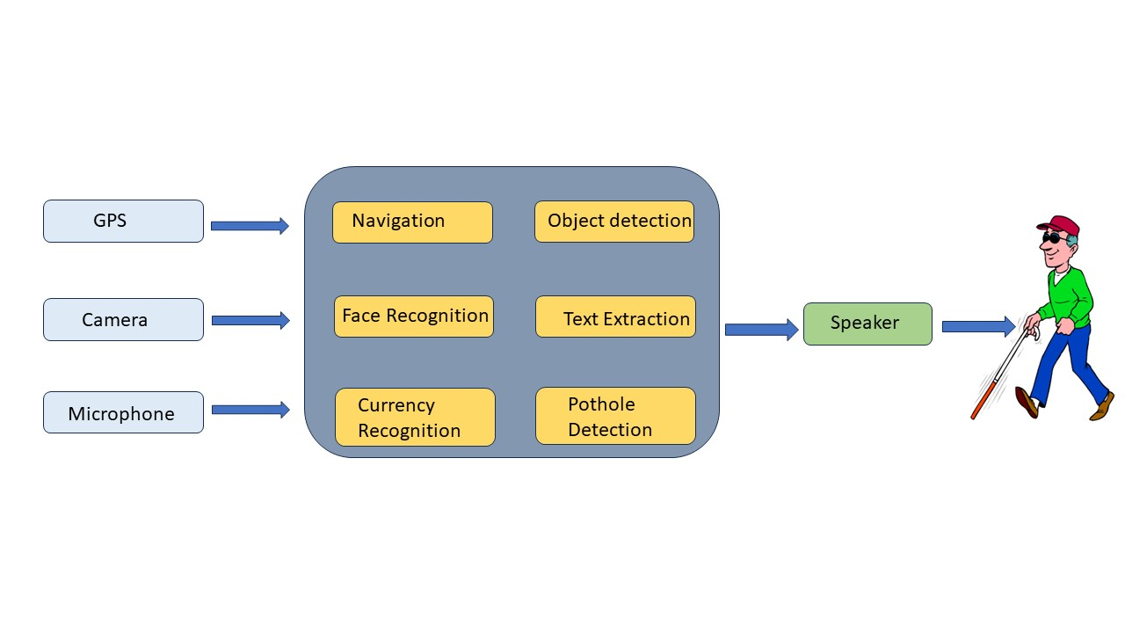
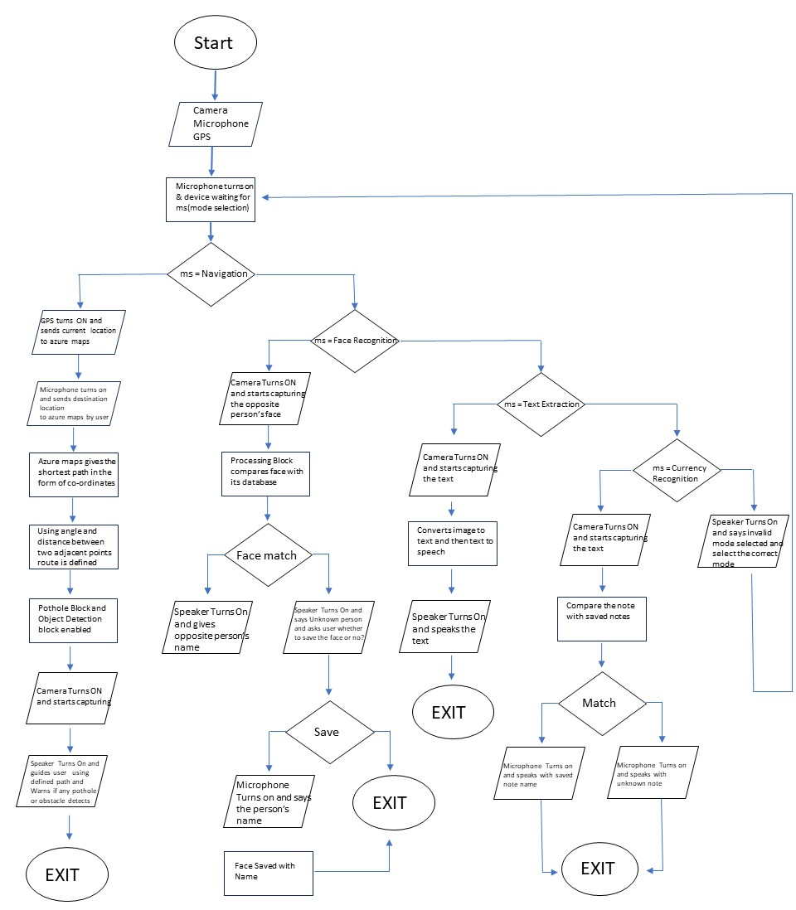
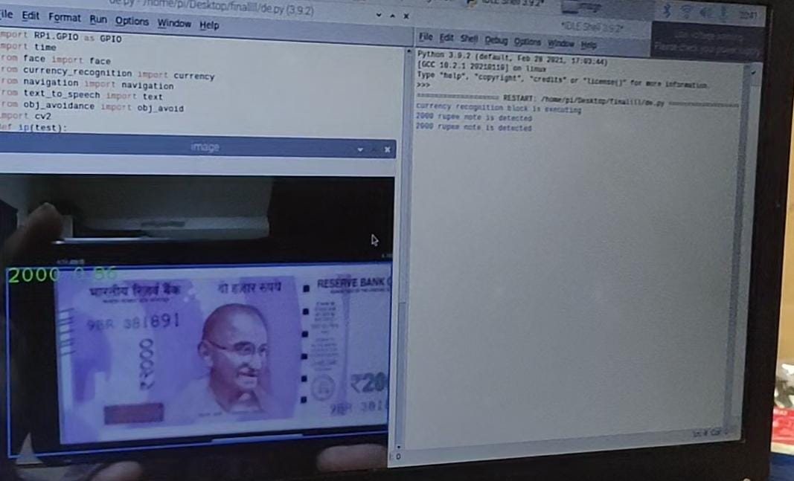
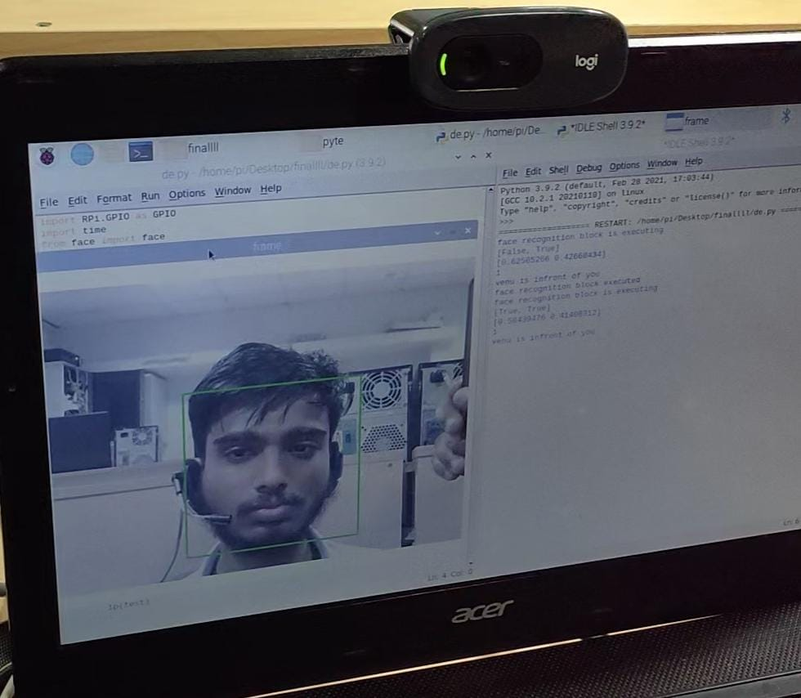
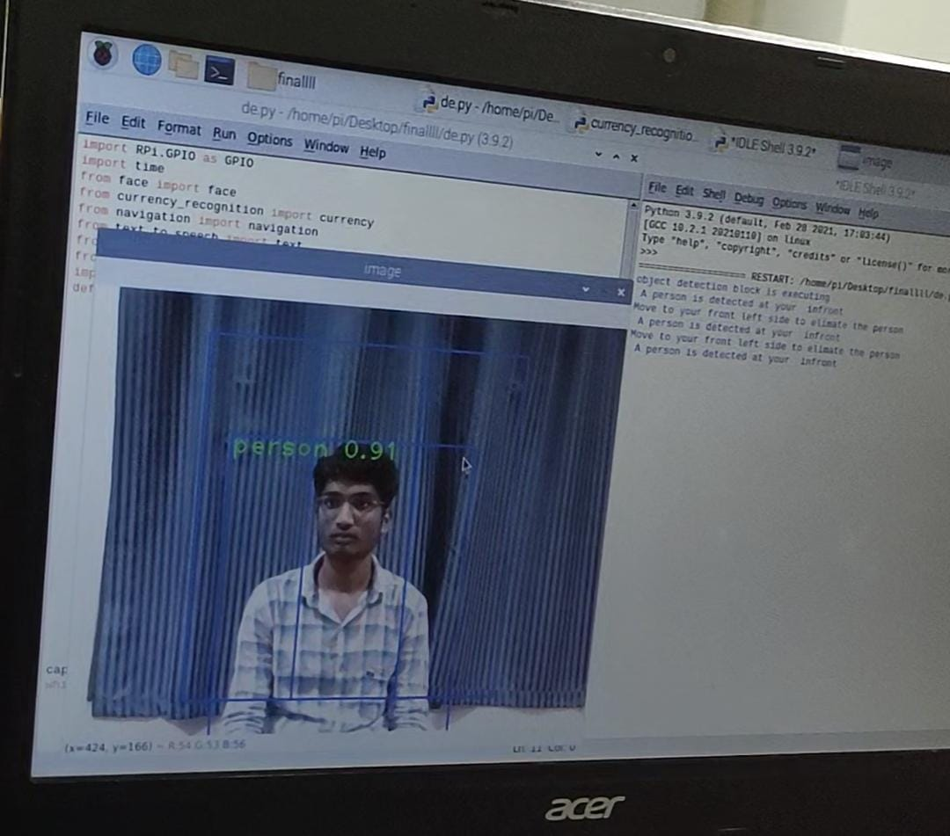
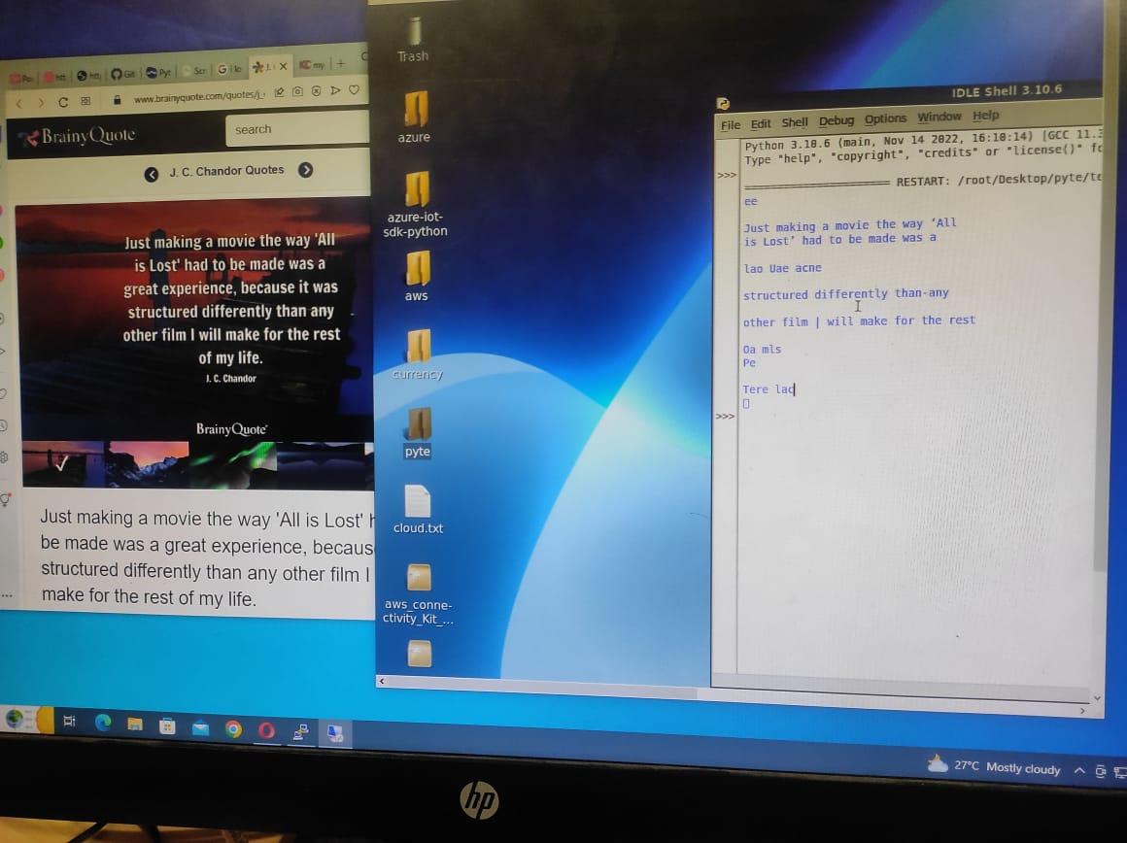
DIGITAL EYE FOR AID OF BLIND PEOPLE
JAGU NAVEEN KUMAR
PABBULETI VENU
Problem Statement/Introduction
Proposed Methodology/Advantages
Blindness is a serious affliction that affects millions of individuals throughout the world. According to a study released by the World Health Organization (WHO) in 2021, there are 39 2 million blind persons globally. It is well known that blind persons may be more likely to get into accidents and suffer injuries in a number of situations, including walking. Additionally, they can encounter certain challenges in the middle of their journey, which would be quite harmful. Accessing information, navigating their surroundings, and interacting with others are just a few of the day-today issues that blind individuals deal with. Their options for learning, working, and interacting with others are constrained by these issues. To break those constraints, we proposed a model, which resolves all problems listed above
The proposed model consists of five (05) unique functional blocks in which each block assists the user in performing the corresponding task through voice commands from the headset.
1. Navigation and vehicle avoidance block: This takes the current coordinates from GPS and destination coordinates from the area name given by the user and guides the user along the shortest path to the destination. Meanwhile directs the user to avoid the vehicles along the path of the journey.
2. Object detection and obstacle avoidance block: Helps the user to detect various objects and clusters them into obstacles and non-obstacles. In case of obstacles, it warns the user to deviate in a sophisticated direction.
3. Face recognition and face-saving block: Recognizes the known persons to the user (from saved faces of the user’s database) and informs the user of their name. In the case of an unknown person, it facilitates the user to save his/her face.
4. Text extraction and text-to-speech conversion block: Helps the user to study the detected text present on the books, hoardings, etc without the dependency on Braille script. It is mainly helpful for blind students.
5. Currency recognition block: Helps the user to identify the currencies of several countries including their values
6.Pothole Detection : Helps the user to identify Pothole in his path .
Implementation Details/Diagram
Implementation Details/Flow Chart
Flowchart Document link : https://drive.google.com/file/d/1z_C75GGOsqZbbYTeasMj4t_sq0eaN7xO/view?usp=sharing
Results Table
Conclusion
This device was created to give persons with vision impairments the independence to carry out their daily tasks. Our proposed model is used to create the processing portion of the design at a high rate of speed and precision. It is a cost-effective smart model with little Internet usage that enables the user to utilize the gadget in a variety of environmental situations. The use of text extraction raises the community's literacy levels among the blind. Because of these sophisticated design elements, blind persons can live better lives with improved perception.
Currency Detection
Face Detection
Object Detection
Text Extraction
REFERENCES
Smart Eye for Visually Impaired-An aid to help the blind people(
Third Eye: An Eye for the Blind to Identify Objects Using Human-powered Technology
Assistive Technology for the Visually Impaired Using Computer Vision

