Slide 1
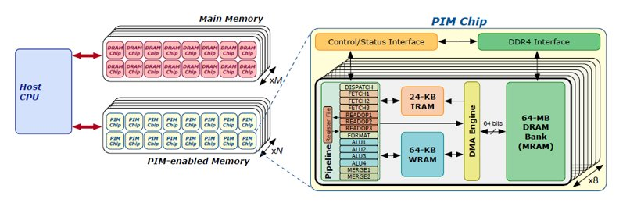
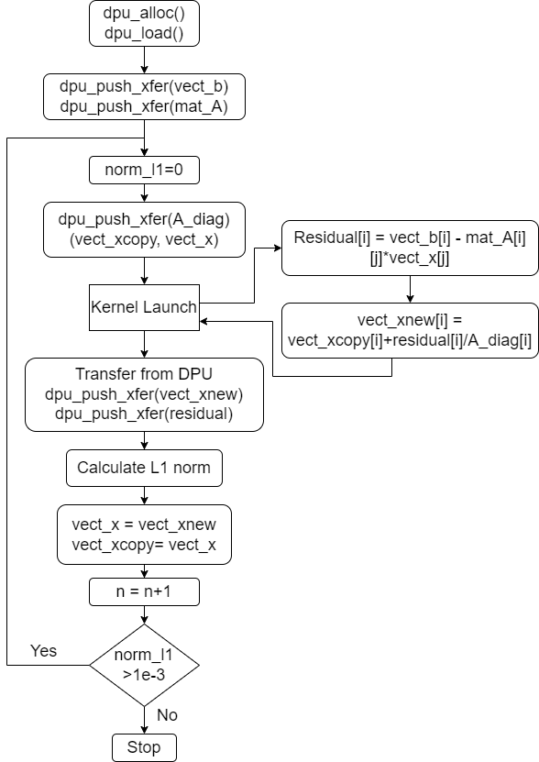
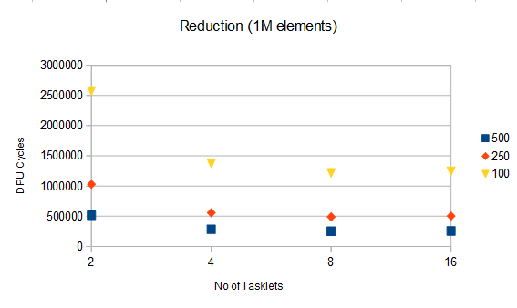
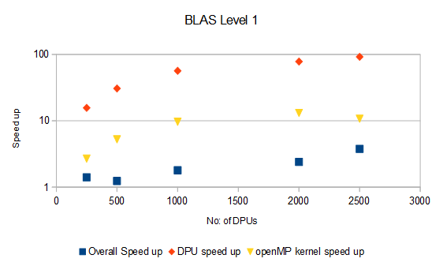
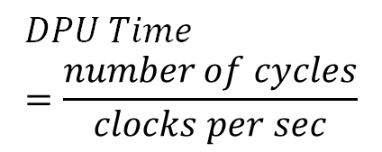
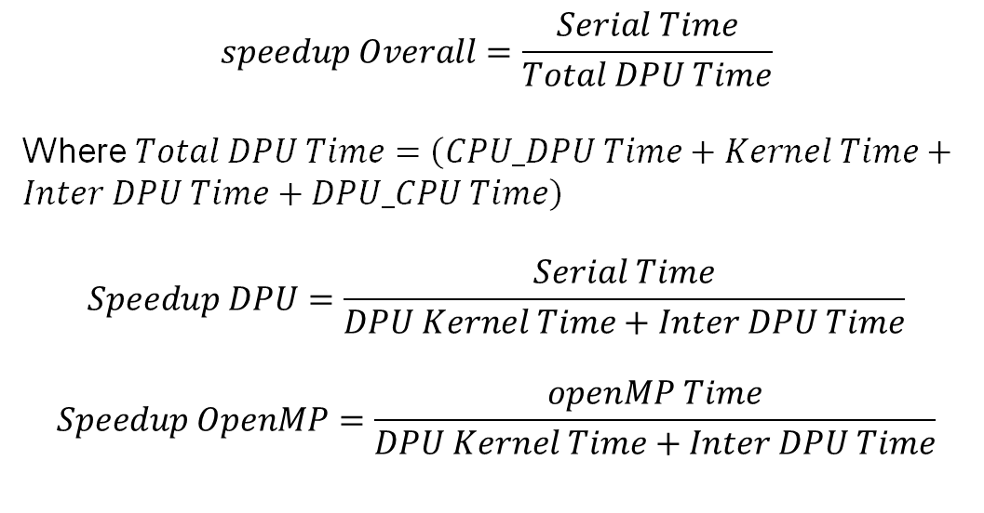
Comprehensive Benchmark Results: Comparing Processing-in-Memory Architecture Effectiveness using UPMEM Hardware
Ambati Rajashekar, Pranjit Das, Avi kumar Shrivastava, Partha Acharya
Next Gen R&D, Tata Consultancy Services
Problem Statement/Introduction
UPMEM PIM Architecture
Moore's law states that the number of transistors on a chip doubles every 2 years. This law is valid from 1970's until recently. Currently this law is fading away due to the size of transistors. Processing Speed of CPU has saturated. Today's computing system are based on Von-Neumann Architecture where CPU and memory are separate units. Today's data intensive workloads include databases, neural networks, data analytics etc. Currently multicore CPU's and Graphical processing units (GPU's) are widely used for these computationally intensive tasks.
For these workloads in modern computing systems, a large amount of execution time and energy consumption happens moving data between memory and CPU cores. The reason for this is that communication happens through a narrow bus with high latency and limited bandwidth. This data movement bottleneck requires a model where the memory system plays an important role in computing by having processing capabilities. This model is known as processing in memory (PIM).
Research in this field started in 90's then named as IRAM (Intelligent RAM)[1] and Computational RAM [2]. Recent advances in 3D stacking technology have enabled cost effective integration of logic and memory. Recent studies show PIM architecture is useful for deep neural network[3] and complex genome assembly[5].
The first publicly available real world PIM architecture has been designed and manufactured by UPMEM company. It uses 2D DRAM arrays and combines these with general purpose processing cores, also called “DRAM Processing Units” (DPU), on the same chip[8]. In this work we used this hardware to understand effectiveness of PIM.
A UPMEM DIMM contains 8 or 16 PIM chips (1 or 2 ranks of 8 chips each). Inside each PIM chip there are 8 DPUs. In 640 DPU system, there are 10 UPMEM DIMMs of 8 chips each. In 2560-DPU system there are 20 UPMEM DIMMs of 16 chips each. Since each chip has 8 DPUs, this will be a total of 2560 DPUs. Real Hardware has Intel Xeon platforms which have up to 20 PIM DIMMs which comes to a total of 2560 DPUs and 160GB of PIM memory.
Inside each DPU, there is a 64MB DRAM bank, called Main RAM(MRAM), a 64 KB scratched pad memory called Working RAM(WRAM), and a 24-KB instruction memory (IRAM). For a 640-DPU system the total main memory would be 40 GB. For a 2560-DPU system it would be 160 GB. Figure on right shows real UPMEM based PIM DIMM. Figure on left shows PIM system organization where main memory and PIM memory and zoomed view of PIM chip. The main RAM(MRAM) is accessed by the host CPU for copying input data and retrieving results. These CPU- DPU data transfers can be done concurrently across multiple MRAM banks.
UPMEM PIM DDR4 DIMM with PIM-DRAM chips. Image downloaded from [8].
Upmem based PIM system with a host CPU, standard main memory and PIM-enabled memory and internal components of a PIM chip. Fig downloaded from [7]
Implemented Algorithms
Implementation Details
BLAS L1, BLAS L2, Reduction, Prefix sum (Scan), Binary Search, Jacobi Iterative technique for solving system of linear equations, Linked list in PIM, Linear congruential random number generators.
BLAS L1: Operation performed is $Y=α∗A+B$ where $A, B$ are vectors and $α$ is a scalar. There is a limitation that data sent to and received from MRAM must be multiple of 8 bytes. OpenMP code performance for all codes are compared with PIM codes.
// Compiling Steps
dpu-upmem-dpurte-clang –DNR_TASKLETS=x -O3 -o blas_l1 blas_l1.c // Compile DPU C code
gcc -O3 --std=c99 -o blasl1_host blasl1_host.c -D_POSIX_C_SOURCE=199309L -g `dpu-pkg-config --cflags --libs dpu` // Compile main host program
./blasl1_host // Execute binary
BLAS L2: Operation is $Y=α∗A∗x+β∗y$ where $A$ is a matrix, $x$ and $y$ are vectors, $α$ and $β$ are scalars. Rows of Matrix $A$ and $y$ vector are split among DPUs whereas $x$ vector is set in full to DPUs.
Reduction: Reduction operation is a parallel primitive to sum all the elements in an array. Partial sum is performed in all DPUs and partial sum's are added in the host to obtain final sum. The same methodology applies to min and max.
Scan: We implement Exclusive scan in PIM. For an element in an array with index $i$, output of scan is the sum of all elements in the array up to ${\left(i−1\right)}^{th}$ index. We implement using Reduce-scan-scan (SCAN-RSS) method.
Linked list: Elements of a singly linked lists are stored in a structure and one structure points to next structure and so on. Linked lists are created in dpu code by using fixed size block allocator (similar to malloc) in WRAM.
Input array is partitioned among DPUs. The elements of the partitioned array are appended into a linked list in every DPU. Search variable is broadcasted to all DPUs. Individual Linked lists are maintained in all DPUs. Initially, Structure pointer of tasklets point to the starting node of the list. The tasklets are iterated to their next positions such that all tasklets have equal chunk to search for. Now all the tasklets will search in parallel for the variable by iterating to the next element one by one
Optimization technique: MRAM-WRAM Transfer
Send data in small chunks from MRAM (64 MB) to WRAM (64 KB) mram_read()
Compute in WRAM
Transfer result back to MRAM mram_write().
Note: Size of transfer should be a multiple of 8 and less than 2048 bytes for a given tasklet.
Transfer from CPU to DPU
Array A and B of each 100M size with type uint32_t.
DPU Kernel Launch
Compute BLAS L1 in DPUs using tasklets. $Y=α∗A+B$
Compute BLAS L1 in DPUs using tasklets. 𝑌=𝛼∗𝐴+𝐵
Transfer from DPU to CPU
Transfer result array and merge back in CPU.
100 M elements array in host
With 2500 DPUs – 40000 elements/DPU
With 10 Tasklets – 4000 elements/tasklet
Flow chart for Jacobi method for solving AX=B
$$DPU Time=\frac{number of cycles}{clocks per sec}$$
DPU cycles against tasklets for varying DPUs
Speed up for BLAS L1 given Vector Size=50M, tasklets =10
Results Tables
Conclusions/Recommendations
We used Python script file to vary Vector Size, Num DPUs, tasklets simultaneously and store it in a .csv file.
Validation is done for all codes by writing serial algo in the same code and comparing the result.
A warm up iteration and three iterations are performed and average of those 3 iterations are noted for DPU times.
Initially, Codes are run on simulator, and finally are tested on original hardware. Prediction of number of cycles on simulator is inaccurate. Therefore, we must rely on hardware for performance measurement.
Experiments show that the number of cycles in DPU decrease with increasing tasklets up to 10.
As the DPUs increase till upper limit (2500) for a fixed tasklet, number of cycles in DPU decreases. All the available DPUs have to be utilized for obtaining speed up w.r.to serial and multi core CPUs.
We observed an average speed up of 62.75X in PIM in comparison to serial code for BLAS L1, L2, Reduction and Scan algorithms. and 9.17X speed up for the above codes w.r.to multi core processor. Insert operation in linked list yielded a good speed up of 451X.
Data Push and receive times combined are more than 70 percent of total time for our current workloads. So, an application has to have more kernel time such that it dominates the transfer time to get full benefit out of PIM.
Some of the limitations of UPMEM PIM are as follows. Division/Multiplication and floating-point operations are implemented using software library routine. There is no hardware support.
Dynamic memory allocation on the DPU stack is not supported. That limits the usage of well used memory creation functions such as malloc, calloc in C.
There is no inter DPU communication, All the communication has to happen through the host.
Workloads with less compute, less communication and large memory requirements are well suited for DPU computing as DPUs include support for only integer addition/subtraction/compare and bit-wise operations.
Database query operations such as Create, Read, Update and Delete (CRUD) can get benefit out of PIM as observed from Linked list data structure implementation.
Some use cases mentioned in upmem.com are Compression/Decompression, Data Analytics, Machine Learning & AI (Kmeans, CNN, Decision trees, etc.), Graph Algorithms, 3D Image reconstruction and FFT, n-step FMindex, Skyline (multi-feature preference query), Seismic reconstruction.
Overall UPMEM sdk is easy to use, understand and resembles GPU computing.
$$speedup Overall=\frac{Serial Time}{Total DPU Time}$$
Where $Total DPU Time=\left(CPU_DPU Time+Kernel Time+Inter DPU Time+DPU_CPU Time\right)$
$$Speedup DPU=\frac{Serial Time}{DPU Kernel Time+Inter DPU Time}$$
$$Speedup OpenMP=\frac{openMP Time}{DPU Kernel Time+Inter DPU Time}$$
Algorithm | Vector/Matrix Size | Num DPUS | Speed up Overall | Speed up DPU | Speed up OpenMP
BLAS L1 | 100M | 2500 | 3.04 | 129.89 | 19.92
BLAS L2 | (50000X50000) | 2500 | 7.13 | 30.67 | 0.82
Reduction | 100M | 2000 | 2.66 | 86.38 | 12.37
Exclusive Scan | 50M | 2500 | 2.75 | 12.16 | 4.43
Matrix Size | Total Parallel time(s) | Serial Time(s) | No: of Iterations | L1 Norm
5000X5000 | 156.12 | 2.11 | 23 | 0.00089
Jacobi Solver given No: of DPUs=500, tasklets = 10
Summary of results: Max speed up values obtained in each algo
Operation | DPU Time (s) | Inter DPU Time (s) | OpenMP Time (s) | Speedup OpenMP
Search | 0.000173 | 0.000944 | 3.6E-3 | 2.73
Insert | 1.55E-6 | NA | 7.02E-4 | 451.65
Delete | 0.000136 | NA | 1.05E-3 | 7.68
Linked list with size of 6M given number of DPUs=1000 and tasklets=10. In case of multicore CPU (OpenMP) number of threads = 10
REFERENCES
Understanding a modern processing-in-memory architecture. presentation by safari group: Presentataion by safari group,” 2020
J. G ́omez-Luna, I. E. Hajj, I. Fernandez, C. Giannoula, G. F. Oliveira, and O. Mutlu, “Benchmarking a new paradigm: Experimental analysis and char- acterization of a real processing-in-memory system,” IEEE Access, vol. 10, pp. 52565–52608, 2022.
Upmem processing in memory technology white paper,” 2022
N. Bowman, N. Cardwell, C. Kozyrakis, C. Romer, and H. Wang, “Evaluationof existing architectures in iram systems,” in Workshop on Mixing Logic and DRAM, 24th International Symposium on Computer Architecture, p. 23, 1997
D. G. Elliott, M. Stumm, W. M. Snelgrove, C. Cojocaru, and R. McKenzie, “Computational ram: Implementing processors in memory,” IEEE Design & Test of Computers, vol. 16, no. 1, pp. 32–41, 1999.
J. Liu, H. Zhao, M. A. Ogleari, D. Li, and J. Zhao, “Processing-in-memory for energy-efficient neural network training: A heterogeneous approach,” in 2018 51st Annual IEEE/ACM International Symposium on Microarchitecture (MI-CRO), pp. 655–668, IEEE, 2018
S. Ghose, A. Boroumand, J. S. Kim, J. G ́omez-Luna, and O. Mutlu, “Processing-in-memory: A workload-driven perspective,” IBM Journal of Research and De-velopment, vol. 63, no. 6, pp. 3:1–3:19, 2019
S. Angizi, N. A. Fahmi, W. Zhang, and D. Fan, “Pim-assembler: A processing-in-memory platform for genome assembly,” in 2020 57th ACM/IEEE design au-tomation conference (DAC), pp. 1–6, IEEE, 2020.

