Slide 1
Coverage Closure – Is it a “Game of Dice” or “Top 10 Tests” or “Automated Closure”?
Aditya Sharma, T. Nagasundaram,
M. Nitin Kumar, Nikhita Raj J

Slide 2
Agenda
Conventional Coverage Closure : CRV
Smart Selection of Coverage Rich Tests : Test Ranking
Automated Coverage Closure : GBV
Summary & Conclusion

Slide 3
Conventional Coverage Closure
“Calling-it-a-day” in a typical SoC verification project?
approach is to use the coverage metrics available
Though not silver bullets (functional & assertion coverage), but are the most formidable
Now with the acknowledged coverage metrics, the process involves three phases:
─ Coverage definition
─ Coverage collection (running simulations)
─ Coverage analysis & closure (iterative)

Slide 4
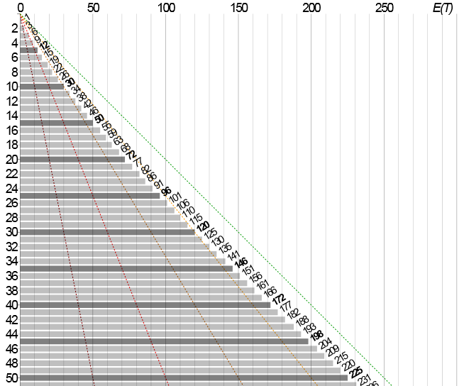
CRV ─ more of a “Game of Dice”
Hit & Try
Typical constraint random
generator has well known
redundancy built in
Coupon Collector’s Problem
Expected number of trails grows as Θ(nlog(n))

Slide 5
Game of Dice - Samples
APB-SPI IP
Number of Coverage Points or (State Space) : 192 (N)
NUM_XACTNS needed for 100% Coverage ≥ N*ln(N)
N*ln(N) : 1009
UVM SoC Reference Kit
Number of Coverage Points or (State Space) : 2749 (N)
NUM_XACTNS needed for 100% Coverage ≥ N*ln(N)
N*ln(N) : 21769

Slide 6
A typical UVM environment for a SoC looks as below:

Slide 7
Smart selection of Coverage Rich Tests : Test Ranking
SoC verification comprises of several tests for single & multiple peripherals
Typical regression of these individual tests are run with different seeds to cover a good state-space
Now the question is how to arrive at a minimal sub-set to cover reasonable state-space automatically?

Slide 8
Test Ranking
This is where a Test Ranking feature can be very useful!
The challenge is : Out of existing huge
set of tests (and seeds) identify the top
contributors!

Slide 9
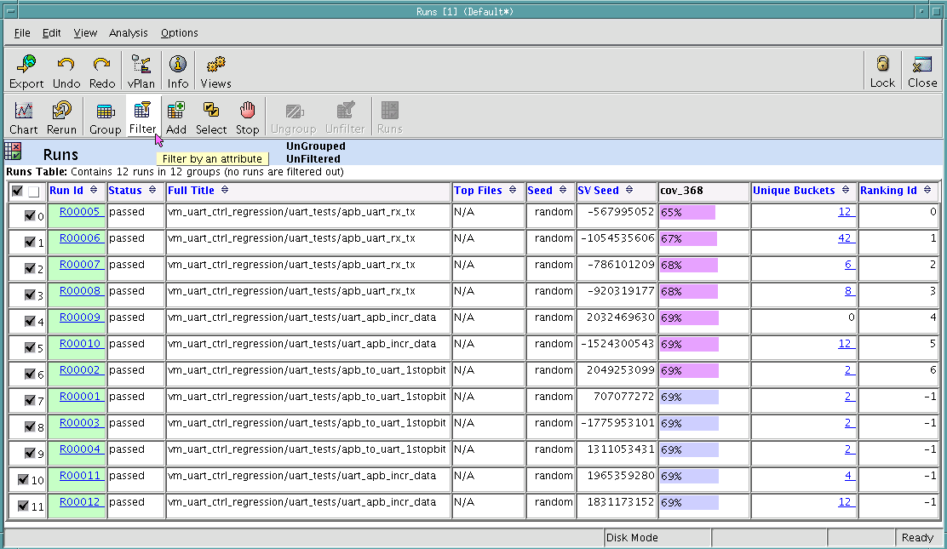
Test ranking in UVM
Most EDA tools support this feature today
We have used Aldec’s Riviera-PRO
Below are few screenshots from other vendor tools (for completion sake)
IUS
VCS

Slide 10
Test Ranking Results : UVM SoC Reference Kit
UVM SoC Kit – Initial donation by Cadence
CVC ported to other tools, scripts, updated code
Freely available at www.accellera.org
TCL commands

Slide 11
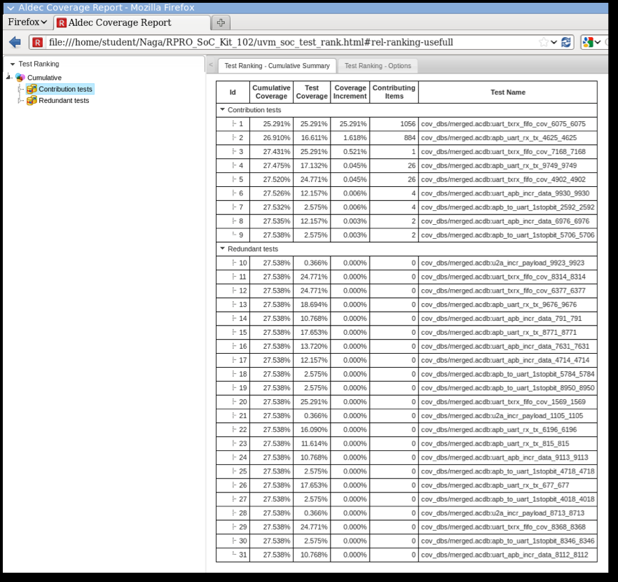
Test Ranking Results with Aldec

Slide 12
Automated Coverage Closure : GBV
GBV enables capturing entire state space one-shot in a single graph
N vs. N*ln(N) advantage
Stimulus coverage goals
often correlate to existing
functional coverage goals
Hence facilitating faster
coverage closure

Slide 13
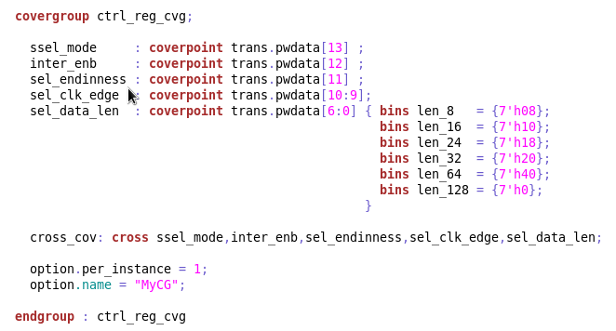
APB-SPI Use Case : Cover Group
Closer look to covergroup depicts total 192 cross coverage bins

Slide 14
GBV with TrekUVM
In this work we used Breker Verification System’s TrekUVM as a test generator & APB-SPI UVM verification environment as a case study
Automated Coverage Closure can be a reality with a model of state space driving a test generator to provide the needed UVM sequences
192 paths corresponding to 192 cross coverage bins for APB-SPI can be depicted in a single graph
Turn On Coverage Closure Mode
Automatically fill the holes & get 100% Coverage ☺

Slide 15
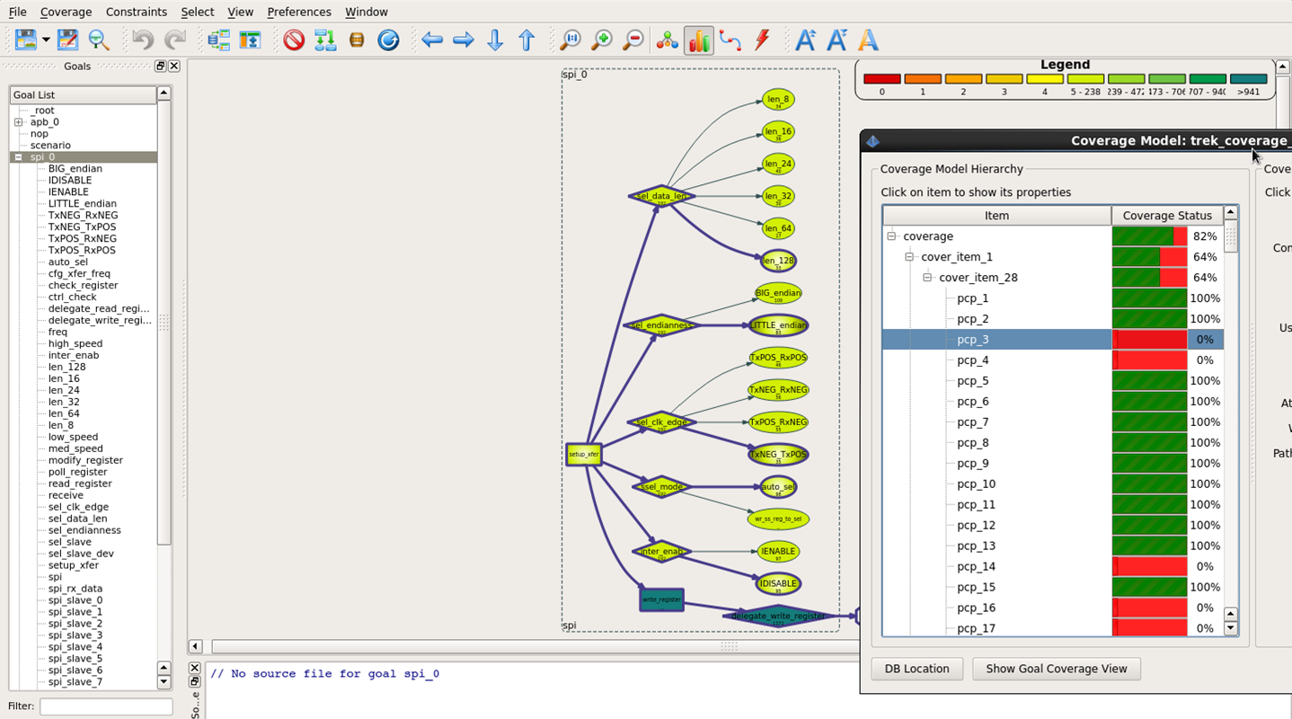
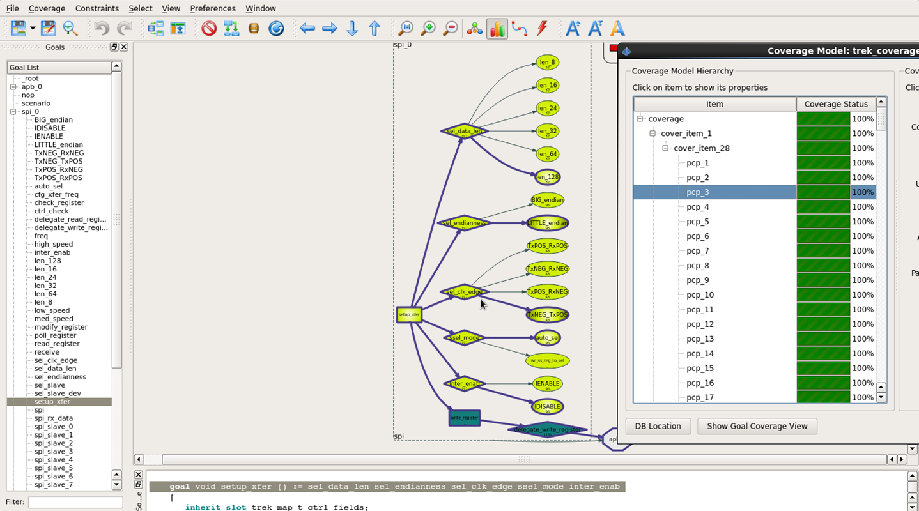
Auto Coverage Mode OFF/ON

Slide 16
NUM_XACTNS vs. FCOV : APB-SPI IP

Slide 17
Summary
CRV : Redundancy is inherent. Good at times, many a times too much redundancy. Leads to lot of manual coverage closure
Test Ranking : Helps identifying high value tests. No rescue from manual coverage closure
GBV : Eliminates redundancy totally while still preserving constraint randomness. Small effort to capture state-space as graph, fills coverage holes automatically.
We used it in this case study for input stimulus only

Slide 18
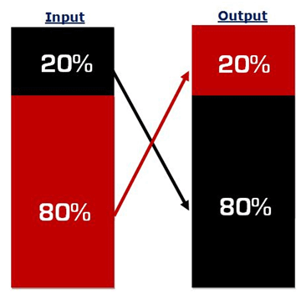
Conclusion
CRV is closely correlated to Coupon Collector Problem in probability theory
First 80% vs. Rest 20% - 80-20 rule
Coverage Closure above 80% solely via randomness is not feasible ☹
Lesser time to tapeout-s
Coverage closure via smart automation techniques can become the key differentiator technology

Slide 19
Reference
Coupon collector’s problem: http://en.wikipedia.org/wiki/Coupon_collector’s_problem
Model Based Testing: https://en.wikipedia.org/wiki/Model-based_testing
Breker Verification Systems (http://www.brekersystems.com)
http://tinyurl.com/uvmsoc

Slide 20
Questions…?

Slide 21
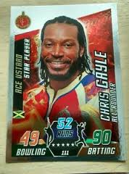
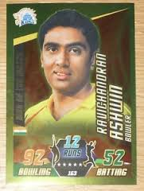
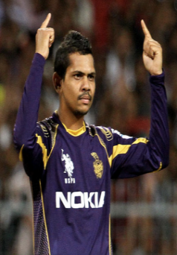
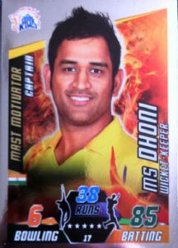
The Coupon Collector’s Problem
N – total number of different coupons.
X_{i} – time to get the i-th coupon.
$E\left[\sum_{i=1}^{N}{X_{i}}\right]$ = $\frac{N}{N}+\frac{N}{N−1}+…\frac{N}{1}=N\left(\ln{N+c+}\text{Θ}\left(\frac{1}{N}\right)\right)$
Only one coupon in a pack.
Target is to collect all coupons.
How many packs to be bought?

