Slide 1
Compute Link Express – CXL CXL Consortium
Presenter: Narasimha Babu GVL
Synopsys
11

Slide 2
Outline
CXL Overview
Representative CXL use cases
CXL 3.0 Features
Switches
Coherent Memory Sharing
Pooling and Sharing
Fabrics & Use cases

Slide 3
Introducing the CXL™ 3.0 Specification
August 2022

Slide 4
CXL Board of Directors
Industry Open Standard for High Speed Communications
200+ Member Companies

Slide 5
Industry Landscape
Cloudification of
the Network & Edge
Proliferation of Cloud Computing
Growth of
AI & Analytics

Slide 6
CXL Overview
New breakthrough high-speed fabric
Enables a high-speed, efficient interconnect between CPU, memory and accelerators
Builds upon PCI Express® (PCIe®) infrastructure, leveraging the PCIe® physical and electrical interface
Maintains memory coherency between the CPU memory space and memory on CXL attached devices
Enables fine-grained resource sharing for higher performance in heterogeneous compute environments
Enables memory disaggregation, memory pooling and sharing, persistent memory and emerging memory media
Delivered as an open industry standard
CXL 3.0 specification is fully backward compatible with CXL 2.0 and CXL 1.1
Future CXL Specification generations will include continuous innovation to meet industry needs and support new technologies

Slide 7
Representative CXL Usages
Caching Devices / Accelerators
Accelerators with Memory
Memory Buffers
TYPE 1
TYPE 2
TYPE 3
DDR
Processor
DDR
Processor
DDR
Processor
DDR
DDR
DDR
CXL
CXL
CXL
PROTOCOLS
PROTOCOLS
PROTOCOLS
CXL.io
CXL.cache
CXL.io
CXL.cache
CXL.memory
CXL.io
CXL.memory
Accelerator
NIC
HBM
Accelerator
Memory Controller
Memory
Memory
Memory
Memory
Cache
HBM
Cache
USAGES
USAGES
USAGES
PGAS NIC
NIC atomics
GP GPU
Dense computation
Memory BW expansion
Memory capacity expansion
Storage class memory

Slide 8
CXL Specification Release Timeline
March 2019
September 2019
November 2020
August 2022
CXL 1.0 Specification Released
CXL Consortium Officially Incorporates
CXL 1.1 Specification Released
CXL 2.0 Specification Released
CXL 3.0 Specification Release

Slide 9
CXL 3.0 Specification
Industry trends
Use cases driving need for higher bandwidth include: high performance accelerators, system memory, SmartNIC and leading edge networking
CPU efficiency is declining due to reduced memory capacity and bandwidth per core
Efficient peer-to-peer resource sharing across multiple domains
Memory bottlenecks due to CPU pin and thermal constraints
CXL 3.0 introduces…
Fabric capabilities
Multi-headed and fabric attached devices
Enhance fabric management
Composable disaggregated infrastructure
Improved capability for better scalability and resource utilization
Enhanced memory pooling
Multi-level switching
New enhanced coherency capabilities
Improved software capabilities
Double the bandwidth
Zero added latency over CXL 2.0
Full backward compatibility with CXL 2.0, CXL 1.1, and CXL 1.0
Notes:
- Doubling bandwidth: Bandwidth boost with 64 GT/s (PAM-4)

Slide 10
CXL 3.0 Specification
Fabric capabilities and management
Improved memory sharing and pooling
Enhanced coherency
Peer-to-peer
Expanded capabilities for increasing scale and optimizing resource utilization
Fabric capabilities and fabric attached memory
Enhance fabric management framework
Memory pooling and sharing
Peer-to-peer memory access
Multi-level switching
Near memory processing
Multi-headed devices
Multiple Type 1/Type 2 devices per root port
Fully backward compatible to CXL 2.0, 1.1, and 1.0
Supports PCIe® 6.0
Notes:
Multi-level switching – may be pushed to CXL 3.0 ECN depending on specification development

Slide 11
CXL 3.0 Spec Feature Summary
Features | CXL 1.0 / 1.1 | CXL 2.0 | CXL 3.0
Release date | 2019 | 2020 | August 2022
Max link rate | 32GTs | 32GTs | 64GTs
Flit 68 byte (up to 32 GTs)
Flit 256 byte (up to 64 GTs)
Type 1, Type 2 and Type 3 Devices
Memory Pooling w/ MLDs
Global Persistent Flush
CXL IDE
Switching (Single-level)
Switching (Multi-level)
Direct memory access for peer-to-peer
Enhanced coherency (256 byte flit)
Memory sharing (256 byte flit)
Multiple Type 1/Type 2 devices per root port
Fabric capabilities (256 byte flit)
Not supported
Supported

Slide 12
RECAP: CXL 2.0 FEATURE SUMMARY
MEMORY POOLING
1
H1
H2
H3
H4
H#
Device memory can be allocated across multiple hosts.
1
CXL 2.0 Switch
D1
D2
D3
D4
D#
2
Multi Logical Devices allow for finer grain memory allocation
2

Slide 13
RECAP: CXL 2.0 FEATURE SUMMARY
SWITCH CAPABILITY
CXL 2.0
[Add
H1
CXL
Supports single-level switching
Enables memory expansion and resource allocation
CXL Switch
CXL
CXL
CXL
CXL
D1
D2
D3
D#

Slide 14
CXL 3.0: SWITCH CASCADE/FANOUT
Supporting vast array of switch topologies
CXL 3.0
CXL 3.0
H1
H1
CXL
1
Multiple switch levels (aka cascade)
Supports fanout of all device types
D1
CXL
D#
CXL
CXL
CXL Switch
CXL Switch
D2
CXL
CXL
D3
1
CXL
1
CXL
1
CXL
CXL Switch
CXL Switch
CXL Switch
CXL
CXL
CXL
CXL
CXL
CXL
CXL
CXL
D1
D2
D3
D#
D1
D#
D1
D#

Slide 15
CXL 3.0: DEVICE TO DEVICE COMMS
H1
H2
H3
H4
H#
1
CXL 3.0 enables peer-to-peer communication (P2P) within a virtual hierarchy of devices
Virtual hierarchies are associations of devices that maintains a coherency domain
CXL
CXL
CXL
CXL
CXL
CXL Switch(es)
1
1
P2P access
CXL
CXL
CXL
CXL
CXL
CXL
CXL
D1
D2
D3
D4
D5
D#
D3
D6

Slide 16
CXL 3.0: COHERENT MEMORY SHARING
1
Device memory can be shared by all hosts to increase data flow efficiency and improve memory utilization
Host can have a coherent copy of the shared region or portions of shared region in host cache
CXL 3.0 defined mechanisms to enforce hardware cache coherency between copies
H1
H2
H#
S1 Copy
S1 Copy
S2 Copy
S2 Copy
2
CXL
CXL
CXL
CXL Switch(es)
1
3
2
Standardized CXL Fabric Manager
CXL
D1
Shared Memory
S1
1
S2
3
Pooled Memory

Slide 17
CXL 3.0: POOLING & SHARING
H1
H2
H3
H4
H#
S1 Copy
S2 Copy
S1 Copy
S1 Copy
1
Expanded use case showing memory sharing and pooling
CXL Fabric Manager is available to setup, deploy, and modify the environment
S2 Copy
S3 Copy
S3 Copy
CXL 2.0 Switch(es)
1
2
Standardized CXL Fabric Manager
2
D1
D2
D3
D4
D#
S2
S1
S3

Slide 18
CXL 3.0: MULTIPLE DEVICES OF ALL TYPES PER ROOT PORT
CXL 2.0
CXL 3.0
H1
H1
CXL
CXL
1
1
Each host’s root port can connect to more than one device type
CXL Switch
CXL Switch
CXL
CXL
CXL
CXL
CXL
CXL
CXL
CXL
D
Memory
Memory
Memory
FPGA
NIC
FPGA
Memory
Type 1 or Type 2
Device
Type 3 Devices
Type 2
Device
Type 1
Device
Type 2
Device
Type 3
Device

Slide 19
CXL 3.0: FABRICS OVERVIEW
CXL 3.0 Switch
CXL 3.0 Switch
CXL
CXL
CXL
CXL
Node
Node
Node
Node
1
CXL 3.0 enables non-tree architectures
Each node can be a CXL Host, CXL device or PCIe device
Node
CXL
CXL
Node
CXL 3.0 Switch
1
CXL 3.0 Switch
Node
CXL
CXL
Node
CXL 3.0 Switch
CXL 3.0 Switch
CXL
CXL
CXL
CXL
Node
Node
Node
Node
Notes:
Note: CXL fabric supports up to 2 levels of switching from a given node to any other node in the system

Slide 20
CXL 3.0: FABRICS EXAMPLE
1
Nodes can be any combination:
Hosts
Type 1 – Device with cache
Example: Smart NIC
Type 2 – Device with cache and memory
Example: AI Accelerator
Type 3 – Device with memory
Example: memory expander
CXL Switch
CXL Switch
CXL
CXL
CXL
CXL
Node
Host
Node
Host
Host
CXL
CXL
End-Point
CXL Switch
1
CXL Switch
Node
CXL
CXL
Host
CXL Switch
CXL Switch
CXL
CXL
CXL
CXL
Host
Node
Host
Node

Slide 21
CXL 3.0: GLOBAL FABRIC ATTACHED MEMORY (GFAM) DEVICE
CXL 3.0 enables Global Fabric Attached Memory (GFAM) architecture which differs from traditional processor centric architecture by disaggregating the memory from the processing unit and implements a shared large memory pool
Memory can be of the same type or different types which can be accessed by multiple processors directly connected to GFAM or through a CXL switch
CPU
CPU
GPU
NIC
CXL Switch
CXL
Switch
Fabric
Interface
GFAM
DRAM
DRAM
NVM
NVM

Slide 22
CXL 3.0: FABRICS EXAMPLE USE CASE
Machine Learning Accelerator and GFAM Device in a Fabric Architecture
Host
Host
Host
Accelerator
Accelerator
Accelerator
GFAM enables multiple media types, i.e. DRAM, Flash, future memory types
CXL Switch
FM vHost
GFAM
GFAM
GFAM
DRAM
DRAM
NVM
NVM

Slide 23
CXL 3.0: FABRICS EXAMPLE USE CASE
HPC/Analytics
Accelerator
Accelerator
Accelerator
Accelerator
Sharing memory and networking devices to reduce cost and improve efficiency
Host
Host
Host
Host
CXL Switch
FM vHost
GFAM
GFAM
GFAM
NIC
NIC

Slide 24
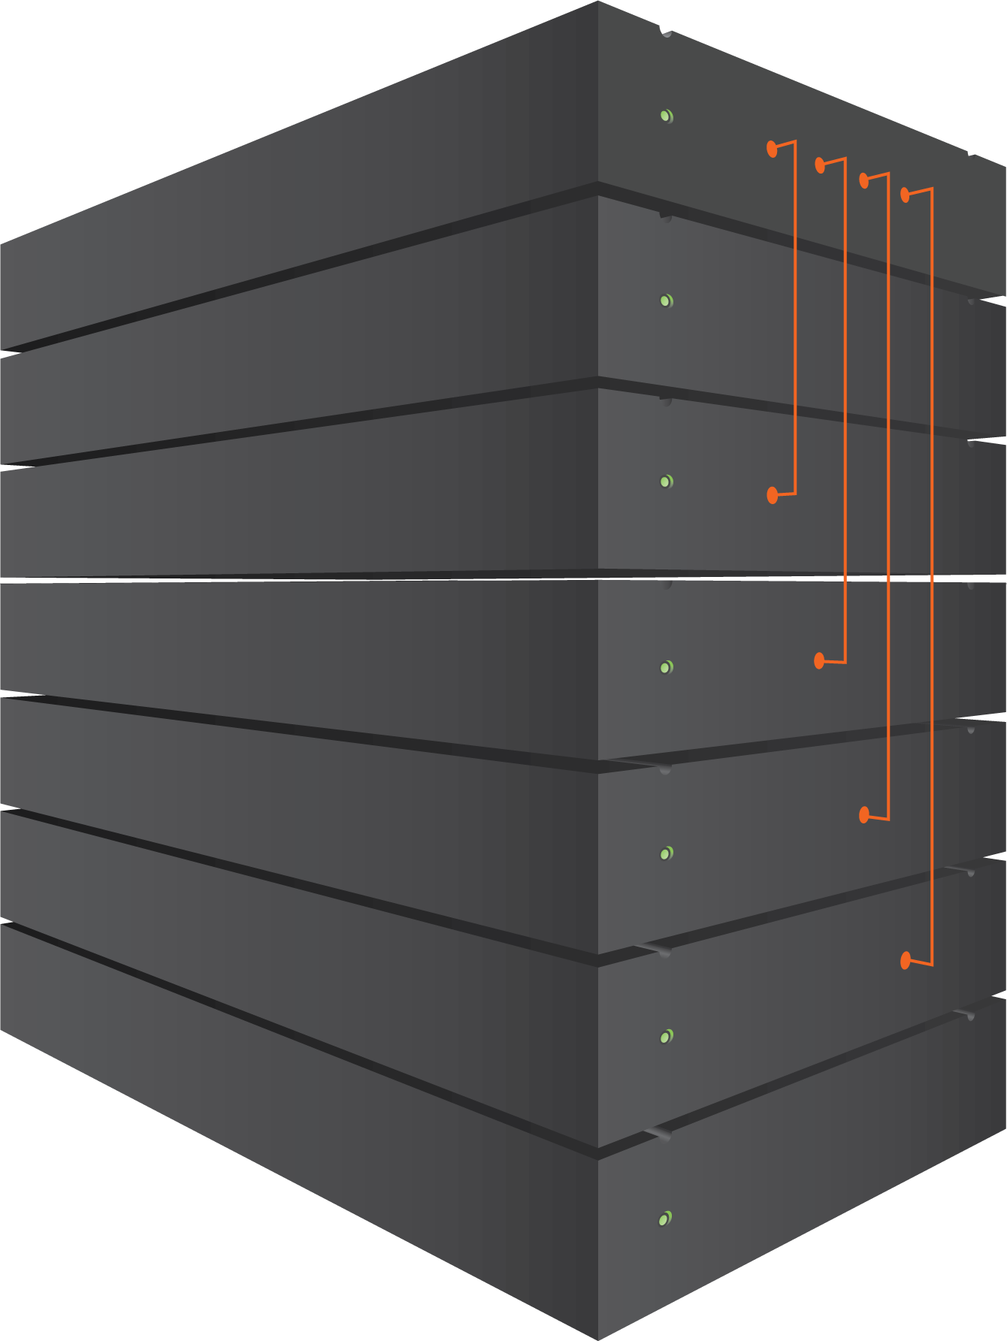
CXL 3.0: FABRICS EXAMPLE USE CASE
Composable Systems with Spine/Leaf Architecture
CXL 3.0 Fabric Architecture
Interconnected Spine Switch System
Leaf Switch NIC Enclosure
Leaf Switch CPU Enclosure
Leaf Switch Accelerator Enclosure
Leaf Switch Memory Enclosure
CXL Switch
CXL Switch
CXL Switch
Spine Switches
Example traffic flow
Fabric Manager
CXL Switch
CXL Switch
CXL Switch
Leaf Switches
Accelerator
Memory
CPUs
CPUs
GFAM
GFAM
GFAM
NIC
NIC
End Devices

Slide 25
CXL 3.0 Summary
CXL 3.0 features
Full fabric capabilities and fabric management
Expanded switching topologies
Enhanced coherency capabilities
Peer-to-peer resource sharing
Double the bandwidth and zero added latency compared to CXL 2.0
Full backward compatibility with CXL 2.0, CXL 1.1, and CXL 1.0
Enabling new usage models
Memory sharing between hosts and peer devices
Support for multi-headed devices
Expanded support for Type-1 and Type-2 devices
GFAM provides expansion capabilities for current and future memory
Call to Action
Download the CXL 3.0 specification
Support future specification development by joining the CXL Consortium
Follow us on Twitter and LinkedIn for updates!

