Slide 1
Compliance driven Integrated circuit development based on ISO26262
Haridas Vilakathara
Manikantan panchapakesan
NXP Semiconductors, Bangalore

Slide 2
Outline
Functional safety basic concepts (ISO26262 view)
IC failure and their causes
Management of random faults
Safety architecture
Safety analysis
Management of systematic faults
Product creation process
Compliance driven development process
Safety management after release to production

Slide 3
Functional safety basic concepts
IEC 61508/ISO 26262 safety concept
It is impossible to develop a zero error (bug free) system
Specification, implementation or realization errors
Random hardware failure may occur due to
Reasonably foreseeable operational errors,
Reasonably foreseeable misuse.
It is is possible to build a system with acceptable failure rate
Acceptable failure rates vary per application
Classified by automotive safety integrity levels (ASIL) &
frequency and severity of functional failures
If a failure occurs, the system needs to be transferred into a safe state
Failure event should not lead to unacceptable risk
System must detect all faults that could lead to a hazardous event
The fault reaction time to achieve safe state must be short enough to avoid any hazardous event
Safe state can be defined as
Fail safe or fail operational
Depends on application

Slide 4
IC failure and their causes
Safety architecture for detection and management of random failure (manage fault)
Random failures
Due to
Random defects inherent to Semiconductor process
Environmental conditions
Usage & handling
Systematic failures
Bugs introduced during, specification, design, development
n detected bugs during verification cycle
Due to not following best practices and methodologies for product development
Compliance driven process development and continues improvement (avoid fault)

Slide 5
Outline
Functional safety basic concepts (ISO26262 view)
IC failure and their causes
Management of random faults
Safety architecture
Safety analysis
Management of systematic faults
Product creation process
Compliance driven development process
Safety management after release to production

Slide 6
Functional safety architecture
Based on fault reaction time & safety strategy
How much a system can tolerate the IC functional failure
Fail safe, fail operational etc.
Based on application profile
Type of IC (ASIC, MCU, SoC etc)
Safety architecture to detect fault, diagnose fault and to act on fault within reasonable time

Slide 7
Application consideration
IC Developed specifically for a customer (in context)
Clear specification from customer including safety requirements
Handle ISO26262 requirements through a development interface agreement (DIA)
IC Developed for more than one applications (safety element out of context)
Assumptions are made on application profile
system level design, safety concept, and requirements based on the product application scenarios
Validate the assumptions through “proven in use” kind of arguments

Slide 8
Safety architecture (key requirements)
To detect fault
Shall incorporate sufficient failure detection & diagnostic features
To detect environmental conditions
Temp sensor, voltage sensor etc.
To detect operational anomalies
Memory errors, watchdog features etc.
Safe island
Protected heavily to guarantee reliable operations under extreme conditions
Provide diagnostic information back to system within FTTI
Process fault
Logic to isolate fault and to assess the severity of fault
Act on fault
Depends on application requirements
Fully operational (redundancy) Fail safe ( safe mode of operation), fail operational (reduced functionality)
Validate fault
Its hall be possible to fully verify & validate safety requirements
Fault injection testing

Slide 9
Outline
Functional safety basic concepts (ISO26262 view)
IC failure and their causes
Management of random faults
Safety architecture
Safety analysis
Management of systematic faults
Product creation process
Compliance driven development process
Safety management after release to production

Slide 10
Qualitative safety analysis (FMEA)
FMEA results
Potential IC failure modes and causes.
Critical characteristics of the IC
Help in design priority setting
Recommended actions for reducing severity,
Eliminate or reduce the causes of IC failure modes
Improve failure detection
Feedback of design changes to the design community

Slide 11
Quantitative safety analysis (FMEDA)
Based on Diagnostics coverage
Ratio of detectable failures probability against all failure probability
Diagnostic or self checking elements modelled
Complete Failure Mode Coverage .
All failure modes of all components must be in the model
Failure Mode Classifications in FMEDA
Safe or Dangerous: Failure modes are classified as Safe or Dangerous
Detectable : Failure modes are given the attribute DETECTABLE or UNDETECTABLE
Four attributes to Failure Modes: Safe Detected(SD), Safe Undetected(SU), Dangerous Detected(DD), Dangerous Undetected(DU)
Goal : Statistical Safety: based on Safety Integrity Level (ASIL)

Slide 12
Combined Safety analysis
D-FMEA inputs (function criticality) are used as scaling factor in FMEDA
Life test +
Field data
Technology
FITs
Map to IC
mission profile
λ_{Operating Conditions}
DFMEA
Functions
Failure modes and fault-sensitivity from Design-FMEA.
Diagnostics Coverage
(safety self-monitoring
to detect deviations)
FMEA inputs used
as a scaling factor
SPFM / LFM
λ₁
FMEDA
λ₂
Hardware
Blocks failure rate

Slide 13
Outline
Functional safety basic concepts (ISO26262 view)
IC failure and their causes
Management of random faults
Safety architecture
Safety analysis
Management of systematic faults
Product creation process
Compliance driven development process
Safety management after release to production

Slide 14
Safe IC development process
Product creation process
Based on a gated product Creation and Management process
Compliance driven development process
V model with safety extensions
Safety analysis
Combined qualitative (FMEA) and quantitative (FMEDA)
fault injection testing for validation of diagnostic coverage
Safety management after release to production
Managed through a separate department (test and product engineering)

Slide 15
Outline
Functional safety basic concepts (ISO26262 view)
IC failure and their causes
Management of random faults
Safety architecture
Safety analysis
Management of systematic faults
Product creation process
Compliance driven development process
Safety management after release to production

Slide 16
Product creation and management
Divide the project into manageable phases and sub phases
Thorough gate review process
Product and process compliance at every gate review/audit

Slide 17
Outline
Functional safety basic concepts (ISO26262 view)
IC failure and their causes
Management of random faults
Safety architecture
Safety analysis
Management of systematic faults
Product creation process
Compliance driven development process
Safety management after release to production

Slide 18
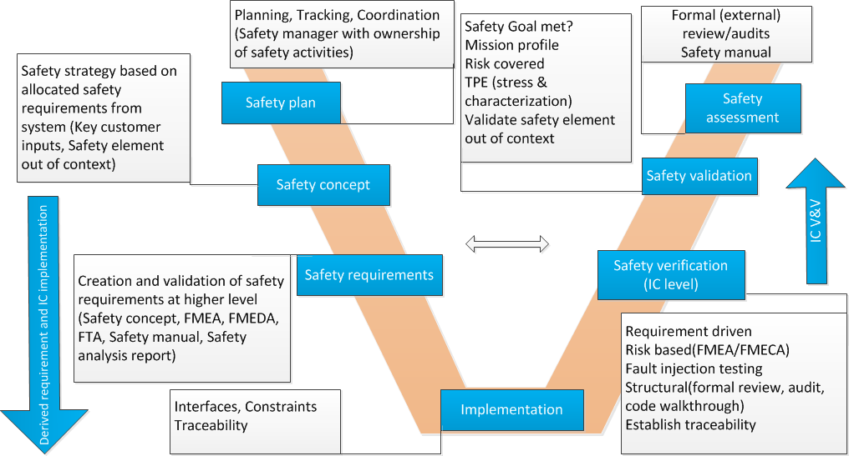
Safety lifecycle on top of “V” model
s

Slide 19
Safety life cycle extension
Project plan | Safety extension to project plan | Proof of safety
Project planning Project organization Development process | Safety life cycle activities ( Safety org, Safety manager, safety plan, tracking & assessment) Safety team organization & management | Safety case and Safety arguments
Requirement management
Requirement capture & requirement engineering, FMEA(qualitative) | Derive Safety goals, safety requirements, safety concept, and safety requirements and methods. FMEA, FMEDA & FTA ( quantitative) | Safety goals, Safety concept Safety requirements with proof of traceability FMECA/FMEDA/FTA reports Safety manual
Verification & validation
Product assessments V&V Reviews/audit | Safety V&V, Safety assessment, Tool qualification | Safety V&V reports Safety assessment reports Validation reports (proven in use argument)
Configuration management
Work products Baseline management Change management | Safety case as CI Impact analysis on safety functions(for CR) | Baseline for safety case & safety case reports Traceability and impact analysis report liked to requirement management
QM & process assurance
Quality manual Template/guidelines, Checklist/examples | Safety culture, Project level tailoring, Continuous improvements Reviewing and tracking compliance with plans. Identifying and documenting deviations from plans. | Tool confidence report, Evidence on safety culture deployment, Project tailoring report. Qualification reports, Risk assessment reports, Periodic confirmation review reports

Slide 20
Safety organization
Safety plan integrated into overall project plan
Safety extension to key process

Slide 21
(Safe)Requirement management
DOORS based formal requirement management with bi directional traceability
Formal process to track
Customer requirements
Allocated requirements from system
All requirements can be tracked to a design, verification and validation item
No design element in repository without an assigned requirement
Any PR raised can be tracked to a corresponding requirement ID
Impact on existing requirements can be identified for CR

Slide 22
Requirement management tree

Slide 23
Requirement Verification
Requirements Verification (product right)
Checks consistency of the requirements specification artefacts and other development products (design, implementation, ...)
Req->design->RTL/schematics-> netlist-> Back End ->GDS2
Safety not compromised during design translation process
Each requirements are associated with a verification item
Verification is performed throughout the entire safety lifecycle, by each specific party involved, for each of the major work products.
Compliance driven verification is the key

Slide 24
Requirement validation
Requirements Validation (right product)
Check IC requirements specification against customers goals and requirements
Provides assurance that the hardware item derived requirements are correct and complete with respect to system requirements allocated to the hardware item
Ensure that the highest level safety requirement, the safety goal, has been met and that they are correct
The product is safe to use within the mission profile
Validation has a specific meaning against “safety element out of context”. Make sure that safety goals are met trough creation of “proven in use arguments”

Slide 25
V&V work flow (safety extension)
Clear ownership on who does what within V&V organization

Slide 26
Compliance driven Verification scope
Compliance driven verification
Coverage: Link coverage item to requirements with evidence( 100% requirements coverage) In addition to other standard coverage metrics
Test plan, test item, test results linked to DOORS to establish traceability
Verification at every stage of data translation ( req-design-RTL-netlist-post layout)
Constraints driven
Interface constraints(limit, boundary value etc.), rules, design constraints such as Boundary value analysis, negative testing, control flow (protocols), data flow (protocol), overflow, underflow
Design intent verification
Intended operational environment and rules
Temporal behavior to stimuli (protocol sequence, error recovery
Risk oriented
Inputs from FMEA/FMECA
Fault injection testing
Coverage for safety architecture components & diagnostic capabilities
Structural
formal review, audit, code walkthrough

Slide 27
Validation (safety extensions)
Check whether safety goal is met
Customer driven or safety element out of context
Confirmation check on safety goals, safety architecture against functional safety of the items at intended use case level
Use case validation
Question/review safety goals from a use case perspective
Compliance with governing standards and other regulatory requirements
Interface standards, EMI/EMC etc.
Fault injection testing
Validate safety architecture and diagnostic features
Evidences against all the above

Slide 28
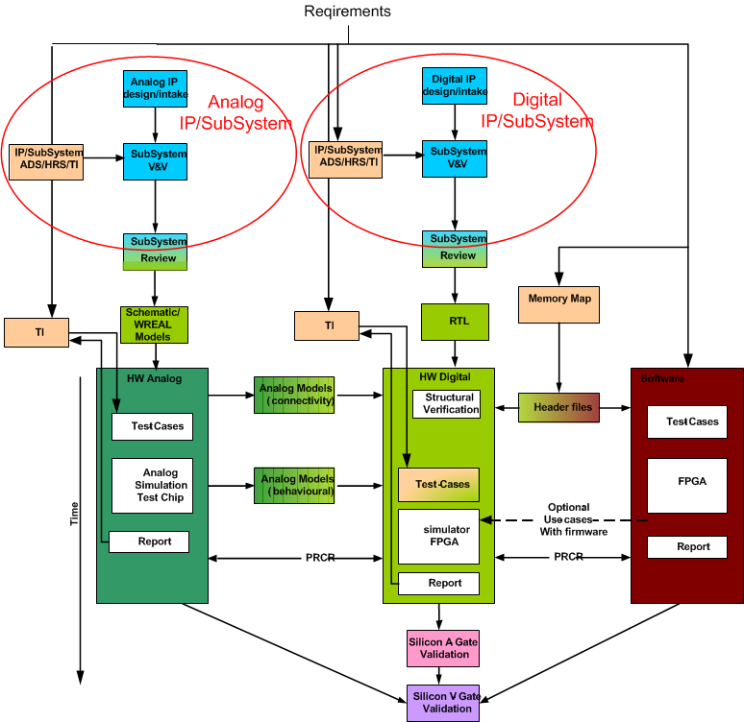
Verification & validation flow

Slide 29
Requirement traceability
Both requirements and test items are in DOORS data base
Impact on verification items due to requirement changes are immediately notified
Easy to trace back a problem report back to the originating requirement
Automated reporting on V&V progress

Slide 30
Tool qualification
Why tool qualification
IC design involves many translation process, and tool in general has the capacity to introduce error during various translation process
e.g. RTL-> Synth netlist -> post layout
Verification tools may fail to detect errors in the hardware items
Tool qualification makes sure that tool correctly functions (improve confidence in tool function)
The library components and different views used during the design translation process also need to be of mature quality and qualified one

Slide 31
Tool qualification flow

Slide 32
Configuration & Change management process
Configuration management plan aligned with ISO TS 16949, ISO9001
Maintenance of safety case as a living argument to provide a mechanism to establish the interdependency between the elements of safely case
Change management
Establish link between change management & problem reporting process and requirement management (through DOORS)
Safety representative in CCB
Ascertain the impact on functional safety w.r.t change requests

Slide 33
Quality management and process assurance
Process Gap analysis (safety)
Safety culture within organisation & project team
Process tailoring with respect to the project
Process assurance
Design data base management
Design assurance

Slide 34
Process gap analysis

Slide 35
Gap analysis
Requirement engineering | Demonstrate process for - Requirement capture - To establish requirement traceability
Process assurance | Reviewing and tracking compliance with plans. Identifying and documenting deviations from plans. Determining if transition criteria have been met between lifecycle stages.
Configuration management | Demonstrate supporting processes - Change Management - Management of Requirements - Configuration Management
Quality management | Quality manual update for safety life cycle process & methodologies Supporting process (check list, templates guide lines ) e.g. FMEA/FMEDA template & process
Safety culture | Evidence of management of Safety Life Cycle activities Organisation chart showing safety role Competence management (training & qualification program) Safety assessment

Slide 36
Safety culture
Normal development process | Safety culture
Safety measures are not planned. No Specific budget for safety | Necessary measures are planned according to safety plan (planning, tracking, coordination). Safety plan is integrated into project plan (receivables, deliverables, and resources)
Risk analysis & tracking is done, but may not structured (updated on regular basis) | Structured risk analysis is a must at beginning of project, and is continuously updated with evidence
Typically an FMEA cycle is followed (qualitative analysis) | Both qualitative (FMEA) and quantitative (FMECA/FMEDA,FTA) analysis is a followed at beginning of a project and is continuously updated with evidence
Change request are accepted at any stage (primarily look only into schedule impact) | Change requests are analyzed and evaluated against functional safety and accepted only through a strict formal change management process ( four eye principle) and impact analysis
Safety assessment not a must | Safety assessment is a must and evidence preserved until end of life

Slide 37
ISO 26262 tailoring for IC (HW only) project (example)
ISO26262 tailoring for Dolphin | Applicability | Remark
2 –Management of functional safety | Applicable | Based on functional safety plan
3 –Concept phase | Driven by customer inputs
4 –Product development at the system level | Mostly applicable | Primarily towards system validation
5–Product development at the hardware level | Applicable | Most of the diagnostic requirements are here
6–Product development at the software level | Limited (for IC do not contain a MCU) | Validate API (MCU) interface
7 –Production and operation | Applicable (IC test & production & engineering) | Big influence on FIT by Sem Con manufacturing process
8 –Supporting processes | Mostly applicable
9 –ASIL oriented and safety analysis | Based on customer inputs & application profile | Different use cases

Slide 38
Design environment management
Focus on effort spend up front to prevent design problems due to design environment
Infrastructure review Scope
Data base structure
Development standards & flows
CM, CR/PR system and tracking methodology
Effective simulation analysis and regression systems
E.g. Automation in simulation/synthesis log analysis.
Communication between architects, design engineers, & verification engineers
Documentation availability & traceability
Planned audit
Collect the documentation maintained w.r.t database
Check all the team members in the team get right information at right time
Establish inks & traceability
Audit on CR /PR tracking
Defect density
CR/PR flow
CM audit

Slide 39
Design assurance
Formal reviews & audits
By external experts
IP Vendor & IP quality checklist (IP reuse & IP intake strategy )
Technology Library
Process Reliability measures
Project level
Data base (CM, CR/PR, Documentation)
Compliance check against FRS/Impl/Verification
Verification strategy/methodology review
Verification coverage review
Explicit SoC constraints review
Non functional requirement review (coverage)
Layout review by a separate team
Pin/PAD list

Slide 40
Questions
Finalize slide set with questions slide

