Slide 1


Choice is yours :
Either struggle to tame ‘X’ in the wilderness of multimillion gates and nets,
OR
Take it for a walk in the RTL park
Nitin Jaiswal , Harsh Garg , Mayank Bindal

Slide 2

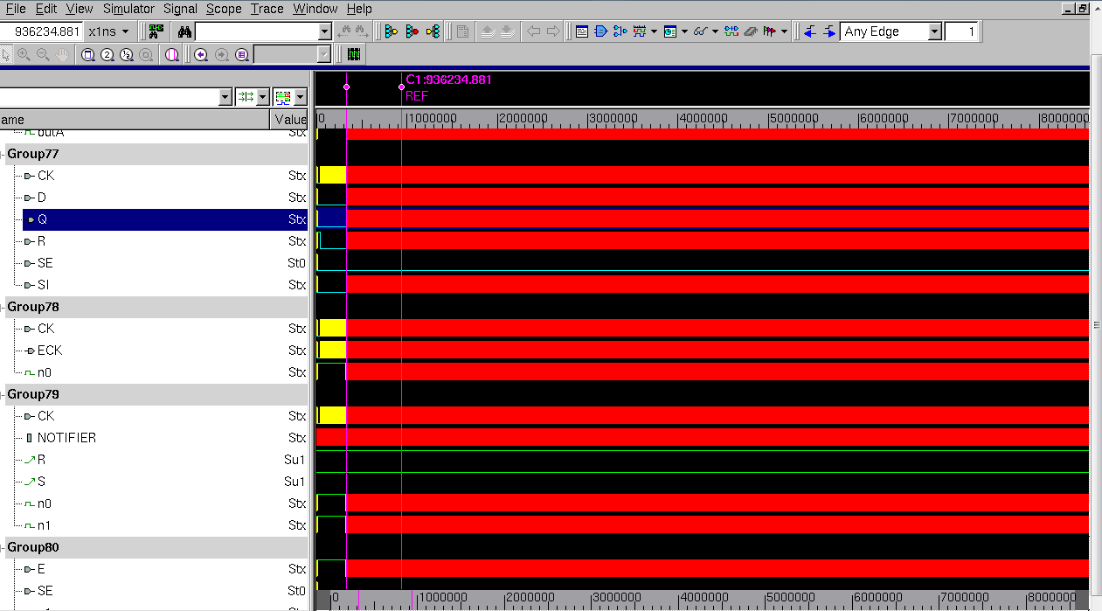
Blood-Shed by the Beast

Slide 3
Agenda
X-optimism – The Beast
X-prop – Lets tame it
Freescale case studies – Taming the creature
X-bloodbath leads to
Conclusion

Slide 4
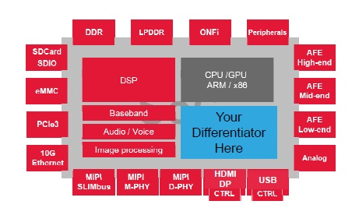
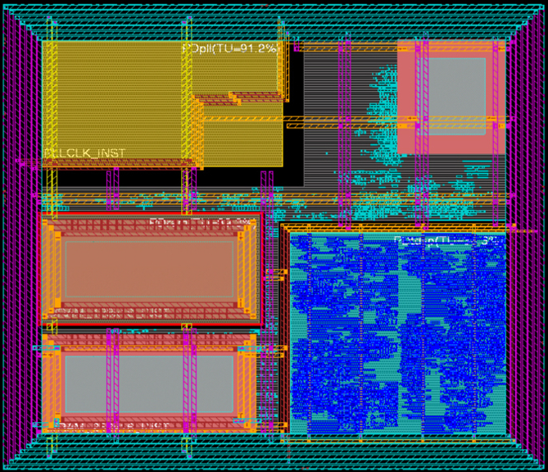
How does he manage to escape RTL and grow into a “BEAST” ?

Slide 5
X-optimism at RTL due to Verilog Semantics – Unclean edge
The direction of the change towards the value 1 is posedge and towards the value 0 is negedge, i.e.
  — A posedge shall be detected on the transition from 0 to x, z, or 1, and from x or z to 1
  — A negedge shall be detected on the transition from 1 to x, z, or 0, and from x or z to 0
Is this behaviour realistic ?
always @ (posedge clk)
q<=d;
clk
1’b1
d
q

Slide 6
X-optimism at RTL due to Verilog Semantics – IF statement
If control expression of “IF” statement evaluates to true, then first statement shall be executed. But if it evaluates to false (value is 0 or x or z), then the else statement shall be executed.
a
cond | a | b | RTL | GLS | On Silicon
X | 0 | 0 | 0 | 0 | 0
X | 0 | 1 | 1 | X | X
X | 1 | 0 | 0 | X | X
X | 1 | 1 | 1 | X | 1
if( cond )
Y = a;
else
Y = b;
y
cond
b
Achieved by Xprop at RTL stage itself

Slide 7
Introduction to X-prop
VCS has introduced improved semantics for handling “X” value in RTL simulations under X-propagation technology where it,
Considers effect of both 0 and 1 for all possible assignments controlled by an X and creates new pseudo-variables
At the end, merges the pseudo-variables using “merge mode” and assigns to the original (destination) variable(s)
  tmerge : Yields X when all values are different (like ternary op)
  xmerge : Yields X always (unconditional)
if( cond )
a = 0;
else
a = 1;
Rename
Merge & Assign
a¹ = 0;
a = merge(a¹, a²);
a² = 1;

Slide 8
Taming the creature in Freescale Designs

Slide 9




Corrupting the clock you want to be sampled - If statement
Xprop Simulation
Normal Simulations
sysclk
if (sel0)
begin
out = sysclk;
end
else
begin
out = diff_sysclk_b;
end
// single_clk_selection
diff_sysclk_b
sel0
cfg_eng_use_p
POR Sampling Logic
1

Slide 10
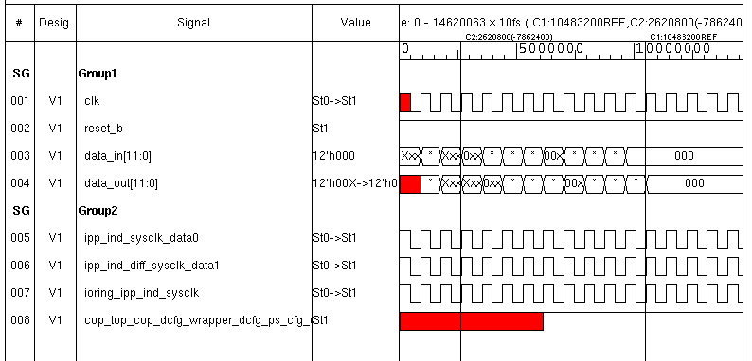
Normal VCS Behavior
Select line X
Valid output clock despite X at slect line

Slide 11
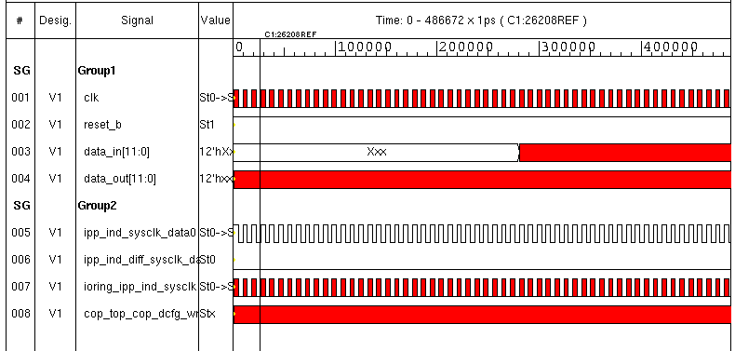
Xprop behavior
Xprop on output clock due to X on select line
Xprop on downstream logic and fdbk path due to X on clock
Xprop on downstream logic and fdbk path due to X on clock
Select line X

Slide 12

Small delays can corrupt big designs –
Unclean edge
pad_int_in
int_ind_pad
jtag_upd_data
count
ibe_pwrseq
ipp_ibe_b
0 -> 1
1 -> 0

Slide 13
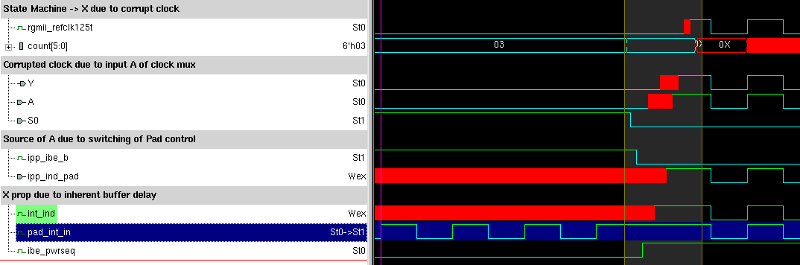
Xprop – The big picture
X propagating due to delay of the buffers.

Slide 14
Security lapse – If statement
Hreset_b
System Fabric
Individual Reset from battery
Datapath
IP Converter
Core
Security block
DANGER !!!
Security breached
Security block

Slide 15
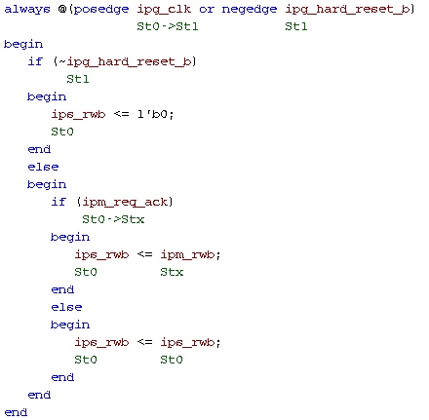
Problematic Code
For normal simulations , ips_rwb never latches X.

Slide 16
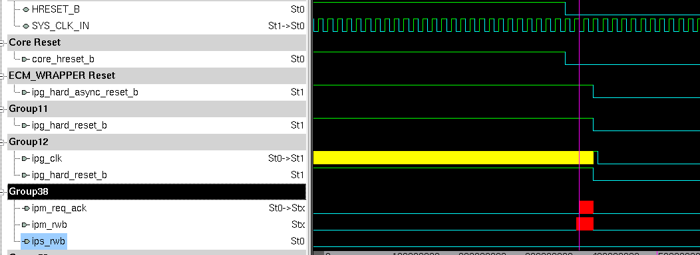
Miss in normal simulations
Ips_rwb is not getting corrupted inspite of ipm_rwb being corrupt

Slide 17
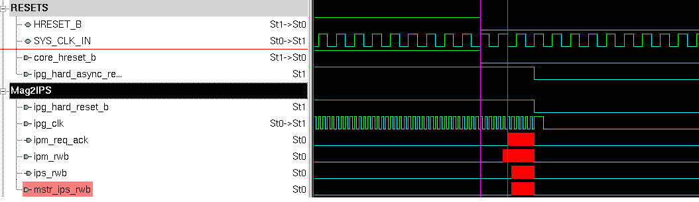
Xprop catches it
Ips_rwb getting corrupted

Slide 18
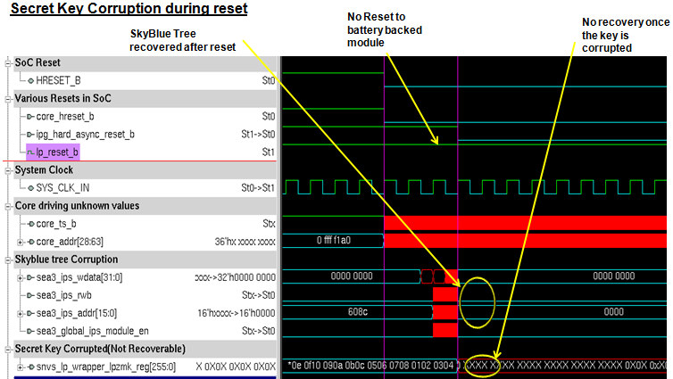

Slide 19
X-bloodbath at GLS leads to
Loss of precious after logic freeze time
  Painful debug in a mesh of multi million gates .
  Localization of ‘X’ becomes difficult
  If confirmed bug , schedule slip on charts
Confidence on design
  Only 1-5% of testsuite run on GLS
Stabilizing testbench is a daunting task.
  Most of the time , issue is found in testbench than design
Analyzing and implementing ECO becomes risky

Slide 20
Conclusion
Although initial bring-up can be challenging, X-Prop presents an effective solution to the problem of X-optimism in RTL simulations
Capable of reducing testbench bring-up time and number of iterations of gate level simulations.
  Reduced bring up time in IDC Digital Networking Freescale projects by more than 50 % .
Normal RTL/GL Simulations may fail to catch various functional issues.
We were able to catch various design/testbench issues in simulation by selectively enabling XPROP on various Freescale designs.
No critical logical ECOs after deployment of Xprop in Freescale IDC Digital Networking designs.
Enabling Xprop increases simulation time by 15-20% (effective ROI .. !)

Slide 21
Questions

