Slide 1
Challenges in Mixed Signal Verification
Amlan Chakrabarti
Sachin-Sudhakar Kulkarni

Slide 2
Agenda
Introduction
Challenges in mixed signal verification
Prior work
Proposed solution
Results
Conclusion
Acknowledgements

Slide 3
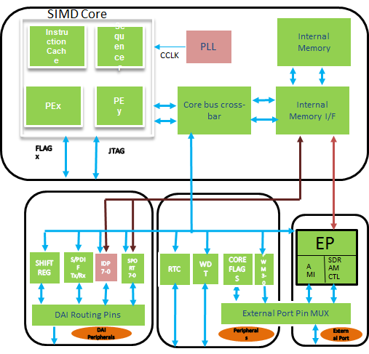
Introduction
Need to integrate more mixed signal components into SOCs.
Digital
Analog
Mixed

Slide 4
Challenges in Mixed Signal Verification
Challenges in mixed signal verification include –
handling complex interactions between digital and analog circuits.
relationship between signal “value” and signal “strength” in both domains needs to be specified.
long simulation time when simulating with a Spice netlist.
creating system level failure scenarios at the IP level itself.
at the system level we need to know jitter margins of individual IPs.
challenges in verifying PLLs.

Slide 5
Prior work in this field
Prior work for handling interactions between digital and analog circuits
“Connect rules” developed to describe the signals which traverse the digital ->analog boundary and vice-versa.

Slide 6
Prior work (contd.)
Default connect rules applied by the simulation tool
D2A rules
(Digital) 0 → (Analog) 0V
(Digital) 1 → (Analog) Local Supply voltage
A2D rules
(Analog) <=50% of Local supply voltage → (Digital) 0
(Analog) >=50% of Local supply voltage → (Digital) 1
Earlier mixed signal simulations run using a moderate/high accuracy for analog components.
With many connect rules and a single accuracy setting for all analog components, simulations used to be slow.

Slide 7
Proposed Solution
Challenge of handling complex interactions between digital and analog circuits
Analog blocks with multiple-voltage domains, where supply voltage varies
D2a rule : d2a hiv=80% lov=20% node=<path to node> vdd=<supply_voltage_node>;
A2D rule : a2d loth=20% hith=80% node=<path to node> vdd=<supply_voltage_node>;
thresholds are a percentage of the supply voltage, not a fixed value
Challenge in multi voltage analog blocks where the voltage level can vary dynamically during a simulation.
Supply voltage may remain constant.
Developed a Level Translator block to handle this.

Slide 8
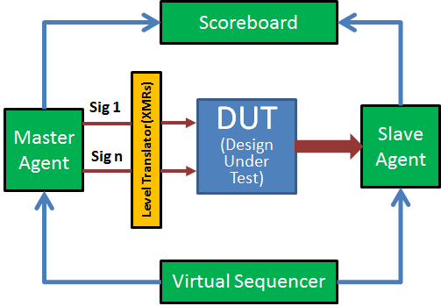
Level Translator
Appropriate voltage is driven using Cross-Module References (XMRs) depending on the mode of operation.

Slide 9
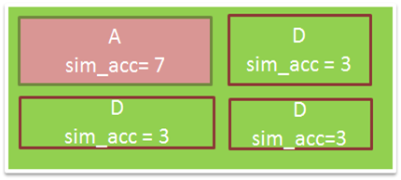
Long simulation time
Challenge of long simulation time when simulating with a Spice netlist
Use high accuracy for the analog units (slower simulation) and low/medium accuracy for the digital units(faster simulation)

Slide 10
Cross-Module References (XMRs)
Use Cross-Module References (XMRs) to reduce the usage of Connect Rules.
Conventional verification flow for verifying an analog unit
Stimulus applied to the analog unit from a Spice deck.
Checking is through visual checking and scripting.

Slide 11
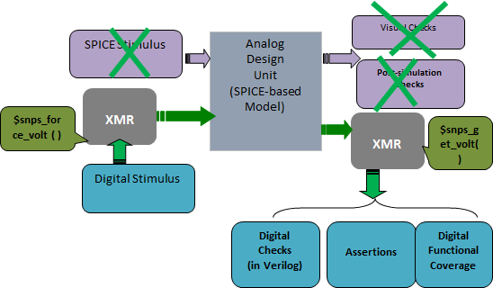
Cross-Module References (contd.)
Through XMRs internal nodes in the analog view can be accessed from the digital view (testbench environment).
eliminate conversion between digital and analog domains

Slide 12
Creating system-level failure scenarios at the IP level
Challenge of creating system-level failure scenarios at the IP level
At the system level, it is important to know how much jitter can be tolerated by the individual IPs .
If the jittered clock is generated from a PLL, it is difficult to control the amount of jitter generated.
Can be achieved by replacing the PLL with a jitter model.
What is jitter ?

Slide 13
Jitter modeling
In jitter model we modify the clock period or the width of a data bit driven from the clock.
Types of jitter we have modelled –
Deterministic (sinusoidal, triangular, etc.)
sj_offset + (sj_ampl*$sin(2*3.1416*curr_sj_freq*$realtime));
where
sj_offset = an initial offset of the jitter sinusoid
sj_ampl = amplitude of the jitter sinusoid
curr_sj_freq = frequency of the jitter sinusoid
- Random (Gaussian)
rj_offset + $dist_normal(rj_seed, 0, rj_stdev)*10/1000;
where
rj_offset = an initial offset for the random jitter
rj_seed = initial seed for the normal distribution
rj_stdev = standard deviation for the density function
- Combination of deterministic and random
Gives an idea of the data eye.

Slide 14
Challenges in PLL verification
Challenges in verifying PLLs
If the PLL has an LC oscillator, in simulations the LC oscillator won’t toggle after power supplies come up.
Solved by adding a kick to the LC tank by forcing some voltage on the LC tank nodes at the start of the simulation
$snps_force_volt (testbench.pll_inst.lcpll.tank_bias, 1.2);
Long ramp-up times for Bandgap and regulator
solved by using a separate simulation for Bandgap/Regulator ramp-up.
for all other operational modes, force the bandgap reference voltage and regulator supply voltages.
$snps_force_volt(<node_name>) -voltage <in volts> –time <time units>

Slide 15
Challenge in VCO modeling
Challenge in developing an accurate model of the VCO
In SystemVerilog, VCO can be modeled using real numbers.
avoids the need to use Verilog-A or Verilog-AMS models.
Code snippet
output wire vco;
real minfreq,maxfreq,currentfreq;
real minvolt = 0.3;real maxvolt =0.9;
parameter ghz = 1e+09;
always@*
begin minfreq = 0.9504 * ghz ; maxfreq = 8.084 * ghz ;
end
always @*
gain = (maxfreq – minfreq)/ (maxvolt –minvolt);
real fctl,halfperiod;

Slide 16
VCO model using SystemVerilog
always @*
if (vctl < maxvolt && vctl > minvolt)
fctl = (vctl – minvolt)*0.25*gain;
else if(vctl >= maxvolt)
fctl = (maxvolt-minvolt)*0.25*gain;
else if(vctl <= minvolt)
fctl = 0.25*gain;
always@*
currentfreq = fctl +minfreq;
always @*
halfperiod = (1000*ghz)/(2*currentfreq);
initial vcoPre = 0;
//Generate clock
always
#halfperiod vcoPre = ~vcoPre;
assign vco =vcoPre;

Slide 17
Results
Waveforms with the Level Translator block
LP signals (LP11, LP01, LP00)
HS-0
HS Signals (Sync Pattern and Data Payload)
LP-11
Stimulus from the Digital UVM testbench
Actual LP and HS voltage levels at the PADs [“Converter”]
De-serialized data out of the CSI2 Rx-PHY

Slide 18
Results (contd.)
Results for PLL Spice simulations using targeted accuracy settings and Cross-Module References
closed loop simulations complete in 4-5 hours
earlier simulations used to run for 16-18 hours
Introduction of jitter on data on a serial interface
Bit width is NOT constant

Slide 19
Conclusion
Mixed signal implies blocks which have both analog and digital content.
Significant challenges need to be solved to reap maximum benefits from mixed signal verification.
To handle complex interactions between digital and analog circuits, a level translator block may be needed.
Long simulation time when simulating with a Spice netlist can be solved using targeted simulation accuracy settings and cross-module references (XMRs).
Replacing the PLL with a jitter model enables to control the amount of jitter generated.

Slide 20
Acknowledgements
We would like to acknowledge our colleagues for their valuable suggestions during this effort
Ratheesh Mekkadan
Deepa Ananthanarayanan

Slide 21
Thank You !
© 2014 Advanced Micro Devices, Inc. All rights reserved. AMD, the AMD Arrow logo, and combinations thereof are trademarks of Advanced Micro Devices, Inc. Other product names used in this publication are for identification purposes only and may be trademarks of their respective companies.

Slide 22
Questions ?

