Slide 1
Abstract
CDC-RDC analysis has evolved as an inevitable stage in RTL quality signoff in the last two decades. Over this period, the designs have grown exponentially to SOC’s having 2 trillion+ transistors and chiplet’s having 7+ SOC’s. Today CDC verification has become a multifaceted effort across the chips designed for clients, servers, mobile, automotives, memory, AI/ML, FPGA etc… with focus on cleaning up of thousands of clocks and constraints, integrating the SVA’s for constraints in validation environment to check for correctness, looking for power domain and DFT logic induced crossings, finally signing off with netlist CDC to unearth any glitches and corrupted synchronizers during synthesis.
As the design sizes increased in every generation, the EDA tools could not handle running flat and the only way of handling design complexity was through hierarchical CDC-RDC analysis consuming abstracts. Also, hierarchical analysis helps to enable the analysis in parallel with teams across the globe. Even with all these significant progress in capabilities of EDA tools the major bottleneck in CDC-RDC analysis of complex SOC’s and Chiplets is consuming abstracts generated by different vendor tools. Different vendor tool abstracts are seen because of multiple IP vendors, even in house teams might deliver abstracts generated with different vendors tools.
The Accellera CDC Working-Group aims to define a standard CDC-RDC IP-XACT model to be portable and reusable regardless of the involved verification tool.
As moving from monolithic designs to IP/SOC with IPs sourced from a small/select providers to sourcing IPs globally (to create differentiated products), the quality must be maintained as driving faster time-to-market. In areas where the standards (SystemVerilog, OVM/UVM, LP/UPF) are present, the integration is able to meet the above (quality, speed). However, in areas where standards (in this case, CDC-RDC) are not available, most options trade-off either quality, or time-to-market, or both :-( Creating a standard for inter-operable collateral addresses this gap.
This workshop aims to remind the definitions of CDC-RDC Basic Concepts and constraints, as well as the description of the reference verification flow, and addressing the goals, scope & deliverables of the Accellera CDC Working Group in order to elaborate a specification of the standard abstract model.
1

Slide 2
Presenters Bio
Bill Gascoyne
Bill currently works at Blue Pearl Software in documentation, training, and software QA.
He previously worked as an applications engineer and in technical training at LSI Logic, and in technical training at Magma Design Automation.
Bill holds a BSEE from Worcester Polytechnic Institute.

Slide 3
Presenters Bio
Ping Yeung
Ping is a Senior Manager at Nvidia. He was part of the team that developed and introduced Assertion-Based Verification (ABV) and Clock-Domain-Crossing (CDC) to the electronic design industry.
He has over 30 years of experience in the industry, including positions at 0-In, Synopsys, Siemens EDA, and Oski Technology.
He has published 30+ papers and holds 7 patents in the CDC and formal verification areas.
3

Slide 4
Presenters Bio
Chetan Choppali Sudarshan
Chetan is a Senior Staff RTL Design Engineer at Marvell Technology working on connectivity chips.
He has 8 years of experience in the industry, he previously worked at Intel.
He holds a Master in Electrical Engineering from Arizona State University.
4

Slide 5
Presenters Bio
Don MIlls
Don is a Technical Staff engineer at Microchip Technology Inc and is tasked to support front end methodology corporate wide. Don provides internal training at Microchip Technology included CDC training.
Don has 40 years of experience in the industry and has worked on over 35 chips during that time. Many of these chips required functional safety CDC analyses including chips for commercial avionics.
Don earned his Bachelors degree in Electrical Engineering in 1986 from Brigham Young University
5

Slide 6
Presenters Bio
Iredamola Olopade
Dammy is a retired Senior Principal Engineer from Intel, where he led Quality and Innovation.
He built teams, managed teams and led teams as a technical contributor. His Quality work focused on the prevention of metastability (CDC, RDC, Glitches), innovated new tools/solutions with leading EDA companies for Clock/Reset/Voltage-domain-crossings.
His multi-disciplinary expertise was essential in tackling complex challenges.
His Innovation work centered on taking key technologies from incubation to products, making sure the culture/environment supported the nurturing of creative ideas, and the corporation appropriately invested in the future, as it focused on executing on the flagship projects.
He is an avid mentor who prioritizes relationships (faith, family, friends).
6

Slide 7
Presenters Bio
Farhad Ahmed
Farhad currently works as a Principal Product Engineer at Siemens EDA Software.
He has been working in Chip Design and EDA companies for last 30+ years.
He graduated with a B.Sc.(EE) degree from Bangladesh University of Engg. & Technology and a M.Sc.(EE) from Washington State University.
He started his career as an RTL Logic Designer for Sun Microsystems working on SPARC microprocessors.
7

Slide 8
Presenters Bio
Devendra Kumar Gupta
Devendra is a Principal Design/Verification Engineer at Agnisys.
He has 33 years of experience in the industry, he previously worked at C-DOT, Fujitsu, Multilink/Vitesse, OnSemi on Telecom ASICs/FPGAs architecture, design and verifications
He graduated with a B.E.(EcE) degree from Jodhpur University and a M.Tech.(Microwave Electronics) from Delhi University.
8

Slide 9
CDC/RDC Interchange Format Standard
Jean-Christophe
BRIGNONE
Ashish SONI
Joachim VOGES
Devender KHARI
Suman
CHALANA
Manish BHATI
Farhad AHMED
Chetan CHOPPALI SUDARSHAN
Bill
GASCOYNE
Kranthi
PAMARTHI
Jan HAYEK
Jebin MOHANDAS
9

Slide 10
Breakthrough in CDC-RDC Verification Defining a Standard for Interoperable Abstract Model
Accellera CDC Working Group Authors
Jean-Christophe
BRIGNONE
Ashish SONI
Joachim VOGES
Devender KHARI
Suman
CHALANA
Manish BHATI
Farhad AHMED
Chetan CHOPPALI SUDARSHAN
Bill
GASCOYNE
Kranthi
PAMARTHI
Jan HAYEK
Jebin MOHANDAS
10

Slide 11
Bridging the Gap: Standardizing CDC and RDC Closure with Interoperable Abstract Models
Accellera CDC Working Group
Authors
Devender
KHARI
Ashish SONI
Jean-Christophe
BRIGNONE
Jebin MOHANDAS
Suman
CHALANA
Manish BHATI
Farhad AHMED
Joachim
VOGES
Jan
HAYEK
Chetan CHOPPALI SUDARSHAN
Bill
GASCOYNE
Kranthi
PAMARTHI
11

Slide 12
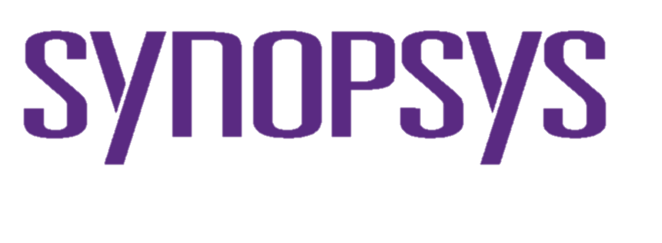
Standardizing CDC and RDC abstract models
Accellera CDC Working Group
Anupam
BAKSHI
Ping
YEUNG
Chetan
CHOPPALI SUDARSHAN
Farhad
AHMED
Iredamola OLOPADE
Sean
O'DONOHUE
Bill
GASCOYNE
Kranthi
PAMARTHI
12

Slide 13
Presenters Introduction
IP & Product Companies
Ping Yeung (Nvidia)
Senior Manager at Nvidia.
over 30 years of experience in the industry, including positions at 0-In, Synopsys, Siemens EDA, and Oski Technology.
Chetan Choppali Sudarshan (Marvell)
Senior Staff RTL Design Engineer at Marvell Technology working on connectivity chips.
8 years of experience in the industry, he previously worked at Intel.
Don Mills (Microchip Technology Inc)
Technical Staff engineer at Microchip Technology Inc and is tasked to support front end methodology corporate wide. Don provides internal training at Microchip Technology included CDC training.
Don has 40 years of experience in the industry and has worked on over 35 chips during that time..
Iredamola Olopade (Accellera Allied Member Individuals)
Dammy is a retired Senior Principal Engineer from Intel, where he led Quality and Innovation.
built teams, managed teams and led teams as a technical contributor. His Quality work focused on the prevention of metastability (CDC, RDC, Glitches), innovated new tools/solutions with leading EDA companies for Clock/Reset/Voltage-domain-crossings.
EDA Vendors Company
Bill Gascoyne (Blue Pearl Software)
currently works at Blue Pearl Software in documentation, training, and software QA.
previously worked as an AE and in technical training at LSI Logic, and in technical training at Magma Design Automation.
Farhad Ahmed (Siemens EDA Software)
currently works as a Principal Product Engineer at Siemens EDA Software.
has been working in Chip Design and EDA companies for last 30+ years.
Devendra Kumar Gupta (Agnisys)
Principal Design/Verification Engineer at Agnisys.
33 years of experience in the industry, he previously worked at C-DOT, Fujitsu, Multilink/Vitesse, OnSemi on Telecom ASICs/FPGAs architecture, design and verifications
To join the Accellera CDC WG
For member Companies
https://workspace.accellera.org/wg/CDC
For non member Companies
https://www.accellera.org/community
13

Slide 14
Agenda
 | Topic | Slide update/create | Presenter | Time
#0 | Workshop introduction |  | Bill Gascoyne | 5m
#1 | CDC-RDC |  |  | 50m
 | CDC-RDC Basic Knowledge | Bill Gascoyne (Blue Pearl), Jan Hayek (Bosch Sensortec) | Bill Gascoyne (Blue Pearl SW) | 10m
 | Setup Constraints & Verification | Ping Yeung (Nvidia) Jebin Vijai (Intel) | Ping Yeung (Nvidia) | 5m
 | Structural CDC/RDC | Chetan Choppali Sudarshan (Marvell) Suman Chalana (Qualcomm) | Chetan Choppali Sudarshan (Marvell) | 10m
 | CDC Assertion-Based Verification | Kranthi Pamarthi (Renesas Electronics) Manish Bhati (Siemens EDA) | Don Mills (Microchip Technology) | 10m
 | CDC-RDC Hierarchical Flow | Jean-Christophe Brignone, Ashish Soni (ST) | Don Mills (Microchip Technology) | 5m
 | Q & A |  |  | 10m
#2 | Accellera CDC WG |  |  | 32m
 | Standard | Iredamola Olopade, Jebin Vijai (Intel) | Iredamola Olopade (Accellera) | 3m
 | Assertion | Kranthi Pamarthi (Renesas Electronics), Manish Bhati (Siemens EDA) | Ping Yeung (Nvidia) | 3m
 | Output | Joachim Voges (Infineon), Devender Khari (Agnisys) | Farhad Ahmed (Siemens EDA) | 3m
 | Testing | Farhad Ahmed (Siemens EDA), Suman Chalana (Qualcomm) | Farhad Ahmed (Siemens EDA) | 3m
 | Format | Devender Khari (Agnisys) | Devendra Gupta (Agnisys) | 5m
 | Training | Jean-Christophe Brignone, Diana Kalel, Ashish Soni (ST) | Bill Gascoyne (Blue Pearl SW) | 3m
 | Call For Contribution | Jean-Christophe Brignone (ST), Anupam Bakshi (Agnisys) | Bill Gascoyne (Blue Pearl SW) | 2m
 | Q & A |  |  | 10m
14

Slide 15
1.1 CDC-RDC Basic Knowledge:
Synchronous vs. asynchronous clocks
Problems related to Clock Domain Crossing (CDC)
CDC Synchronization
Problems related to Reset Domain Crossing (RDC)
RDC Synchronization
Notes:
CDCs, or Clock Domain Crossings, concern the transfer of data using clocks that are asynchronous to one another. Part of the charter of the training sub-group is to make sure discussions of CDCs begin with everyone on the same page, so we’re going to spend a few minutes doing just that. The first step is to agree on just what asynchronous clocks are, and so we first need to agree on what synchronous clocks are. Synchronous clocks come from the same source, and they have an easily-established timing relationship. In short, for data paths between synchronous clocks, static timing analysis works, and there is no need for heroic measures to ensure that they function properly. Asynchronous clocks, on the other hand, come from different sources, or they have a timing relationship that is unknown or difficult to establish. Note that any two sources, even two with identical specs, should be treated as asynchronous because they have different error bars. In such a case, static timing analysis would seem to work, but the real world would eventually disagree. Another counter-example would be two clocks from the same source where, for example, one was divide by ten and the other divide by nine. This timing relationship would be possible to establish, but timing-wise it might not be amenable to static timing analysis. Lastly, we are talking about designs that have multiple clocks, as opposed to designs that have no clock at all.

Slide 16
Synchronous vs. Asynchronous
CDC-RDC basic knowledge
Accellera CDC Working Group
Synchronous clocks
Same source
Have an easily-established timing relationship
Static Timing Analysis works
Asynchronous clocks
From different sources
Timing relationship unknown or difficult to establish
Static Timing Analysis doesn’t work
Notes:
CDCs, or Clock Domain Crossings, concern the transfer of data using clocks that are asynchronous to one another. Part of the charter of the training sub-group is to make sure discussions of CDCs begin with everyone on the same page, so we’re going to spend a few minutes doing just that. The first step is to agree on just what asynchronous clocks are, and so we first need to agree on what synchronous clocks are. Synchronous clocks come from the same source, and they have an easily-established timing relationship. In short, for data paths between synchronous clocks, static timing analysis works, and there is no need for heroic measures to ensure that they function properly. Asynchronous clocks, on the other hand, come from different sources, or they have a timing relationship that is unknown or difficult to establish. Note that any two sources, even two with identical specs, should be treated as asynchronous because they have different error bars. In such a case, static timing analysis would seem to work, but the real world would eventually disagree. Another counter-example would be two clocks from the same source where, for example, one was divided by ten and the other divided by nine. This timing relationship would be possible to establish, but timing-wise it might not be amenable to static timing analysis.
(Lastly, we are talking about designs that have multiple clocks, as opposed to designs that have no clock at all.)

Slide 17
Coin Toss Analogy
Think of a setup/hold violation result as the toss of a coin
Heads or Tails, but also very rarely it might just stay on its edge (metastability) before falling one way or the other
Fixing metastability and fixing data coherency are independent
For one bit, fixing metastability is enough
Coherency doesn’t matter, since either heads or tails is fine
For multiple bits, must fix metastability AND data coherency
Requires all heads or all tails from multiple coins
A losing bet!
Notes:
The root of the problem with CDCs is that they lead to timing violations on the receiving registers. I find the best way to think of timing violations is to compare the results to the toss of a coin. This is actually a very apt analogy, because if you think about it, there are three possible outcomes to tossing a coin. The vast majority will be either heads or tails, but if you toss the coin millions of times, every once in a while it’s going to stick the landing. While it’s not likely that anyone has ever seen a coin land on its edge and remain stable, we’ve probably all seen a case where the coin has spun on its edge before eventually falling to either heads or tails, and if we’re going to toss the coin millions of times, we can’t wait around for it to fall one way or the other. We’re on the clock here! In fact, the longest we can wait is one clock cycle, right? That, ladies and gentlemen, is metastability, the coin being on its edge for more than a clock cycle, or more to the point, a register being neither one nor zero for more than a clock cycle. So the first problem we need to deal with is metastability. We also need to worry about data coherency, whether all of our bits match what they should be from one clock cycle to the next. These two problems are independent. You can fix one without fixing the other. Now, for one bit, all we need to worry about is metastability. Data coherency fixes itself, since a single bit can only be either one or zero. But if you have multiple bits, you need to worry about both issues, because you’re not satisfied with either heads or tails, you’re only satisfied with all heads or all tails for multiple coins. That’s not a very good bet.

Slide 18
What is Clock Domain Crossing?
A_in
B_in
B_out
A1
B1
Clk_A
Clk_B
What is a Clock Domain?
flip-flops with same clock (clock tree) or derived clocks sharing the same source
Clock Domain Crossing
Data from one clock domain is captured (sampled) in another clock domain
18

Slide 19
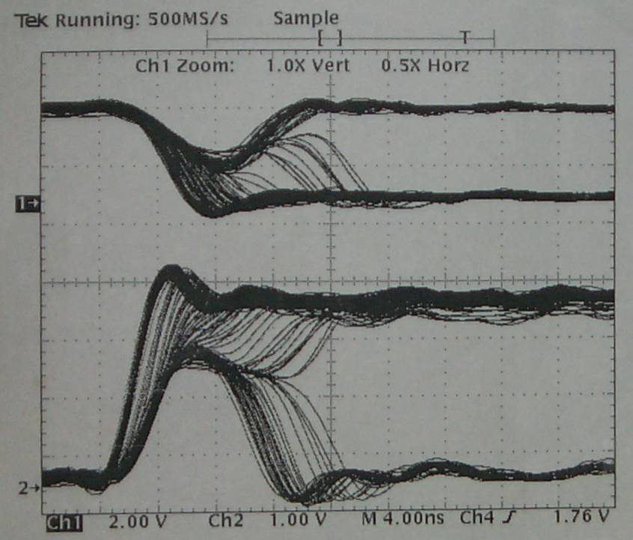
Why do CDCs need fixing?
Metastability
Timing violations on registers resulting in an indeterminate state lasting long enough to violate timing assumptions of the following circuits
… the coin decided too late / has not decided yet
D3
Q3
clk_1
F3
Q1
clk_2
Δt
D4
Q4
Q2
D1
Q1
D2
Q2
F4
D3
F1
F2
D4
D5
D5
Q5
Q3
clk_1
clk_2
F5
Q4
Q5
(a) structure
(b) waveform
(c) Physical representation
Notes:
The working group has identified three issues that will be addressed, the first being metastability, where the receiving register holds to an indeterminate state for longer than one clock cycle. To refer back to the previous analogy, this is the coin standing or spinning on its edge.

Slide 20
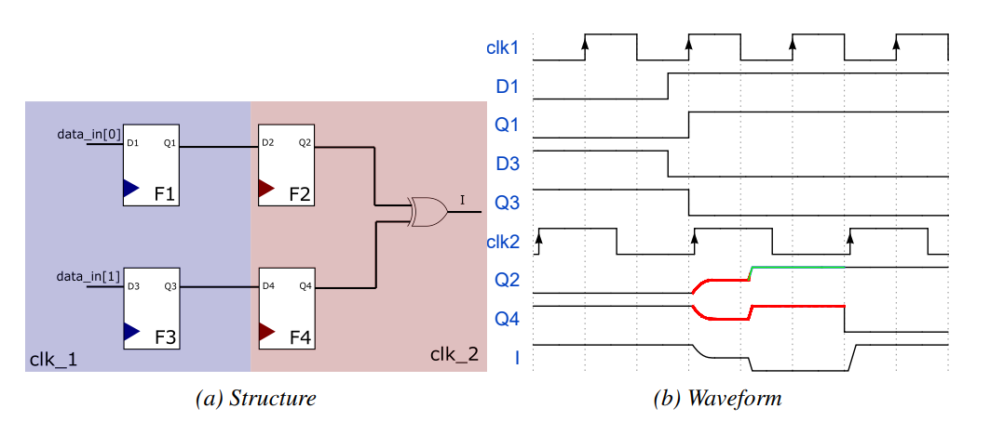
Why do CDCs need fixing?
Loss of Data Coherency
The indeterminate state settles to a random value
Notes:
The second issue is loss of data coherency. Multiple receiving registers may not go metastable, but they’ll still fall randomly to one or zero. However, the requirement is that the combination of multiple bits needs to match the results from either clock cycle “n” or clock cycle “n+1”. So for multiple bits, stable but random isn’t good enough.

Slide 21
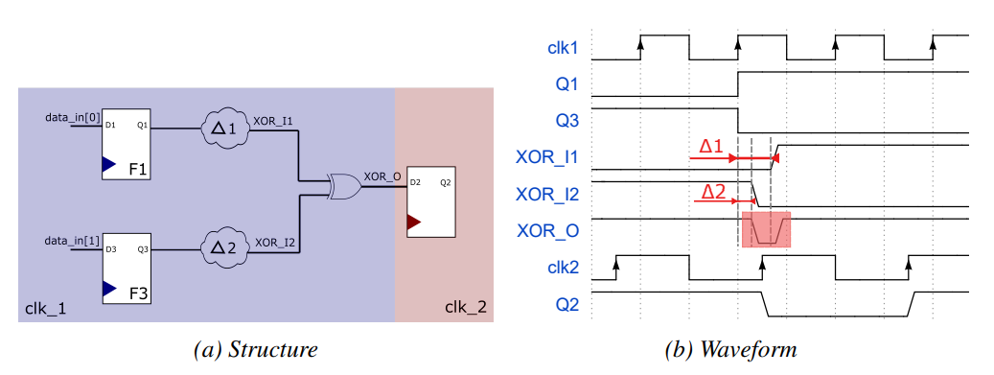
Why do CDCs need fixing?
Glitches
Multiple synchronized paths reconverge to cause unexpected momentary transitions
Notes:
The third issue the group seeks to address is similar to the second, but in this case we have multiple source bits and only one receiving register, so that bad timing could result in a glitch being clocked into the receiving register.
Additionally, edge transitions from glitches increase the possibility of an edge transitions during setup or hold time of the receiving FF thus decreasing the MTBF as discussed on the next slide.

Slide 22
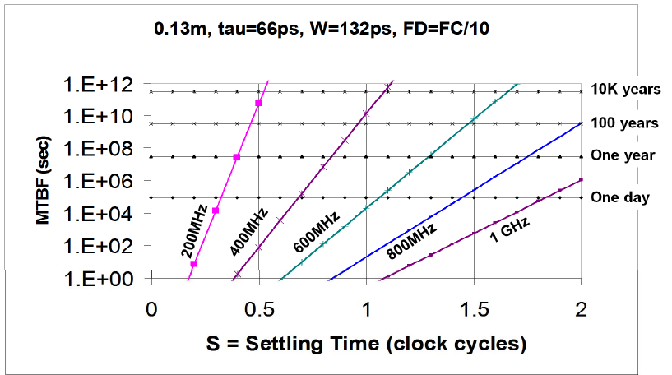
MTBF Mean Time Between Failures
given metastability at t = 0, probability of metastability at t > 0 -> e^{-t/τ}
failure: still metastable at next clock edge
- failure = p(enter m.s) x p(still m.s after T_{S})
= T_{W}/T_{C} x e^{-Ts/τ}
- rate(failure)
= rate(enter m.s) x p(still m.s after T_{S})
= T_{W} x f_{C} x f_{D} x e^{-Ts/τ}
MTBF = 1 / rate(failure)

Slide 23
Synchronization
4.1 Multi-flop synchronizers
Synchronizing one bit with two DFFs changes odds of metastability on the 2nd flop from ~1/p to ~1/p²
The probability of a metastability event in the receiving Flop (F2):
For a typical .25um ASIC technology, T₀=9.6nS,τ=0.31nS, and for T_{r}=2.3nS, F_{c}=100Mhz and F_{d}=1Mhz, the MTBF=20.1 days.
When using a 2-flop synchronizer, the MTBF at the output of the 2nd flop will be 9.57 ∙ 10¹⁰years.
… add a 3rd DFF for ~1/p³ → improving MTBF to any level is possible at the cost of transmission delay
D3
F3
Q3
$$MTBF=\frac{e^{\frac{t_{r}}{τ}}}{T_{0}∗F_{c}∗F_{d}}∗\frac{e^{\frac{T_{r}}{τ}}}{T_{0}∗F_{c}}$$
D1
Q1
D2
Q2
Δt
D4
F4
Q4
F1
F2
clk_2
D5
F5
Q5
clk_1
D3
F3
Q3
D1
Q1
D2
Q2
Dm
Qm
Δt
D4
F4
Q4
F1
F2
Fm
clk_2
D5
F5
Q5
clk_1
Notes:
The best known solution for a single bit CDC is to place a second register on the receiving side. Technically, it would still be possible for a metastable state to pass through two registers, but the probability, instead of being proportional to 1/p, is proportional to 1/p squared. The precise equation is listed here for reference. The likelihood of a failure increases with frequency, but will remain quite low. For very high reliability applications, some designers feel more comfortable adding a third register so that the failure probability drops further, becoming proportional to 1/p cubed. In any case, it’s still true that this is a solution for metastability. The result is still random, and will match cycle n or cycle n+1 only by coincidence.

Slide 24
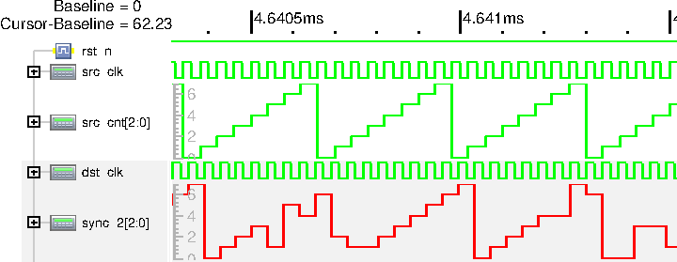
Synchronization
4.1 Multi-flop synchronizers
With multiple bits, metastability is still addressed but data coherency is a problem!
If multiple bits change on the same cycle, the result of each bit is random
This synchronization works only if the data is “gray” (only one bit changes)
src_cnt[2:0]
sync_2[2:0]
D1
Q1
D2
Q2
Dm
Qm
F1
F2
Fm
src_clk
dst_clk
Notes:
For a multi-bit register, or for two independently synchronized paths that converge, data coherency is still a problem if it is possible for multiple bits to change on the same cycle. A double register is an acceptable solution for a multi-bit register only if it can be guaranteed that the data has only one bit changing on any given cycle.
In the shown example you see what may happen if you do not honor this requirement: The input of the bus-synchronizer is a simple counter that overruns creating a sawtooth curve (src_cnt; green). The output can be still be somehow recognized as sawtooth curve; but with embedded random values that have no correspondence on the source side; whilst other values available at source side cannot be found on the receiving signal.
Unless a cdc-jitter-modeling synchronizer is used in the simulation, you will not see these effects in simulation which makes the issue more severe.

Slide 25
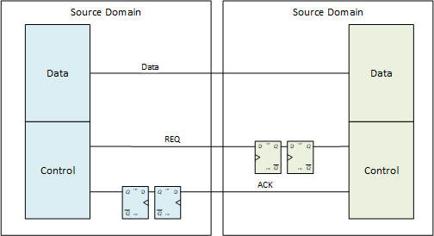
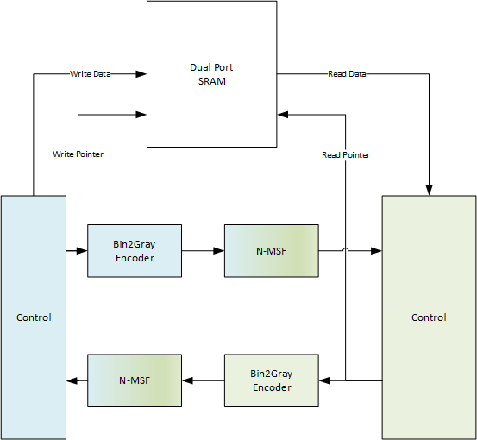
Synchronization
FIFO
Increased bandwidth
Throttling
Handles intermittent peaks of incoming data rate
4.2 Protocol-based synchronizers
Simple Qualifier
Handshake protocol
Notes:
More robust multi-bit solutions include the use of a qualifier signal to verify that the source data is stable, a more complex handshake protocol, or a FIFO, which is a preferred solution for many FPGA designers.

Slide 26
Asynchronous Reset Release
In addition to setup and hold, DFF models also have recovery time
Time between asynchronous Set/Reset release and clock when data and output are different
Violating recovery time is no different than violating setup/hold
Possible to synchronize asynchronous reset on release edge only
Static analysis is sufficient to make this determination
Async
RST1
D
Q
D
R
Q
CLK
CLK1
CLK
CLK0
D
R
Q
D
R
Q
CLK
CLK
D
R
Q
CLK1
CLK
Reset Clock Crossing
Notes:
There’s another timing parameter that’s important for data registers with asynchronous set or clear, and that’s recovery time, or the minimum time required between the inactive edge of the asynchronous reset and the active edge of the clock. Violating recovery time is no different, really, than violating setup or hold time, except that the starting output value is known. This is a somewhat easier problem to solve than CDCs. It is possible to create a driving circuit that synchronizes only the inactive edge of the asynchronous reset signal, and this situation can be determined by static analysis.

Slide 27
Asynchronous Reset Release
In addition to setup- and hold-, DFF models also have recovery-time
Time between asynchronous Set/Reset release and clock when data and output are different
Violating recovery time is no different than violating setup/hold
Possible to synchronize asynchronous reset on release edge only
Static analysis is sufficient to make this determination
Async
RST
Async
RST
Sync RST
D1
Q1
Q1
D
Q
D
Q
F1
R1
R2
D2
Q2
Q2
CLK0
CLK0
F2
CLK0
AsyncRST
Q1
SyncRST
Q2
Notes:
There’s another timing parameter that’s important for data registers with asynchronous set or clear, and that’s recovery time, or the minimum time required between the inactive edge of the asynchronous reset and the active edge of the clock. Violating recovery time is no different, really, than violating setup or hold time, except that the starting output value is known. This is a somewhat easier problem to solve than CDCs. It is possible to create a driving circuit that synchronizes only the inactive edge of the asynchronous reset signal, and this situation can be determined by static analysis.

Slide 28
The Reset assertion RDC problem
Paths passing from CLR to Q are usually not timing closed
Using reset ordering
Reset
Reset
Comb Logic
D
Q
D
Q
D
Q
D
Q
F2
F1
F2
F1
CLK
CLK
Using a CDC Control CDC Control must be synchronous with target domain
Destination Reset
Reset
Qualifier
Reset
D
Q
D
Q
F1
F2
D
Q
D
Q
CLK
F1
F2
CLK
Notes:
The final issue the CDC working group proposes to address is reset domain crossing, or RDC. While recovery time deals only with the inactive edge of the asynchronous reset signal, RDC concerns itself with situations where the active edge of a register’s asynchronous reset signal creates a timing issue on the next register which does not share that asynchronous reset signal. If all of our models had complete timing on the reset-to-Q path of each register, it would be possible to treat this as simply a special case of for CDC, but sadly that’s often not the case. Types of RDC solutions include proper timing of different asynchronous reset signals, or the use of qualifier signals similar to what we saw in the earlier CDC solutions. There will be further discussion of this later in this presentation.

Slide 29
1.2 CDC Setup & Constraints
CDC Verification flow
Setup constraints
Challenges
Notes:
CDCs, or Clock Domain Crossings, concern the transfer of data using clocks that are asynchronous to one another. Part of the charter of the training sub-group is to make sure discussions of CDCs begin with everyone on the same page, so we’re going to spend a few minutes doing just that. The first step is to agree on just what asynchronous clocks are, and so we first need to agree on what synchronous clocks are. Synchronous clocks come from the same source, and they have an easily-established timing relationship. In short, for data paths between synchronous clocks, static timing analysis works, and there is no need for heroic measures to ensure that they function properly. Asynchronous clocks, on the other hand, come from different sources, or they have a timing relationship that is unknown or difficult to establish. Note that any two sources, even two with identical specs, should be treated as asynchronous because they have different error bars. In such a case, static timing analysis would seem to work, but the real world would eventually disagree. Another counter-example would be two clocks from the same source where, for example, one was divide by ten and the other divide by nine. This timing relationship would be possible to establish, but timing-wise it might not be amenable to static timing analysis. Lastly, we are talking about designs that have multiple clocks, as opposed to designs that have no clock at all.

Slide 30
CDC Verification flow
RTL
Design Compilation
Parameters, defines
SV packages, SV configuration, SV interfaces
Setup Constraints
Clock, reset, and IO signals
Configuration: stable, constant inputs
Structural CDC Check
CDC schemes validation and debugging
Abstract Model Generation
Dynamic/Formal CDC Verification
CDC constraints and protocols
Design Compilation
Design
db
Setup Constraints
Structural CDC
Abstract
Model
CDC
paths
CDC
Protocols
Dynamic CDC

Slide 31
Setup Constraints
The set of constraints used to guide CDC verification
Clocks
Resets
Configuration signals
Black boxes
Primary inputs/outputs
Don’t rely blindly on timing constraints
Pseudo-static signals
Exclusive signals
Gray coded buses
Custom synchronizers
False path
Reusing timing constraints is risky
Clock groups for timing analysis =/= Clock groups for CDC analysis
Signal paths waived for timing analysis =/= Signal paths waived for CDC analysis

Slide 32
Challenge #1: Design Parameters
Blocks/IPs have many parameters
Some used for design, performance, optimization
Some used for integration, mode
Some used for DFT, DFP, DFM, etc
Most parameters will affect CDC results
Some parameters may not affect CDC results
Data_width, Addr_width
FIFO_depth, RAM_size
The Abstract Model will become parameter-specific
design parameters
IP Block
mode parameters
performance parameters
power parameters
test parameters
To specify or not to specify

Slide 33
Challenge #2: Configuration Signals
Blocks/IPs have many configuration signals
Some used for design, performance, optimization
Some used for integration, mode
Some used for DFT, DFP, DFM, etc
Most configuration signals will affect CDC results
Clock select, gating signals
The Abstract Model will become configuration-specific
design configs
IP Block
mode configs
performance configs
power configs
To constrain or not to constrain

Slide 34
Challenge #3: CDC Waivers
Blocks/IPs have many CDC violations
Some are on the input signals
Some are on the output signals
Some of the input violations can be waived
Pseudo-static input signals
Output signals
Some of the input violations must not be waived
The Abstract Model will become waiver-specific
IP Block
Input waiver
X
Output waiver
X
To waive or not to waive

Slide 35
1.3 Structural CDC/RDC
Structural CDC
User defined synchronization modules
CDC constraints
Reset Domain Crossings
Notes:
CDCs, or Clock Domain Crossings, concern the transfer of data using clocks that are asynchronous to one another. Part of the charter of the training sub-group is to make sure discussions of CDCs begin with everyone on the same page, so we’re going to spend a few minutes doing just that. The first step is to agree on just what asynchronous clocks are, and so we first need to agree on what synchronous clocks are. Synchronous clocks come from the same source, and they have an easily-established timing relationship. In short, for data paths between synchronous clocks, static timing analysis works, and there is no need for heroic measures to ensure that they function properly. Asynchronous clocks, on the other hand, come from different sources, or they have a timing relationship that is unknown or difficult to establish. Note that any two sources, even two with identical specs, should be treated as asynchronous because they have different error bars. In such a case, static timing analysis would seem to work, but the real world would eventually disagree. Another counter-example would be two clocks from the same source where, for example, one was divide by ten and the other divide by nine. This timing relationship would be possible to establish, but timing-wise it might not be amenable to static timing analysis. Lastly, we are talking about designs that have multiple clocks, as opposed to designs that have no clock at all.

Slide 36
Structural CDC Analysis Process
RTL
Design compilation
Setup constraints
Clocks
resets
Configuration signals
I/O configuration
Manual modification
specs
Setup_check
is the design correctly constrained ?
Errors correction
Structural checks
are all the CDCs well synchronized ?

Slide 37
Structural CDC - Commonly Used Synchronization Schemes
Transmitting Clock Domain
Receiving Clock Domain
Domain A
Domain B
A1
A2
B1
B2
Bus[N-1:0]
D
Q
D
Q
D
Q
clk1
clk2
C1
Clk
Clk
Clk
C2
Double-FF synchronizer
MUX synchronizer
clk1
clk2
Bus[N-1:0]
Write Data
wdata
rdata
Read Data
Write Enable
wen
Source
Destination Domain
Write Addr
waddr
raddr
Read Addr
wptr
rptr
Request
Binary to Gray
Converter
Memory
Binary to Gray
Converter
Full Flag Generation
Full
Empty
Empty Flag Generation
Acknowledgment
Grey to Binary Converter
Grey to Binary Converter
Handshake synchronizer
Write Domain
FIFO synchronizer
Read Domain
Notes:
Chetan notes - These are some of the commonly used synchronization schemes in CDC. We start off with the famous Double Sync, where we have two back to back FF in the receiver domain and the data going from the TX flop gets synchronized to receiver domain.
Then we have MUX syncronizaion techniques, where we have a select bit that blocks the data transfer from TX to RX, the select is synchronized and sent to RX domain via a double sync.
We then have a handshake sync, where the TX and RX domain talk to each other for seamless transfer of data, as seen we will have doule sync along the way with a request and ack sent and received between RX and TX. Last is FIFO based synchronizer which is widely known, where we will have the rd/wr poiner synchronized as shown in the image, to help with clock domain transfer

Slide 38
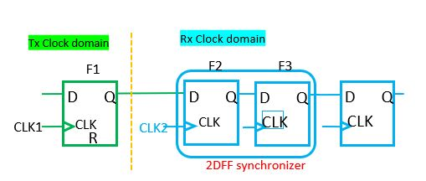
Structural CDC – User defined sync modules
Double FF Synchronizer
Most design houses prefer to use their own CDC components
Disable automatic detection of the specific synchronizer type that you don’t want the tool to recognize automatically
Declare your own scheme as user-defined synchronizer (before scheme detection)
Example: Use my own 2DFF only
Disable auto-detection of 2DFF
Declare your own module as 2DFF
Notes:
Chetan notes - As I said in the previous slide Double Sync is widely famous and used for CDC. Most design houses want to optimize and have their own back to back FF. Tools allow this feature and recognizes the back to back FF that is defined by the design house during its analysis.

Slide 39
Structural CDC
Various Signal Configurations possible for structural CDC Analysis
Constant
Static
Mutually exclusive / Gray code
Externally synchronized
CDC False paths
Not recommended (avoid using it to mask real CDCs)
Purpose
Define signal behavior that can help to reduce CDC analysis noise
Exclude certain paths which may not have any standard synchronizer but safe for CDC
Helps to speed up CDC analysis
Notes:
Chetan notes - We can have multiple signal configurations when we are performing structural CDC analysis, such as Constant, Static, Externally synchronized, Mutually exclusive, and CDC False path (usually not recommended) This can help with analysis, but at the same time we need to be careful with the usage to end up not masking an actual CDC issue. However, if used accurately it can help with speeding up of CDC analysis this is really helpful as we are moving towards bigger and complex designs, and the analysis run time ends up hitting the roof.

Slide 40
Structural CDC
CDC Constraints – Constant Declaration
It can be applied on a port or on an internal signal
A constant signal does not change in a given mode and hence does not cause a CDC issue
Purpose
Define signal behavior that can help to reduce CDC analysis noise
Exclude certain paths which may not have any standard synchronizer but safe for CDC
Helps to speed up CDC analysis
Notes:
Chetan notes - Similar to previous slide, we will all know our designs and know some of the signals are constats and doesn’t impact or have a impact from CDC perspective. We can decleare them as constants and this helps with reducing noise and same time speed up.

Slide 41
Structural CDC
CDC Constraints – Static Declaration
Any signal that does not change while the destination is active
Same as quasi-static or pseudo-static
A static signal does not cause CDC issues because
The receiver clock is not active
The receiver is under reset
Notes:
Chetan notes - There are some singals that can be assumed as static, for instance signals that doesn’t have a CDC impact maybe because RX domain is not active. Also these signals are usually stable for a very long period of time. We can declare those signals as static and this helps with reducing noise.

Slide 42
Structural CDC
CDC Constraints – Gray Coded Declaration
A bus can be specified as gray coded – Only one bit can toggle at a time
CDC Constraints – Mutually Exclusive Toggle Declaration
A set of independent signals that can toggle only one at a time can be defined as mutually exclusive toggle
Helps in avoiding convergence violations
R1
in1
D
Q
D
Q
D
Q
CK
CK
CK
R
R
R
Define in1, in2 & in3 as mutually exclusive signals
in2
R2
D
Q
D
Q
D
Q
D
Q
Source
domain
CK
CK
CK
CK
R
R3
R
R
R
in3
D
Q
D
Q
D
Q
Destination
domain
CK
CK
CK
SCLK
R
DCLK
R
R
Notes:
Chetan notes - There are other constraints where we can specify a set of signals as mutually exclusive as well based on scenarios. Doing so helps in avoiding convergence violations.

Slide 43
Structural CDC
CDC Constraints - Externally Synchronized
A block level input/output port can be declared as externally synchronized
Represents the output of a control synchronizer (2DFF/Edge/Pulse)
Can be used as the control path for complex synchronizers (MUX Synchronizer, Glitch Protector)
Helps in auto-detection of the above composite synchronization scheme types
CDC Constraints - CDC False Path Declaration
CDC Checks can be disabled on certain paths by user-defined constraints
User can set a constraint to let the tool automatically identify a functionally false path and hence reports the path as a safe path
Notes:
Edited both sections to correct mistakes on the content– Changed by Farhad
Chetan notes-As we are growing the design size, we will end up getting external IPs or designs from different teams, we will have cases where some signals are synchronized externally. We can declare them as needed, but its good to review these to make sure we do not mask any actual CDC issues. Same goes with false path declaration, we should ONLY add them if needed and we feel its safe.

Slide 44
Asynchronous Reset De-assertion
Missing Reset Synchronizer
Async
RST1
D
R
Q
CLK1
CLK
Valid Reset Synchronizer
D
R
Q
D
R
Q
CLK
CLK
D
R
Q
CLK1
CLK
Reset Clock Crossing
Reset signal crossing from one clock domain to another
The asynchronous de-assertion of the reset signal at the destination flop can cause the signal to become metastable
Reset signals are required to be synchronized to destination domains for synchronous de-assertions
Notes:
Chetan notes - Just as CDC is important, RDC is equally important in converging on designs. The async de-assertion of reset needs to synchronized to the receiver domain to avoid metastable issues. If we do not have these reset synchronizers we will have some potential metastability issues during de-assertion

Slide 45
Reset-Domain Crossing
Asynchronous reset domains causes meta-stability
Contain registers whose resets are asserted asynchronously
Originate in one asynchronous reset domain​
Sampled by register(s) in a different reset domain​
Reset ordering of different resets in the design
rst1
asynchronous path
rst2
dff1
dff2
clk

Slide 46
1.4 CDC Assertions
Assertion Based Verification
Overcoming Limitations
Notes:
JV
In the previous slides, we’ve seen different design structures that we can use at Clock or Reset Domain Crossings. The Structural Verification is a powerful method because it can confirm good structures and it can report bad structures. Nevertheless, it has limitation that we can overcome by an Assertion Based Verification.
CDCs, or Clock Domain Crossings, concern the transfer of data using clocks that are asynchronous to one another. Part of the charter of the training sub-group is to make sure discussions of CDCs begin with everyone on the same page, so we’re going to spend a few minutes doing just that. The first step is to agree on just what asynchronous clocks are, and so we first need to agree on what synchronous clocks are. Synchronous clocks come from the same source, and they have an easily-established timing relationship. In short, for data paths between synchronous clocks, static timing analysis works, and there is no need for heroic measures to ensure that they function properly. Asynchronous clocks, on the other hand, come from different sources, or they have a timing relationship that is unknown or difficult to establish. Note that any two sources, even two with identical specs, should be treated as asynchronous because they have different error bars. In such a case, static timing analysis would seem to work, but the real world would eventually disagree. Another counter-example would be two clocks from the same source where, for example, one was divide by ten and the other divide by nine. This timing relationship would be possible to establish, but timing-wise it might not be amenable to static timing analysis. Lastly, we are talking about designs that have multiple clocks, as opposed to designs that have no clock at all.

Slide 47
Structural CDC/RDC - Limitations
1- Constraints based static checks
2- Rules based static checks
Affect the results of the structural checks
Not possible to have rules for all architectures
Are taken blindly for the structural verification
False positives / negatives
e.g., a CDC can be bypassed if the crossing signal is pseudo-static
Cannot verify correctness of design
set_case_analysis 0 configuration_signal
set_case_analysis 1 configuration_signal
synchronous
asynchronous
Notes:
Good as they are, structural CDC/RDC checks are not enough to guarantee all types of domain crossings. They have limitations. These limitations can be covered with Assertions that can be generated from CDC collateral for Formal and Dynamic Verification. The goal of the Assertion sub-working-group is to create System Verilog Assertions (SVA) from the constraints and rules. These rules and constraints can be specified for a fully white box design or at the boundaries of a block-box IP.
Here is an example of a constraint that affects the structural check. When configuration_signal is high, the design is asynchronous otherwise it’s a simple synchronous design.
Designers tend to try a lot of variations from textbook CDC/RDC architectures based on design requirements. Its not possible to have a priori rules for all variations and expect same correlation between different EDA tools. Due to the variations, it is possible to have a lot of false positive and false negative CDC/RDC violations. It consumes a lot of time to debug all these violations and determine the actual violation. Lastly, static rules do not verify the correctness of the design, they check the efficacy of a CDC/RDC architecture. It may be enough; it may not be enough. With SVA, the design intent of a crossing can be verified.
JV
The structural verification is a static method, which means it does not apply patterns or waveforms so that it is not limited to what exists in a test pattern.
[left]
On the other hand, it doesn’t make sense to verify the pure structure of a design without any information about what happens on the structure. As a simple example, you need reasonable mode constraints to exclude completely unrealistic cases from your analysis. Or here in our example, we decide between a synchronous and an asynchronous configuration by the select input of the clock MUX. Depending on the static constraint on the select input, the destination flop receives the same clock as the source flop or an asynchronous clock.
So, we see that the constraints affect the results of the structural checks and we have to think about the justification of the constraints, if they contradict to each other or if they reduce the verification coverage.
[right]
On the right-hand side, we see the 2nd pillar of the structural verification: the structural rules. The rules tell us what is a good or a bad structure. But what if the design architecture does not match any of the implemented rules or the verification tool understands the structure in a wrong way? This may lead to false negative and potentially also to false positive results. It is necessary that your design has a correct structure, but this is not sufficient to guarantee that the sequential process on the structure is also correct. This means, the structural verification is good in showing an incorrect design but it cannot prove the correctness of the design.

Slide 48
Overcoming Limitations-Assertions based Verification
Assumptions
Assertions
1- Constraints based static checks
2- Rules based static checks
Affect the results of the structural checks
Not possible to have rules for all architectures
Are taken blindly for the structural verification
False positives / negatives
e.g., a CDC can be bypassed if the crossing signal is pseudo-static
Cannot verify correctness of design
set_case_analysis 0 configuration_signal
set_case_analysis 1 configuration_signal
synchronous
asynchronous
Notes:
Constraints of a block can be used to “assume” the working conditions of a block. Constraints are user specified.
If the CDC/RDC collateral generated for a block has enough information relating to a crossing, Assertions can be generated to verify that the crossing will successfully take place.
Work of this sub-working group will create SVA generation guidance based on collateral thereby helping with successful CDC integrations.
JV
We can overcome the limitations of the Structural Verification, if we complement it by an Assertion-Based Verification. The constraints translate into assumptions. The structural rules are replaced by assertions describing properties of the legal processes in the design. The properties can even be sequential properties, which means they describe a legal behavior over time. The usual language to write assumptions and assertions is called SVA which means System Verilog Assertions. It’s a complex and powerful language and we’ll see some examples on the next slides, but the good news is: It’s possible to automatically generate the System Verilog Assertions in the verification flow.
The System Verilog Assertions can be verified in a Formal Verification or they can also be added to a functional simulation.

Slide 49
Overcoming Limitations-Assertions based Verification
1- Constraints based static checks
Constraints to be double checked with the functional verification
Configuration signals
define_constant –value [0/1] –signal [signal name]
always@*
begin
assert_cdc_constant_prop : assert (select === value)
select
Notes:
Here is an example of a constraint that is converted into an assumption. Quite simply, select takes on the “value” specified in the constraint.
JV
Now let’s look at 2 examples how constraints translate into assumptions. The first case is a static value on the select input of the clock MUX. The SVA assumption says: “always at wildcard”, this means forever the signal has the property to stay constantly at the assigned value.

Slide 50
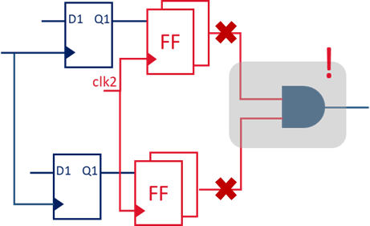
Overcoming Limitations-Assertions based Verification
1- Constraints based static checks
Constraints to be double checked with the functional verification
Mutually exclusive
define_exclusive –signals [set of signals names]
1
checkpoint for data coherency
property mutex (data, clk);
@(posedge clk)
$onehot0(data ^ $past(data));
endproperty
2
Notes:
In this example, we are defining a group of signals to be mutually exclusive ensuring that there are no re-convergence glitches.
JV
Another typical constraint in the structural verification of Clock Domain Crossings declares signals to toggle mutually exclusive. This property is also known from Gray-coded data. The translation into an assumption in SVA compares the current and the previous data value and expects that the result contains no or a single ‘1’. In the example we see converging paths in the fan-out of synchronizers which is checkpoint for data coherency issues and this property is one among a few others that we need to avoid this type of issues.

Slide 51
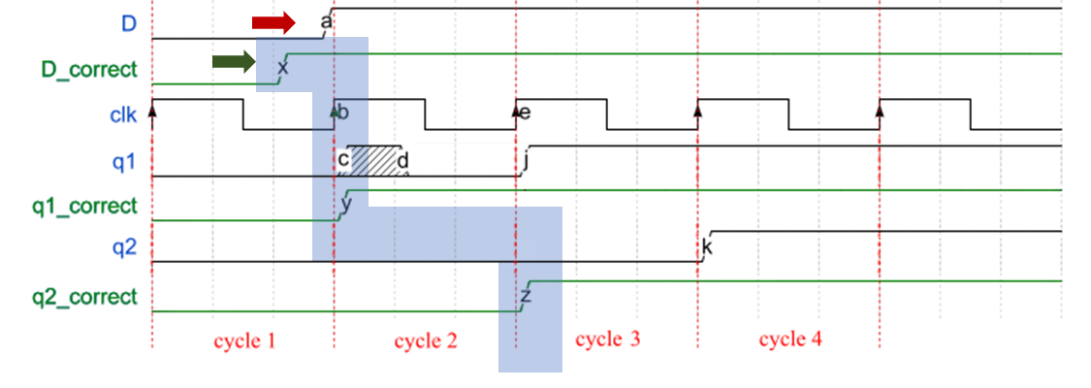
Overcoming Limitations-Assertions based Verification
2- Rules based static checks
Fundamentally target to verify design intent
CDC paths are not covered by STA :
Make sure source data is stable while crossing.
D
q1
D1
Q1
D2
Q2
q2
D3
Q3
clk1
clk
property cdc_data_stable (D, NUM_CYCLES);
@(posedge clk)
##1 $changed(D) |-> $stable(D)[*(NUM_CYCLES-1)];
endproperty
NUM_CYCLES is based on synchronization latency
Notes:
On to Rules based Static Checks. Since CDC paths are not covered by Static Timing Analysis (STA), assertions generated for these rules help fill the holes. For example, in this single bit data crossing, Data needs to be stable while crossing the domain. We create a property based on this. 1 cycle after the data changes, it must be stable for NUM_CYCLES-1, NUM_CYCLES being the sync-latency – 2 in this case. The clock used for SVA is not required to be same as any of the clocks participating in the crossing. It can be anything we want to successfully sample the data.
JV
After these 2 examples for assumptions, now let’s look at another 2 examples for assertions.
Here we see a Clock Domain Crossing which is terminated by a double-flop synchronizer. The asynchronous data path is not verified by Static Timing Analysis. In a crossing from a higher to a lower clock frequency, it is not guaranteed by the structure that the data pulse is wide enough to be captured by the receiver. For the verification of the correct behavior, we introduce an assertion saying that after a change of the data signal, the signal is stable for a number of cycles. Depending on the application, you may disallow more than 1 signal transition in the synchronizer pipeline.

Slide 52
Overcoming Limitations-Assertions based Verification
2- Rules based static checks
Fundamentally target to verify design intent
CDC paths are not covered by STA :
Make sure source data is stable for several cycles.
Enabler : Make sure source data is stable wrt to its enabler.
Source data must be static when CDC Control is enabling.
Source data can toggle when CDC Control is disabling.
CDC Control must be a known value
property qual_data_stable (SRC_DATA,QUAL,SETUP_ROOM);
##1 $changed(SRC_DATA) |-> (QUAL === 1’b0)[*SETUP_ROOM];
endproperty
SETUP_ROOM = Synchronization Latency + Implementation Headroom
Notes:
Another example, this time multiple bits of data crossing through a re-circulation multiplexer. Here a sample property is that when source data changes the CDC Control must be disabling the crossing for enough time to not cause metastability.
JV
The last example shows a synchronization scheme for buses. In addition to the data bus, a control signal or so-called qualifier is sent to the destination side. The qualifier enables the new data to propagate into the destination register. After a change of the source data, the qualifier signal declares the data to be valid. The SystemVerilog Assertion says: The qualifier signal is expected to arrive at the destination after a number of synchronization cycles plus a delay but not earlier. An earlier transition of the qualifier would be considered as a violation of the protocol.

Slide 53
ABV - Assertions based Verification
UPF
Constraints .tcl
Structural checks
RTL
“all CDCs’re defined”
Constraints .sdc
Synchronizers .rpt
Assumptions generator
Protocol generator
Formal checks
Constraints assertions .sv
Protocol assertions .sv
bind
bind
Simulation
Notes:
Here is the Assertion Based Verification flow as the sub-working-group envisions …
Structural Checks require RTL, block constraints and any other constraints like power constraints if available. From the structural checks, a collateral for all data crossings within the IP can be extracted. This collateral can be used to generate SVA to verify and test the limitations of the crossings. Similarly, Assumptions of a block can be generated based on the environment constraints.
Any tool of choice can then utilize this information to create checkers and bind them to the crossing-related collateral in case of a blackbox or to crossing-related RTL in case of a whitebox, for formal or dynamic verification.
JV
Now, we have an idea how these formal assumptions and assertions look like. What is now the verification flow build around these elements? Here we see a flow chart of the Assertion-based Verification. It starts with the structural checks that read the RTL code and the power model in UPF together with verification constraints and clock and pin constraints from the implementation constraint files. The structural check results in a synchronizer report.
Now, we need two generators. The 1st one is the assumptions generator that converts the verification constraints into a representation in the SVA language. These SystemVerilog Assertions still act as constraints for the next verification step.
The 2nd one is the protocol generator. It generates SystemVerilog Assertions describing the legal behavior of the synchronization protocols.
As we’ve seen before, both types of assertions may describe aspects of the sequential behavior which complements the purely structural verification.
The binding connects the signals in the assertions and in the RTL and elaborates all together to a common model. This model can then be verified by Formal Checks as far as the complexity allows. In any case, it can be used in a simulation which then highlights any violation of a protocol or constraint in a waveform.

Slide 54
Dynamic or Formal CDC Verification
CDC constraint properties
Assertions are generated based on the setup constraints
Ideally, should be done concurrently with structural CDC check
CDC protocol properties
Assertions are generated based on the CDC paths
Dynamic or Formal Verification is to ensure
structural CDC check is done with the proper constraints and assumptions
the identified CDC paths follow the protocols defined by the CDC schemes
the result of the structural CDC verification is valid
Notes:
JV
To summarize: These are the key elements of the Assertion-based verification:
1st the CDC constraint properties:
The assertions are generated based on the setup constraints, which ideally should be done concurrently with the structural CDC check.
The 2nd element are the CDC protocol properties. The assertions are generated based on the CDC paths.
The dynamic or formal verification then ensures that
the structural CDC check is done with the proper constraints and assumptions
the identified CDC paths follow the protocols defined by the CDC schemes
the result of the structural CDC verification is valid

Slide 55
1.5 Hierarchical CDC/RDC
Hierarchical Flow
Notes:
CDCs, or Clock Domain Crossings, concern the transfer of data using clocks that are asynchronous to one another. Part of the charter of the training sub-group is to make sure discussions of CDCs begin with everyone on the same page, so we’re going to spend a few minutes doing just that. The first step is to agree on just what asynchronous clocks are, and so we first need to agree on what synchronous clocks are. Synchronous clocks come from the same source, and they have an easily-established timing relationship. In short, for data paths between synchronous clocks, static timing analysis works, and there is no need for heroic measures to ensure that they function properly. Asynchronous clocks, on the other hand, come from different sources, or they have a timing relationship that is unknown or difficult to establish. Note that any two sources, even two with identical specs, should be treated as asynchronous because they have different error bars. In such a case, static timing analysis would seem to work, but the real world would eventually disagree. Another counter-example would be two clocks from the same source where, for example, one was divide by ten and the other divide by nine. This timing relationship would be possible to establish, but timing-wise it might not be amenable to static timing analysis. Lastly, we are talking about designs that have multiple clocks, as opposed to designs that have no clock at all.

Slide 56
CDC-RDC Hierarchical Flow
Why ?
CDC-RDC Verification at SoC level
Flat RTL analysis only possible for small SoC and/or SoC simple clock-reset strategy
Hierarchical strategy means first identify sub-blocks to be analyzed separately then modeled
Each CDC-RDC model being integrated at SoC level
Allows parallelization of sub-blocks analysis and noiseless analysis at SoC level
Re-utilization of sub-blocks clean up effort at SoC level by using CDC-RDC models
Reduces SoC runtime & the total of violations to be analyzed at SoC level which leads to increase in productivity
Challenges:
Dependency to sub-blocks provider to deliver CDC-RDC model
Compatibility of CDC-RDC models in case of multiple EDA tools usage

Slide 57
CDC-RDC Hierarchical Flow
How ?
Constraints refining
SoC level
Constraint
Checks
In Context Abstract Checks
CDC-RDC Structural Checks
Abstraction Models integration
Constraint Setup
Compilation
elaboration
Setup stage
Setup HIER stage
Struct stage
Constraints Setup
Constraint Checks
CDC-RDC Structural Checks
Abstraction Models generation
Out Context Model Checks
IP level
Constraints refining
Notes:
CDC-RDC Verification at SoC level
Flat RTL analysis only possible for small SoC and/or SoC simple clock-reset strategy
Hierarchical strategy means first identify sub-blocks to be analyzed separately then modeled
Each CDC-RDC model being integrated at SoC level
Allows parallelization of sub-blocks analysis and noiseless analysis at SoC level
Challenges:
Dependency to sub-blocks provider to deliver CDC-RDC model
Compatibility of CDC-RDC models in case of multiple EDA tools usage

Slide 58
CDC-RDC Hierarchical Flow
How ?
Constraints refining
SoC level
Constraint
Checks
In Context Abstract Checks
CDC-RDC Structural Checks
Abstraction Models integration
Constraint Setup
Compilation
elaboration
Setup stage
Setup HIER stage
Struct stage
Constraints Setup
Constraint Checks
CDC-RDC Structural Checks
Abstraction Models generation
Out Context Model Checks
IP level
Constraints refining
Notes:
CDC-RDC Verification at SoC level
Flat RTL analysis only possible for small SoC and/or SoC simple clock-reset strategy
Hierarchical strategy means first identify sub-blocks to be analyzed separately then modeled
Each CDC-RDC model being integrated at SoC level
Allows parallelization of sub-blocks analysis and noiseless analysis at SoC level
Challenges:
Dependency to sub-blocks provider to deliver CDC-RDC model
Compatibility of CDC-RDC models in case of multiple EDA tools usage

Slide 59
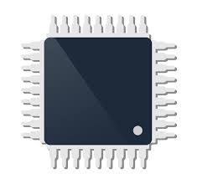
CDC-RDC Hierarchical Flow
What?
Core
IP
IP
Core
Core
Processor
Reset_1
clk_3
Enable
clk_1
Bridge_1
clk_2
clk_4
Clock, Reset, Power, Boot Management
Abstraction Models enable all Boundary related CDC-RDC info required at SoC integration Checks
Much better approach compared to Black Box
IP
IP
Bridge_2
clk_5
clk_7
clk_6
clk_8
Reset_2
Bridge_N
Boundary information only

Slide 60
CDC-RDC Hierarchical Flow
CDC models from different tools
Core
IP1
IP3
Core
Tool A
Tool C
Core
Processor
Reset_1
clk_3
Enable
clk_1
Bridge_1
clk_2
clk_4
CDC models are currently lacking standardization.
CDC models from different tools are not compatible.
Clock, Reset, Power, Boot Management
IP2
clk_5
clk_7
IP4
Bridge_2
Tool B
Tool D
clk_6
clk_8
Reset_2
Bridge_N
Boundary information only
Notes:
- Cadence example

Slide 61
2.1 Accellera CDC Working Group
Presentation
The five sub working groups
Call for contribution
Notes:
CDCs, or Clock Domain Crossings, concern the transfer of data using clocks that are asynchronous to one another. Part of the charter of the training sub-group is to make sure discussions of CDCs begin with everyone on the same page, so we’re going to spend a few minutes doing just that. The first step is to agree on just what asynchronous clocks are, and so we first need to agree on what synchronous clocks are. Synchronous clocks come from the same source, and they have an easily-established timing relationship. In short, for data paths between synchronous clocks, static timing analysis works, and there is no need for heroic measures to ensure that they function properly. Asynchronous clocks, on the other hand, come from different sources, or they have a timing relationship that is unknown or difficult to establish. Note that any two sources, even two with identical specs, should be treated as asynchronous because they have different error bars. In such a case, static timing analysis would seem to work, but the real world would eventually disagree. Another counter-example would be two clocks from the same source where, for example, one was divide by ten and the other divide by nine. This timing relationship would be possible to establish, but timing-wise it might not be amenable to static timing analysis. Lastly, we are talking about designs that have multiple clocks, as opposed to designs that have no clock at all.

Slide 62
Accellera CDC WG initiative
The WG was formed in Jan. 2023 to explore the need for the creation of a standard to converge CDC collateral integration from different tools/vendors for ease (time-to-market) and quality (bug-free silicon).
Fundamentally, what is being proposed is a common CDC interface standard that:
Every vendor/tool can translate their native format to/from (maintaining their IP)
Every IP can run their tool-of-choice to verify and produce collateral, and generate the standard format for SOCs that use a different tool
Every SOC can quickly (time-to-market) and safely (quality) integrate either native collateral, or translate from the standard collateral into their tool-of-choice
The Accellera CDC WG goal, as approved by the Accellera board is as follows:
Produce a Language Reference Manual (LRM) for publication
Enable all EDA vendors in developing tools that meet this specification in generated collateral
Enable IP companies to generate collateral using various vendor/tools
Enable SOC companies to consume generate collaterals from different vendor/tools into their tool-of-choice
Notes:
The Accellera CDC Working Group has been formed in Janauary 2023, aiming to provide a specification of the CDC-RDC modelling standard.
For that, it publishes, along committed milestones, incremental versions of the Language Reference Manual.

Slide 63
What was the problem?
As we move from monolithic designs … to IP/SOC with IPs sourced from a small/select providers … to sourcing IPs globally (to create differentiated products) …
We must maintain quality as we drive faster time-to-market
In areas where we have standards (SystemVerilog, OVM/UVM, LP/UPF), the integration is able to meet the above (quality, speed)
But in areas where we don’t have standards (in this case, CDC), most options trade-off either quality, or time-to-market, or both :-(
Creating a standard for inter-operable collateral addresses this gap

Slide 64
Accellera CDC WG initiative
Pre-WG launched Sep ‘22 to evaluate need. WG launched Jan ’23
147 members from 23 companies (as of Dec 03 ‘24)
5 active sub-groups:
Output-Collateral, Format, Assertions, Testing, Training
V0.5 available for public review in February 2025
Timeline
Ver | Focus | Timeline
v0.1 | CDC | Oct 2023
v0.3 | RDC & Assertions | July 2024
v0.5 | Complexities & Extensions | Feb 2025
v1.0 | Final LRM release | June 2025
Agnisys | Aldec | AMD | Analog Devices | ARM | Arteris | Blue Pearl Software | Cadence
Huawei | Infineon | Intel | Marvel | Microchip Technologies | Microsoft | NVIDIA | NXP
Qualcomm | Renesas | Robert Bosch | Siemens EDA | ST Micro | Synopsys | Verilab
Notes:
The WG was formed in Jan. 2023 to explore the need for the creation of a standard to converge CDC collateral integration from different tools/vendors for ease (time-to-market) and quality (bug-free silicon).
Fundamentally, what is being proposed is a common CDC interface standard that:
Every vendor/tool can translate their native format to/from (maintaining their IP)
Every IP can run their tool-of-choice to verify and produce collateral, and generate the standard format for SOCs that use a different tool
Every SOC can quickly (time-to-market) and safely (quality) integrate either native collateral, or translate from the standard collateral into their tool-of-choice
The Accellera CDC WG goal, as approved by the Accellera board is as follows:
Produce an LRM for publication
Enable all EDA vendors in developing tools that meet this specification in generated collateral
Enable IP companies to generate collateral using various vendor/tools
Enable SOC companies to consume generate collaterals from different vendor/tools into their tool-of-choice

Slide 65
Achievements

Slide 66
Accellera CDC WG Scope
Tool-agnostic interoperable collateral
Supporting hierarchical CDC/RDC/Glitch structural analysis
Human readable, and machine parseable
LP/UPF compliant
Multi-mode/param/instance comppliant
Covering majority of common interface protocols (e.g. AMBA, UCIe, etc.)
Constraints/Assumptions can be verified with SVAs
Can meet other needs (e.g. FPGA, Analog)

Slide 67
The Five Sub Working Groups
Structure
WG Leads / co-Leads
Meetings
Leads / co-Leads monthly
Members
main WG monthly
Sub WG weeklies
Output Collateral
Format
Assertion
Training
Testing

Slide 68
2.2 Assertion Subgroup
Notes:
CDCs, or Clock Domain Crossings, concern the transfer of data using clocks that are asynchronous to one another. Part of the charter of the training sub-group is to make sure discussions of CDCs begin with everyone on the same page, so we’re going to spend a few minutes doing just that. The first step is to agree on just what asynchronous clocks are, and so we first need to agree on what synchronous clocks are. Synchronous clocks come from the same source, and they have an easily-established timing relationship. In short, for data paths between synchronous clocks, static timing analysis works, and there is no need for heroic measures to ensure that they function properly. Asynchronous clocks, on the other hand, come from different sources, or they have a timing relationship that is unknown or difficult to establish. Note that any two sources, even two with identical specs, should be treated as asynchronous because they have different error bars. In such a case, static timing analysis would seem to work, but the real world would eventually disagree. Another counter-example would be two clocks from the same source where, for example, one was divide by ten and the other divide by nine. This timing relationship would be possible to establish, but timing-wise it might not be amenable to static timing analysis. Lastly, we are talking about designs that have multiple clocks, as opposed to designs that have no clock at all.
JV
Now, let’s talk about the subgroup number 3 of 5: the Assertion Subgroup.

Slide 69
Assertion Subgroup Mission
Assertion
Goal
1. Produce Language Reference Manual (LRM) addendum for Assertions.
2. Enable all EDA vendors in developing tools that meet specification for generating System Verilog Assertions (SVA) along with collateral.
3. Enable Intellectual Property (IP) companies to generate SVA along with collateral using various vendors/tools.
4. Enable System On Chip (SOC) companies to consume generated SVA from any vendor/tool into their tool of choice.
Notes:
JV
The mission of the subgroup is the specification of the assertions in an addendum of the Language Reference Manual. This should enable the EDA companies to develop the generators for SystemVerilog Assertions and enable the IP providers to actually generate the SVA as a part of the IP collaterals and then enable the users of the IP to execute the assertion-based verification flow in their tool of choice.

Slide 70
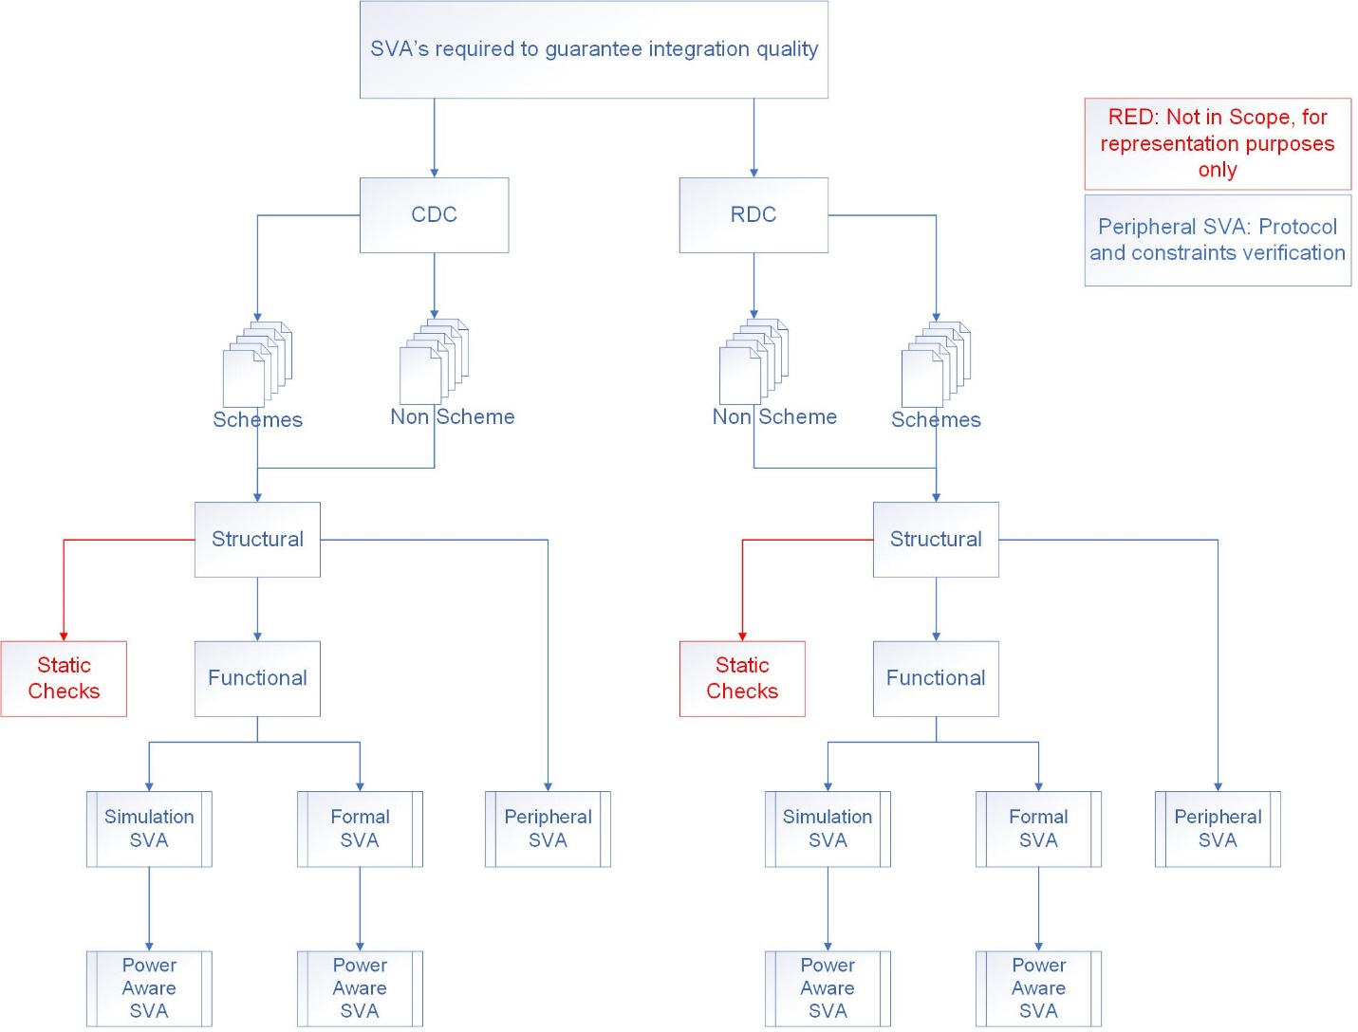
Assertion Subgroup
Assertion
CDC architectures are studied for possible verification strategies.
Guidance to produce re-useable SVA for both Formal and Dynamic Verification.
Guidance extracted from collateral.
Guidance must follow SVA LRM.
Guidance must be tool/vendor independent.
Current Work
Future Work
Notes:
JV
Currently, the subgroup studies different design architectures for possible verification strategies based on assertions and works on some guidance how to validate the SystemVerilog Assertions of a module and how to verify the CDCs and RDCs after the integration of the modules. This can happen by formal verification or by dynamic simulation.

Slide 71
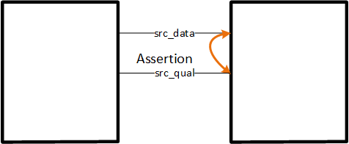
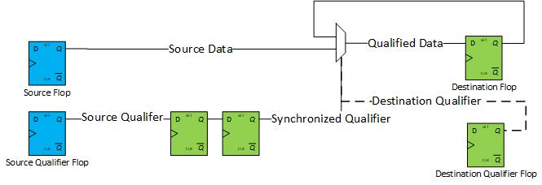
Assertion Subgroup
Assertion
Possible Integration Scenarios under consideration:
Blackbox IP to Blackbox IP at SoC level.
SoC level glue logic to Blackbox IP.
Blackbox to SoC level glue logic.
Full Whitebox verification at IP level.
Notes:
JV
The integration of the modules can lead to models providing different degrees of abstraction.
If you connect two modules,
you may see both of them as blackboxes or
you may see one of them as a blackbox with a detailed view of the other one and the blackbox can be at the driver or at the receiver side or
you have a detailed view of both modules.
All of these options are considered by the assertion subgroup.

Slide 72
2.3 Output Collateral Subgroup
Notes:
CDCs, or Clock Domain Crossings, concern the transfer of data using clocks that are asynchronous to one another. Part of the charter of the training sub-group is to make sure discussions of CDCs begin with everyone on the same page, so we’re going to spend a few minutes doing just that. The first step is to agree on just what asynchronous clocks are, and so we first need to agree on what synchronous clocks are. Synchronous clocks come from the same source, and they have an easily-established timing relationship. In short, for data paths between synchronous clocks, static timing analysis works, and there is no need for heroic measures to ensure that they function properly. Asynchronous clocks, on the other hand, come from different sources, or they have a timing relationship that is unknown or difficult to establish. Note that any two sources, even two with identical specs, should be treated as asynchronous because they have different error bars. In such a case, static timing analysis would seem to work, but the real world would eventually disagree. Another counter-example would be two clocks from the same source where, for example, one was divide by ten and the other divide by nine. This timing relationship would be possible to establish, but timing-wise it might not be amenable to static timing analysis. Lastly, we are talking about designs that have multiple clocks, as opposed to designs that have no clock at all.

Slide 73
Output Collateral Subgroup
Output-Collateral
Attributes for CDC/RDC block model
Address most industry standard interfaces
Identify limitations and extensions for the attributes
Notes:
Goal
1. Set of attributes for CDC-RDC model block
2. The set of attributes are to be sufficient to address a specific pre-defined set of known industry standard interfaces and be able to objectively test the completeness and claim usefulness of the defined set of attributes for those interfaces.
3. Define the limitation of said set of attributes, by identifying the CDC and RDC schemes for which the set of attributes is sufficient and the CDC and RDC schemes for which the defined set of attributes is not guaranteed to support.
JV
1. The Output Collaterals Subgroup is defining a set of attributes to build an abstracted model of a block. This model should support the verification of the Clock Domain Crossings and Reset Domain Crossings for the instance of the block in an encompassing design.
2. The focus is set on modeling known industry standard interfaces with a limited complexity. This will lead to a Language Reference Manual covering a large part of the potential applications already in the first quarter of 2025.
3. The limitations in the initial Language Reference Manual show already the path to future extensions of the standard so that it can cover more complex aspects of module interfaces.

Slide 74
Attributes Table in LRM v0.4
Domain | Attribute | Type | Values | Mandatory
module | name | string | {module name} | Yes
parameter | name | string | {parameter name} | Yes
parameter | value | range-list | {values} | Optional
parameter | type | defined set | {string, Boolean, number (hex, decimal, oct, binary)} | Optional
parameter | ignore | Boolean | {true, false} | Optional
port | name | string | {port name} | Yes
port | direction | defined set | {input, output, inout} | Yes
port | type | defined set | {data, clock, virtual_clock, async reset, cdc_control, rdc_control, virtual_reset} | Yes
port | logic | defined set | {combo, buffer, inverter, glitch-free-combo, internal-sync} | Optional
port | cdc_control_from _clock | ; separated list | {clock-names} | Optional
port | associated_from_clocks | ; separated list | {clock-names} | Yes
port | associated_to_clocks | ; separated list | {clock-names} | Optional
port | associated_inputs | ; separated list | {ports} | Optional
port | associated_outputs | ; separated list | {ports} | Optional
port | cdc_control | ; separated list | {associated-ports} | Optional
port | polarity | defined set | {high, low, low_high} | Yes
port | ignore | defined set | {blocked, hanging} | Optional
port | cdc_static | ; separated list | {clock-names} | Optional
port | constant | ; separated list | {binary, hex, and of any length} | Optional
port | gray_coded | Boolean | {true, false:default} | Optional
port | clock_period | string | {clock period} | Optional
port | associated_from_reset | ; separated list | {reset-names} | Optional
port | associated_to_reset | ; separated list | {reset-names} | Optional
port | rdc_control_from_reset | ; separated list | {reset-names} | Optional
port | rdc_control_to_reset | ; separated list | {reset-names} | Optional
port | rdc_control_to_clock | ; separated list | {clock-names} | Optional
port | rdc_clock_gate_location | defined set | {external or internal} | Optional
tool | name | string | {tool name} | Yes
tool | version | string | {tool Version} | Yes
design | version | string | {design milestone} | Optional
design | date | string | {collateral generation date} | Yes
design | username | string | {user/tool that generated the collateral} | Optional
design | description | string | {description} | Optional
set_cdc_clock_group | clocks | ; separated list | {clock-names} | Yes
set_cdc_clock_group | name | string | {group-name} | Optional
set_reset_group | reset | ; separated list | {clock-names} | Yes
set_reset_group | name | string | {group-name} | Optional
Output-Collateral
Notes:
Parameter
Port Attribute Modelling
Removal of keywords that are not EDA-Tool-Agnostic
Removal of clock_group and reset_group
Set_cdc_clock_group
Adding more examples to describe usage of reset, polarity, ignore,cdc_static and constant
Deferring usage of “gray_code” and clock_period to LRM 0.2
JV
Here, you see the list of the supported attributes in the current LRM version 0.3. It’s already so many attributes that you cannot read them anymore on one page.
The attributes are split into different domains which is indicated by the color.
The biggest domain are the port attributes in green. One of the mandatory CDC-attributes is the list of clocks at the drivers of a port in the attribute associated_from_clocks.
The model supports also a parametrization with the attributes in the blue domain which makes the model more flexible and re-usable.
In the purple section at the bottom you see an attribute for clock groups with a CDC-specific semantic.
Now, let’s look at some examples.

Slide 75
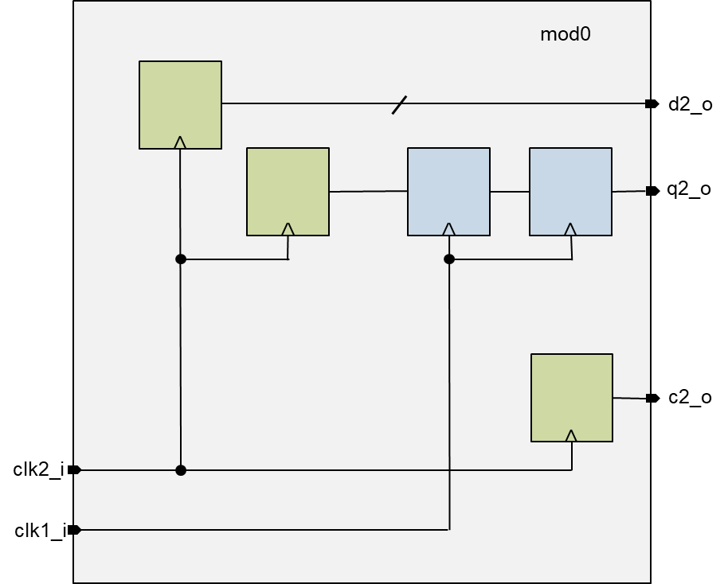
Port Attribute Modelling
Output-Collateral
example in Tcl-format for output interface
cdc_set_module mod0
cdc_set_port d2_o \ -type data \
-direction output \
-associated_from_clocks clk2_i \
-cdc_control q2_o
cdc_set_port q2_o \
-type cdc_control \
-direction output \
-cdc_control_from_clock clk2_i \
-associated_from_clock clk1_i \
-associated_outputs d2_o
cdc_set_port c2_o \
-type data \
-direction output \
-associated_from_clock clk2_i
Blue boxes are in clk1_i clock domain
Green boxes are in clk2_i clock domain
Notes:
JV
Here, we see the interface model of some outputs of a module.
The lower port c2 is a simple one not being prepared for a Clock Domain Crossing. The attributes are also simple: just the type data, the direction and the associated clock of the driver – nothing special.
The upper port d2 is a bus. It is related to a cdc_control output q2. Both the data port and the control port have attributes that show the relation between them: cdc_control at the data port and associated_outputs at the control port.
This structure supports that the data bus can cross a clock domain boundary and can be captured in a receiving module in the blue clock domain.

Slide 76
cdc_set_clock_group (Tcl format)
Output-Collateral
1 domain
2 domains
c k
c k
g c k 0
g c k 1
g c k 0
g c k 1
cdc_set_clock_group -name common_domain -clocks {ck gck0 gck1}
cdc_set_clock_group -name small_domain -clocks {ck}
cdc_set_clock_group -name large_domain -clocks {gck0 gck1}
3 domains
c k
2 clock
branches
c k
compatibility sets: common members allowed
g c k 0
g c k 1
g c k 0
g c k 1
cdc_set_clock_group -name domain_C -clocks {ck}
cdc_set_clock_group -name domain_0 -clocks {gck0}
cdc_set_clock_group -name domain_1 -clocks {gck1}
cdc_set_clock_group -name left_branch -clocks {ck gck0}
cdc_set_clock_group -name right_branch -clocks {ck gck1}
Notes:
JV
These diagrams give you an idea of the before-mentioned CDC clock groups.
By definition, there are no Clock Domain Crossings between clocks in the same group.
We see four examples with synchronous clocks being connected by a green arrow. Asynchronous clocks are connected by red arrow.
If all clocks are synchronous to each other, the exist in one common clock domain.
If all are asynchronous to each other, each clock exists in its own domain.
If two of the three clocks are synchronous to each other, they build a large domain and the third one builds a small domain.
The example in the bottom right corner deviates from the concept of classical clock domains.
It supports two generated clocks being derived from the same root clock.
The generated clocks are balanced to their root clock but propagate on two clock branches with a larger physical distance so that they are not balanced to each other.
We see that the CDC clock groups support common members, here the root clock ck.
In this case, the clock groups can be understood as compatibility sets which is an extension of the concept of clock domains.

Slide 77
2.4 Testing Subgroup
Notes:
CDCs, or Clock Domain Crossings, concern the transfer of data using clocks that are asynchronous to one another. Part of the charter of the training sub-group is to make sure discussions of CDCs begin with everyone on the same page, so we’re going to spend a few minutes doing just that. The first step is to agree on just what asynchronous clocks are, and so we first need to agree on what synchronous clocks are. Synchronous clocks come from the same source, and they have an easily-established timing relationship. In short, for data paths between synchronous clocks, static timing analysis works, and there is no need for heroic measures to ensure that they function properly. Asynchronous clocks, on the other hand, come from different sources, or they have a timing relationship that is unknown or difficult to establish. Note that any two sources, even two with identical specs, should be treated as asynchronous because they have different error bars. In such a case, static timing analysis would seem to work, but the real world would eventually disagree. Another counter-example would be two clocks from the same source where, for example, one was divide by ten and the other divide by nine. This timing relationship would be possible to establish, but timing-wise it might not be amenable to static timing analysis. Lastly, we are talking about designs that have multiple clocks, as opposed to designs that have no clock at all.

Slide 78
Testing Subgroup Mission
Testing
Goal
1. Evaluate the set of Accellera CDC attributes and protocols for completeness
using multiple tools from multiple vendors.
2. Demonstrate the use of the complete set of attributes and protocols as defined
and formatted by other sub-groups.
3. Provide RTL design examples within which the defined attributes and protocols
can be further qualified and evaluated.

Slide 79
Testing Subgroup Mission
Testing
Work Details
1. Review small examples provided in the latest LRM
2. Create small RTL test cases based on the examples
By the Subgroup members
3. Analyze the RTL test cases using various EDA tools
4. Make the test cases available for EDA vendors as first level QA testing

Slide 80
WIP (Work In Progress)
Tasks Materials | Tasks to be completed
There are 40 Figures in the LRM | Divide up the figures among the members to create small unit test cases and HDM model setup. Then run them with available in-house EDA tools to verify the HDM flow. Bill already created some of them and posted on the Testing SW website. Devendra, JC and Jerome to look into the rest.
There are some example cases being drawn in Table 13 & Table 14 in LRM 0.4 draft | Farhad is investigating the tables and create unit test cases and create HDM flow and run Questa CDC/RDC tool on them
Updating the spreadsheet | JC to update the spreadsheet to map the figures with respect to LRM 0.3
Convert Verilog test cases to VHDL | We plan to create equivalent VHLD test cases for each(some) unit test cases. We will investigate to use online free software available to do such translation.
Based on LRM 0.3/ LRM 0.4 draft
Once the initial work is done, will review latest LRM and make modification to the unit cases as per needed
Target to have all the unit test cases ready by end of Dec’ 2024
VHDL version will be worked on in 2025
Deven to give a demo of IDS-Integrate tool Agnisys to SWG members to provide automatic connectivity of blocks with CDC info

Slide 81
2.5 Format Subgroup
Notes:
CDCs, or Clock Domain Crossings, concern the transfer of data using clocks that are asynchronous to one another. Part of the charter of the training sub-group is to make sure discussions of CDCs begin with everyone on the same page, so we’re going to spend a few minutes doing just that. The first step is to agree on just what asynchronous clocks are, and so we first need to agree on what synchronous clocks are. Synchronous clocks come from the same source, and they have an easily-established timing relationship. In short, for data paths between synchronous clocks, static timing analysis works, and there is no need for heroic measures to ensure that they function properly. Asynchronous clocks, on the other hand, come from different sources, or they have a timing relationship that is unknown or difficult to establish. Note that any two sources, even two with identical specs, should be treated as asynchronous because they have different error bars. In such a case, static timing analysis would seem to work, but the real world would eventually disagree. Another counter-example would be two clocks from the same source where, for example, one was divide by ten and the other divide by nine. This timing relationship would be possible to establish, but timing-wise it might not be amenable to static timing analysis. Lastly, we are talking about designs that have multiple clocks, as opposed to designs that have no clock at all.
JV
The next sub-group cares for the Format of the Output Collaterals.

Slide 82
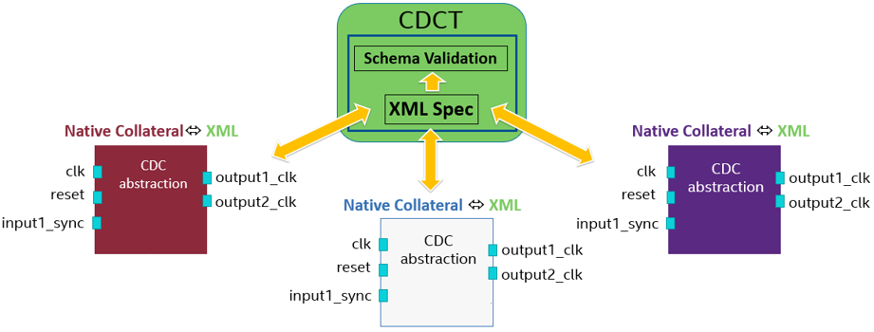
Format Subgroup Mission
Format
Goal:
Determine exact format for domain specific language to capture the required attributes/data from input/output collaterals
Methodology:
Evaluated different options like Excel, IP-XACT, TCL, JSON, etc.
Experimented with populating the formats to ascertain the ability to meet the requirement
Determined pros and cons for each option of format
The format should support easy translation to the formats of different EDA tools and vice-versa
Outcome: CDC Workgroup voted for a combination of IP-XACT and TCL as the chosen format for CDC
Notes:
The Format sub-working-group had the difficult job of coming up with a DSL (Domain Specific Language) to capture the attributes required by the input/output/assertion and other sub-groups.
Secondly to ensure that the CDC design intent is captured with high fidelity.
Our methodology was to review all the possible formats like IP-XACT, Tcl, Excel, Json etc. Then see how difficult or easy it was to capture the specification in each of these formats. Then review the pros and cons for each format option.
Finally come up with a recommendation after approval from the entire CDC Workgroup.
JV
What we’ve seen in the previous examples was just pseudo-code but not the real language. The Format subgroup had the task to analyze several existing languages and formats if they can be used for our purpose like IP-XACT which is an xml-based format, Tcl, EXCEL, JSON and then come to a recommendation for the working group.

Slide 83
Format features
Format
Describing IP can be easily done by IP-XACT
IP-XACT is industry standard for IP definition and packaging
Good for standardizing the structure of CDC specification
Use models of IP and Product companies
to verify and produce collateral
to generate the standard format for SoCs that use a different tool
Integration of IP
Dynamic environment requires programmability for CDC definition
Tcl is preferred and widely used in industry
Use models for Product and EDA companies
EDA companies to provide transformers for Tcl to/from IP-XACT
Also provide translators to and from its native format from and to the standard format
Standard is tool agnostic
Notes:
There were two distinct requirements for the sub-group .. The need to describe IP and to describe integration of IPs.
IPs themselves could be static or could have some dynamic behavior as far as CDC is concerned. For describing the IP CDC, IP-XACT is a widely used standard for IP definition and packaging. Its used very often by IP and Product companies.
For Integration of IPs the dynamic environment requires programmability not available readily in IP-XACT. Tcl is preferred here and is widely used in the industry by Product companies and EDA companies.
75
There two main requirements for an abstracted model: one is to describe the IP module when generating the model, the other one is an easy integration when using the model. For the IP definition and packaging, IP-XACT is an industry standard which is then a static model. For the users in EDA and semiconductor companies, Tcl is a widely used language which supports the typical elements of a programming language.

Slide 84
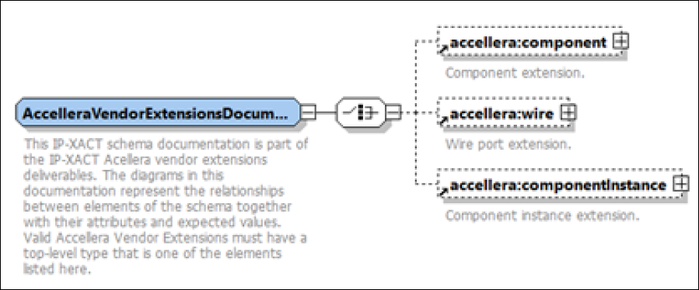
IP-XACT Format for CDC (1/4)
Format
The IP-XACT standard already captures some attributes related to clock and reset
IP-XACT allows extending the standard using vendor extensions
Vendor extensions for CDC are defined as Accellera Vendor extensions at different elements in the design hierarchy
Top level elements for the Accellera vendor extensions for CDC are:
accellera:component
accellera:wire
accellera:componentInstance
Notes:
The Format sub-working-group had the difficult job of coming up with a DSL (Domain Specific Language) to capture the attributes required by the input/output/assertion and other sub-groups.
Secondly to ensure that the CDC design intent is captured with high fidelity.
Our methodology was to review all the possible formats like IP-XACT, Tcl, Excel, Json etc. Then see how difficult or easy it was to capture the specification in each of these formats. Then review the pros and cons for each format option.
Finally come up with a recommendation after approval from the entire CDC Workgroup.
JV
What we’ve seen in the previous examples was just pseudo-code but not the real language. The Format subgroup had the task to analyze several existing languages and formats if they can be used for our purpose like IP-XACT which is an xml-based format, Tcl, EXCEL, JSON and then come to a recommendation for the working group.

Slide 85
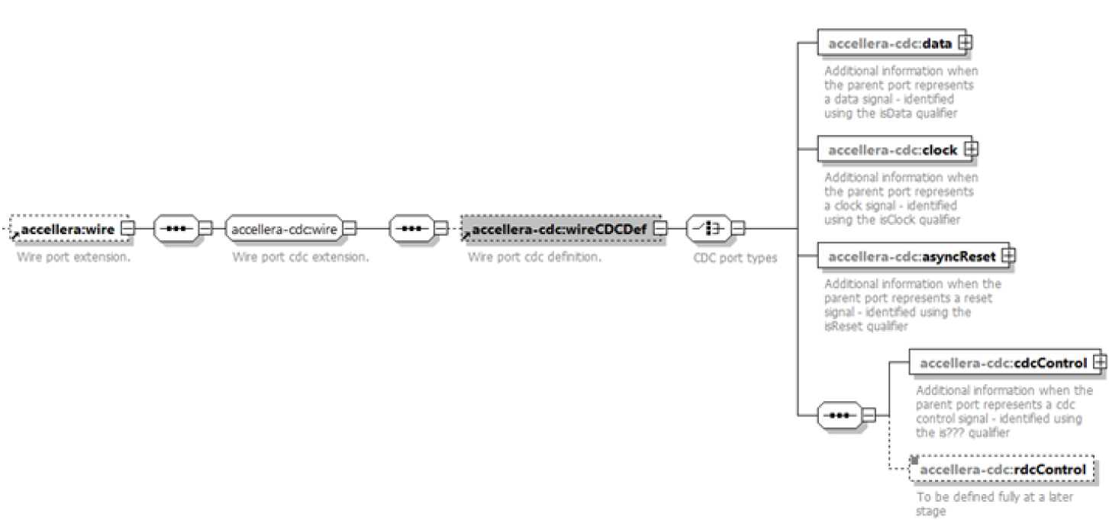
IP-XACT Format for CDC (2/4)
Format
accellera:wire is used to define an Accellera specific wire port extension, which contains the wire port CDC definition
accellera-cdc:data
accellera-cdc:clock
accellera-cdc:asyncReset
accellera-cdc:cdcControl
accellera-cdc:rdcControl
Notes:
The Format sub-working-group had the difficult job of coming up with a DSL (Domain Specific Language) to capture the attributes required by the input/output/assertion and other sub-groups.
Secondly to ensure that the CDC design intent is captured with high fidelity.
Our methodology was to review all the possible formats like IP-XACT, Tcl, Excel, Json etc. Then see how difficult or easy it was to capture the specification in each of these formats. Then review the pros and cons for each format option.
Finally come up with a recommendation after approval from the entire CDC Workgroup.
JV
What we’ve seen in the previous examples was just pseudo-code but not the real language. The Format subgroup had the task to analyze several existing languages and formats if they can be used for our purpose like IP-XACT which is an xml-based format, Tcl, EXCEL, JSON and then come to a recommendation for the working group.

Slide 86
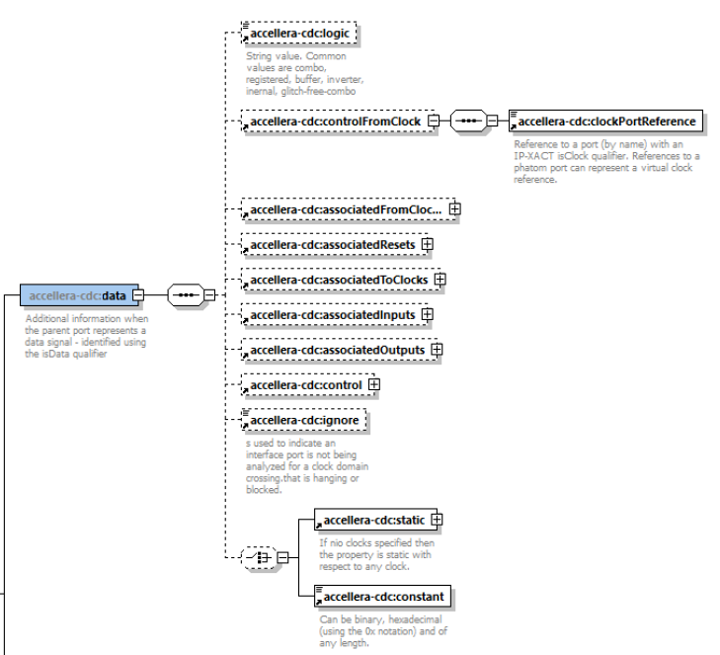
IP-XACT Format for CDC (3/4)
Format
When a port represents a data signal, all attributes required for CDC are captured in this extension
Similarly, the schema is defined for asyncReset, cdcControl, and rdcControl
Notes:
The Format sub-working-group had the difficult job of coming up with a DSL (Domain Specific Language) to capture the attributes required by the input/output/assertion and other sub-groups.
Secondly to ensure that the CDC design intent is captured with high fidelity.
Our methodology was to review all the possible formats like IP-XACT, Tcl, Excel, Json etc. Then see how difficult or easy it was to capture the specification in each of these formats. Then review the pros and cons for each format option.
Finally come up with a recommendation after approval from the entire CDC Workgroup.
JV
What we’ve seen in the previous examples was just pseudo-code but not the real language. The Format subgroup had the task to analyze several existing languages and formats if they can be used for our purpose like IP-XACT which is an xml-based format, Tcl, EXCEL, JSON and then come to a recommendation for the working group.

Slide 87
IP-XACT Format for CDC (4/4)
Format
The extension accellera-cdc:componentCDCDef is defined to capture the clock groups of a component using the accellera-cdc:clockGroup extensions
It contains references to clock ports or phantom ports (virtual clock) in addition to name, displayName, and description.
Notes:
The Format sub-working-group had the difficult job of coming up with a DSL (Domain Specific Language) to capture the attributes required by the input/output/assertion and other sub-groups.
Secondly to ensure that the CDC design intent is captured with high fidelity.
Our methodology was to review all the possible formats like IP-XACT, Tcl, Excel, Json etc. Then see how difficult or easy it was to capture the specification in each of these formats. Then review the pros and cons for each format option.
Finally come up with a recommendation after approval from the entire CDC Workgroup.
JV
What we’ve seen in the previous examples was just pseudo-code but not the real language. The Format subgroup had the task to analyze several existing languages and formats if they can be used for our purpose like IP-XACT which is an xml-based format, Tcl, EXCEL, JSON and then come to a recommendation for the working group.

Slide 88
TCL Format for CDC
Format
TCL Format for CDC specification is a set of API commands
One cdc file per block/module
users specify the CDC attributes for ports of that module
users can also specify clock groups
EDA tools should process the CDC specification in TCL format and generate corresponding IP-XACT collateral
Similarly, there could be a requirement for generating TCL specification of CDC from IP-XACT
API Commands
cdc_set_module : indicates the block/module name for which cdc specification is being provided in a file
cdc_set_port : sets attributes of a port
cdc_set_clock_group : set clock groups of synchronous clocks
cdc_set_param : defines parameters within the scope of a module
Notes:
The Format sub-working-group had the difficult job of coming up with a DSL (Domain Specific Language) to capture the attributes required by the input/output/assertion and other sub-groups.
Secondly to ensure that the CDC design intent is captured with high fidelity.
Our methodology was to review all the possible formats like IP-XACT, Tcl, Excel, Json etc. Then see how difficult or easy it was to capture the specification in each of these formats. Then review the pros and cons for each format option.
Finally come up with a recommendation after approval from the entire CDC Workgroup.
JV
What we’ve seen in the previous examples was just pseudo-code but not the real language. The Format subgroup had the task to analyze several existing languages and formats if they can be used for our purpose like IP-XACT which is an xml-based format, Tcl, EXCEL, JSON and then come to a recommendation for the working group.

Slide 89
2.6 Training Subgroup
Notes:
The Accellera CDC Training Working Group is one of the 5 Working Groups, gathering 39 members from 18 companies

Slide 90
Training Subgroup Mission
Training
Goal
1. Raising awareness of the importance of defining a standard CDC-RDC model
2. Provide generic documentation to let the CDC-RDC IP model user understand :
1.1 CDC-RDC basic knowledge
1.2 List of attributes & definition (related to IP CDC-RDC features/properties) as defined and agreed by the main CDC WG
3. Presentation of the hierarchical flow
2.1 tool dependency issue
2.2 necessity to create an inter operational CDC-RDC model
4. Inter operational CDC-RDC model integration manual
Notes:
The primary goal of the Training sub-working group is to raise awareness of the importance of defining a standard CDC/RDC model. In support of this goal, we will provide generic documentation for users to understand both the basics of CDC/RDC issues, and the attributes and definitions defined by and agreed to by the main working group. Also important is to present the hierarchical flow for using the model, both with respect to tool dependency issues, and to understand what is necessary to create an inter-operational CDC/RDC model. Hopefully we’ve gotten off to a good start on these first three points with this presentation. The final task is to create a manual for the integration of inter-operational CDC/RDC models.

Slide 91
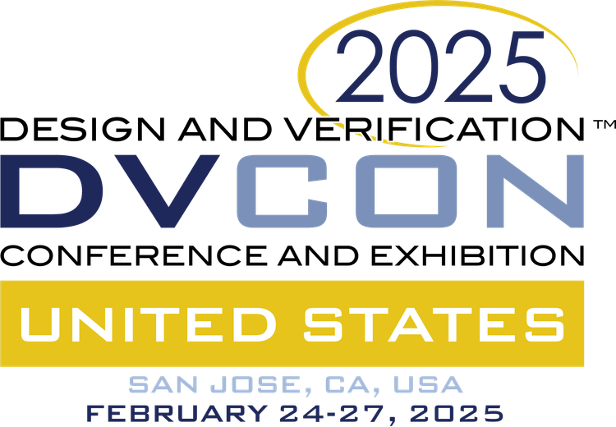
Conferences
Training
Accellera CDC WG work promotion through conferences
Past/current conferences
DVCON Europe 2023
DVCON US 2024
DVCON Japan 2024
DVCON India 2024
DVCON Europe 2024
IP-SoC Design Reuse conference Europe 2024
DVCON US 2025
Targeted conferences (To Be Confirmed)
DVCON Japan / India / Europe / Taiwan / China 2025
DAC 2025
DATE 2026
VLSI 2026
Notes:
A message is much more effective if you have a mountaintop to shout it from, and so prior to this presentation, we’ve made a similar presentation last year at DVCon Europe, and we’re targeting similar presentations at future DVCons in Japan, India, China, Taiwan, and back again in Europe, as well as DAC, DATE, and the VLSI Technology Symposium.

Slide 92
2.7 Call For Contribution
Notes:
This is also the opportunity to call for contribution to all of you as the Accellera CDC WG needs additional contributors from IP-SoC Companies & EDA Vendors Companies so, don’t hesitate to join our experts community to address one or two passionating activities among the five sub-groups (Output Collateral, Format, Assertion, Testing & Training) and representing your company through exciting missions …

Slide 93
CDC LRM Draft 0.3 was open for public review till September 2024
CDC LRM Draft 0.5 will be available for public review in February 2025
https://accellera.org/downloads/drafts-review

Slide 94
Call for Contribution ! Accellera CDC Working Group
https://workspace.accellera.org/wg/CDC
Notes:
… and if you are part of a Company which is already member of the Accellera Systems Initiative, you can join to the following web address

Slide 95
Call for Contribution ! Accellera CDC Working Group
https://workspace.accellera.org/wg/CDC
https://workspace.accellera.org/wg/CDC
Non-Accellera members can join and provide feedback on the standard:
https://www.accellera.org/community
Notes:
… or in case your Company is not member of the Accellera Systems Initiative, you can also contribute through the community, which web address is also given here.
so … don’t wait more and click on the corresponding link … see you !

Slide 96
CDC/RDC Interchange Format Standard
Questions
Notes:
Thanks having attended to this tutorial / workshop, feel free to comment or ask any question related to the different topics presented today !

